Slide 1
MSc Project
(CMP060L050S)
Mid-Point Review Presentation
Detecting Supply Chain and Dependency Confusion Attacks in Open-Source Ecosystems
Student Name: Shivani Burma
Student ID: A00076190
Supervisor Name: Badis Aoun

Slide 2
Outline
context​
problematic statement​
objectives ​
methodology​
project management​
literature review​
next steps

Slide 3
Context
Open-Source Software Dependence
Modern software development increasingly depends on open-source repositories such as PyPI for reusable components and faster software delivery.
Organisations integrate numerous third-party packages to reduce development effort and accelerate innovation.
Emerging Security Challenge
This dependency creates a growing software supply chain attack surface where attackers exploit trusted repositories rather than directly attacking organisations.
Dependency confusion and typosquatting attacks are particularly dangerous because malicious packages often appear legitimate during installation.
Project Focus
Current security approaches mainly identify threats after deployment.
This project focuses on proactive detection before installation by analysing package metadata, similarity patterns and risk indicators, enabling earlier identification of suspicious packages within open-source ecosystems.

Slide 4
Problem Statement - WHY
Core Problem
Open-source repositories contain millions of packages, making manual verification highly time-consuming and impractical.
However, package managers may automatically install malicious packages when attackers exploit dependency resolution mechanisms.
Who is Affected?
Software developers may unknowingly integrate malicious dependencies.
Organisations face security breaches, service disruption, financial losses and reputational damage.
End users may receive compromised software through trusted applications.
Research Challenge
Existing approaches focus heavily on known malware and vulnerability detection.
There is a lack of effective methods for identifying suspicious packages before execution.
Importance
Early detection can reduce software supply chain risks and strengthen trust within open-source ecosystems.

Slide 5
Objective - WHAT
Main Objective
Develop an automated machine learning framework capable of detecting dependency confusion and typosquatting attacks within PyPI repositories.
Technical Objectives
Collect package metadata from PyPI API.
Generate realistic typosquatting attack samples.
Extract security-relevant package features.
Develop a risk-scoring framework to prioritise suspicious packages.
Analytical Objectives
Train and compare Logistic Regression, Decision Tree and Random Forest models.
Identify the most effective approach for suspicious package classification.
Expected Contribution
Improve early threat detection.
Support developer decision-making.
Reduce software supply chain security risks through practical and scalable detection mechanisms integrated within a Streamlit dashboard

Slide 6
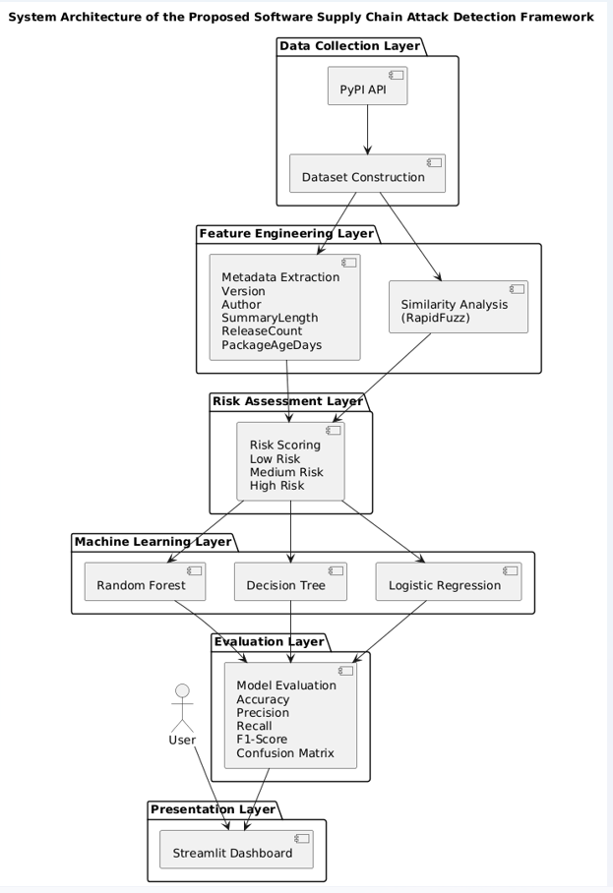
Methodology - HOW
Data Collection and Dataset Construction
Legitimate package metadata is collected from the PyPI API.
Suspicious package variants are generated using realistic typosquatting techniques to simulate software supply chain attacks.
Feature Engineering
Key features include Similarity Score, Name Length, Summary Length, Release Count and Package Age.
These indicators capture both naming behaviour and package maturity characteristics.
Risk Assessment and Machine Learning
Packages are classified into Low, Medium and High-Risk categories.
Logistic Regression, Decision Tree and Random Forest models are trained and evaluated.
Justification
Combining similarity analysis, metadata analysis and machine learning provides broader detection capability than relying on individual techniques alone.
Figure 1: System Architecture

Slide 7
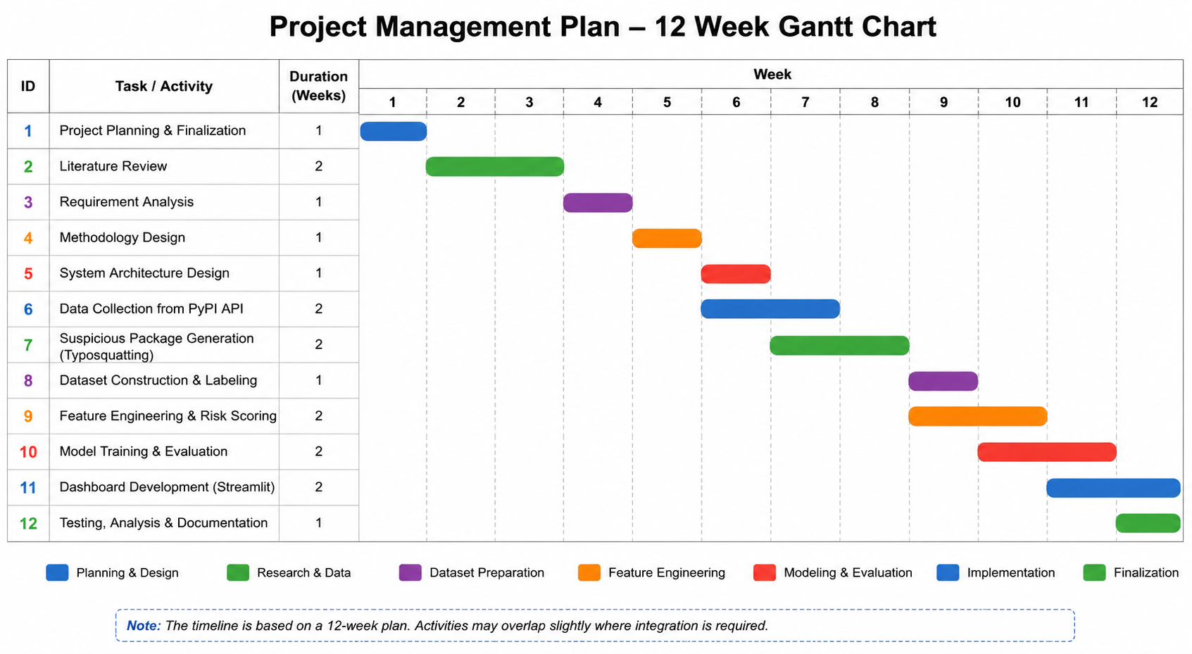
Project Management
Project Planning Strategy
A phased development approach was adopted to ensure systematic progression from research to implementation.
Literature Review and Methodology were completed before technical development to establish a strong theoretical and experimental foundation.
Progress Achieved
Proposal, Literature Review and Methodology phases have been completed.
System architecture, dataset design and machine learning workflow have been clearly defined.
Current Status
Dataset construction and feature engineering activities are currently in progress.
Project remains aligned with the planned schedule and milestones.
Remaining Activities
Model training and evaluation.
Risk scoring implementation.
Streamlit dashboard development.
Testing, validation and dissertation completion.
Figure: Gantt Chart

Slide 8
Literature Review
Software Supply Chain Threats: Gokkaya et al. (2025) identify software supply chain attacks as a growing cybersecurity threat driven by increasing dependency on open-source repositories.
Dependency Confusion and Typosquatting: Kydyraliev (2024) and Vu et al. (2025) show that attackers exploit package naming and dependency resolution weaknesses rather than software vulnerabilities themselves.
Metadata-Based Detection: Halder et al. (2024) demonstrate that package metadata can support early threat detection without executing software code.
Machine Learning Potential: Zhang et al. (2024) highlight that machine learning can detect complex attack patterns beyond traditional rule-based approaches.
Research Gap: Existing studies rarely integrate similarity analysis, metadata analysis, risk scoring and machine learning within a deployable detection framework.

Slide 9
Next Steps
Implementation Phase
Complete PyPI dataset construction.
Finalise feature engineering and risk-scoring mechanisms.
Prepare training and testing datasets.
Experimental Phase
Train Logistic Regression, Decision Tree and Random Forest models.
Compare performance using Accuracy, Precision, Recall and F1-Score.
Select the best-performing detection model.
Deployment Phase
Integrate the selected model into the Streamlit dashboard.
Develop package analysis and risk visualisation features.
Final Deliverables
Automated suspicious package detection framework.
Practical dashboard for developers and security analysts.
Comprehensive evaluation demonstrating the effectiveness of machine learning for software supply chain attack detection.

Slide 10
References
Gokkaya, B., Aniello, L. and Halak, B. (2025). Software supply chain: A taxonomy of attacks, mitigations and risk assessment strategies. Journal of Information Security and Applications, [online] 97, p.104324. doi: https://doi.org/10.1016/j.jisa.2025.104324
Halder, S., Bewong, M., Arash Mahboubi, Jiang, Y., Islam, M.R., Islam, M.Z., Ip, R.H., Ahmed, M.E., Ramachandran, G.S. and Babar, M.A. (2024). Malicious Package Detection using Metadata Information. Proceedings of the ACM Web Conference 2022, pp.1779–1789. doi: https://doi.org/10.1145/3589334.3645543
Meder Kydyraliev (2024). Defender’s Perspective: Dependency Confusion and Typosquatting Attacks. [online] SLSA. Available at: https://slsa.dev/blog/2024/08/dep-confusion-and-typosquatting
Vu, M.-K., Nguyen, T.-C. and Vu, D.-L. (2025). POSTER:TYPOSQUATTING ATTACKS ON THE RUST ECOSYSTEM. Proceedings of the 20th ACM Asia Conference on Computer and Communications Security, pp.1791–1793. doi: https://doi.org/10.1145/3708821.3735340
Zhang, J., Huang, K., Huang, Y., Chen, B., Wang, R., Wang, C. and Peng, X. (2024). Killing Two Birds with One Stone: Malicious Package Detection in NPM and PyPI using a Single Model of Malicious Behavior Sequence. ACM Transactions on Software Engineering and Methodology. doi: https://doi.org/10.1145/3705304

