Slide 1
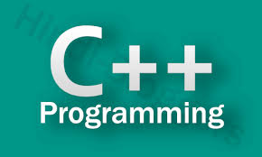
Mrs J Sreedevi
Assistant Professor
Dept of CSE, MGIT

Slide 2
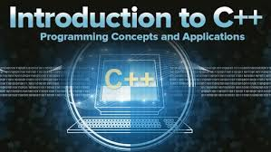
C++ is a middle-level language, as it encapsulates both high and low level language features.
C++ is a middle-level programming language developed by Bjarne Stroustrup starting in 1979 at Bell Labs.
C++ runs on a variety of platforms, such as Windows, Mac OS, and the various versions of UNIX.
C++ was originally called ‘C with classes,’ and was built as an extension of the C language. Its name reflects its origins; C++ literally means ‘increment C by 1.’
It was renamed C++ in 1983, but retains a strong link to C, and will compile most C programs.
Compared to C, C++ added object-oriented features to C such as classes, abstraction, and inheritance.

Slide 3
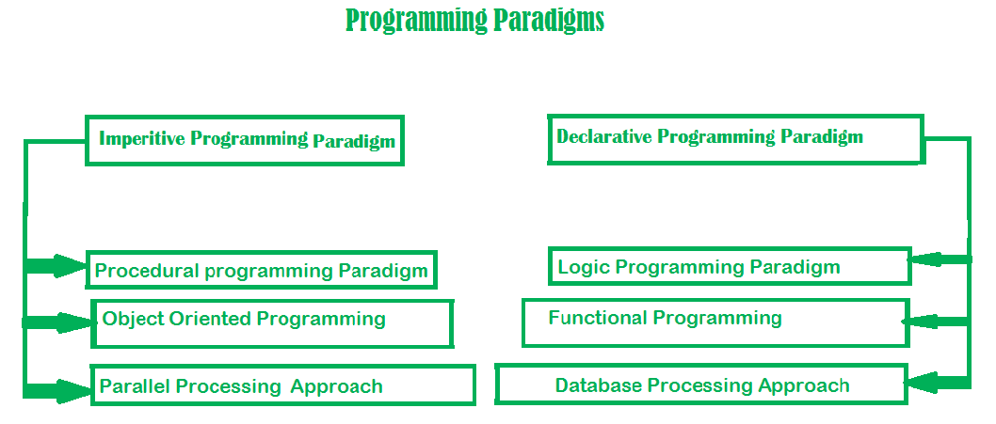
Different paradigms for problem solving

Slide 4
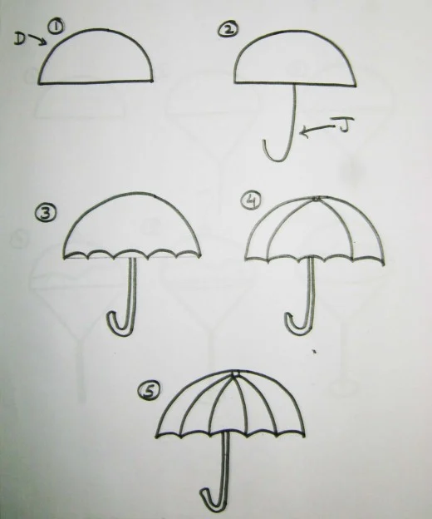
Imperative programming(how to do) It’s about writing a list of instructions to tell the computer what to do step by step Example: Giving step by step directions to get the result of umbrella

Slide 5
In an imperative programming paradigm, the order of the steps is crucial, because a given step will have different consequences depending on the current values of variables when the step is executed.
Example in C:
#include <stdio.h>
int main()
{
int sum = 0;
sum += 1;
sum += 2;
sum += 3;
sum += 4;
sum += 5;
printf("The sum is: %d\n", sum);
}

Slide 6
1.1 Procedural programming paradigm
Procedural programming (which is also imperative) allows splitting those instructions into procedures.
NOTE: Procedures aren't functions. The difference between them is that functions return a value, and procedures do not.
A great example of procedures would be the well known for loop. The for loop's main purpose is to cause side effects and it does not return a value.

Slide 7
To illustrate, let's find the sum of first ten natural numbers in the procedural paradigm approach.
Example in C:
#include <stdio.h>
int main()
{ int sum = 0; int i =0;
for(i=1;i<11;i++)
{ sum += i; }
printf("The sum is: %d\n", sum);
//prints-> The sum is 55
return 0;
}
In the example above, we've used a simple for loop to find the summation of the first ten natural numbers.

Slide 8
Languages that support the procedural programming paradigm are:
C
C++
Java
Pascal

Slide 9
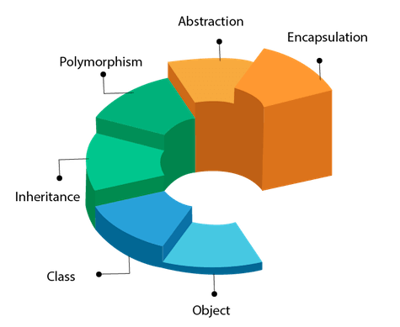
1.2. Object oriented programming
The program is written as a collection of classes and object which are meant for communication. More emphasis is on data rather procedure.
Examples of Object Oriented programming paradigm:
Java, c++,Visual Basic .NET, Python

Slide 10
class Test
{
private:
int data1;
float data2;
public:
void function1()
{
data1 = 2;
}
float function2()
{
data2 = 3.5;
return data2;
}
};
int main()
{
Test o1, o2;
}

Slide 11
1.3 Parallel processing
It is the processing of program instructions by dividing them among multiple processors.
A parallel processing system allows many processors to run a program in less time by dividing them up.
Languages that support the Parallel processing approach:
NESL (one of the oldest ones)
C
C++

Slide 12
Parallel processing approach is often the best use when:
You have a system that has more than one CPU or multi-core processors which are commonly found on computers today.
You need to solve some computational problems that take hours/days to solve even with the benefit of a more powerful microprocessor.
You work with real-world data that needs more dynamic simulation and modeling.

Slide 13

2.Declarative programming(what to do)
Declarative programming is a programming paradigm in which the programmer defines what needs to be accomplished by the program without defining how it needs to be implemented.
In other words, the approach focuses on what needs to be achieved instead of instructing how to achieve it.
Example : Instructing your friend to draw a umbrella

Slide 14
2.1 Logic programming paradigm
The logic programming paradigm takes a declarative approach to problem-solving. It's based on formal logic.
The logic programming paradigm isn't made up of instructions - rather it's made up of facts and clauses. It uses everything it knows and tries to come up with the world where all of those facts and clauses are true.

Slide 15
Languages that support the logic programming paradigm:
Prolog
Absys
ALF (algebraic logic functional programming language)
Alice
Ciao

Slide 16
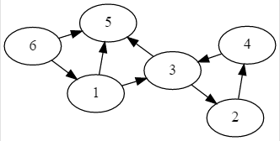
We will create a predicate to represent the fact that there is an edge from one node to another
edge(1, 3). edge(1, 5). edge(2, 4). edge(3, 2). edge(3, 5). edge(4, 3). edge(6, 1). edge(6, 5)..
When interacting with Prolog code ,the language is trying to prove that facts are correct.
?- edge(1, 3). true ;
?- edge(1, 6). false.

Slide 17
2.2 The functional programming paradigms
The functional programming paradigms has its roots in mathematics and it is language independent.
The key principal of this paradigms is the execution of series of mathematical functions.
Data are loosely coupled to functions. The function hide their implementation.
Function can be replaced with their values without changing the meaning of the program.
Example: perl, javascript, python mostly uses this paradigm

Slide 18
2.3Database/Data driven programming approach –
This programming methodology is based on data and its movement. A database program is the heart of a business information system and provides file creation, data entry, update, query and reporting functions. There are several programming languages that are developed mostly for database application.
For example SQL.
CREATE DATABASE databaseAddress;
CREATE TABLE Addr (
PersonID int,
LastName varchar(200),
FirstName varchar(200),
Address varchar(200));

Slide 19
Class
A class is a blueprint for the object.
A Class is a user defined data-type which has data members and member functions.
Data members are the data variables and member functions are the functions used to manipulate these variables and together these data members and member functions defines the properties and behavior of the objects in a Class.
Object
An Object is an instance of a Class. When a class is defined, no memory is allocated but when it is instantiated (i.e. an object is created) memory is allocated.

Slide 20
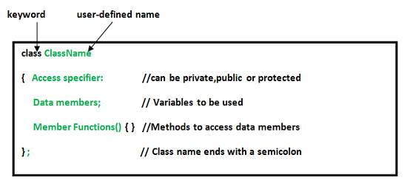
Defining Class and Declaring Objects

Slide 21
class Test
{
private:
int data1;
float data2;
public:
void function1()
{
data1 = 2;
}
float function2()
{
data2 = 3.5;
return data2;
}
};
int main()
{
Test o1, o2;
}

Slide 22
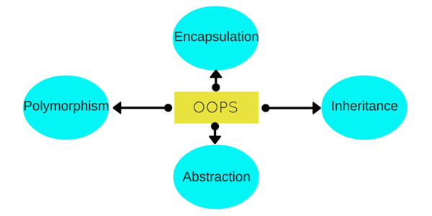
Object Oriented Programming Concepts

Slide 23
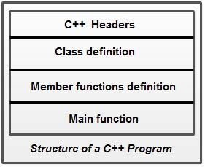
Structure of a C+ + Program

Slide 24
A simple C++ program (without a class)
/*
* Multiple line
* comment
*/
#include<iostream>
//Single line comment
using namespace std;
//execution of program begins
int main()
{
// displays Hello World! on screen
cout<<"Hello World!";
return 0;
}
Compile :
g++ filename.cpp
Run:
./a.out
Hello World!

Slide 25
By specifying the using directive
using namespace std;
cout<<"Hello World";
By specifying the full member name
std: :cout<<"Hello World";
By specifying the using declaration
using std:: cout;
cout<<"Hello World";

Slide 26
C++ Variable
A variable is a name of memory location. It is used to store data. Its value can be changed and it can be reused many times.
The example of declaring variable is given below:
int x;
float y;
char z;
We can also provide values while declaring the variables as given below:
int x=5,b=10; //declaring 2 variable of integer type
float f=30.8;
char c='A';

Slide 27
Rules for defining variables
A variable can have alphabets, digits and underscore.
A variable name can start with alphabet and underscore only. It can't start with digit.
No white space is allowed within variable name.
A variable name must not be any reserved word or keyword e.g. char, float etc.
Valid variable names:
int a;
int _ab;
int a30;
Invalid variable names:
int 4;
int x y;
int double;

Slide 28
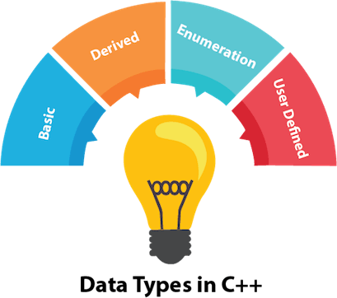
C++ Data Types
Types | Data Types
Basic Data Type | int, char, float, double, etc
Derived Data Type | array, pointer, etc
Enumeration Data Type | enum
User Defined Data Type | structure

Slide 29
The memory size of basic data types may change according
to 32 or 64 bit operating system.
Data Type | Size | Description
int | 4 bytes | Stores whole numbers, without decimals
float | 4 bytes | Stores fractional numbers, containing one or more decimals. Sufficient for storing 7 decimal digits
double | 8 bytes | Stores fractional numbers, containing one or more decimals. Sufficient for storing 15 decimal digits
boolean | 1 byte | Stores true or false values
char | 1 byte | Stores a single character/letter/number, or ASCII values

Slide 30
Ex: To print the size of all data types
#include<iostream>
using namespace std;
int main()
{
cout<<"size of int"<<sizeof(int);
cout<<"size of longint"<<sizeof(long int);
cout<<"size of float"<<sizeof(float);
cout<<"size of double"<<sizeof(double);
cout<<"size of char"<<sizeof(char);
}
output:
size of int 4
size of longint 8
size of float 4
size of double 8
size of char 1

Slide 31
C++ Operators
Arithmetic Operators +, -, *, /, %
Assignment Operator =, +=, -=, *=, /=, %=
Relational Operators ==, !=, >, <, >=, <=
Logical Operators &&, ||, !
Bitwise Operators &, |, ^, ~, <<, >>
Unary operator ++, --
Ternary or Conditional Operator ? :

Slide 32
//Arithmetic opertaors
#include <iostream>
using namespace std;
int main(){
int num1 = 240;
int num2 = 40;//
cout<<"num1 + num2: "<<(num1 + num2)<<endl;
cout<<"num1 - num2: "<<(num1 - num2)<<endl;
cout<<"num1 * num2: "<<(num1 * num2)<<endl;
cout<<"num1 / num2: "<<(num1 / num2)<<endl;
cout<<"num1 % num2: "<<(num1 % num2)<<endl;
return 0;
}

Slide 33
// Assignment Operators
#include <iostream>
using namespace std;
int main(){
int num1 = 240;
int num2 = 40;
num2 = num1;
cout<<"= Output: "<<num2<<endl;
num2 += num1; num2=num2+num1
cout<<"+= Output: "<<num2<<endl;
num2 -= num1;num2=num2-num1
cout<<"-= Output: "<<num2<<endl;
num2 *= num1;
cout<<"*= Output: "<<num2<<endl;
num2 /= num1;
cout<<"/= Output: "<<num2<<endl;
num2 %= num1;
cout<<"%= Output: "<<num2<<endl;
return 0; }

Slide 34
//Relational Operators
#include<iostream>
using namespace std;
int main()
{
int num1=5,num2=3;
cout<<"num1==num2 \t"<<(num1==num2);
cout<<"\nnum1<num2 \t"<<(num1<num2);
cout<<"\nnum1>num2 \t"<<(num1>num2);
cout<<"\nnum1!=num2 \t"<<(num1!=num2);
};
Output:
num1==num2 0
num1<num2 0
num1>num2 1
num1!=num2 1

Slide 35
//Logical Operators
#include <iostream>
using namespace std;
int main(){
bool b1 = true;
bool b2 = false;
cout<<"b1 && b2: "<<(b1&&b2)<<endl;
cout<<"b1 || b2: "<<(b1||b2)<<endl;
cout<<"!(b1 && b2): "<<!(b1&&b2);
return 0;
}
Output:
b1 && b2: 0
b1 || b2: 1
!(b1 && b2): 1

Slide 36
Bitwise Operators
#include <iostream>
using namespace std;
int main(){
int num1 = 11; /* 11 = 00001011 */
int num2 = 22; /* 22 = 00010110 */
int result = 0;
result = num1 & num2;
cout<<"num1 & num2: "<<result<<endl;
result = num1 | num2;
cout<<"num1 | num2: "<<result<<endl;
result = num1 ^ num2;
cout<<"num1 ^ num2: "<<result<<endl;
result = ~num1;
cout<<"~num1: "<<result<<endl;
result = num1 << 2;
cout<<"num1 << 2: "<<result<<endl;
result = num1 >> 2;
cout<<"num1 >> 2: "<<result;
return 0;
}
Output:
num1 & num2: 2
num1 | num2: 31
num1 ^ num2: 29
~num1: -12
num1 << 2: 44 num1 >> 2: 2

Slide 37
Ternary Operator
#include <iostream>
using namespace std;
int main(){
int num1, num2;
num1 = 99;
num2 = (num1 == 10) ? 100: 200;
cout<<"num2: "<<num2<<endl;
num2 = (num1 <= 99) ? 100: 200;
cout<<"num2: "<<num2;
return 0;
}
Output:
num2: 200
num2: 100

Slide 38
Unary Operators
#include <iostream>
using namespace std;
int main(){
int num1 = 240;
cout<<"num1++ is: "<<num1++<<endl;
cout<<"num1-- is: "<<num1--;
return 0;
}
OutPut:
num1++ is: 240
num1-- is: 241

Slide 39
Scope resolution operator in C++(::)
#include<iostream>
using namespace std;
char c='a'; // global variable
int main()
{
char c='b'; //local variable
cout<<"Local variable: "<<c <<"\n";
cout<<"Global variable: "<<::c <<"\n";
//using scope resolution operator
return 0;
}
Output:
Local variable: b
Global variable: a

Slide 40
//Scope resolution operator in class
#include <iostream>
using namespace std;
class programming {
public:
void output(); //function declaration
};
// function definition outside the class
void programming::output() {
cout << "Function defined outside the class.\n";
}
int main() {
programming x;
x.output();
return 0;
}
Output:
Function defined outside the class.

Slide 41
Level | Precedence group | Operator | Description | Grouping
1 | Scope | :: | scope qualifier | Left-to-right
2 | Postfix (unary) | ++ -- | postfix increment / decrement | Left-to-right
 |  | () | functional forms
 |  | [] | subscript
 |  | . -> | member access
3 | Prefix (unary) | ++ -- | prefix increment / decrement | Right-to-left
 |  | ~ ! | bitwise NOT / logical NOT
 |  | + - | unary prefix
 |  | & * | reference / dereference
 |  | new delete | allocation / deallocation
 |  | sizeof | parameter pack
 |  | (type) | C-style type-casting
4 | Pointer-to-member | .* ->* | access pointer | Left-to-right
5 | Arithmetic: scaling | * / % | multiply, divide, modulo | Left-to-right

Slide 42
Level | Precedence group | Operator | Description | Grouping
6 | Arithmetic: addition | + - | addition, subtraction | Left-to-right
7 | Bitwise shift | << >> | shift left, shift right | Left-to-right
8 | Relational | < > <= >= | comparison operators | Left-to-right
9 | Equality | == != | equality / inequality | Left-to-right
10 | And | & | bitwise AND | Left-to-right
11 | Exclusive or | ^ | bitwise XOR | Left-to-right
12 | Inclusive or | | | bitwise OR | Left-to-right

Slide 43
Level | Precedence group | Operator | Description | Grouping
13 | Conjunction | && | logical AND | Left-to-right
14 | Disjunction | || | logical OR | Left-to-right
15 | Assignment-level expressions | = *= /= %= += -= >>= <<= &= ^= |= | assignment / compound assignment | Right-to-left
 |  | ?: | conditional operator
16 | Sequencing | , | comma separator | Left-to-right

Slide 44
Example 1:
10 – 3 % 8 + 6 / 4
3%8 = 3
10-3+6/4
6/4= 1
10-3+1
10-3=7
7+1 =8

Slide 45
Example 2:
17-8/4*2+3- ++a
Assume a=5
++a=6
17-8/4*2+3-6
8/4 = 2
17-2*2+3-6
2*2=4
17-4+3-6
17-4=13
13+3-6
16-6 = 10

Slide 46
What is the output of the following Program
#include<iostream>
using namespace std;
int main()
{
int z,a=4,b=5,c=6;
z=++a + b++ + a++ + ++c;
cout<<"z="<<z;
return 0;
}
o/p = ?

Slide 47
Type Conversion in C++
Type Conversion
Implicit
Explicit

Slide 48
Implicit Type Conversion Also known as ‘automatic type conversion’.
bool -> char -> short int -> int ->
unsigned int -> long -> unsigned ->
long long -> float -> double -> long double
Example:
#include <iostream>
using namespace std;
int main()
{
int x = 10; // integer x
char y = 'a'; // character c
// y implicitly converted to int. ASCII
// value of 'a' is 97
x = x + y;
// x is implicitly converted to float
float z = x + 1.0;
cout << "x = " << x << endl
<< "y = " << y << endl
<< "z = " << z << endl;
return 0;
}
output:
x = 107
y = a
z = 108

Slide 49
Explicit Type Conversion:
Syntax:
(type) expression
Example:
#include <iostream>
using namespace std;
int main()
{
double x = 1.2;
// Explicit conversion from double to int
int sum = (int)x + 1;
cout << "Sum = " << sum;
return 0;
}
Output:
Sum = 2

Slide 50
C++ Control Statements
Iteration Statements
Selection Statements
Jump Statements
if… else
switch … case
break
continue
goto
while
do…while
for

Slide 51
C++ if-else
various types of if statements in C++.
if statement
Syntax:
if(condition)
{
//code to be executed
}
Ex: given number is even or not
#include <iostream>
using namespace std;
int main () {
int num = 10;
if (num % 2 == 0)
{
cout<<"It is even number";
}
return 0;
}

Slide 52
IF-else Statement
Syntax:
if(condition)
{
//code if condition is true
}
else
{
//code if condition is false
}
Ex: given number is even or odd
#include <iostream>
using namespace std;
int main () {
int num;
cout<<"Enter a Number: ";
cin>>num;
if (num % 2 == 0)
{
cout<<"It is even number"<<endl;
}
else
{
cout<<"It is odd number"<<endl;
}
return 0;
}

Slide 53
IF-else-if ladder Statement
Syntax:
if(condition1){
//code to be executed if condition1 is true
}else if(condition2){
//code to be executed if condition2 is true
}
else if(condition3){
//code to be executed if condition3 is true
}
...
else{
//code to be executed if all the conditions are false
}

Slide 54
Ex:to check the grade for given marks
#include <iostream>
using namespace std;
int main () {
int num;
cout<<"Enter a number to check grade:";
cin>>num;
if (num <0 || num >100)
{
cout<<"wrong number";
}
else if(num >= 0 && num < 50){
cout<<"Fail";
}
else if (num >= 50 && num < 60)
{
cout<<"D Grade";
}
else if (num >= 60 && num < 70)
{
cout<<"C Grade";
}
else if (num >= 70 && num < 80)
{
cout<<"B Grade";
}
else if (num >= 80 && num < 90)
{
cout<<"A Grade";
}
else if (num >= 90 && num <= 100)
{
cout<<"A+ Grade";
}
}

Slide 55
switch
switch(expression){
case value1:
//code to be executed;
break;
case value2:
//code to be executed;
break;
......
default:
//code to be executed if all cases are not matched;
break;
}

Slide 56
Ex:
#include <iostream>
using namespace std;
int main () {
int num;
cout<<"Enter a number to check grade:";
cin>>num;
switch (num)
{
case 10: cout<<"It is ten"; break;
case 20: cout<<"It is twenty"; break;
case 30: cout<<"It is thirty"; break;
default: cout<<"Not 10, 20 or 30"; break;
}
}

Slide 57
For Loop
for(initialization; condition; incr/decr){
//code to be executed
}
Ex:
#include <iostream>
using namespace std;
int main() {
for(int i=1;i<=10;i++){
cout<<i <<"\n";
}
}

Slide 58
While loop
while(condition){
//code to be executed
}
Ex:
#include <iostream>
using namespace std;
int main() {
int i=1;
while(i<=10)
{
cout<<i <<"\n";
i++;
}
}

Slide 59
Do-While Loop
do{
//code to be executed
}while(condition);
Ex:
#include <iostream>
using namespace std;
int main() {
int i = 1;
do{
cout<<i<<"\n";
i++;
} while (i <= 10) ;
}

Slide 60
Break
The C++ break is used to break loop or switch statement. It breaks the current flow of the program at the given condition.
This example jumps out of the loop when i is equal to 5:
Example
#include <iostream>
using namespace std;
int main() {
for (int i = 1; i <= 10; i++)
{
if (i == 5)
{
break;
}
cout<<i<<"\n";
}
}
Output:
1
2
3
4

Slide 61
Continue Statement
The C++ continue statement is used to continue loop. It continues the current flow of the program and skips the remaining code at specified condition. In case of inner loop, it continues only inner loop.
Ex:
#include <iostream>
using namespace std;
int main()
{
for(int i=1;i<=10;i++){
if(i==5){
continue;
}
cout<<i<<"\n";
}
}
output:
1
2
3
4
6
7
8
9
10

Slide 62
Goto Statement
The C++ goto statement is also known as jump statement. It is used to transfer control to the other part of the program.
Ex:
#include <iostream>
using namespace std;
int main()
{
ineligible:
cout<<"You are not eligible to vote!\n";
cout<<"Enter your age:\n";
int age;
cin>>age;
if (age < 18){
goto ineligible;
}
else
{
cout<<"You are eligible to vote!";
}
}
output:
You are not eligible to vote!
Enter your age:
16
You are not eligible to vote!
Enter your age:
7
You are not eligible to vote!
Enter your age:
22
You are eligible to vote!

Slide 63
Strings
A string variable contains a collection of characters surrounded by double quotes:
string greeting = "Hello";
Example 1: C++ String to read a word
C++ program to display a string entered by user.
#include <iostream>
using namespace std;
int main()
{
char str[100];
cout << "Enter a string: ";
cin >> str;
cout << "You entered: " << str << endl;
cout << "\nEnter another string: ";
cin >> str;
cout << "You entered: "<<str<<endl;
return 0;
}

Slide 64
C++ String to read a line of text
cin.get(addr, size)
To read the text containing blank space, cin.get function can be used. This function takes two arguments.
First argument is the name of the string (address of first element of string) and second argument is the maximum size of the array.
Example 2: C++ program to read and display an entire line entered by user.
#include <iostream>
using namespace std;
int main()
{
char str[100];
cout << "Enter a string: ";
cin.get(str, 100);
cout << "You entered: " << str << endl;
return 0;
}

Slide 65
String functions using char array
strlen(variable)- length of the str
Ex: strlen(str)
strcmp(var1, var2)==0 - both the strs are equal
If ==1 both the strings are not equal
Ex: strcmp(“hello”,”hello”) returns 0 as both strings are equal.
strcpy(dest,src) – copy src to dest
Ex: strcpy(str2,str1)- str1 is copied to str2
strcat(var1,var2)- combine two strings
Ex: strcat(str1,str2)- combine str1 and str2, result will be in str1

Slide 66
string Object
-In C++, you can also create a string object for holding strings.
-string objects has no fixed length, and can be extended as per your requirement
getline(cin,var) function takes the input stream as the first parameter which is cin and str as the location of the line to be stored.

Slide 67
Example 3: C++ string using string data type
#include <iostream>
using namespace std;
int main()
{ // Declaring a string object
string str;
cout << "Enter a string: ";
getline(cin, str);
cout << "You entered: " << str << endl;
return 0;
}

Slide 68
compare(string_to_compare )
#include<iostream>
#include<string>
using namespace std;
int main()
{
string str("c++ program");
string str1("cpp program");
// Comparing strings using compare()
if ( str.compare(str1) == 0 )
cout << "Strings are equal";
else
cout << "Strings are unequal";
return 0;
}

Slide 69
String concatenation ( + operator)
#include <iostream>
#include <string>
using namespace std;
int main () {
string firstName;
string lastName;
string fullName;
cout<<“enter first name”;
getline(cin,firstName);
cout<<“enter last name”;
getline(cin,lastName);
fullName=firstName+lastName;
cout << fullName;
return 0;
}

Slide 70
String Length
length()-length of the str
#include <iostream>
#include <string>
using namespace std;
int main()
{
string txt = "ABCDEFGHIJKLMNOPQRSTUVWXYZ";
cout << "The length of the txt string is: " << txt.length();
return 0;
}

Slide 71
Access Strings
#include <iostream>
#include <string>
using namespace std;
int main() {
string myString = "Hello";
cout << myString[1];
return 0;
}

Slide 72
Change String Characters
#include <iostream>
#include <string>
using namespace std;
int main() {
string myString = "Hello";
myString[0] = ‘c';
cout << myString;
return 0;
}

Slide 73
string substr(int pos,int n)-
It creates a new string object of n characters.
// CPP program to illustrate substr()
#include <string.h>
#include <iostream>
using namespace std;
int main()
{
// Take any string
string s1 = "MGITCSE";
// Copy three characters of s1 (starting
// from position 4)
string r = s1.substr(4, 3);
// prints the result
cout << "String is: " << r;
return 0;
}

Slide 74
get sub-string after a character In this a string and a character is given and you have to print the sub-string followed by the given character. Extract everything after the “:” in the string “mgit:cse”.
// CPP program to illustrate substr()
#include <string.h>
#include <iostream>
using namespace std;
int main()
{
// Take any string
string s = "mgit:cse";
// Find position of ':' using find()
int pos = s.find(":");
// Copy substring after pos
string sub = s.substr(pos + 1);
// prints the result
cout << "String is: " << sub;
return 0;
}

Slide 75
string replace()
This function replaces the portion of string that begins at character position pos and spans len characters.
Syntax:
Consider two strings str1 and str2.
Syntax would be:
str1.replace(pos,len,str2);
Parameters
str1 − It is a string object.
pos − It is an insertion point.
len − It contains information about number of characters to erase.
str2- replace with str2 data

Slide 76
//replace C with C++
#include<iostream>
using namespace std;
int main()
{
string str1 = "This session is about C language";
string str2 = "C++";
cout << "Before replacement, string is :"<<str1<<'\n';
str1.replace(21,1,str2);
cout << "After replacement, string is :"<<str1<<'\n';
return 0;
}

Slide 77
Storage Classes in C++
Storage classes are used to specify the scope, visibility and lifetime of variables.
Syntax:
storage_class var_data_type var_name;
Following are the storage classes, which can be used in a C++ Program
auto
register
static
Extern
mutable

Slide 78
auto Storage Class
The auto storage class is the default storage class for all local variables.
{
int var1;
auto int var2;
}

Slide 79
#include <iostream>
using namespace std;
int main()
{
// Declaring an auto variable
// No data-type declaration needed
auto a = 9;
auto b = 14.23;
auto c = "C++ prog lang";
auto d = 'A';
// printing the auto variables
cout << a << " \n";
cout << b << " \n";
cout << c << " \n";
cout << d << " \n";
return 0;
}

Slide 80
register Storage Class
The register storage class is used to define local variables that should be stored in a register instead of RAM
{
register int m;
}
#include <iostream>
using namespace std;
int main()
{
cout << "Demonstrating register class\n";
// declaring a register variable
register string s = "c++";
// printing the register variable 's'
cout << "Value of the variable s:"<<s;
return 0;
}

Slide 81
Static
Static variables are the variables which are initialized & allocated storage only once at the beginning of program execution, no matter how many times they are used and called in the program. A static variable retains its value until the end of program.
#include<iostream>
using namespace std;
void fun()
{
static int i = 10;
i++;
cout <<"static i= "<<i<<endl;
}
void fun_nonstatic()
{
int i = 10;
i++;
cout<<"nonstatic i="<<i<<endl;
}
int main()
{
fun();fun();fun();
fun_nonstatic();
fun_nonstatic();
fun_nonstatic();
return 0;
}

Slide 82
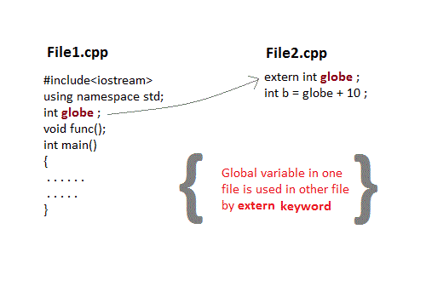
Extern Variables
This keyword is used to access variable in a file which is declared & defined in some other file, that is the existence of a global variable in one file is declared using extern keyword in another file.

Slide 83
#include <iostream>
int count=5;
int main()
{ write_extern();
return 0;
}
Save file as main1.cpp

Slide 84
#include <iostream>
extern int count;
void write_extern(void)
{
std::cout << "Count is " << count << std::endl;
}
$g++ main1.cpp support.cpp -o write
$./write
Output:
5

Slide 85
Arrays:
Array in C++ is a group of similar types of elements that have contiguous memory location.
array index starts from 0. We can store only fixed set of elements in C++ array.
Syntax:
type arrayName [ arraySize ];
ex:
int a[10];
initialize arrays:
int a[5]={1,2,3,4,5};
0 1 2 3 4
string cars[4];
string cars[4] = {"Volvo", "BMW", "Ford", "Swift"};
cout << cars[0];

Slide 86
Single Dimensional Array
#include <iostream>
using namespace std;
#include <iomanip>
using std::setw;
int main ()
{
int n[ 5 ];
for ( int i = 0; i < 5; i++ ) {
n[ i ] = i + 10;
}
cout << "Element" << setw( 13 ) << "Value" << endl;
// output each array element's value
for ( int i = 0; i < 5; i++ ) {
cout<<setw(4)<<i<<setw(13)<<n[i ]<<"\n";
}
return 0;
}
output:
Element Value
0 10
1 11
2 12
3 13
4 14

Slide 87
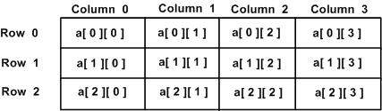
Two Dimensional Arrays:
Defined as Array of Arrays
It Can also represent a Matrix
Each element is represented as a[row][col], Where a[][] is a 2-D array

Slide 88
Initialization:
int a[3][4] = {
{0, 1, 2, 3} , {4, 5, 6, 7} , {8, 9, 10, 11} };
OR
int a[3][4] = {0,1,2,3,4,5,6,7,8,9,10,11};

Slide 89
#include <iostream>
using namespace std;
int main () {
// an array with 5 rows and 2 columns.
int a[5][2] = { {0,0}, {1,2}, {2,4}, {3,6},{4,8}};
// output each array element's value
for ( int i = 0; i < 5; i++ )
for ( int j = 0; j < 2; j++ ) {
cout << "a[" << i << "][" << j << "]: ";
cout << a[i][j]<< endl;
}
return 0;
}
output:
a[0][0]: 0
a[0][1]: 0
a[1][0]: 1
a[1][1]: 2
a[2][0]: 2
a[2][1]: 4
a[3][0]: 3
a[3][1]: 6
a[4][0]: 4
a[4][1]: 8

Slide 90
//Matrix addition
#include<iostream>
using namespace std;
main()
{
int m1[5][5], m2[5][5], m3[5][5];
int i, j, r, c;
cout<<"Enter the no.of rows of the matrices to be added(max 5):";
cin>>r;
cout<<"Enter the no.of columns of the matrices to be added(max 5):";
cin>>c;
cout<<"\n1st Matrix Input:\n";
for(i=0;i<r;i++)
{
for(j=0;j<c;j++)
{
cout<<"\nmatrix1["<<i<<"]["<<j<<"]= ";
cin>>m1[i][j];
}
}

Slide 91
cout<<"\n2nd Matrix Input:\n";
for(i=0;i<r;i++)
{
for(j=0;j<c;j++)
{
cout<<"\nmatrix2["<<i<<"]["<<j<<"]= ";
cin>>m2[i][j];
}
}
cout<<"\nAdding Matrices...\n";
for(i=0;i<r;i++)
{
for(j=0;j<c;j++)
{
m3[i][j]=m1[i][j]+m2[i][j];
}
}
cout<<"\nThe resultant Matrix is:\n";
for(i=0;i<r;i++)
{
for(j=0;j<c;j++)
{
cout<<"\t"<<m3[i][j];
}
cout<<endl;
}
}

Slide 92
Pointers
A pointer is a variable whose value is the address of another variable.
This variable can be of type int, char, array, function, or any other pointer.
The general form of a pointer variable declaration is −
type *var_name;
Ex:
int *ip; // pointer to an integer
double *dp; // pointer to a double
float *fp; // pointer to a float
char *ch // pointer to character

Slide 93
Initialization of Pointer Variables
The process of assigning the address of a variable to a pointer variable is called as pointer initialization.
The general format of pointer initialization is,
pointer_name= &variable_name;
p1=&x; /*assigns the address of the variable x to the pointer variable p1*/
NULL Pointer: A pointer that is not assigned any value but NULL is known as the NULL pointer.
If there is no address to be specified in the pointer at the time of declaration, it can be assigned NULL value which is standard approach.
Ex: int *p=NULL;

Slide 94
Advantage of pointer
1) Pointer reduces the code and improves the performance, it is used to retrieving strings, trees etc. and used with arrays, structures and functions.
2) We can return multiple values from function using pointer.
3) It makes you able to access any memory location in the computer's memory.

Slide 95
Ex:
Swapping of 2 numbers without using 3rd variable
#include<iostream>
using namespace std;
int main()
{
int *p1,*p2,a=10,b=20;
p1=&a;
p2=&b;
cout<<"before swapping"<<*p1<<"\t"<<*p2;
*p1=*p1+*p2;
*p2=*p1-*p2;
*p1=*p1-*p2;
cout<<"after swapping"<<*p1<<"\t"<<*p2;
}

Slide 96
//printing the addr and value of pointer variables
#include <iostream>
using namespace std;
int main () {
int i = 20; // actual variable declaration.
int *p;
// pointer variable
p = &i; // store address of var in pointer variable
float f=3.23;
float *f1;
f1=&f;
string coll = "MGIT"; // A coll variable of type string
string* ptr = &coll; // A pointer variable, with the name ptr, that stores the address of coll
cout << "Value of integer variable i is: ";
cout << i << endl;
// print the address stored in p pointer variable
cout << "Address stored in p variable: ";
cout << p << endl;
// access the value at the address available in pointer
cout << "Value of *p variable: ";
cout << *p << endl<<endl;
cout << "Value of float variable f is: ";

Slide 97
cout << f << endl;
// print the address stored in p pointer variable
cout << "Address stored in f1 variable: ";
cout << f1 << endl;
// access the value at the address available in pointer
cout << "Value of *f1 variable: ";
cout << *f1 << endl<<endl;
cout << "Value of string variable coll is: ";
cout << coll << endl;
// print the address stored in p pointer variable
cout << "Address stored in *ptr variable: ";
cout << ptr << endl;
// access the value at the address available in pointer
cout << "Value of *ptr variable: ";
cout << *ptr << endl;
return 0;
}

Slide 98
output:
Value of integer variable i is: 20
Address stored in p variable: 0x61fdf0
Value of *p variable: 20
Value of float variable f is: 3.23
Address stored in f1 variable: 0x61fdec
Value of *f1 variable: 3.23
Value of string variable coll is: MGIT
Address stored in *ptr variable: 0x61fdc0
Value of *ptr variable: MGIT

Slide 99
Pointers and Arrays
Pointers are the variables that hold address. Not only can pointers store address of a single variable, it can also store address of cells of an array.
Consider this example:
int* ptr;
int a[5];
ptr = &a[2]; // &a[2] is the address of third element of a[5].
a[0],a[1],a[2],a[3]
Ptr=a;
Ptr=&a[0]
Ex:
&arr[0] is equivalent to arr
&arr[1] is equivalent to arr + 1
&arr[2] is equivalen to arr + 2

Slide 100
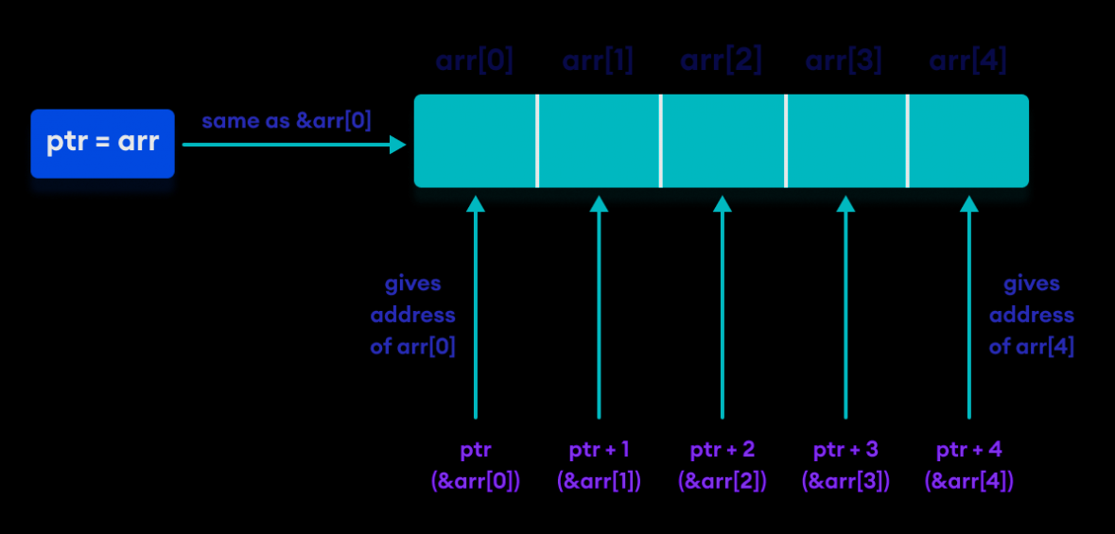

Slide 101
/*C++ Program to display address of elements of an array using both array and pointers*/
#include <iostream>
using namespace std;
int main()
{
float arr[5];
float *ptr;
cout << "Displaying address using arrays: " << endl;
for (int i = 0; i < 5; ++i)
{
cout << "&arr[" << i << "] = " << &arr[i] << endl;
}
Output
Displaying address using arrays:
&arr[0] = 0x61fdf0
&arr[1] = 0x61fdf4
&arr[2] = 0x61fdf8
&arr[3] = 0x61fdfc
&arr[4] = 0x61fe00

Slide 102
// ptr = &arr[0]
ptr = arr;
cout<<"\nDisplaying address using pointers: "<< endl;
for (int i = 0; i < 5; ++i)
{
cout << "ptr + " << i << " = "<< ptr + i << endl;
}
Displaying address using pointers:
&arr[0] = 0x61fdf0
&arr[1] = 0x61fdf4
&arr[2] = 0x61fdf8
&arr[3] = 0x61fdfc
&arr[4] = 0x61fe00

Slide 103
cout << "Enter 5 numbers: ";
for (int i = 0; i < 5; ++i) {
// store input number in arr[i]
cin >> *(arr + i) ;
}
cout<<"\nDisplaying values using pointers: "<< endl;
for (int i = 0; i < 5; ++i)
{
cout << "*ptr + " << i << " = "<< *(ptr + i) << endl;
} return 0;
}

Slide 104
Enter 5 numbers: 1.234
2.2134
3.21
4.24
5.55
Displaying values using pointers:
*ptr + 0 = 1.234
*ptr + 1 = 2.2134
*ptr + 2 = 3.21
*ptr + 3 = 4.24
*ptr + 4 = 5.55

Slide 105
References in C++
When a variable is declared as reference, it becomes an alternative name for an existing variable. A variable can be declared as reference by putting ‘&’ in the declaration.
#include<iostream>
using namespace std;
int main()
{
int x = 10;
// ref is a reference to x.
int &ref = x;
// Value of x is now changed to 20
ref = 20;
cout << "x = " << x << endl ;
// Value of x is now changed to 30
x = 30;
cout << "ref = " << ref << endl ;
return 0;
}
output:
x = 20
ref = 30

Slide 106
Difference between Reference and Pointer
References | Pointers
Reference must be initialized when it is created. | Pointers can be initialized any time.
Once initialized, we cannot reinitialize a reference. | Pointers can be reinitialized any number of time.
You can never have a NULL reference. | Pointers can be NULL.
Reference is automatically dereferenced. | * is used to dereference a pointer.

Slide 107
Structures
C++ Structure is a collection of different data types, methods
Syntax :
struct structure_name
{
int a;
float b;
voi sum()
{
}
// member declarations.
} ;
Instance of Structure
Structure variable can be defined as:
struct Student s;
Here, s is a structure variable of type Student. When the structure variable is created, the memory will be allocated.

Slide 108
Struct Example
Let's see a simple example of struct Rectangle which has two data members width and height.
#include <iostream>
using namespace std;
struct Rectangle
{
int width, height;
};
int main(void) {
struct Rectangle rec;
rec.width=8;
rec.height=5;
cout<<"Area of Rectangle is: "<<(rec.width * rec.height)<<endl;
return 0;
}

Slide 109
Struct Example:
Using Constructor(constructor in C++ is a special method that is automatically called when an object of a class is created.) and Method
#include<iostream>
using namespace std;
struct rec
{
int width,height;
rec(int w,int h)
{
width=w;
height=h;
}
void area()
{
cout<<"area="<<(width*height);
}
};
int main()
{
struct rec r=rec(5,6);
r.area();
return 0;
}

Slide 110
C++ Functions
A function is a group of statements which is used to perform some specific task.
You can pass data, known as parameters, into a function.
Functions are used to perform certain actions, and they are important for reusing code: Define the code once, and use it many times.

Slide 111
Create a function:
return-type function-name(param1, param2, ...)
{
// function-body
}
return-type: suggests what the function will return. It can be int, char, some pointer or even a class object. There can be functions which does not return anything, they are mentioned with void.
Function Name: is the name of the function, using the function name it is called.
Parameters: are variables to hold values of arguments passed while function is called. A function may or may not contain parameter list.

Slide 112
Ex:
#include <iostream>
using namespace std;
void myFunction() {
cout << "I just got executed!";
}
int main() {
myFunction();
return 0;
}

Slide 113
Ex: protype declaration
#include < iostream>
using namespace std;
//declaring the function
int sum (int , int );
int main()
{
int a = 10;
int b = 20;
int c = sum (&a, &b); //calling the function
cout << c;
}
//defining the function
int sum (int x, int y)
{
return (x + y);
}
Prototype Declaration
Actual Parameters
Formal Parameters

Slide 114
Built in functions
Built-in functions are also known as library functions. We need not to declare and define these functions as they are already written in the C++ libraries such as iostream, cmath etc. We can directly call them when we need.
#include <iostream>
#include <cmath>
using namespace std;
int main(){
/* Calling the built-in function
pow(x, y) which is x to the power y
We are directly calling this function
*/
cout<<pow(2,5);
return 0;
}
O/P: 32

Slide 115
Call by Value
In this calling technique we pass the values of arguments which are stored or copied into the formal parameters of functions. Hence, the original values are unchanged only the parameters inside function changes.
Call by reference in C++
In call by reference, original value is modified because we pass reference (address).
Here, address of the value is passed in the function, so actual and formal arguments share the same address space. Hence, value changed inside the function, is reflected inside as well as outside the function.

Slide 116
Ex: swapping of two numbers
#include<iostream>
using namespace std;
void swap(int *x, int *y)
{
int swap;
swap=*x;
*x=*y;
*y=swap;
}
int main()
{
int x=500, y=100;
swap(&x, &y);
cout<<"Value of x is: "<<x<<endl;
cout<<"Value of y is: "<<y<<endl;
return 0;
}
output:
Value of x is: 100
Value of y is: 500

Slide 117
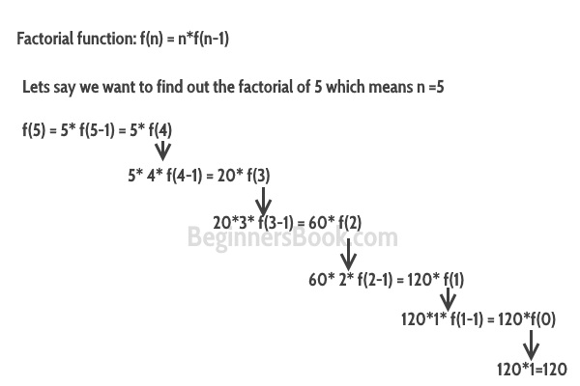
C++ Recursion
The function which calls the same function, is known as recursive function.

Slide 118
Ex: Factorial of a number using recursion
#include <iostream>
using namespace std;
//Factorial function
int f(int n){
/* This is called the base condition, it is
* very important to specify the base condition
* in recursion, otherwise your program will throw
* stack overflow error.
*/
if (n <= 1)
return 1;
else
return n*f(n-1);
}
int main(){
int num;
cout<<"Enter a number: ";
cin>>num;
cout<<"Factorial of entered number: "<<f(num);
return 0;
}

Slide 119
Default Arguments in C++
A default argument is a value provided in a function declaration that is automatically assigned by the compiler if the caller of the function doesn’t provide a value for the argument with a default value.

Slide 120
Ex: Default Arguments in C++
#include<iostream>
using namespace std;
int sum(int x, int y, int z=0, int w=0)
{
return (x + y + z + w);
}
int main()
{
cout << sum(10, 15) << endl;
cout << sum(10, 15, 25) << endl;
cout << sum(10, 15, 25, 30) << endl;
return 0;
}
Output:
25
50
80

Slide 121
Inline Function
Inline function is a function that is expanded in line when it is called.
When the inline function is called whole code of the inline function gets inserted or substituted at the point of inline function call.
This substitution is performed by the C++ compiler at compile time.
The syntax for defining the function inline is:
inline return-type function-name(parameters)
{
// function code
}

Slide 122
Remember, inlining is only a request to the compiler, not a command. Compiler can ignore the request for inlining. Compiler may not perform inlining in such circumstances like: 1) If a function contains a loop. (for, while, do-while) 2) If a function contains static variables. 3) If a function is recursive. 4) If a function return type is other than void, and the return statement doesn’t exist in function body. 5) If a function contains switch or goto statement.

Slide 123
Ex:
#include <iostream>
using namespace std;
inline int Max(int x, int y) {
return (x > y)? x : y;
}
// Main function for the program
int main() {
cout << "Max (20,10): " << Max(20,10) << endl;
cout << "Max (0,200): " << Max(0,200) << endl;
cout << "Max (100,1010): " << Max(100,1010) << endl;
return 0;
}

Slide 124
Pointers to Functions in C++
Like normal data pointers (int *, char *, etc), we can have pointers to functions.
#include <iostream>
using namespace std;
void (*fun_ptr)(int);
void fun(int a)
{
cout<<"Value of a is "<<a;
}
int main()
{
Int *p,a;
p=&a;
fun_ptr = &fun;
// Invoking fun() using fun_ptr
(*fun_ptr)(10);
*p
return 0;
}
output:
Value of a is 10

Slide 125
Dynamic memory allocation
Dynamic memory allocation means creating memory at runtime.
For example, when we declare an array, we must provide size of array in our source code to allocate memory at compile time.
We can dynamically allocate memory required during runtime using new and delete operator in C++.
If we need to allocate memory for more than one element, we must provide total number of elements required in square bracket[ ]. It will return the address of first byte of memory.

Slide 126
new operator
The new operator denotes a request for memory allocation on the Heap. If sufficient memory is available, new operator initializes the memory and returns the address of the newly allocated and initialized memory to the pointer variable.
Syntax to use new operator:
To allocate memory of any data type,
the syntax is:
pointer-variable = new data-type;
ptr = new data-type;
//allocte memory for one element
ptr = new data-type [ size ];
//allocte memory for fixed number of element

Slide 127
C++ delete operator
Delete operator is used to deallocate the memory created by new operator at run-time.
Syntax of delete operator
delete ptr;
//deallocte memory for one element
delete[] ptr;
//deallocte memory for array

Slide 128
Ex:
#include <iostream>
using namespace std;
int main ()
{
int *ptr1;
ptr1 = new int; //memory allocation
float *ptr2 = new float(223.324);//memory allocation
*ptr1 = 28;
cout << "Value of pointer variable 1 : " << *ptr1 << endl;
cout << "Value of pointer variable 2 : " << *ptr2 << endl;
delete ptr1;//deallocating the memory
delete ptr2;//deallocating the memory
}

Slide 129
double *myarray = NULL;
myarray = new double[5];
if(!myarray)
{
cout<<"memory not allocated"<<endl;
}
else
{
for(int i=0;i<5;i++)
myarray[i] = i+1;
cout<<"myarray values : ";
for(int i=0;i<5;i++)
cout<<myarray[i]<<"\t";
}
delete ptr;
delete var;
delete[] myarray;
return 0;
}
// Example program
#include <iostream>
#include <string>
using namespace std;
int main()
{
int *ptr = NULL;
ptr = new int();
int *var = new int(12);
if(!ptr)
{
cout<<"bad memory allocation"<<endl;
}
else
{
cout<<"memory allocated successfully"<<endl;
*ptr = 10;
cout<<"*ptr = "<<*ptr<<endl;
cout<<"*var = "<<*var<<endl;
}

Slide 130
#include<iostream>
using namespace std;
int main()
{
int size,i;
int *ptr;
cout<<"\n\tEnter size of Array : ";
cin>>size;
ptr = new int[size];
//Creating memory at run-time and return first byte of address to ptr.
for(i=0;i<5;i++) //Input arrray from user.
{
cout<<"\nEnter any number : ";
cin>>ptr[i];
}
for(i=0;i<5;i++) //Output arrray to console.
cout<<ptr[i]<<", ";
delete[] ptr;
//deallocating all the memory created by new operator
return 0;
}

Slide 131
Preprocessor Directives:
The preprocessors are the directives, which give instructions to the compiler to preprocess the information before actual compilation starts.
All preprocessor directives begin with #, and only white-space characters may appear before a preprocessor directive on a line
There are 4 main types of preprocessor directives:
Macros
File Inclusion
Conditional Compilation
Other directives

Slide 132
Macros: Macros are piece of code in a program which is given some name.
#define - directive is used to define a macro.
#undef – is used to undefine a macro
Ex:
#include<iostream>
using namespace std;
#define limit 5
int main()
{
for(int i=0;i<=limit;i++)
cout<<i<<endl;
}

Slide 133
Macros with arguments (functions like macros): We can also pass arguments to macros
Ex:
#include <iostream>
using namespace std;
#define MIN(a,b) (((a)<(b)) ? a : b)
int main ()
{
int i, j;
i = 100;
j = 30;
cout <<"The minimum is " << MIN(i, j) << endl;
return 0;
}

Slide 134
#undef
Ex:
#include<iostream>
using namespace std;
#define pi 3.14
int main()
{
int a,l,b;
cout<<"pi="<<pi<<endl;
#undef pi
cout<<"pi="<<pi<<endl;
}

Slide 135
-> File Inclusion:
Inclusion Directive
This category has only one directive, which is called #include. This inclusion directive is used to include files into the current file. The inclusion directive can be used as follows:
Ex: #include <iostream> //includes cpp class library header iostream

Slide 136
-> Conditional Compilation Directives:
#if-#else-#endif Preprocessor Directive
#if(condition)
- - - - - - - - - -
- - - - - - - - - -
#else
- - - - - - - - - -
- - - - - - - - - -
#endif

Slide 137
Ex:
#include<iostream>
using namespace std;
#define MAX 45
int main()
{
#if MAX > 40
cout << "Yes, MAX is greater then 40.";
#else
cout << "No, MAX is not greater then 40.";
#endif
return 0;
}

Slide 138
#elif Preprocessor Directive
#if(condition)
- - - - - - - - - -
- - - - - - - - - -
#elif(condition)
- - - - - - - - - -
- - - - - - - - - -
#elif(condition)
- - - - - - - - - -
- - - - - - - - - -
#else
- - - - - - - - - -
- - - - - - - - - -
#endif

Slide 139
Ex:
#include<iostream>
using namespace std;
#define MKS 65
int main()
{
#if MKS>=78
cout << "\nGrade A";
#elif MKS>=50
cout << "\nGrade B";
#elif MKS>=25
cout << "\nGrade C++";
#else
cout << "\nGrade D";
#endif
return 0;
}

Slide 140
#ifdef Preprocessor Directive
#ifdef preprocessor directive is used to check whether the macro-name is previously defined or not, if defined then the statements given between #ifdef and #else will get execute.
#ifdef macro-name
- - - - - - - - - -
- - - - - - - - - -
#else
- - - - - - - - - -
- - - - - - - - - -
#endif

Slide 141
Ex:
#include<iostream>
using namespace std;
#define MKS 65
int main()
{
#ifdef MONTH
cout << "\nMONTH is defined.";
#else
cout << "\nMONTH is not defined.";
#endif
return 0;
}

Slide 142
#ifndef Preprocessor Directive
#ifndef preprocessor directive is used to check whether the macro-name is previously defined or not, if not defined then the statements given between #ifndef and #else will get execute.
#ifndef macro-name
- - - - - - - - - -
- - - - - - - - - -
#else
- - - - - - - - - -
- - - - - - - - - -
#endif

Slide 143
Ex:
#include<iostream>
using namespace std;
#define MKS 65
int main()
{
#ifndef MAX
cout << "\nMAX is not defined.";
#else
cout << "\nMAX is defined.";
#endif
return 0;
}

Slide 144
#line Preprocessor Directive
The #line preprocessor directive is used to overwrite the default value of pre-defined macro-names __LINE__ and __FILE__. By defalut __LINE__ displays the current line number and __FILE__ displays the current filename.
Ex:
#include<iostream>
using namespace std;
int main()
{
cout << "\nLine number " << __LINE__;
cout << "\nFile name " << __FILE__<<endl;
return 0;
}

Slide 145


