Slide 1

FEED-ME-BACK
Presented By-
Arushi Bhatla
Kanika Khanna
Shraddha Nayak
Shivani Suryawanshi

Slide 2
Problem Statement
After the interview there is no feedback provided to the student
After taking an interview, interviewer have to make notes regarding the interview which could be time consuming
There is no existing platform to schedule interviews that will help a company.

Slide 3
As-Is:
Apply
Invitation
Schedule Interview
Give the Inteview
Wait for the Results
Notification for Acceptance /Rejection
Phases
Doing
Uploading Resumes
Contacting for Refereals
Accept the invitation
Discuss with HR and schedule a time
Meeting people at company
Think of possible outcomes
Looking for next steps
Thinking
/Feeling
Anxiety, Tension
Relieved
Excited,
Anxiety
Stressed:
Do they like me?
Am I doing well?
Panic
Will I get this Job?
Confused/ No growth- what
Pain Points
May schedule the interview in a hurry over the call..
Nervous
No Feedback because of Rejection

Slide 4
To-Be:
Apply
Invitation
Schedule
interview
Give the interview
Wait for the results
Get the detail feedback report
Phases
Doing
Uploading resume on different portal
Accept the invitation
Go to the feedmeback portal and schedule interview
Interaction with the interviewer
Think of possible outcome
Analyze the report and work on lacking skills
Thinking
/Feeling
Anxiety
Excitement
Have a clear thinking about scheduling date through portal.
Confident
Anxiety
Will I get this job?
Satisfied

Slide 5
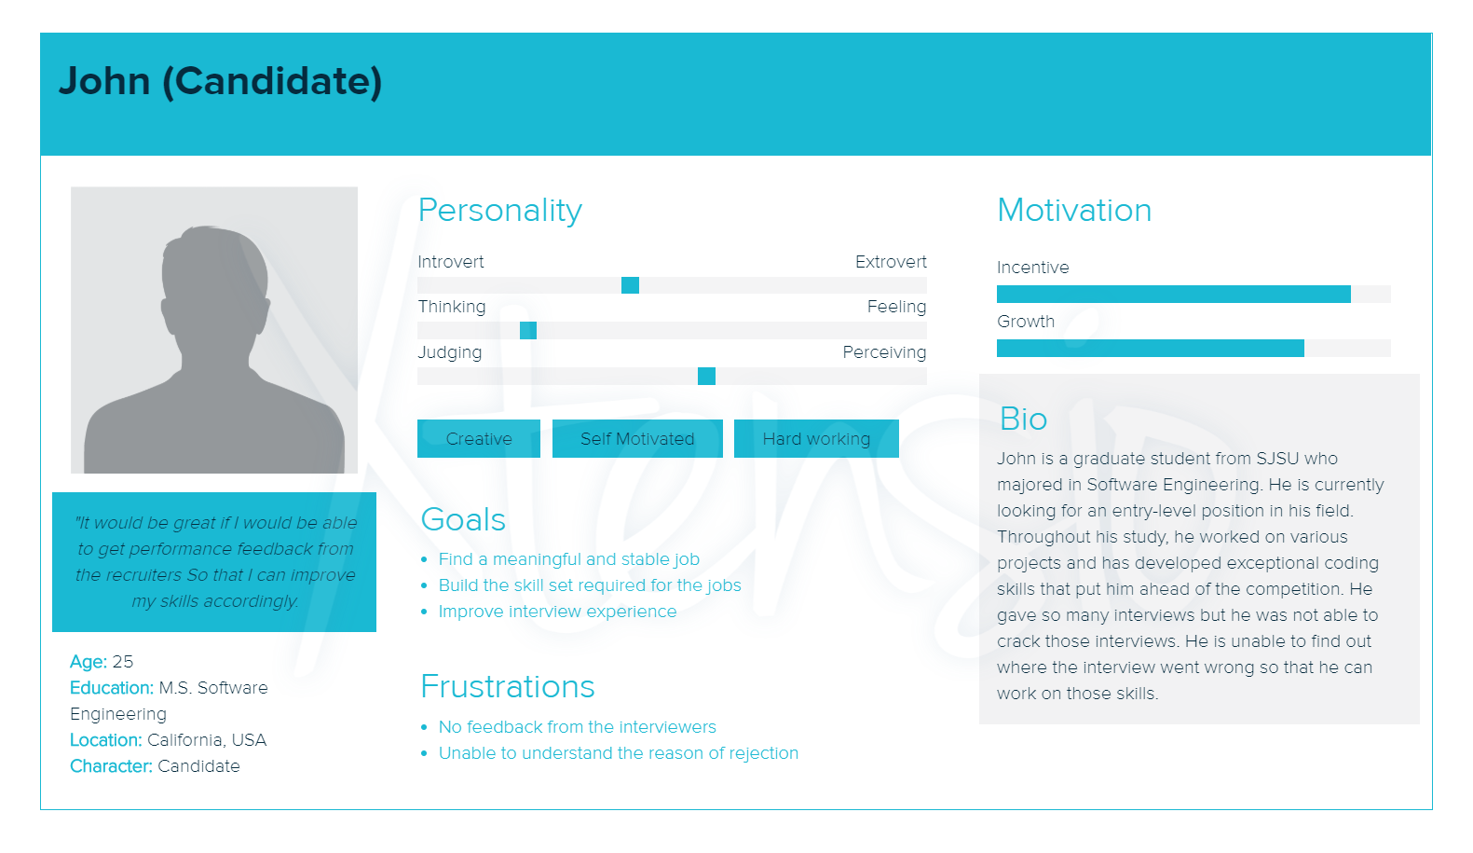
Candidate
Who: Candidate
What: can schedule interview
Wow: gets the detail report of the interview

Slide 6
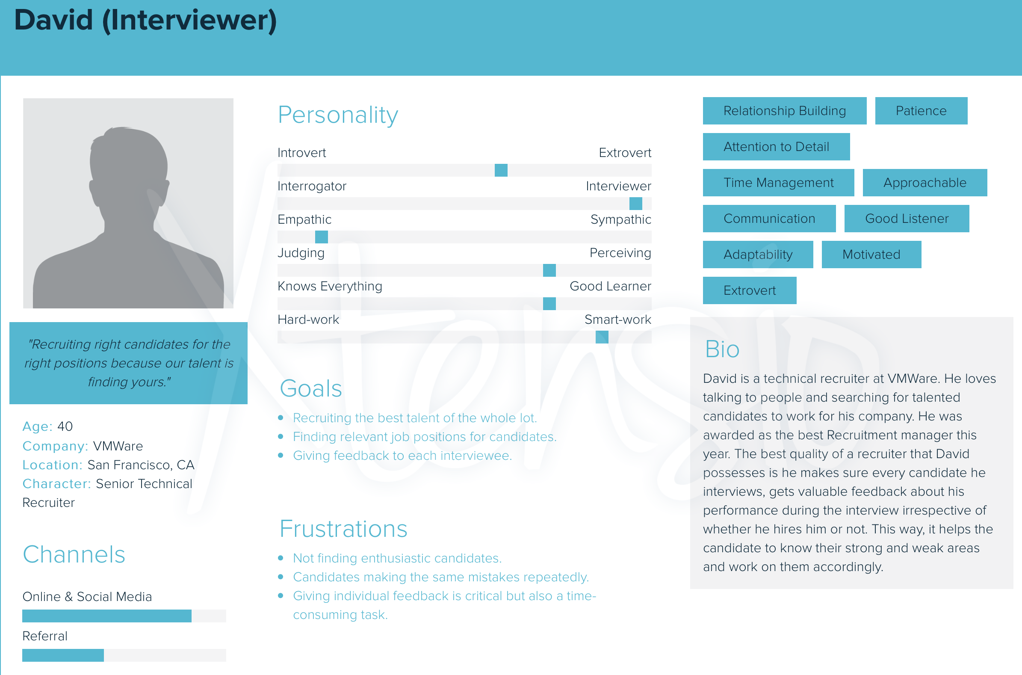
Interviewer
Who: Interviewer
What: Interviews candidate and provide feedback
Wow: within few seconds just by selecting to few questions and not writing whole paragraph

Slide 7
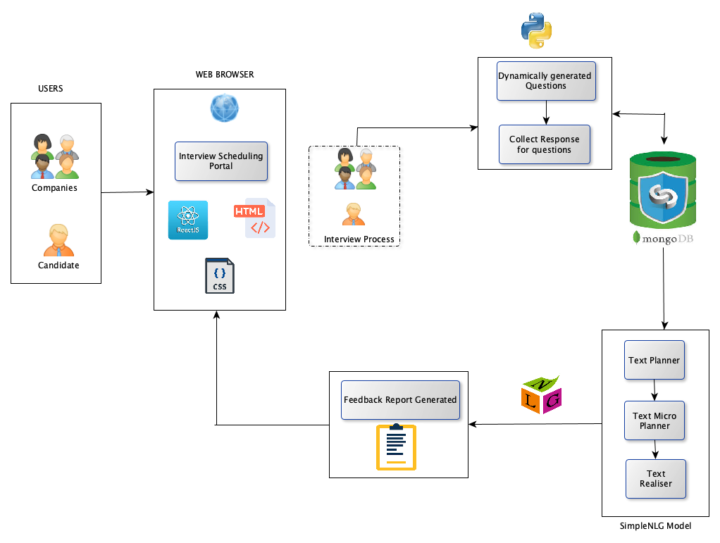
Architecture Diagram

Slide 8
DEMO

