Slide 1
Domain Data Analytics and Visualisation
Subdomain
Sentiment Analysis and Visualisation of Twitter Trends
By:
Dipanshu Nagpal
Shivani Suryawanshi
Priyanka Tikone

Slide 2
Coverage
Introduction
Motivation
Aim and Objectives
Literature Survey
Methodology
Architecture
Implementation
Conclusion
References

Slide 3

Introduction
Sentiment analysis is a process of automatically identifying whether a user generated text expresses positive, negative or neutral opinion about an entity (i.e. product, people, event, topic etc.)
Deals with the sentiments and comes up with some prediction

Slide 4
Motivation
Sentiment analysis of tweets can reveal sentiments of people regarding any topic or event.
Analysing the public sentiment can help, firms trying to find out the response of their products in the market, predicting political elections and predicting socioeconomic phenomena like stock exchange.
It helps in understanding the effect of a particular topic on people, whether the topic garners majority of positive reviews or negative reviews.

Slide 5
Objectives
To build an efficient and accurate model for sentiment classification using machine learning approach, which classifies a tweet as positive or negative.
To download current trends and tweets related to them from twitter using an API and apply this model on those tweets.
To develop a smooth, fast, efficient, reliable and easy to use web application in python which visualises the results of sentiment classification.

Slide 6
Scope
The scope of the project is to provide a user-friendly web based product that extracts people’s sentiment feelings toward topics, which are currently trending on twitter.
System will classify only English tweets.
There are no provisions for classification of other language tweets.
System will classify tweets of only top ten trends of that day and will generate graphs for the same, for analysis.

Slide 7
Abstract
The aim of this project is to develop a web application, which will automatically do the sentiment classification of tweets and generate reports that user can view.
This project deals with analysing sentiments behind the tweets be it positive, negative or neutral, regarding political events.
System does sentiment classification of tweets using supervised machine-learning approach in python.
A web application developed using flask in python displays these results of sentiment analysis in the form of various graphs like line graphs, maps, pie chart etc.
Focus is not only on classifying the tweets, but also on making this task faster and more accurate by removing the parts of the tweets not contributing to the sentiment analysis, with the help of data pre-processing techniques.
These pre-processing techniques include case conversion, punctuation removal, stopword removal, URL removal etc.

Slide 8
Literature Survey
Paper Name | Author | Contribution
1. Application of Machine Learning Techniques to Sentiment Analysis | Anuja P. Jain Asst. Prof Padma Dandannavar | Pre-processing techniques
2. Comparative Analysis of Twitter Data using Supervised Classifiers | Rohit Joshi, Rajkumar Tekchandani | Machine Learning Algorithms
3. Twitter data clustering and visualisation | Andrei Sechelea, Tein Do Huu | Visualisation Methods
4. Twitter data analysis and visualisation using the R language on top of the Hadoop Platform | Martin Sarnovsky, Peter Butka | Hadoop Concepts

Slide 9
Methodology
Sentiment classification levels
Document Level Sentiment Classification
It considers the whole document a basic information unit (talking about one topic).
Sentence Level Sentiment Classification
It aims to classify sentiment expressed in each sentence. The first step is to identify whether the sentence is subjective or objective.
Aspect Level Sentiment Classification
It aims to classify the sentiment with respect to the specific aspects of entities. The first step is to identify the entities and their aspects.

Slide 10
Methodology
Sentiment Analysis Approaches
Sentiment Analysis
Lexicon based approach
Corpus based approach
Machine Learning approach
Unsupervised Learning
Statistical
Semantic
Supervised Learning
Decision Tree Classifier
Linear Classifier
Rule based Classifier
Probabilistic Classifier
Dictionary based approach

Slide 11
Requirement Specification
Hardware Requirements:
RAM: 8 GB
Hard Disk: 1 TB
Processor: Intel core I7
Software Requirements:
Operating System: Windows 2010, Ubuntu
Software: JetBrains PyCharm Community Edition 2016.1.4
Anaconda 3
Database: MongoDB
Language: Python
API: Tweepy
Web Framework: Flask

Slide 12
Architecture
Tweets
Tweets
Tweets
Twitter Application &
Twitter database
Tweepy
Sentiment Analysis System
Data Collection
Sentiment Analysis System
Data Pre-processing
Classifier
Result and Suggestion
Web Application

Slide 13
Implementation
For data collection from twitter, Tweepy API is used.
The tweets extracted from twitter are stored in MongoDB database.
After tweet extraction the tweets are labelled manually with labels such as 1, -1 and o. Here 1 indicates positive sentiment, -1 indicates negative sentiment and 0 indicates neutral sentiment.
The tweets are pre-processed to remove unwanted words and characters which do not contribute to sentiment analysis.
After data pre-processing features such as unigrams, bigrams and trigrams are extracted from the tweets. It forms the feature vector for classification.

Slide 14
Implementation
Supervised machine learning classifiers such as Naïve Bayes, Support Vector Machine, Decision Tree algorithm are used and model is constructed.
Tweets of top 10 trending topics are downloaded and this model is applied on them to get the sentiment of the tweets.
A web based application developed using Flask framework for Python is used to visualise the results of sentiment analysis in the form of maps, bar graphs, pie charts etc.

Slide 15
Data Pre-processing Steps
Case conversion: All words are converted into either lower case
Stop words removal: The commonly used words like a, an, the, has, have etc. are removed.
Punctuation removal: Punctuation marks such as comma or colon are removed.
Stemming: Stemming usually refers to a simple process that chops off the ends of words to remove derivational affixes.
Lemmatization: Deals with removal of inflectional endings only and to return the base or dictionary form of a word, which is known as the lemma

Slide 16
Feature Extraction
Term presence and frequency: It usually consists of n-grams of words and their frequency counts.
In the fields of computational linguistics and probability, an n-gram is a contiguous sequence of n items from a given sample of text or speech. The items can be phonemes, syllables, letters, words or base pairs according to the application.
The n-grams typically are collected from a text or speech corpus.
The features used in this project are unigrams, bigrams and trigrams.

Slide 17
Algorithms
Machine learning approach is used for sentiment classification.
The machine learning algorithms that are used for sentiment classification are
Naïve Bayes Algorithm
Support Vector Machine
Decision Tree

Slide 18
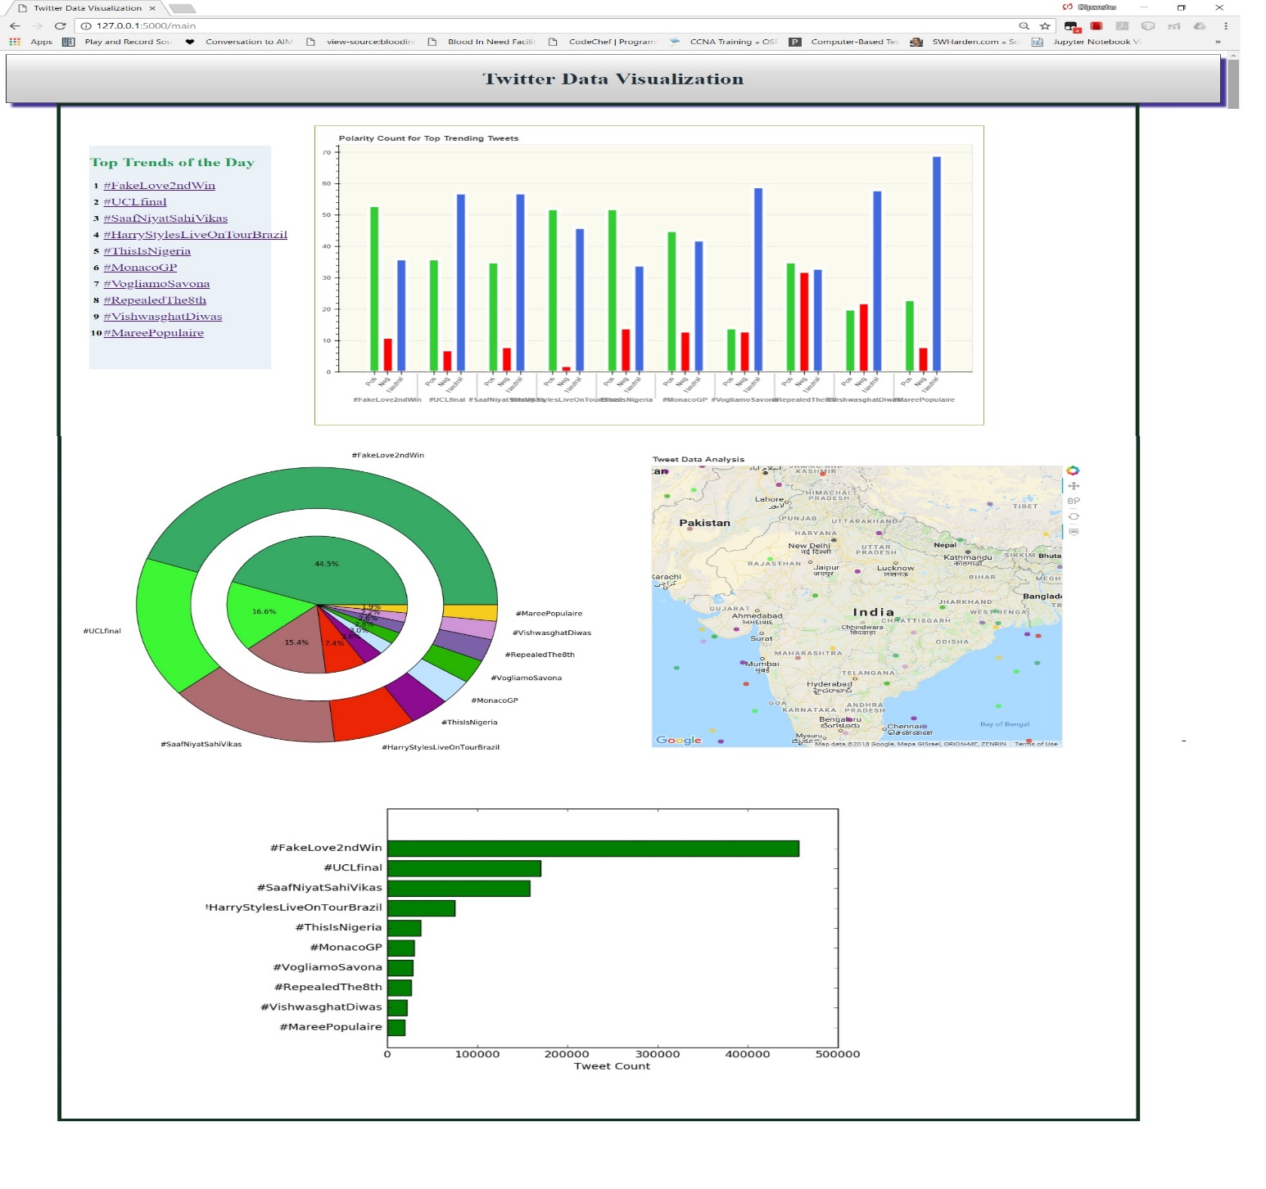
Visualization

Slide 19
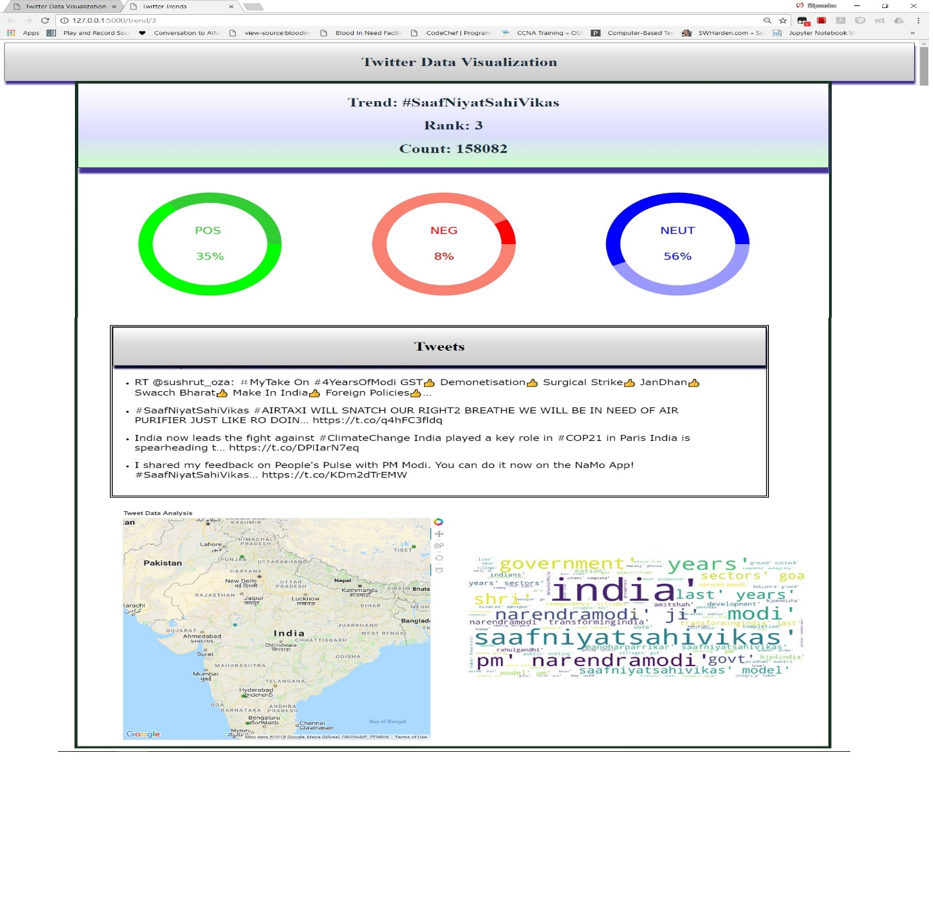
Visualization

Slide 20
Conclusion
In this project, we studied various methods and approaches of sentiment classification.
After analysing all the methods, their advantages and disadvantages we concluded that machine learning approach is more efficient among all other methods.
After experimentation, we found out that pre-processing tweet, to remove unwanted words, which do not express any sentiment, increases the accuracy.
Unigram gives good result than bigram and trigram.

Slide 21
References
Application of Machine Learning Techniques to Sentiment Analysis - Anuja P Jain,Asst. Prof Padma Dandannavar
Comparative Analysis of Twitter Data using Supervised Classifiers - Rohit Joshi, Rajkumar Tekchandani
Twitter data clustering and visualisation - Andrei Sechelea, Tein Do Huu
Twitter data analysis and visualisation using the R language on top of the Hadoop Platform - Martin Sarnovsky, Peter Butka

Slide 22
Thank you!!

