Slide 1

Bank Marketing Prediction Model
Portfolio Project

Slide 2
Project Overview
Project Goal
Dataset Info
To predict whether a client will respond to a marketing campaign and subscribe to a term deposit.
Name: Bank Marketing
Source: UCI Machine Learning Repository
Citation: Moro, S., Cortez, P., & Rita, P. (2014). A Data-Driven Approach to Predict the Success of Bank Telemarketing. Decision Support Systems, 62, 22–31.
DOI: https://doi.org/10.24432/C5K306
License: CC BY 4.0
Tools
Python (pandas, NumPy, seaborn, matplotlib, sci-kit learn)

Slide 3




Project Workflow
Data Understanding
EDA
Preprocessing
&
Data Cleaning
Model Evaluation & Selection

Slide 4
Data Understanding
Steps:
Findings:
Number of rows & columns
Checked column names
Print data types
Check summary statistics of numerical columns (identifies any outliers)
Check for missing values/empty strings
Check for duplicated rows
Check for unique variables in categorical columns (any mistyped words/unexpected values)
Check the target balance by seeing how many rows are ‘no’ vs ‘yes’
No. of rows: 45,211
No. of columns: 17
No missing values/empty strings
No duplicated values
Data types correct
Several categorical columns contain “unknown” category.
Some numeric columns show wide ranges (indicates the presence of extreme values).
The target variable is imbalanced (more “no” than “yes”)

Slide 5
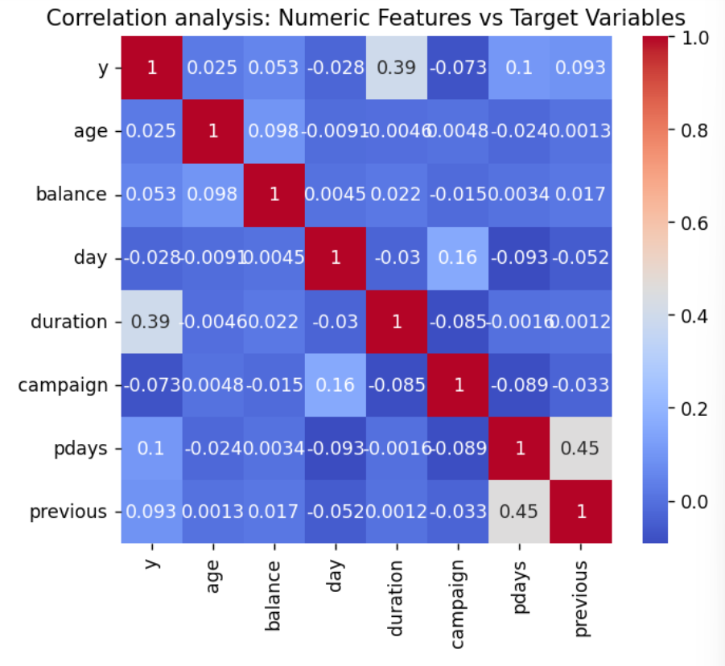
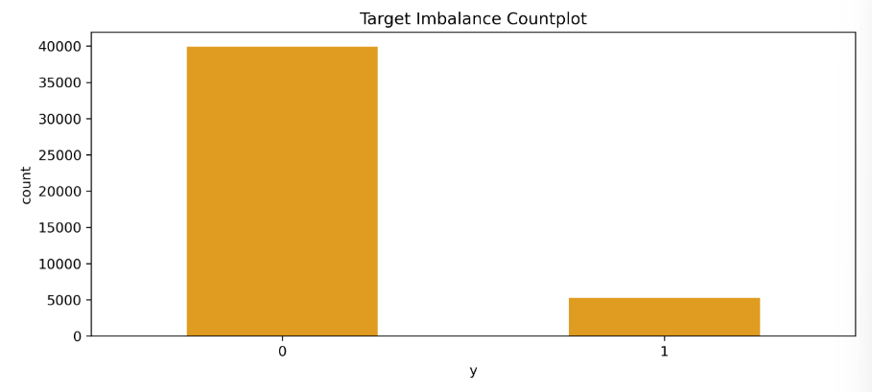
Exploratory Data Analysis
Findings:
Numeric features are right skewed with valid but extreme outliers, especially in balance and duration.
Duration has the strongest correlation to the target and strongly separates target classes - should be removed due to leakage.
The target is highly imbalanced which should be handled during preprocessing.

Slide 6
Preprocessing
Data Cleaning
Feature Engineering
Steps:
Remove ‘Duration’ column to prevent data leakage
Check for missing values and duplicates
  After removal of ‘Duration’ column, 16 duplicates were found and removed to stop dataset distortion
Log transform skewed numeric columns
Columns added:
‘contacted_before’ = converted pdays column into a binary feature (-1 = not previously contacted; 0 = no previous contact; 1 = contacted)
‘age_bucket’ = ‘young’, ‘middle’, ‘senior’
‘balance_positive’ = balance is bigger than 0 => 1
‘long_campaign’ = for number of contacts longer than 15 days

Slide 7
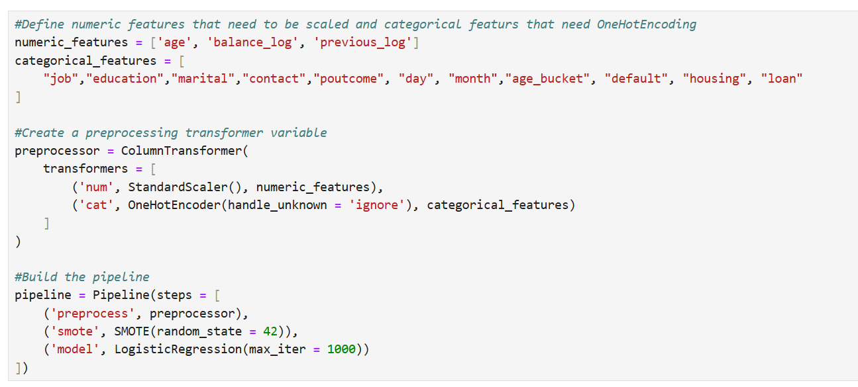
Preprocessing
To prevent data leakage, an automated pipeline was used.
StandardScaler() = As columns are normally distributed or log-transformed, ready for scaling.
OneHotEncoder() = To transform categorical data into binary columns, that is digestible by the models.
SMOTE() = Used for class imbalance and prevent model bias.

Slide 8
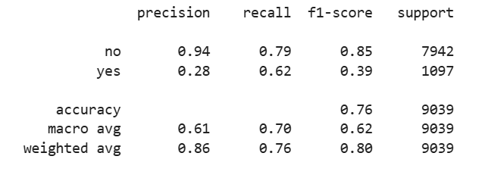
Baseline Model
Logistic Regression:
Logistic regression was chosen as a baseline model to compare to more complex models.
Reasons:
  Logistic regression is easy to understand
  Fast to train
  Stable and predictable
Therefore, advanced models should outperform logistic regression.

Slide 9
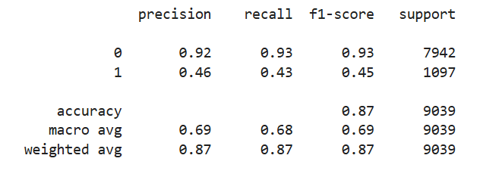
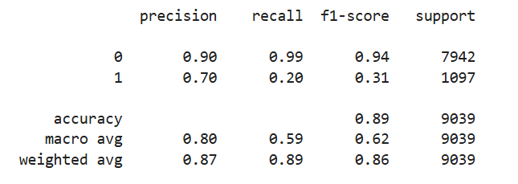
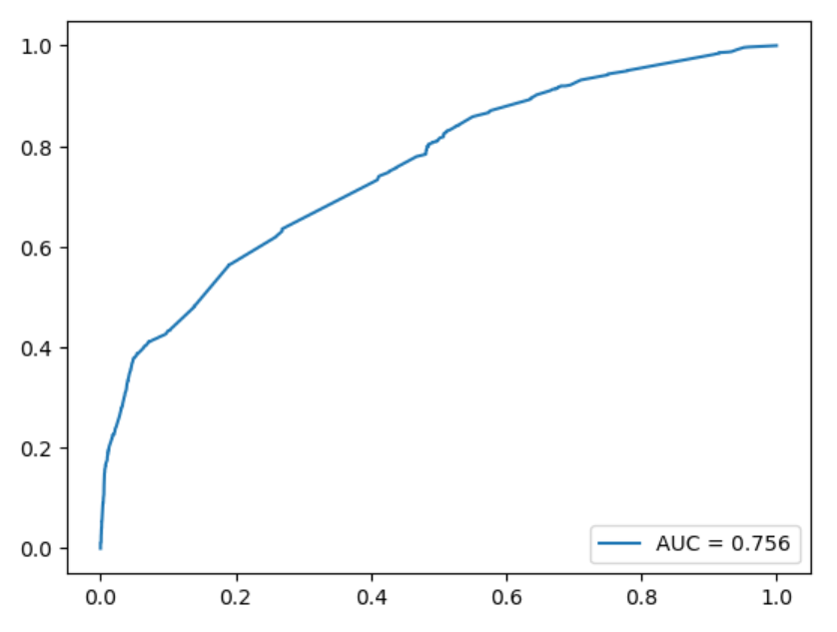
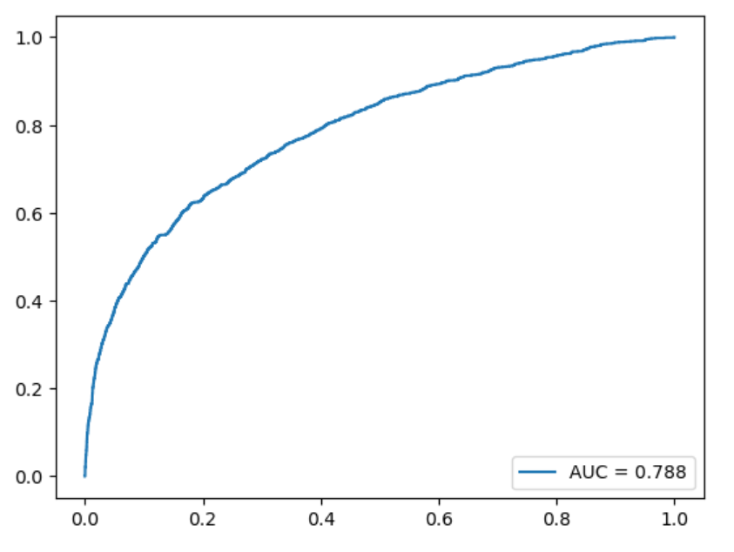
Advanced Models
RandomizedSearchCV() was used for hyperparameter tuning.
Random Forest Model
XGBoost Model

Slide 10
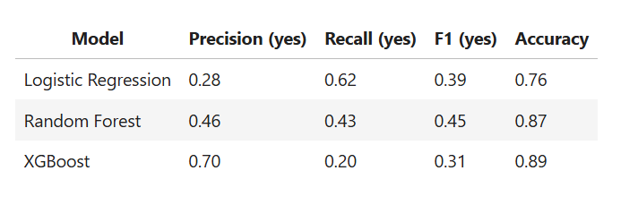
Model Comparison & Selection
Selected Model: Random Forest
Reasoning:
Has the best overall balance when predicting the “yes” class.
Whilst logistic regression and XGBoost excel in one evaluation metric each, neither has the balance needed for effective targeting.
The Random Forest Model is an example of a balanced trade-off – precision, recall, and F1 are all important to goal, therefore need a model that performs consistently across all metrics.
Although precision, recall, and F1-score is below 0.55 for the “yes” class – this is expected for imbalanced classification problems.
Random Forest is the model that is the most dependable for identifying likely responders and supporting targeted marketing decisions.

Slide 11
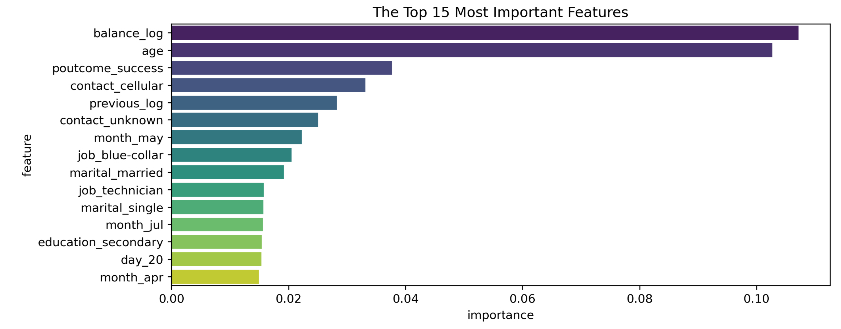
Random Forest Model: Feature Importance
Feature Importance:
The model focuses primarily on balance_log, age, and poutcome_success. This suggests that financial stability, demographic factors, and past campaign outcomes are the driving power behind predictions.
Contact_type, previous_log, and month_may also matter, suggesting that communication strategy and timing influence the model’s decisions more than job or marital status.

Slide 12
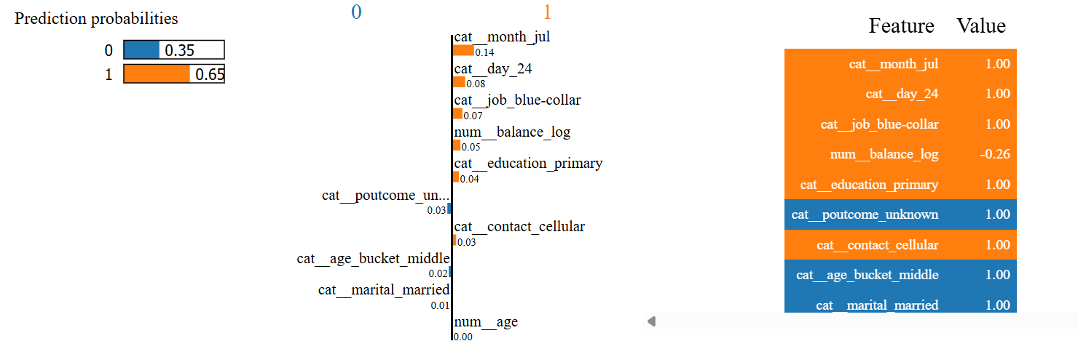
Random Forest Model: LIME Explainability
Correctly Predicted Case:
The model shows a 65% confidence in its positive prediction.
Features, such as the last contact month of July and days since contact, are main drivers in swaying the prediction of the model.

Slide 13
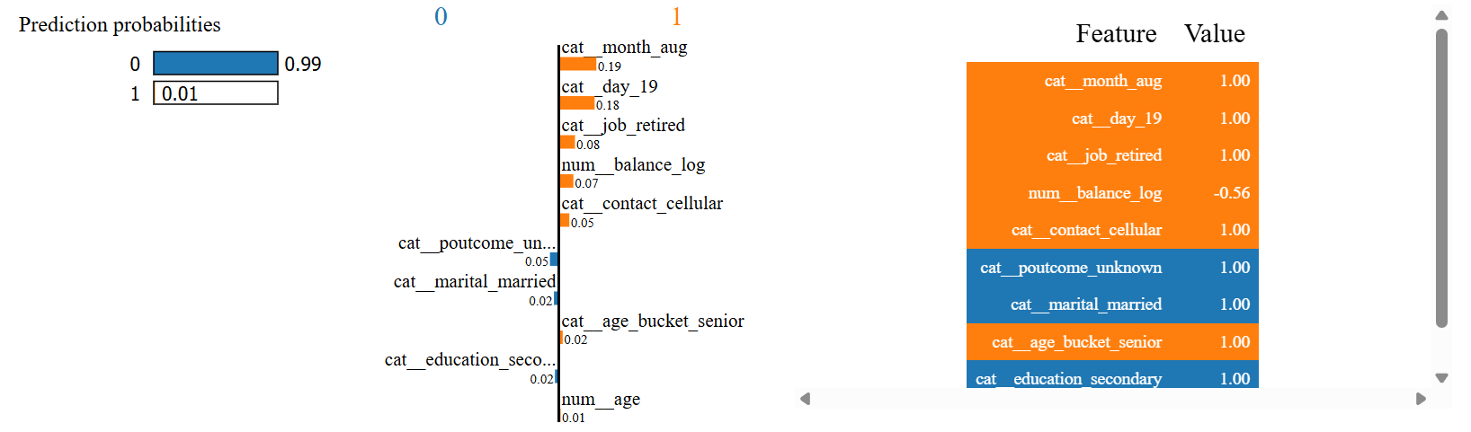
Random Forest Model: LIME Explainability
False Negative Case:
The model is 99% confident in its decision. This suggests that the model is highly over-confident.
There are big contributions from features, such as cat_month_aug, that push for a positive prediction. However, the model seems to begin with a very strong internal bias towards class 0 for this customer, and the positive contributions are not large enough to overcome this.

Slide 14
Future Work
Try other class imbalance techniques. Although this project uses SMOTE, techniques, such as random undertraining, might improve evaluation metrics.
Calibrate the model confidence – The model shows overconfidence and this could be improved through calibration curves and adjusting the decision threshold.
Feature engineering – create features to create stronger signals.
Try more advanced models (e.g. LightGBM) to improve evaluation metrics.

