Slide 1

CSE-5335: Presentation
Maaz Ahmed Sheriff, Krutik Yogeshkumar Shah, Darshil Jigneshkumar Shah, Manideep Shanigaram, Sureddy Shivani Reddy
Section: 5335-001
SUMMER 2023

Slide 2

PHASE 5 Demo
Pages before Login

Slide 3

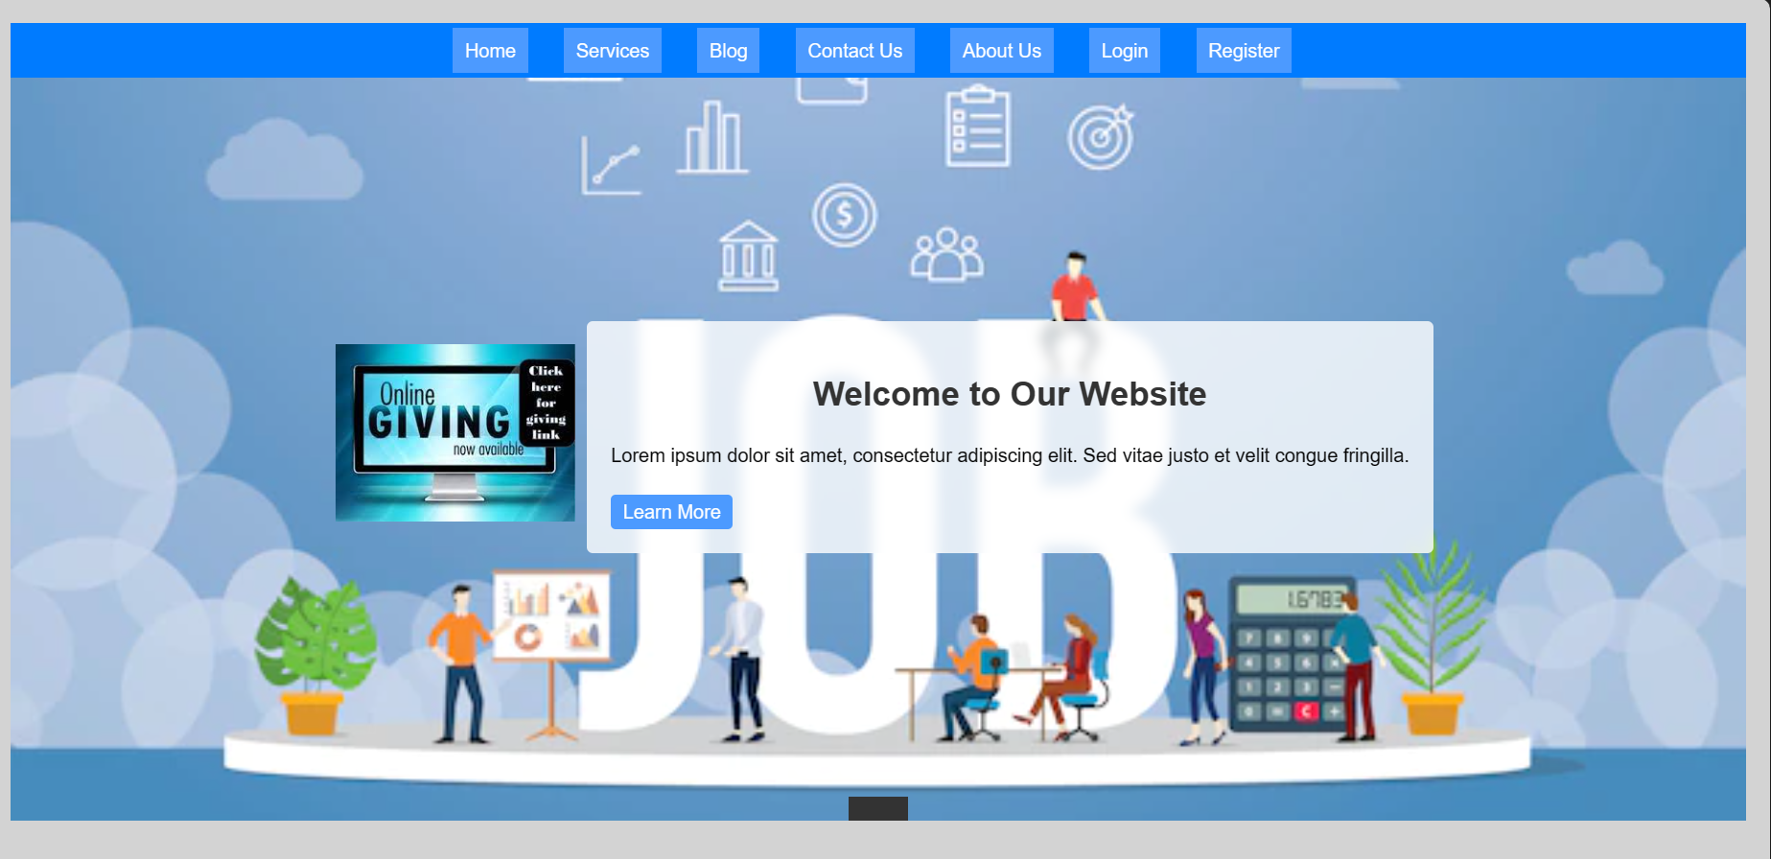
SEMINAR Demo
Page : Homepage
Main Landing page of the URM application
Includes React and CSS for styling
The JSX code includes a navigation section by the “Navhome” component, and is used to render the home page of the web application

Slide 4
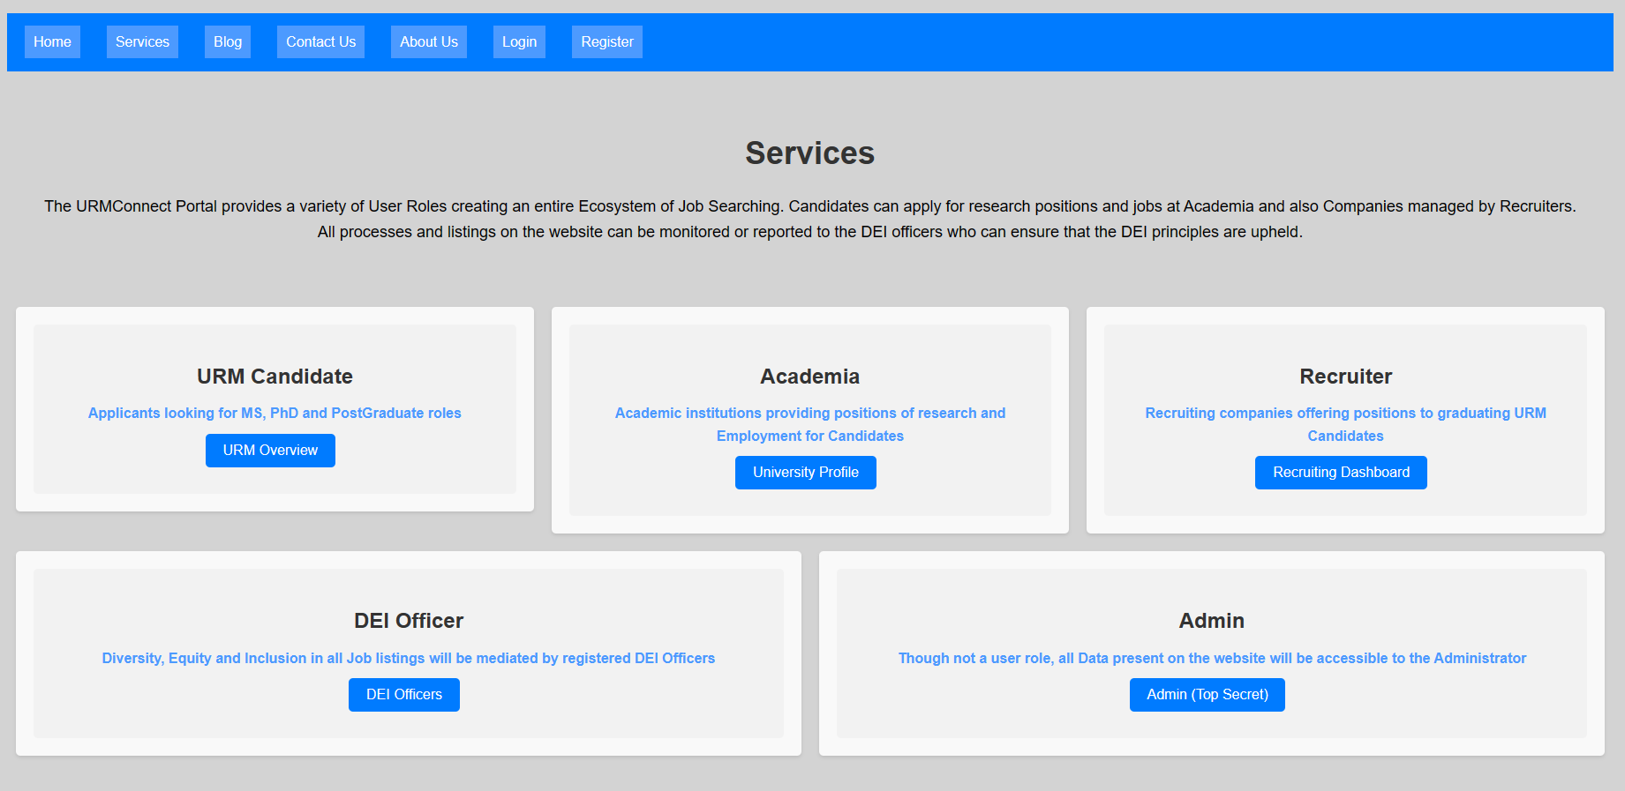
SEMINAR Demo
Page : Services Page
Importing Dependencies
- React, Link from react-router-dom, CSS styles
Functional Component
- Services is the functional component that returns JSX elements
JSX Structure
- Navigation Bar
- Services Cards
- URM Candidate Card
- Academia Card
- Recruiter Card
- DEI Officer Card
- Admin Card
Button Actions
- onClick event handler that uses window.location.href to navigate to specific URLs

Slide 5
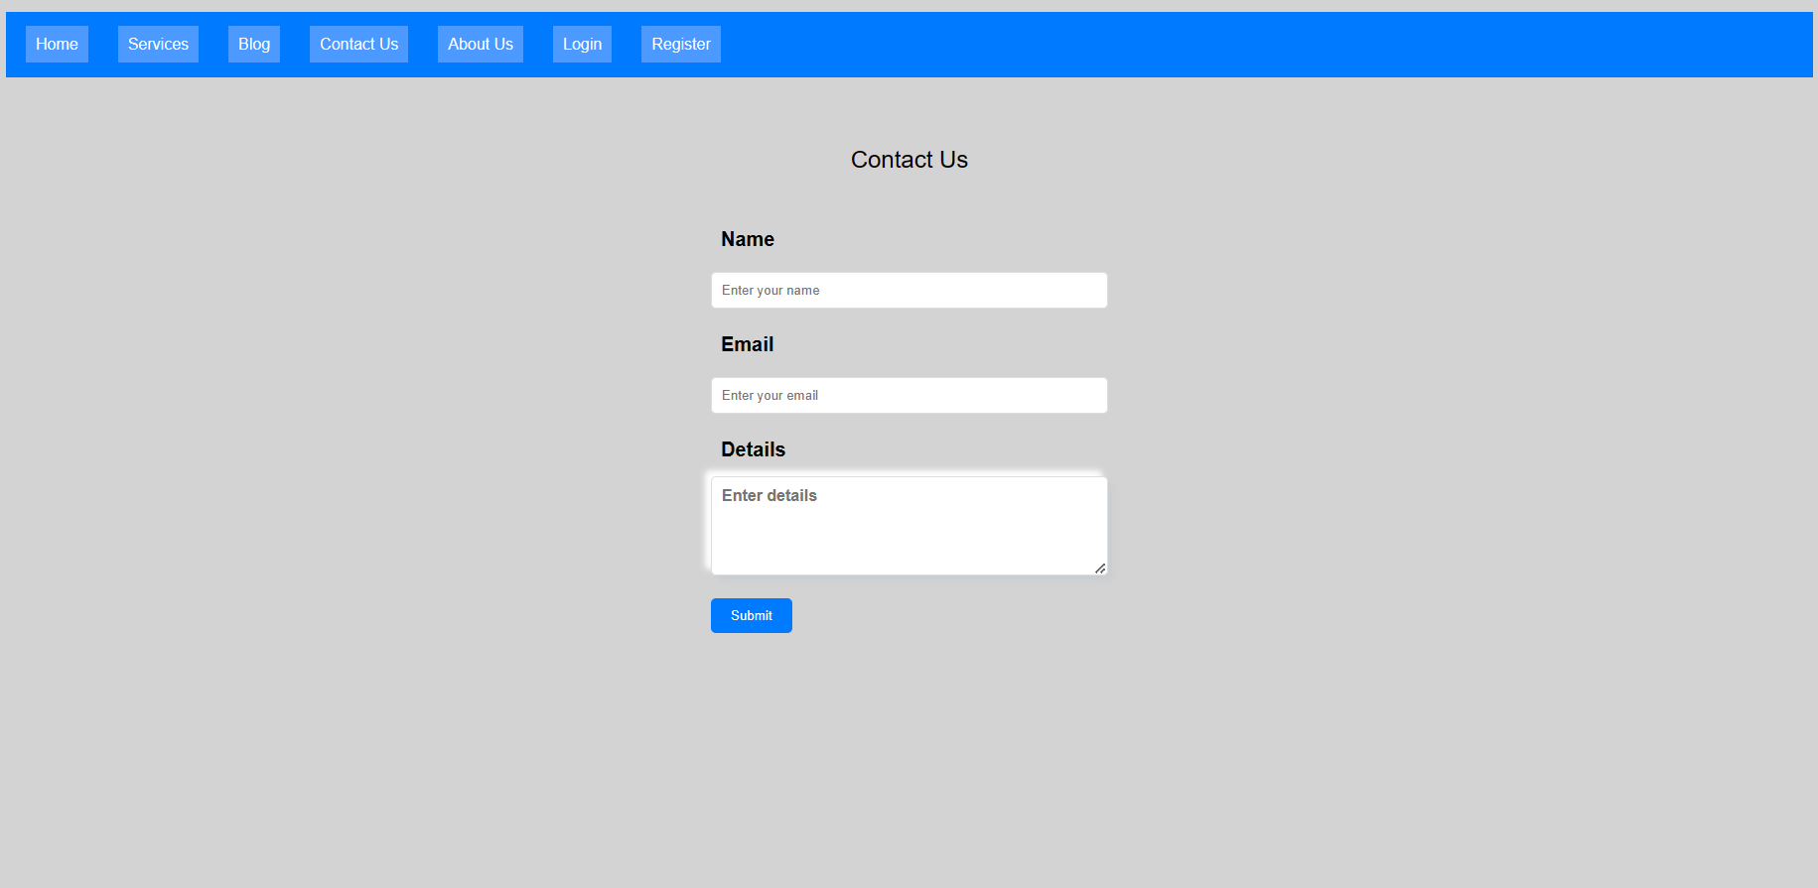
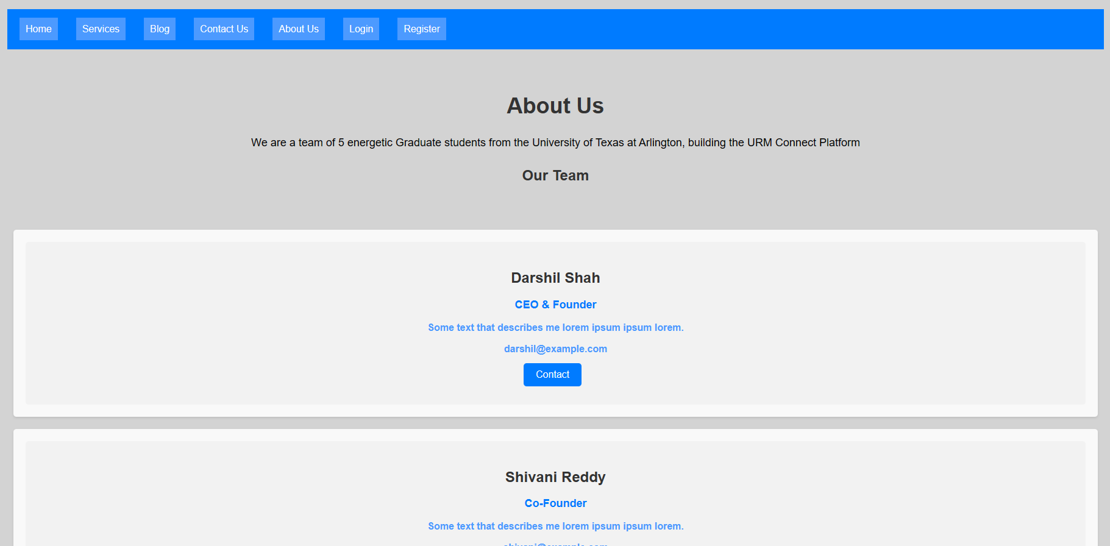
SEMINAR Demo
Page : Contact Us Page and About Us Page

Slide 6
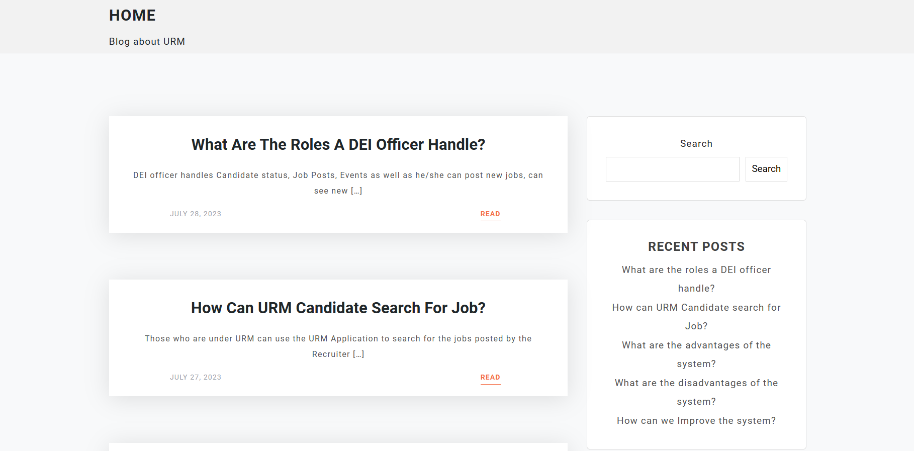
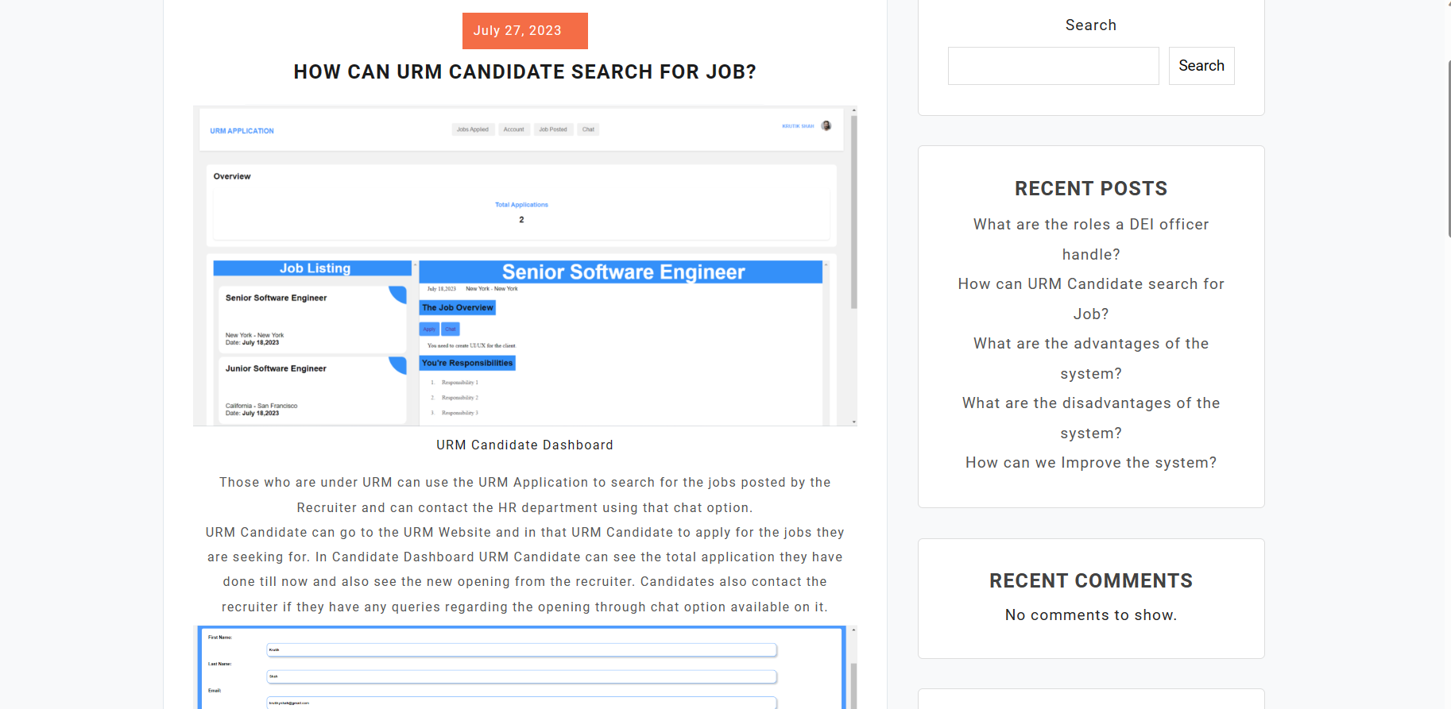
SEMINAR Demo
Page : Blog

Slide 7
SEMINAR Demo
Login Landing

Slide 8
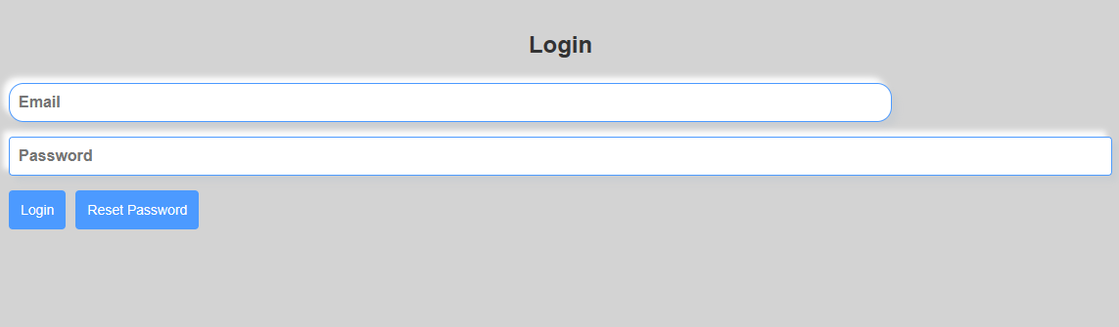
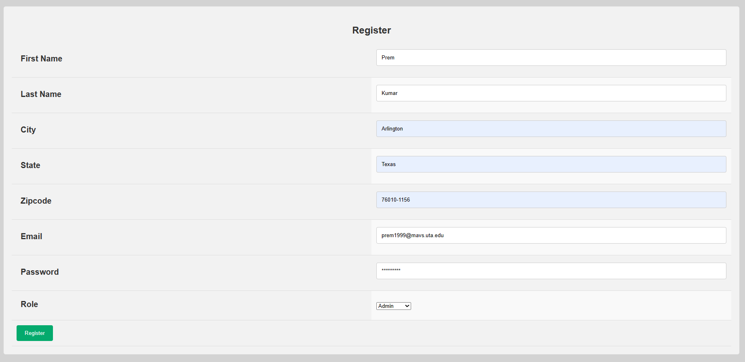
SEMINAR Demo
Page : Login/Register
User Authentication, Access Control, Performance, Data Integrity
Importing Dependencies
- React, useState, axios, useNavigate, Link
Functional Component
- Login/Register
State Management
- uses useState hook to manage the userData state
Event Handlers
- handleChange, handleSubmit
JSX Structure
- The forms onSubmit attribute is set to the handleSubmit function

Slide 9
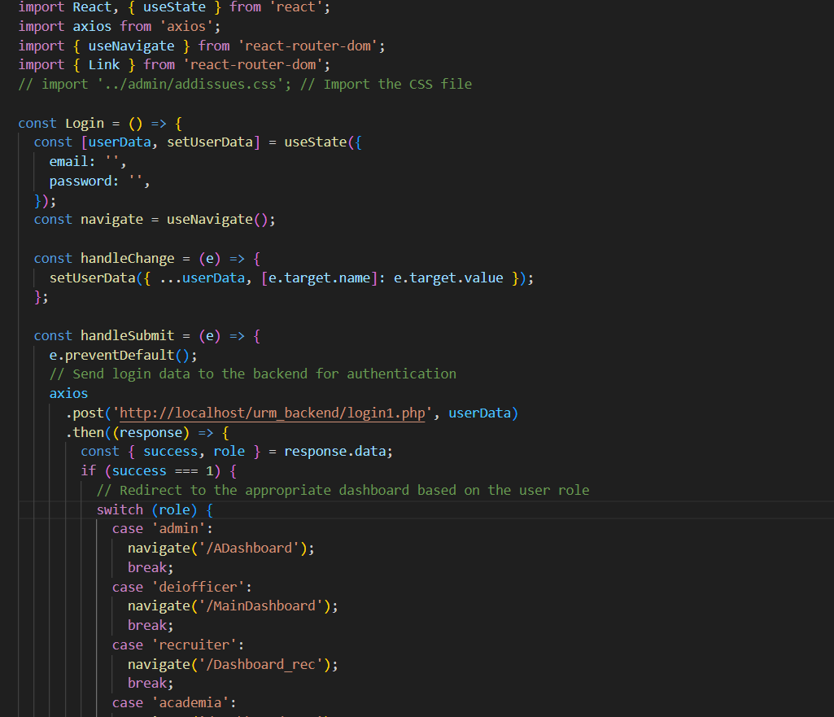
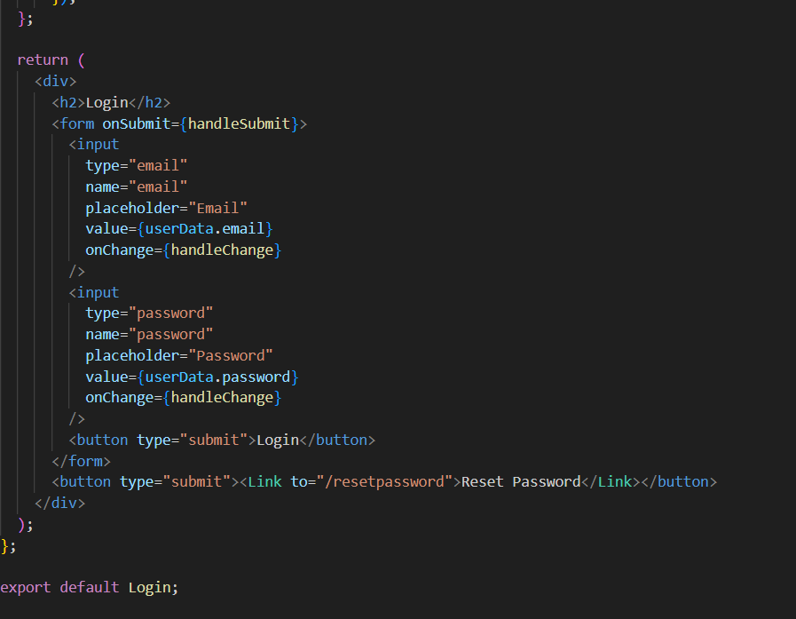
SEMINAR Demo
Page : Login/Register

Slide 10
SEMINAR Demo
Pages after Login

Slide 11
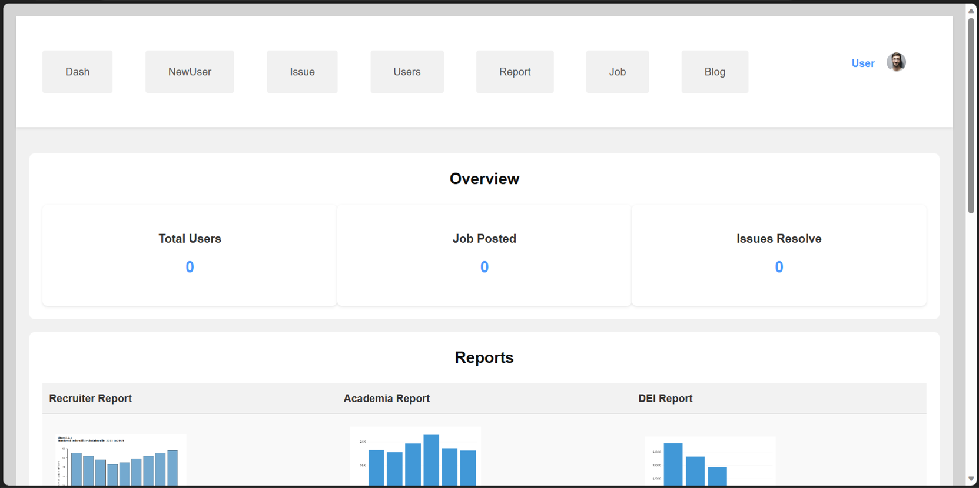
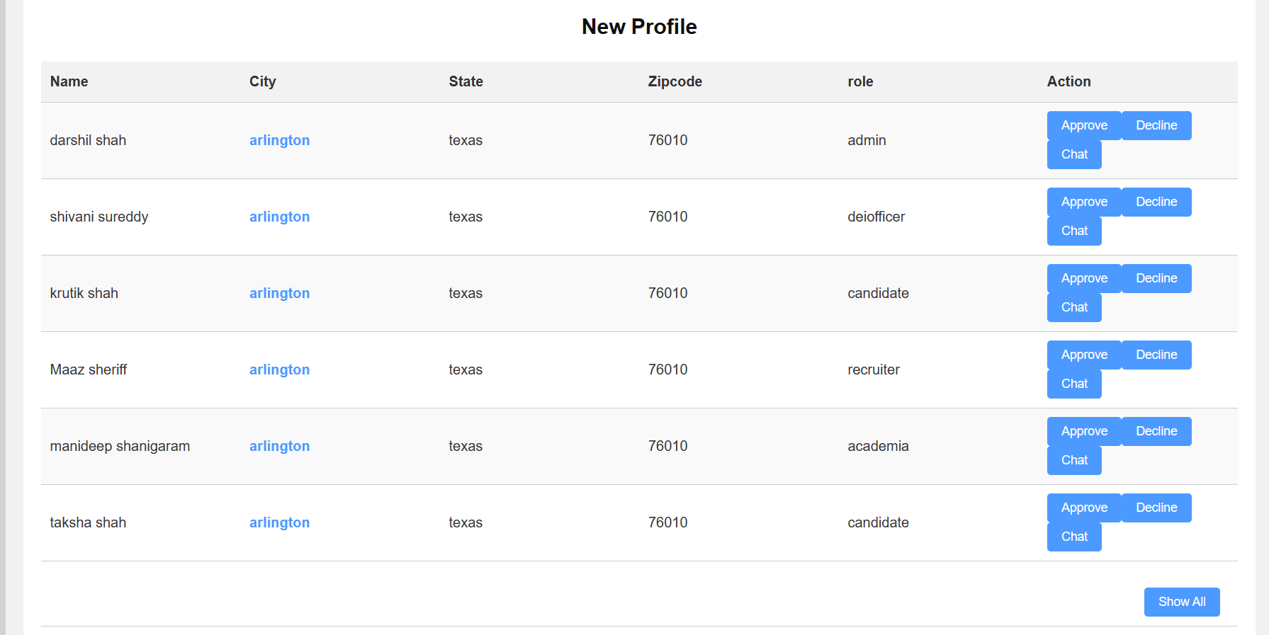
SEMINAR Demo
Page : Admin Dashboard
Admin Dashboard with various sections to display important statistics, reports, user details, job posts.
Database Connection
- Laravel has .env file to define database environment variable
Error Handling
The scripts handle exceptions that may occur during the database operations and return the appropriate message in JSON format

Slide 12
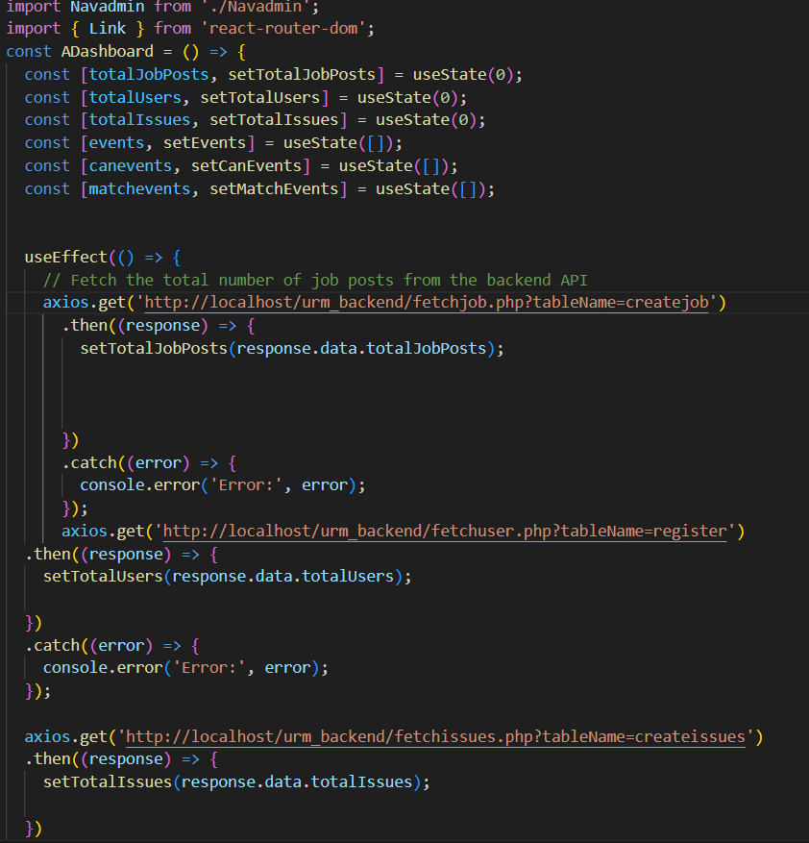
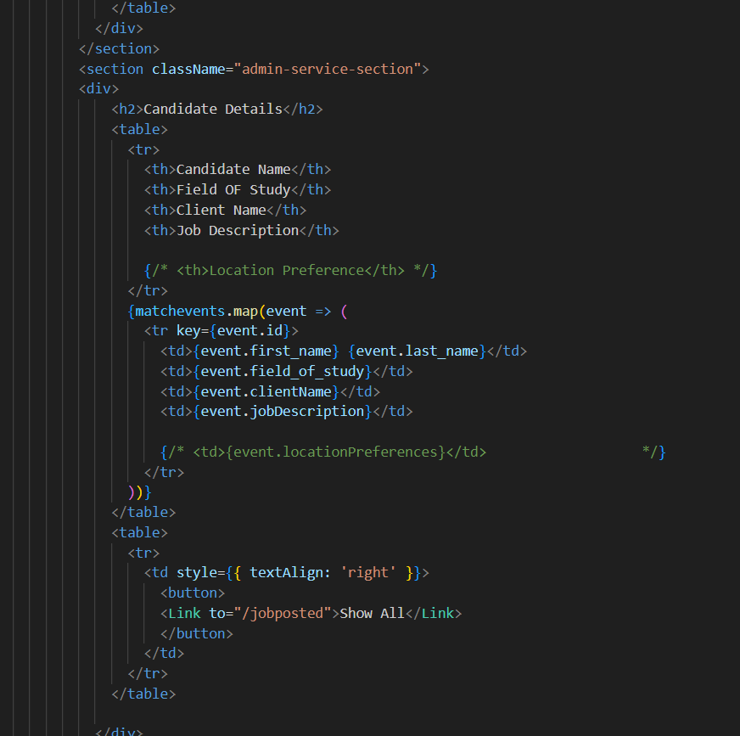
SEMINAR Demo
Page : Admin Dashboard

Slide 13
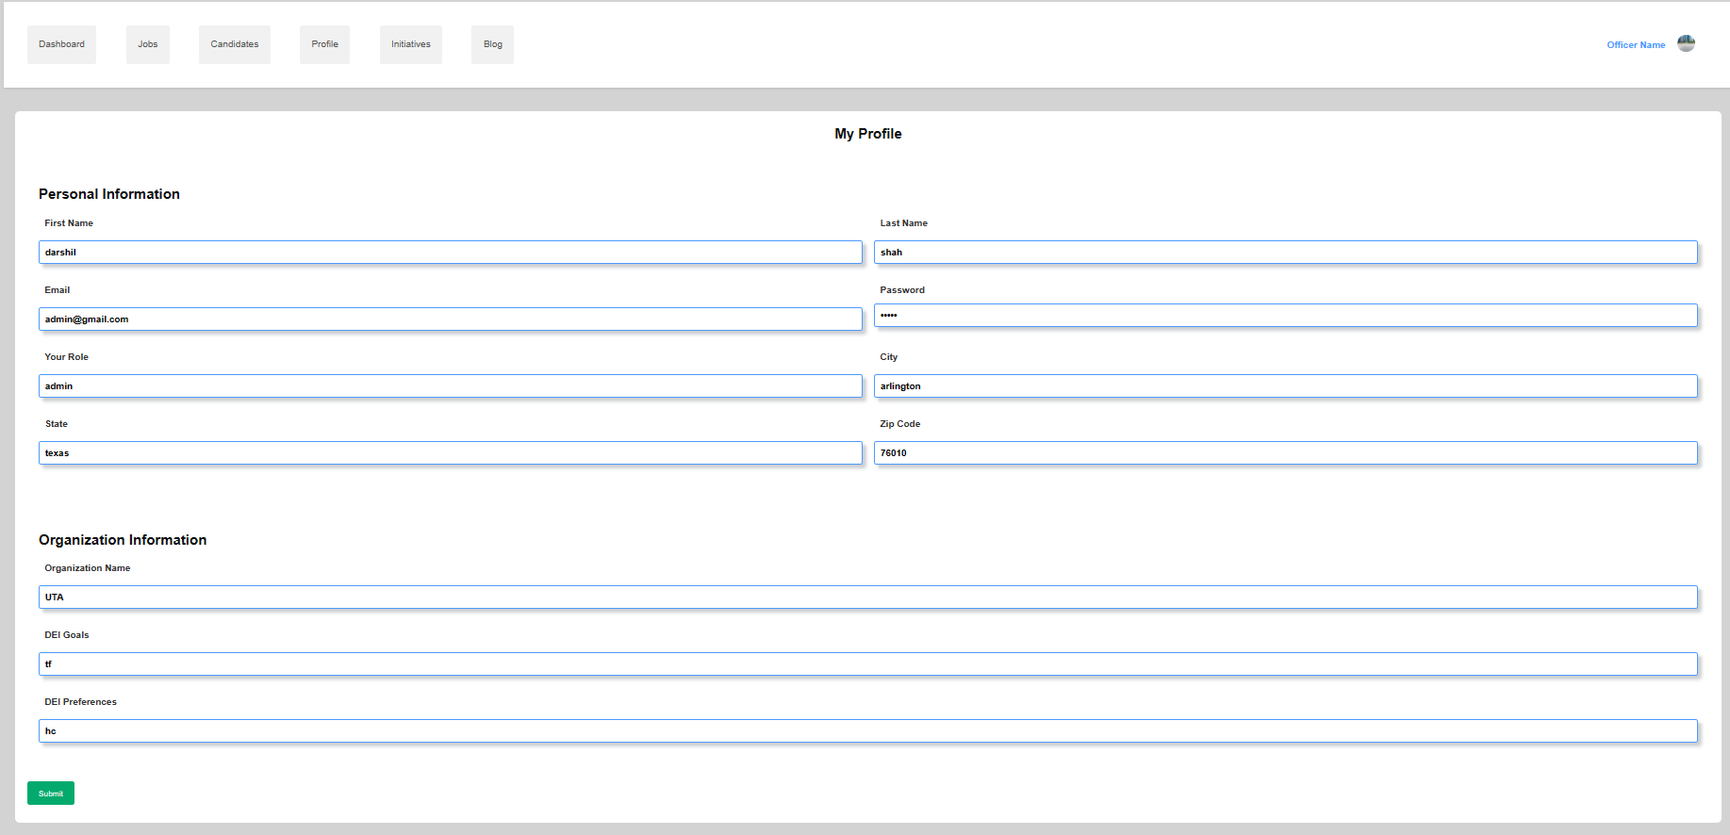
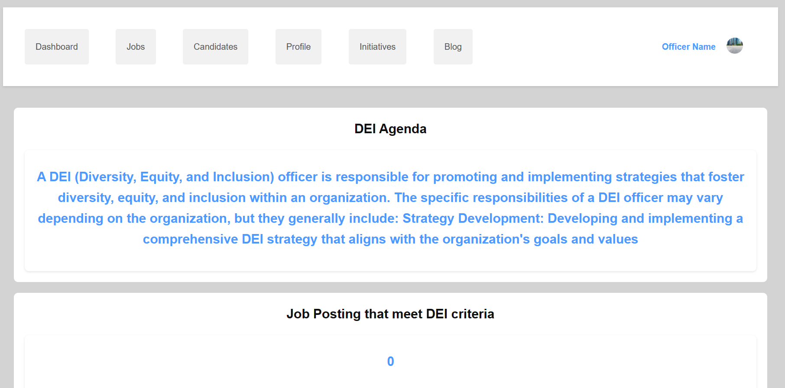
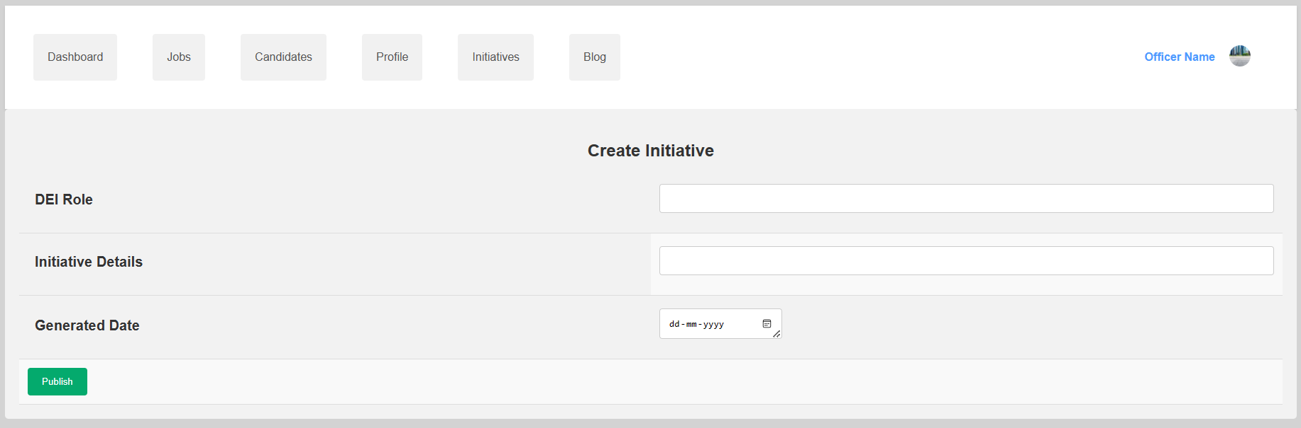
SEMINAR Demo
Page : DEI Officer Dashboard

Slide 14
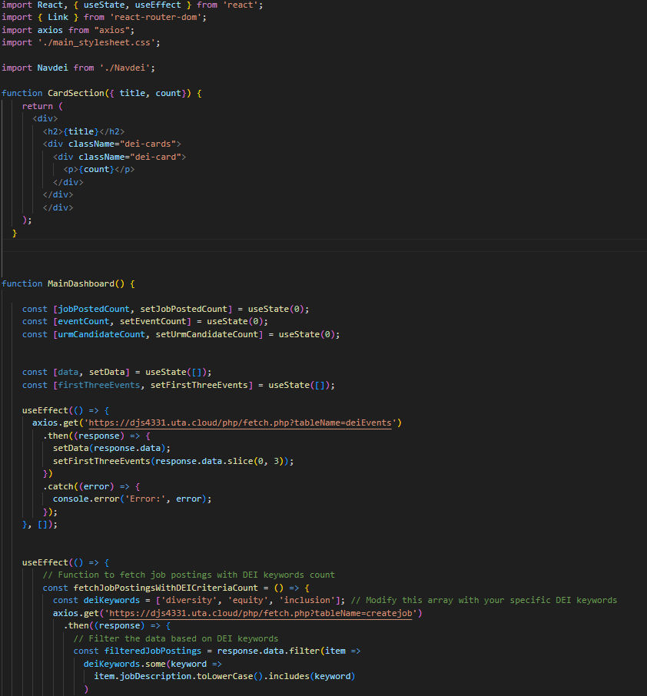
SEMINAR Demo
Page : DEI Officer Dashboard
The component renders different endpoints using useEffect hook and axios.get
useEffect hook
- used to fetch the data from the server when the component is mounted
- useEffect can also return a Clean-up function that handles any necessary cleanup oeartions when the component is unmounted.
Axios.get
- axios.get is used to perform asynchronous HTTP GET request to fetch data from a specified URL
- handles the response data in .then() callback
- allows configurations in the config object.
- axios.get is an essential tool for data fetching in modern Javascript applications

Slide 15
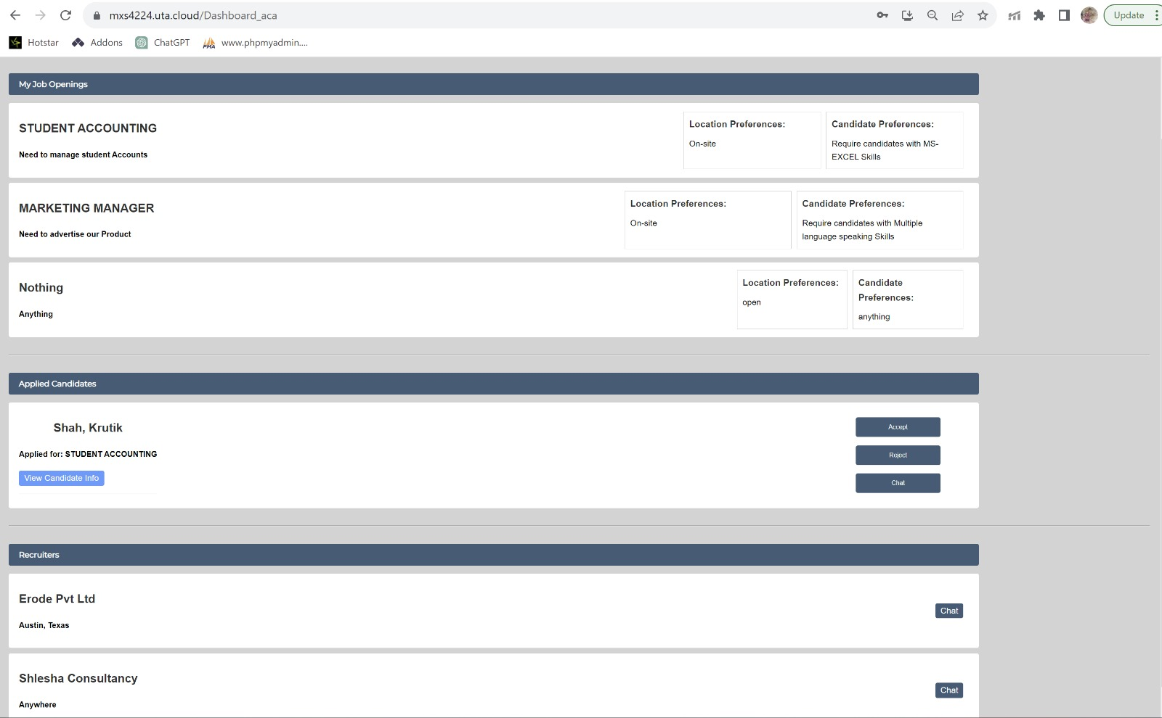
SEMINAR Demo
Page : Academia Dashboard

Slide 16
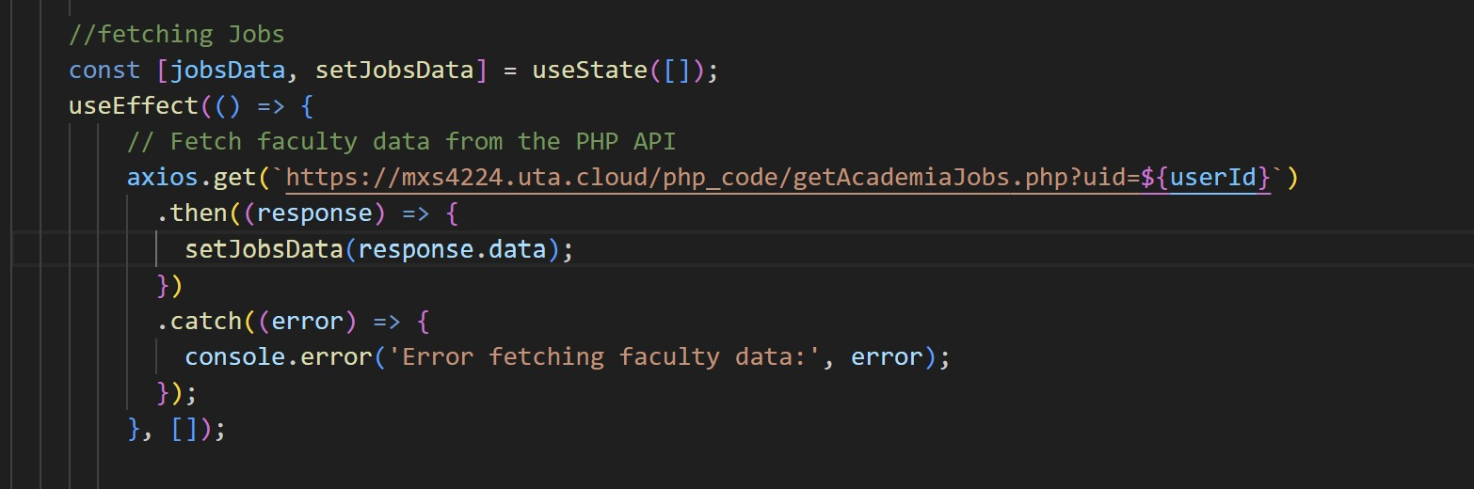
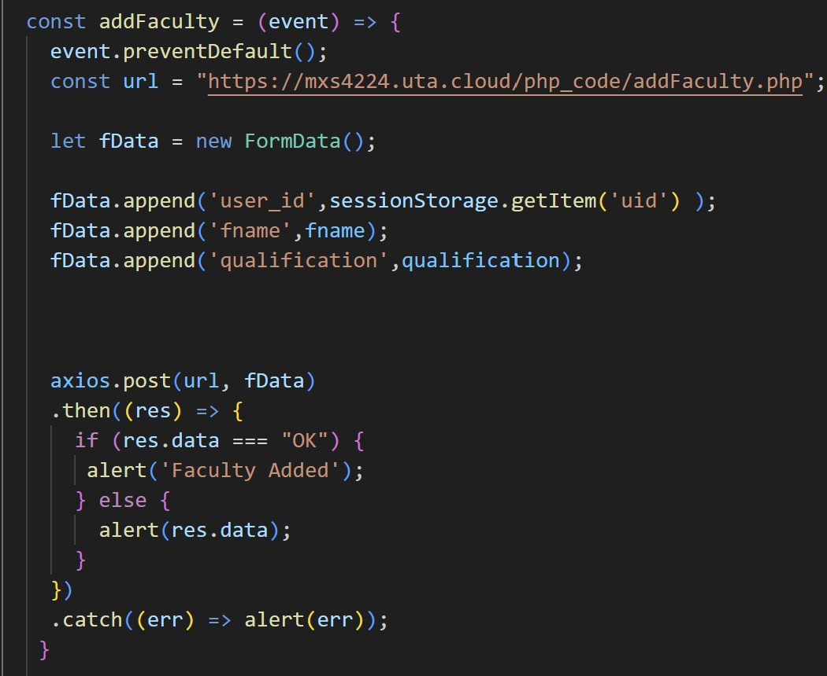
SEMINAR Demo
Page : Academia Dashboard
Axios.post is a powerful tool for sending data to servers and APIs through HTTP POST request.
Helps in Promise-based approach, interoperability, handling responses, errors etc.,

Slide 17
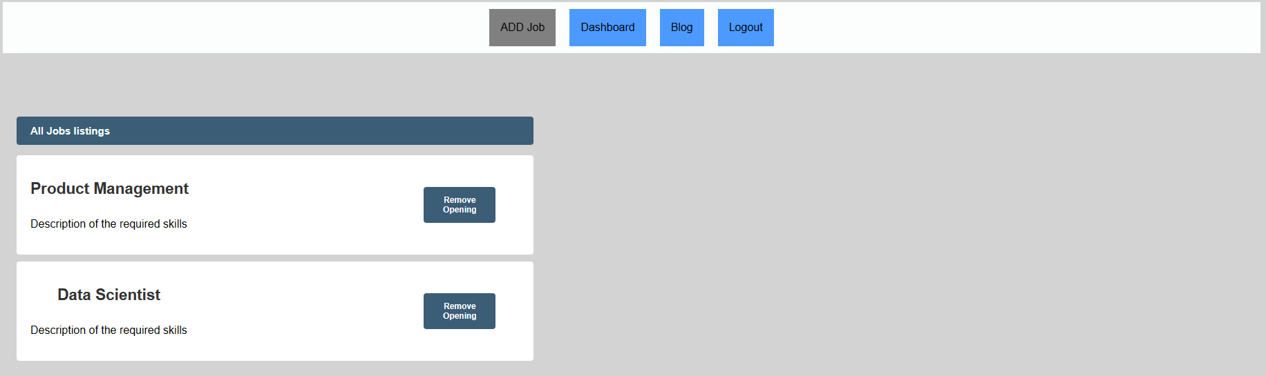
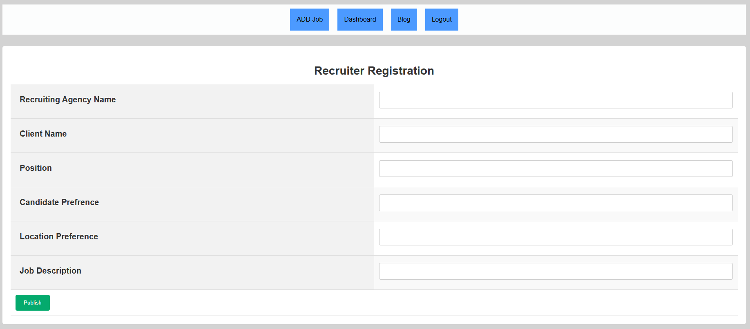
SEMINAR Demo
Page : Recruiter Dashboard

Slide 18
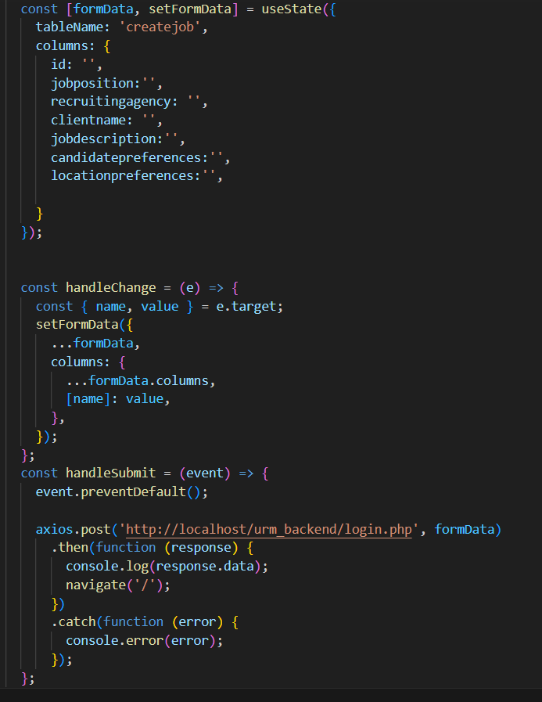
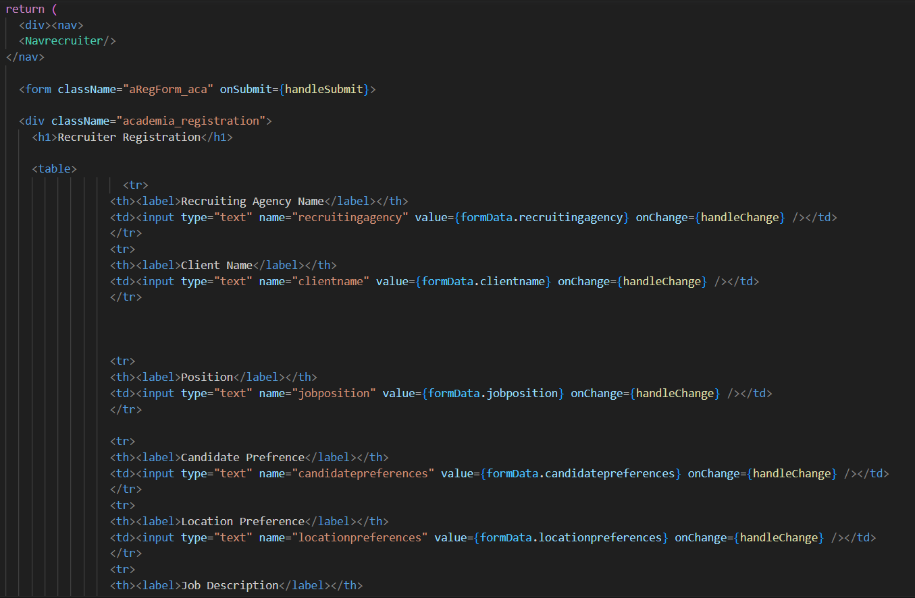
SEMINAR Demo
Page : Recruiter Dashboard

Slide 19
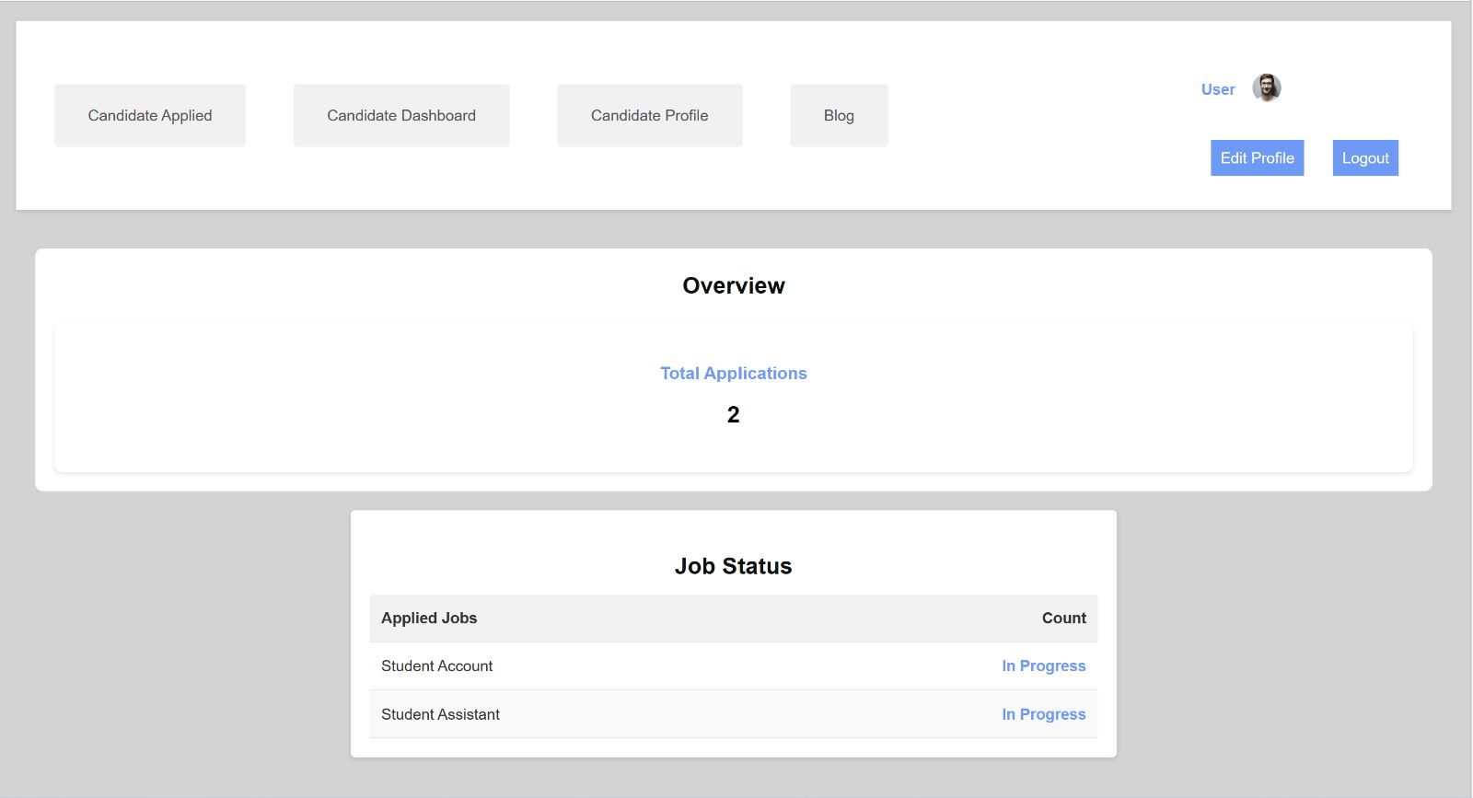
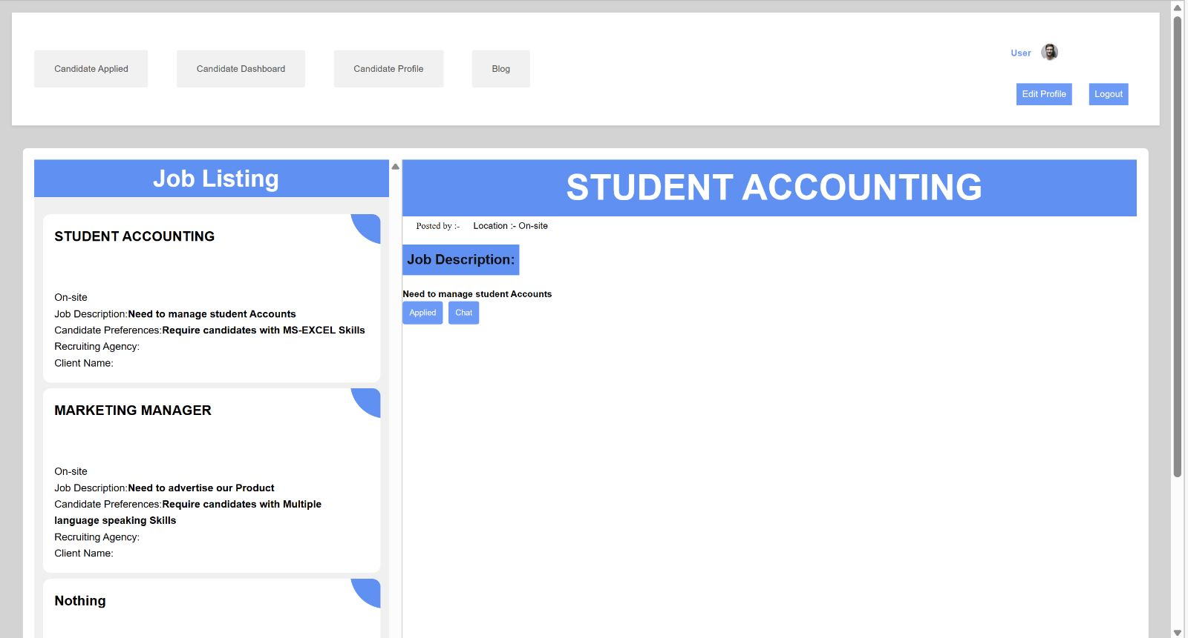
SEMINAR Demo
Page : URM Candidate Dashboard

Slide 20
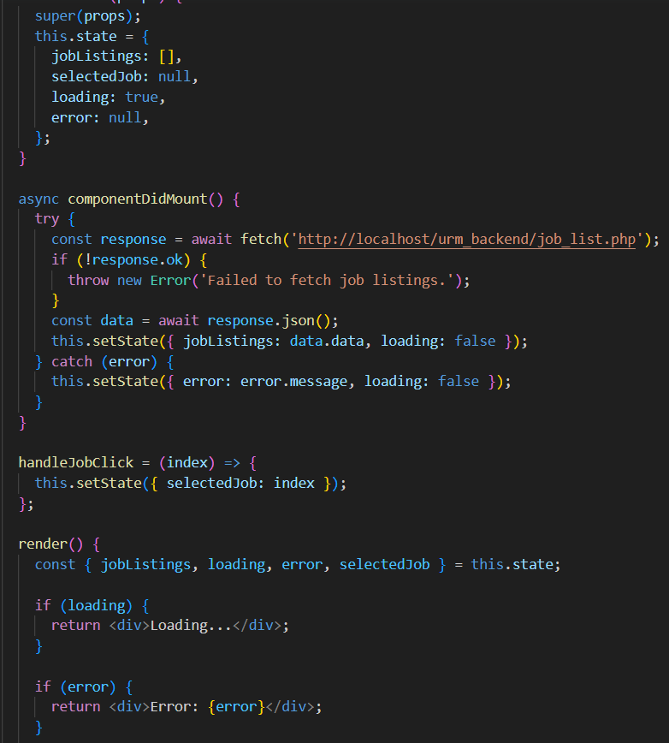
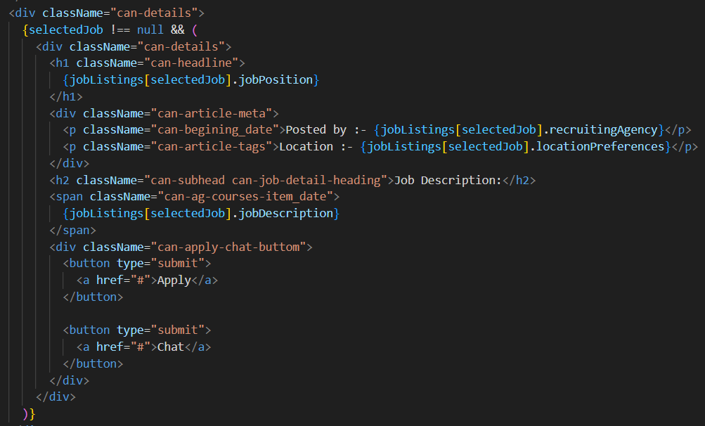
SEMINAR Demo
Page : URM Candidate Dashboard

Slide 21
SEMINAR Demo
Node/ Chat

Slide 22
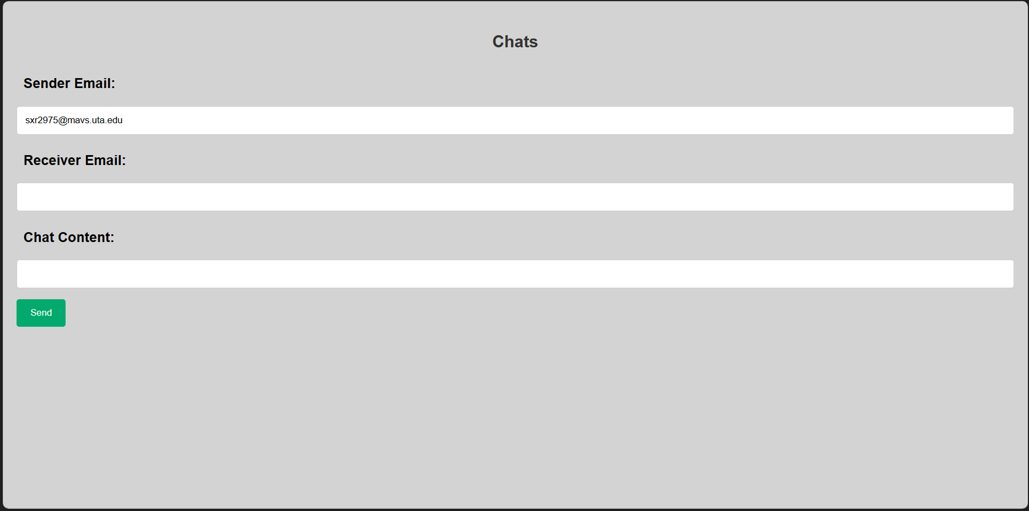
SEMINAR Demo
Page : Chat

Slide 23
SEMINAR Demo
Challenges faced
Challenge
Insertion/Storing of Data
How they were resolved; explain very briefly about the details
Setting up Backend API
Handling POST Requests
Using Axios
Database Connection
Handling errors

Slide 24
SEMINAR Demo
Creative functionalities
List any creative functionality you may have included
Role-based Dashboard
Dashboard Stats
Profile Editing
How they were implemented; explain very briefly about the details
All these functionalities were implemented by leveraging various technologies such as React, PHP, HTML, CSS

Slide 25
SEMINAR Demo
Improvement
List any things which you may have done better
User Experience
Consistency
Performance
Provide reasonable justification
Investing more time in improving the UI implementation can significantly impact user experience

Slide 26
SEMINAR Demo
Future Addition to your Portfolio
Very briefly, explain how this project will be added to your portfolio
Showcase the project as a web application that we developedusing React.js, PHP, Laravel, MySQL for database management
The project serves as a testament to our ability to create real-world web applications

Slide 27

Thank You

