Slide 1
Predicting customer buying behaviour
British Airways

Slide 2
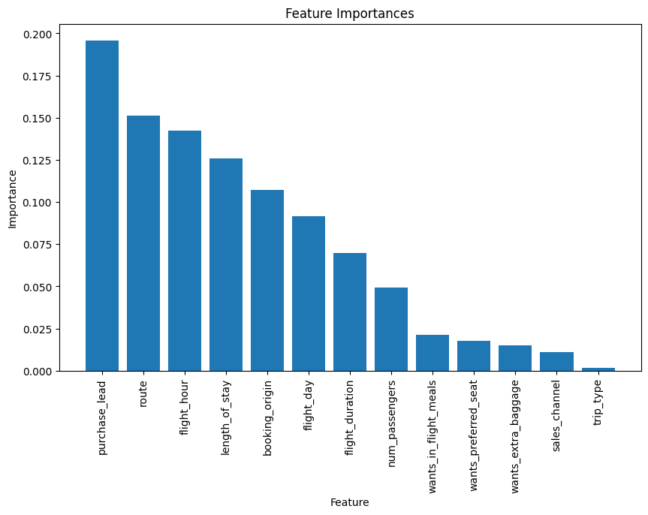
Insights
A Logistic Regression Model for classification of the target variable “booking_complete” was used that provided a 85 percent accuracy.
A corelation matrix(heatmap) between all features showed that all features are distinct and there is no significant corelation between them.
Hence all features were considered for building the model.
The random forest classifier shows that “purchase_lead” and “flight_hour” were amongst the top three most important features affecting customer bookings.

