Slide 1
British Airlines Reviews Processing
- Shivani Sopariwala

Slide 2
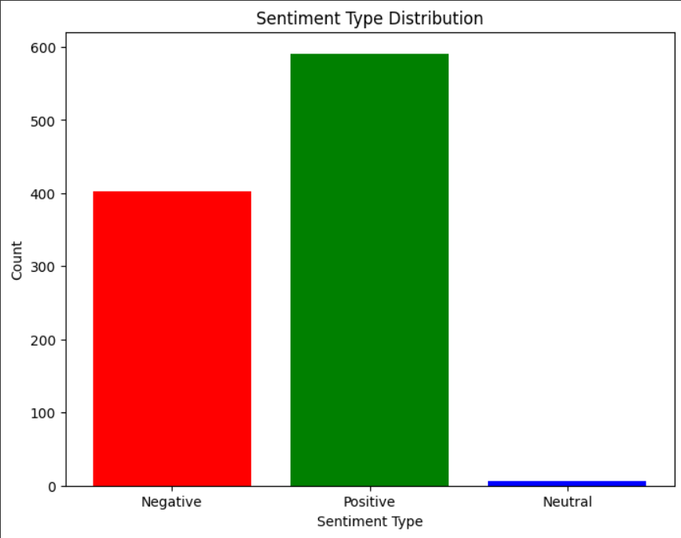
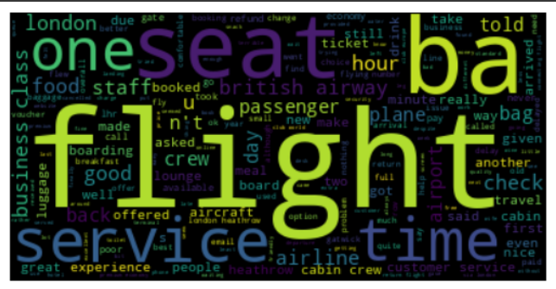
Insights
After performing word cloud analysis the above mapping was obtained.
Further based on this mapping all reviews were classified under one of the following four categories:
1) on flight meals
2) cabin crew services
3) refund policy
4) on ground services
After performing sentiment analysis, we find that maximum number of customers were satisfied with our airlines.
However after performing sentiment score and topic name corelation analysis we find that our food and refund policy needs significant improvement.

