Slide 1
ODI Cricket Data Analysis
Performance Insights, Match Trends & Strategic Recommendations
Shivani Mandora
11 October,2025

Slide 2
Introduction
This presentation explores player performance, match outcomes, and team strategies in ODI cricket.
It uses a Kaggle dataset of over 1.2 million deliveries.
Our goals:
  Identify top-performing players
  Analyze team composition strategies
  Provide strategic recommendations

Slide 3
What's Included in the Excel File
Player Performance Sheet: Runs, balls, strike rate; wickets, economy rate
Match Summary Sheet: Total runs and wickets per match
Team Composition Sheet: Batting order per innings
Use of SORT, FILTER, AVERAGE, SUM for insights

Slide 4
Top 10 Run Scorers
Highlights the most prolific batters across all ODIs
Based on total runs scored
Useful for identifying batting anchors
Refer next slide for the Chart

Slide 5
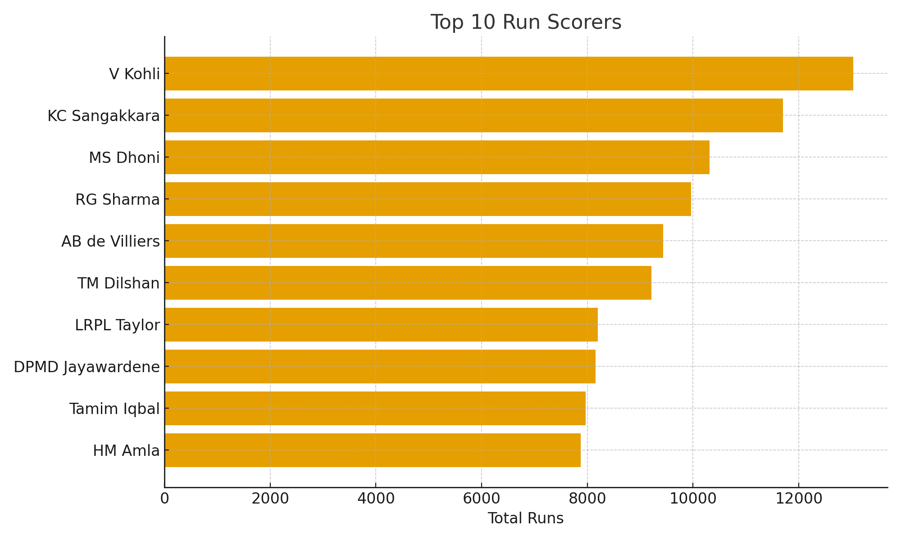
Charts and Visualizations
Top 10 Run Scorers

Slide 6
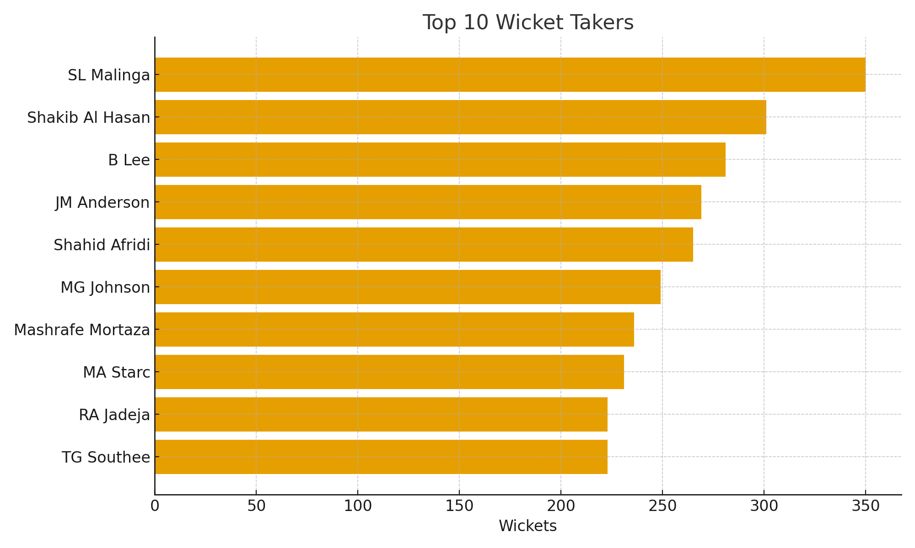
Top 10 Wicket Takers
Highlights consistent bowlers with major breakthroughs
Key impact players in restricting opponents

Slide 7
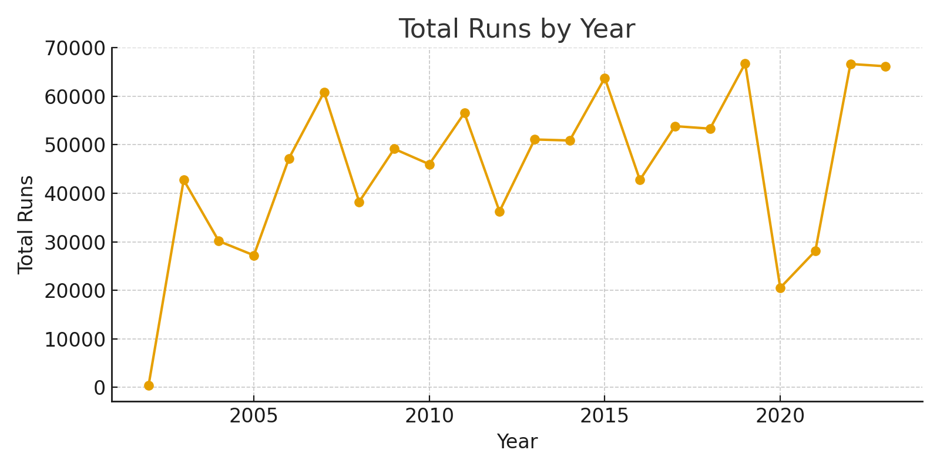
Charts and Visualizations
Total Runs by Year

Slide 8
Strategic Summary & Recommendations
Our analysis of over 1.2 million ODI deliveries reveals patterns in performance and strategy.
  Top batters maintain a 90+ strike rate and high totals
  Bowlers with economy <5.0 and 100+ wickets are pivotal
  All-rounders offer balance and flexibility
  Winning teams often score 275+ and lose fewer than 7 wickets
  Strong openers and No. 3s are critical for batting success
  Early wickets lead to favorable outcomes
Recommendations:
  Prioritize high strike rate and low economy players
  Build around top-order batsmen and strike bowlers
  Use adaptable all-rounders in the middle order
  Maintain batting order consistency for strategic stability

