Slide 1
Student Performance Analysis Using ChatGPT
Exploring Patterns, Disparities, and Predictions

Slide 2
Introduction
This presentation compares two analyses of a student performance dataset covering exam scores in math, reading, and writing, along with demographic and socioeconomic factors.
Approach 1: Conducted using Excel – focused on group averages, correlation, and hypothesis testing (e.g., T.TEST, ANOVA).
Approach 2: Conducted using Python & GPT – included advanced visualizations, machine learning models, equity simulations, and outlier detection.
The goal is to highlight strengths, identify areas for improvement, and draw actionable insights from each method.
This comparison aims to enhance analytical rigor and inform future data-driven decisions in education.

Slide 3
Methodology Summary
• Data cleaning: checked for missing values and duplicates.
• Renamed columns and encoded categorical variables.
• Performed descriptive and visual analysis of scores.
• Used regression and simulation to assess disparities.
• Built models to predict performance from key variables.

Slide 4
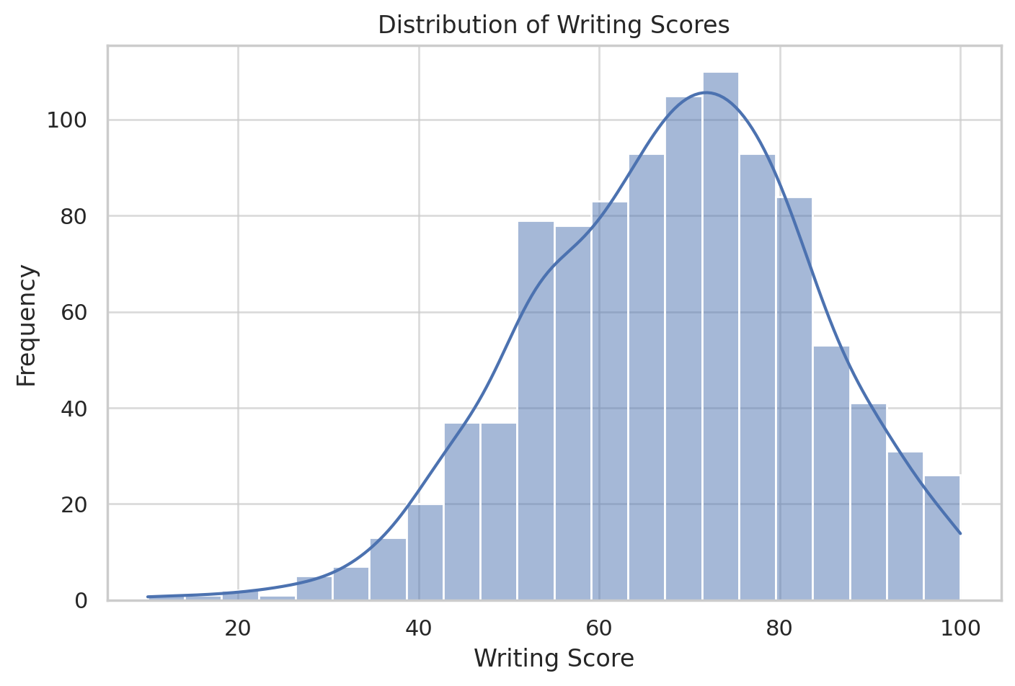
Distribution of Writing Scores

Slide 5
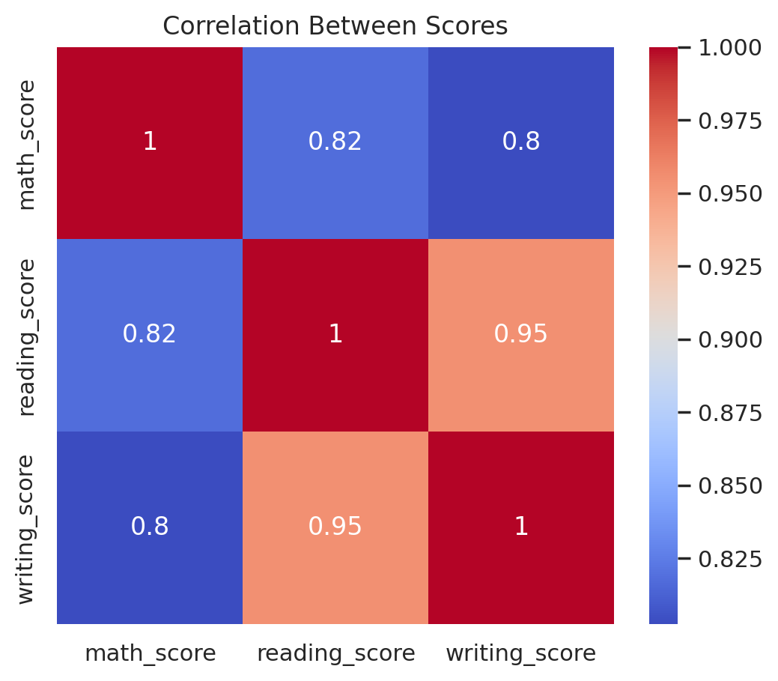
Correlation Between Math, Reading, and Writing Scores

Slide 6
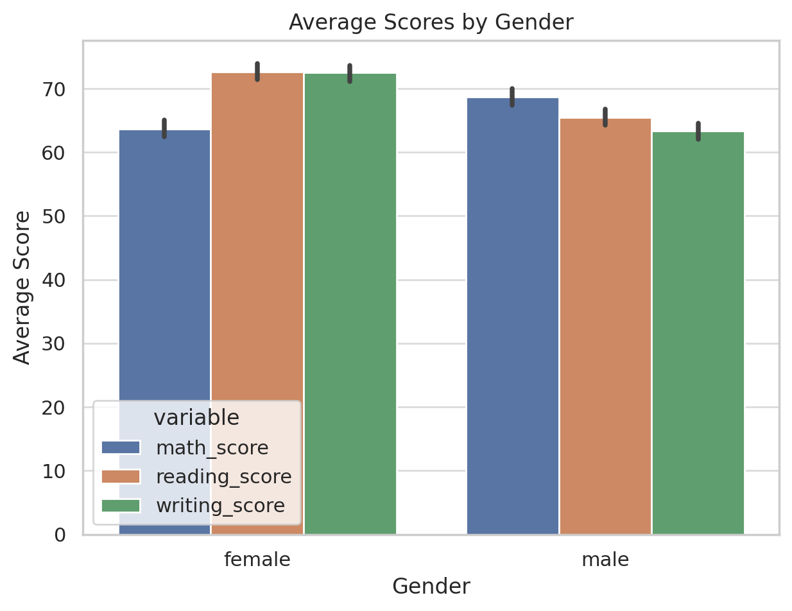
Average Scores by Gender

Slide 7
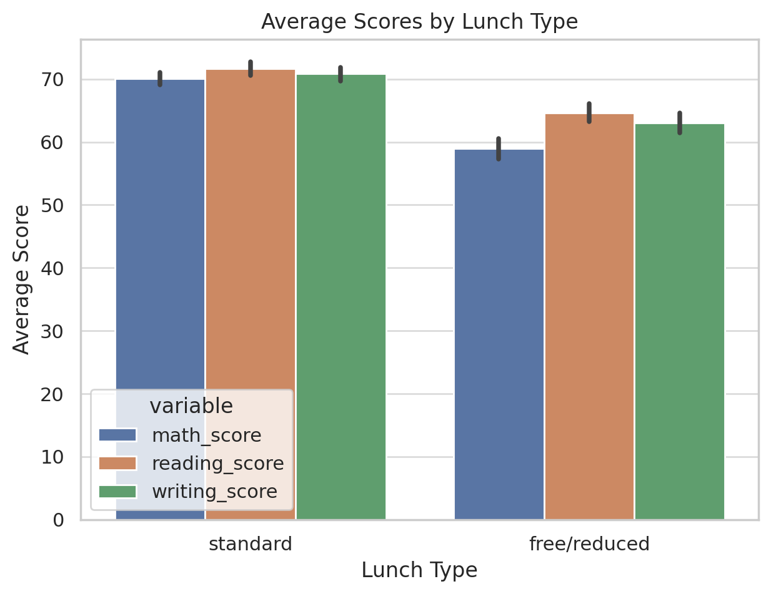
Average Scores by Lunch Type

Slide 8
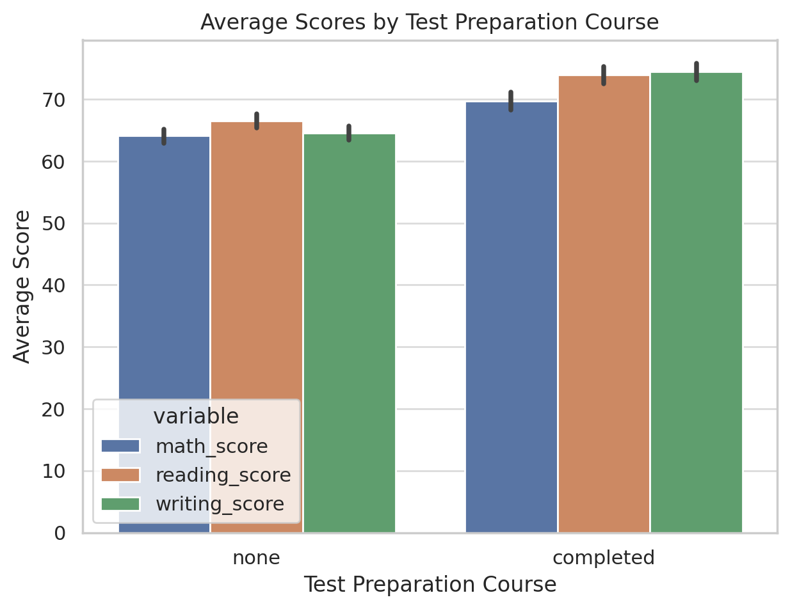
Average Scores by Test Preparation Course

Slide 9
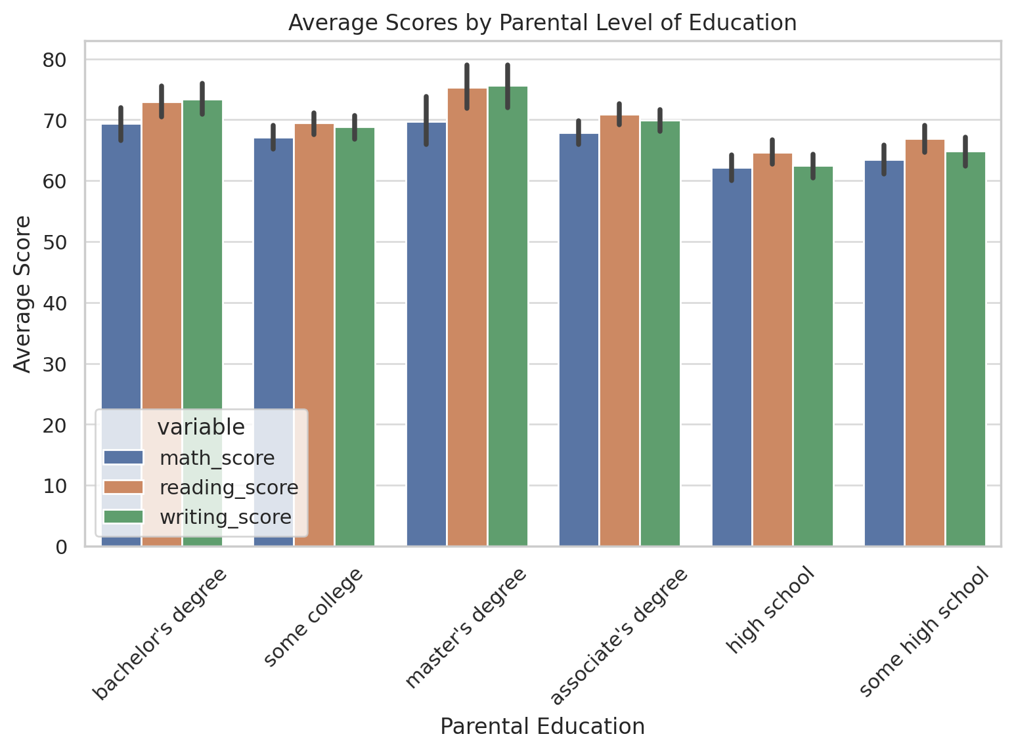
Average Scores by Parental Level of Education

Slide 10
Modeling Recommendations
• Reading score is the strongest predictor of writing performance.
• Use combined academic features (e.g., math + reading) for total score prediction.
• Demographics alone are insufficient for accurate prediction.
• Random Forest outperforms Linear Regression in most use cases.

Slide 11
Prompts for Further Exploration
Which student groups show the widest score variation?
How does performance correlate with multiple demographic factors?
Can we cluster students into performance tiers?
What interventions are most effective for low performers?
Can we predict future outcomes based on current data?
Build a dashboard showing real-time group performance by SES, gender, and education.
Which single factor explains the most variance in total scores?
Cluster students into low, medium, and high performers. What traits define each group?
Simulate removing only one disparity (e.g., lunch) — how much does that improve outcomes?

Slide 12
Key Data Insights
• Reading and writing scores are highly correlated (r = 0.95).
• Gender gap: males outperform in math; females excel in reading and writing.
• Standard lunch and completed test preparation strongly boost scores.
• Parental education is positively associated with performance.

Slide 13
Writing Score Prediction (Random Forest)
• R² Score: 0.91 | RMSE: ~4.54
• Reading score: 92.6% of predictive power
• Math score: 2.9% | Other features: <2% each
• Conclusion: Reading is the dominant predictor of writing performance

Slide 14
Disparities in Student Performance
Gender: Females perform better in reading/writing, males slightly better in math.
Race: Group E leads in scores; Group A and B show lower averages.
Parental Education: Higher levels linked to better scores.
Lunch: Students with standard lunch outperform those on free/reduced lunch.
Test Prep: Completing it raises average scores by ~10–15 points.

Slide 15
Equity Simulation Results
• Scenario: All students receive standard lunch, test prep, and high parental education.
• Original Predicted Average Score: 204.32
• Simulated Equity Score: 228.98
• Predicted Gain: +24.65 points (~8%)

Slide 16
Modeling Total Performance from Demographics
• Linear Regression R²: 0.13 | RF R²: -0.03
• Demographics alone are weak predictors of overall performance.
• Socioeconomic and educational context matters, but does not fully determine success.
• Need to include academic scores (reading, math) for better prediction.

Slide 17
What Worked Well (In Both Analyses)
Area | Your Analysis | GPT Analysis
Core Metrics | Covered math, reading, writing scores, and examined group averages. | Same coverage with detailed distribution analysis.
Correlation | Included Pearson correlation matrix (Reading & Writing ~0.95). | Identical findings and expanded with heatmap visual.
Test Preparation | Identified score gains across all subjects with test prep. | Same conclusion with visualized average score uplift.
Socioeconomic Impact (Lunch) | Highlighted strong score differences by lunch type (SES). | Confirmed and visualized impact clearly.
Gender Differences | Observed female strengths in reading/writing and male edge in math. | Consistent, with gender-grouped score plots.
Parental Education | Identified a positive correlation with student scores. | Same, plus shown in regression and bar chart analysis.

Slide 18
Areas of Improvement or Divergence
Topic | Observation | Suggested Improvements
Toolset Used | Your analysis was Excel-centric. | GPT used Python (Pandas, Seaborn, sklearn) for deeper modeling and better visual clarity.
Modeling Techniques | Basic statistical tools (T.TEST, ANOVA) discussed. | GPT included regression (Linear, Random Forest), RMSE, R² scores, and simulations.
Visualizations | Charts were created but not embedded in this PDF. | GPT-generated presentation includes high-res plots (distributions, group comparisons).
Simulation of Equity | Not attempted. | GPT simulated "equity" scenario (equal lunch, prep, education) → predicted 25-point performance gain.
Error Analysis / Outliers | Not included. | GPT identified 1.2% outliers and analyzed their traits (low SES, no prep, low parent ed).
Depth of Prompts | No AI exploration prompts provided. | GPT provided a set of next-step questions to deepen exploration.

Slide 19
Recommendations for Future Improvement
Augment Excel with Python: Use Jupyter Notebooks for modeling, visualization, and automation.
Include Predictive Modeling: Test linear vs tree-based models to predict student outcomes.
Apply Hypothesis Tests More Broadly: Validate observed patterns using statistical testing.
Simulate Interventions: Estimate impact of improving prep access or reducing SES gaps.
Structure for Impact: Tie findings to practical policy recommendations (e.g., increase prep access, target lunch support).

Slide 20
Conclusions & Lessons Learned
Strengths of Your Approach:
Solid foundational analysis with correct statistical logic.
Efficient use of Excel for quick comparisons and hypothesis testing.
Clearly structured summary that aligns well with educational research.
🔍 Missed Opportunities:
No predictive modeling or feature importance evaluation.
No outlier identification or simulation of policy changes.
Lacked visual exploration of score distributions and relationships.
📈 Advantages of GPT Analysis:
Broader scope using Python and machine learning tools.
Clean visuals, deeper insight into patterns and correlations.
Actionable insights from simulated equity scenario.

