Slide 1





YAADHUM OORAE GLOBAL CONCLAVE HACKATHON
(An Initiative by Chief Minister of Tamil Nadu, India)
TEAM NAME: Unplugged
TEAM LEAD NAME: Shivani.B
TEAM MEMBERS: 1.Sneha Prabha.C
2.Sreejaa.H
TEAM ID: SMT007
TRACK NAME: Smart Transportation and Mobility

Slide 2
INDEX TERMS:
User login
Admin login
GPS
Drive mode
Parking mode
Firebase(Data analytics)
IR sensor(to indicate parking availability)

Slide 3
PROBLEM STATEMENT: The Challenge is to develop a mode to acquire and display data for parking slots to resolve the issues related to parking as well as reduce traffic jam instances caused due to improper parking situations.
MOTIVATION: Nowadays we are facing many problems while parking the vehicles on the road .Due to this reason, the road gets clumsy and jammed everywhere. So we are going to rectify this problem by using an android app (For both driving and parking ).Our app is named by the title “Availability of parking slots”.

Slide 4
INTRODUCTION
We are going to develop a Government affiliated parking slot system.
This is going to be an android app with two modes namely parking and driving modes in which both users and traffic police men can access whenever required .
Initially while driving a vehicle, Driving mode is switched on. After switching, the GPS will be automatically activated and it shows the desired destination from the place where we are.
After reaching the desired destination we are in need of parking the vehicle. At that point of time parking mode is switched on. After switching, the available parking slots will be displayed on the screen from the place where we are.
Availability of parking slots are regularly updated by the traffic police, if the passenger is parking his vehicle outside the parking slot, they will easily monitored by the police and their vehicle number will be displayed in their digital board.

Slide 5
NOVELTY
Most of the apps contain either GPS or availability of parking in malls. The speciality in our project is that we are going to use both GPS and Government affiliated parking slots in our city completely.
Not only these features but also we are going to create an admin login for police, So that they can update the availability of parking slots everyday.
We are also providing parking and driving mode features and we can also detect the passengers those who are parking their vehicles apart from the slots .

Slide 6
PROPOSED MODEL
Availability of parking slots in a city
It guides us destination from the place where we are.
Android App
Two login ids (for user and traffic police)
Two modes (driving and parking mode)
During driving, GPS is switched on automatically
If we have to park our vehicle after certain distance, parking mode is switched on
After switching ,it will show us the possibility of available parking slots from the place where we’re.
Parking slots availability will be updated by the traffic police regularly.
If a passenger is not parking in the correct slot, their vehicle no will be sent to the police and displayed

Slide 7
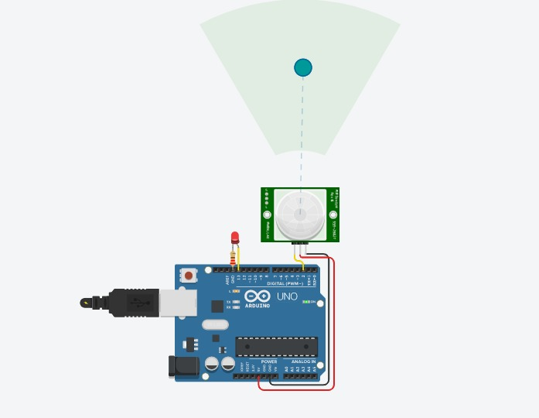
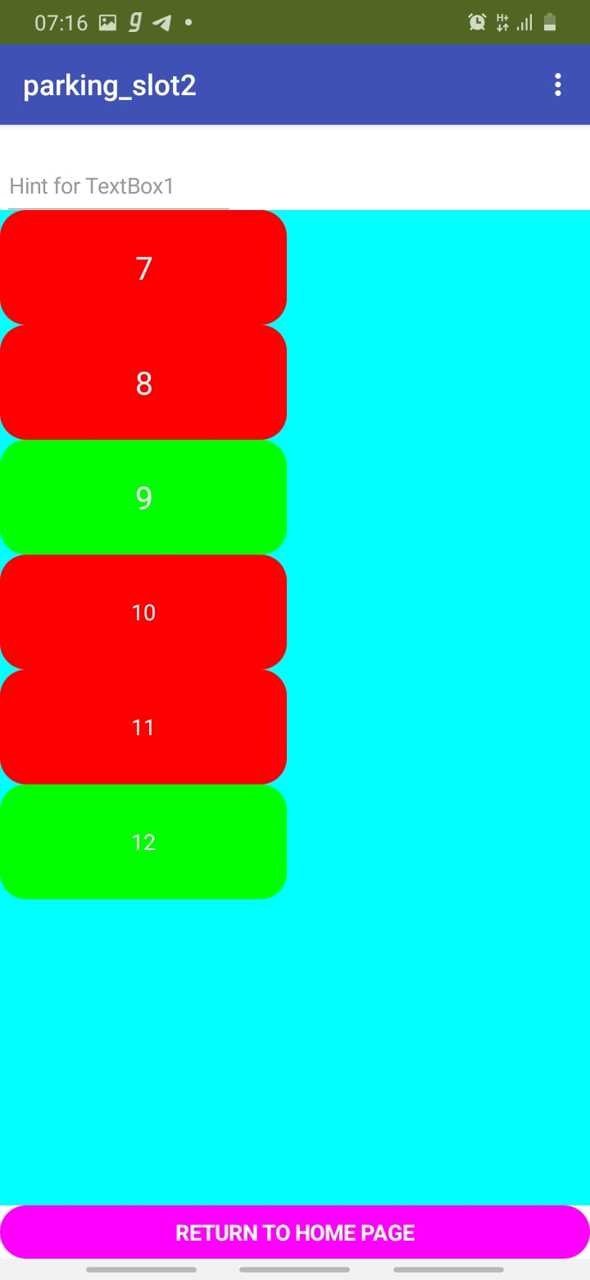
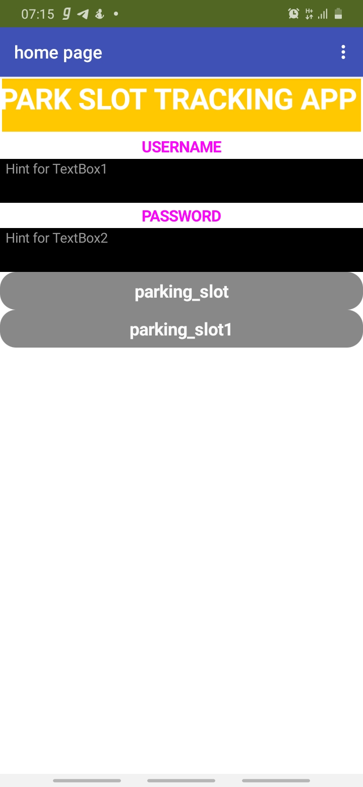
LIVE WORKING SESSION

Slide 8
PROS & CONS OF PROPOSED MODEL:
Pros
Nowadays people are parking their vehicles everywhere on the road. This leads to increase in traffic. So we are going to design the parking availability for the possible parking areas in the city.
Navigation will be easier for the people.
Accidents of vehicles will be reduced.
We need not worry about the availability of parking slots manually.
Cons
Its quite tough for the traffic police to update the availability parking slots regularly.

Slide 9
REFERENCES:
Smart traffic control system with application of image processing techniques,method for determining traffic congestion on roads using image processing techniques and a model for controlling traffic signals based on information received from images of roads taken by video camera, 2014 International Conference on Informatics, Electronics & Vision (ICIEV), 14447422, 10.1109/ICIEV.2014.6850751
Automation of Traffic Control System Using Image Morphological Operations, paper presents the research on controlling the real-time traffic using various image processing techniques in which the pictures are captured using the webcam of various lanes of roads where traffic takes place,2020 International Conference on Information Science and Communication Technology (ICISCT) 19576149,10.1109/ICISCT49550.2020.9080051
An intelligent road traffic control system, this paper reveals the use of a microcontroller to optimize timing plans according to traffic conditions in real-time. The control system is designed to be able to optimize the traffic flow using several kinds of strategies, 2010 IEEE Students Technology Symposium (TechSym) 11308515, 10.1109/TECHSYM.2010.5469286

