Slide 1
VOICE CONTROLLED ROBOT WITH HUMAN INTERACTION
RANJITHA R [1RN18EC174]
SAMPATH T S [1RN20EC416]
SAHANA G [1RN20EC414]
SHIVANI KUMARI [1RN19EC128]

Slide 2
AGENDA
INTRODUCTION
LITERATURE SURVEY
MOTIVATION
OBJECTIVIES
METHODOLOGY
COMPONENTS
CIRCUIT
CODE
REFERENCES

Slide 3
INTRODUCTION
• The use of robots in the present day has moves from industries to the normal day to life
• The use of voice commands to control a robot is much easier for domestic as well as industrial users
Verbal interaction intended for robot controlling is actually sort of an innovative process among many methods which are introduced regarding robotics control
• This project proposes the development of a voice controlled robot which has the ability to follow voice command from user and does communicate with user by using pre-recorded human voice sound.

Slide 4
LITERATURE SURVEY
PAPER | TECHNOLOGY | ADVANTAGE | DISADVANTAGE
Xiaoling Lv, Minglu Zhang and Hui Li, "Robot control based on voice command," 2008 IEEE International Conference on Automation and Logistics, 2008, pp. 2490-2494, doi: 10.1109/ICAL.2008.4636587 . | Ultrasonic Sensor WLAN Motors | Features such as extend reposition and stop is added. Robot can detect the obstacle in all the direction. | Noise is the keyfactor which affects the recognition process.

Slide 5
PAPER | TECHNOLOGY | ADVANTAGE | DISADVANTAGE
A. Chaudhry, M. Batra, P. Gupta, S. Lamba and S. Gupta, "Arduino Based Voice Controlled Robot," 2019 International Conference on Computing, Communication, and Intelligent Systems (ICCCIS), 2019, pp. 415-417 | Arduino Uno R3 ATmega3298P HC-05 Serial Bluetooth L298 H Bridge Motor Driver DC Motor | The most convenient method i.e. speech is used by the user for the communicating with the robot . | We can’t fed the robot with lot of words which can be recongnized by the robot in the future on itself.
M.B. chandu and K. Ganapathy,"Voice Controlled Human Assistence Robot," 2020 6th International Conference on Advanced Computing and Communication Systems (ICACCS), 2020, pp. 971-973, doi: 10.1109/ICACCS48705.2020.9074486. | ATMEGA 16 AUBTM-20 GUI | The robot can start/stop activities and migrate an article starting with one spot then onto next and offering things to the matured individuals in home. | Robot speed is around ¾ the human’s strolling speed , which requires to be improved

Slide 6
MOTIVATION
• The analysis on numerous technique of controlling robot as accomplished quite a few success by introducing a number of innovative and unique methods of robot movement control.
• Previous works on voice controlled robot shows that the design of this robot were complicated and none of them were able to interact with users. Hence development of voice controlled robot which as a ability to interact with user is implemented in this project.

Slide 7
OBJECTIVIES
The main objective of the project is to allows users to control the robot remotely by voice commands.
Operating the robot wirelessly through smart phone
To control the speed of robot automatically.

Slide 8
METHODOLOGY
SEARCH FOR VOICE COMMAND
USER IS GIVING VOICE COMMAND
CONVERSION OF SPEECH TO TEXT
MOVEMENT AND INTERACTION OF ROBOT ACCORDING TO THE COMMAND

Slide 9
METHODOLOGY
The control system of the robot is employed by the voice.
Firebase is a Backend-as-a-Service which act as server, APIs and datastore all written so generically that it can be modify to suit our needs.
When we give any command it converts speech to text and store that command in database and further the command is being read to ESP32 using WiFi. After giving the command robot will first speak the sentence through MP3 Player and then it will act according to the command.
For driving the robot there will be two geared DC motors with gripped tyre which will be operated by the help of DC motor driver(L298N).
The ultrasonic sensor placed in forward direction provide data about any obstacle in front of robot , if there is any object found robot will have the following movements within a speccific range:-
->For less than 20cm(very nearer), the robot will be stopped.
-> For distance more than 20cm and less than 50cm,the robot will reduce it's speed automatically.
->For distance more than 50cm ,the robot will move normally with specified speed.
The robot will continue to follow the previous command until it will receive the next command.

Slide 10
METHODOLOGY
Different Sounds of Voice Recording According to different Command
jujmkkkk
Voice Command | Robot Interaction
Forward | The robot is moving forward.
Backward | The robot is moving backward.
Left | The robot is moving left.
Right | The robot is moving right.
Stop | The robot has stopped moving.

Slide 11
HARDWARE COMPONENTS
1. ESP 32
2. L298N motor driver
3. Ultrasonic sensor
4. Power Supply
5. SD Card( max 32gb)
6. Dc Motors(4)
7. Wheels(4)
8. Mp3 Player
9. Speaker
10. Battery(7-12V dc)
11. Jumper wires

Slide 12

SOFTWARE REQUIRED
Arduino IDE:
It is the open-source Arduino Software (IDE) makes it easy to write code and upload it to the board. We are creating environment for ESP32 and implementing it on the board.

Slide 13
About hardware components
ESP 32:
ESP32 is a series of low-cost, low-power system on a chip microcontrollers with integrated Wi-Fi and dual-mode Bluetooth.
It is especially aimed to provide versatility, robustness and reliability in a large number of applications.
SRAM memory is of 512 KB.
ROM memory is 448 KB.
It has 36 general purpose input / output pins.
2 to 3.6 V operating voltage

Slide 14
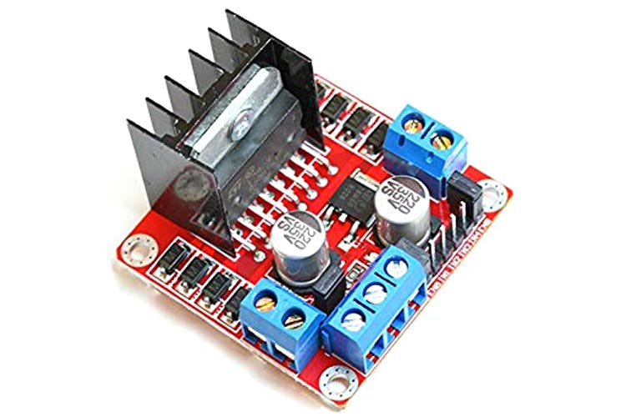
About hardware components
L298N MOTOR DRIVER
• Maximum supply voltage 46V
• Maximum output DC current 4A
• Low saturation voltage
• Over-temperature protection
ULTRASONIC SENSOR
An ultrasonic sensor is an electronic device that measures the distance of a target object by emitting ultrasonic sound waves and converts the reflected sound into an electrical signal. Ultrasonic waves travel faster than the speed of audible sound

Slide 15
About hardware components
• MP3 PLAYER
It is a low cost mp3 module which can be directly connected to speaker. It can be interfaced with arduino uno, esp32 or any other with Rx/Tx capabalities. Audio files can be played directly from a microSD card, FAT16 and FAT32 file systems are supported.
•POWER SUPPLY
This is a general purpose fixed power regulator and dual out supply board. It basically takes an input of 12-0-12 V AC or DC and outputs a constant DC voltage of 5V and 12V Dual out put . It can supply a maximum of 1A of current at 5V&12V.
• DC MOTOR
A DC gear motor works as same as basic dc motor but also includes a gearbox to create a single motion control component. This design allows speed reduction while increasing torque output in electromechanical applications.

Slide 16
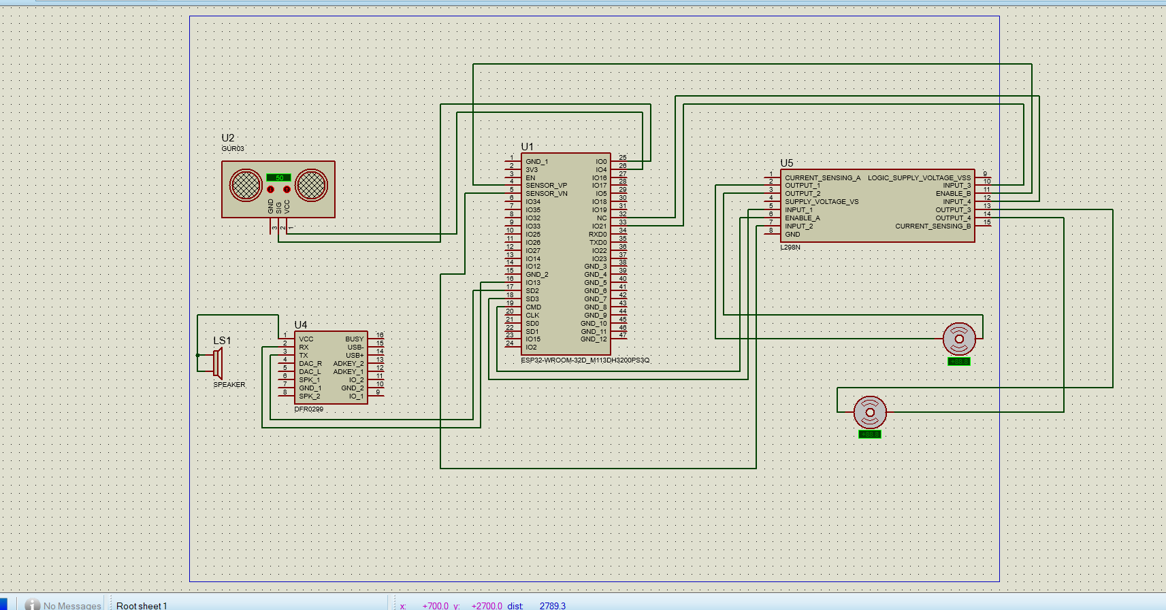
Circuit Diagram

Slide 17
FLOW CHART

Slide 18
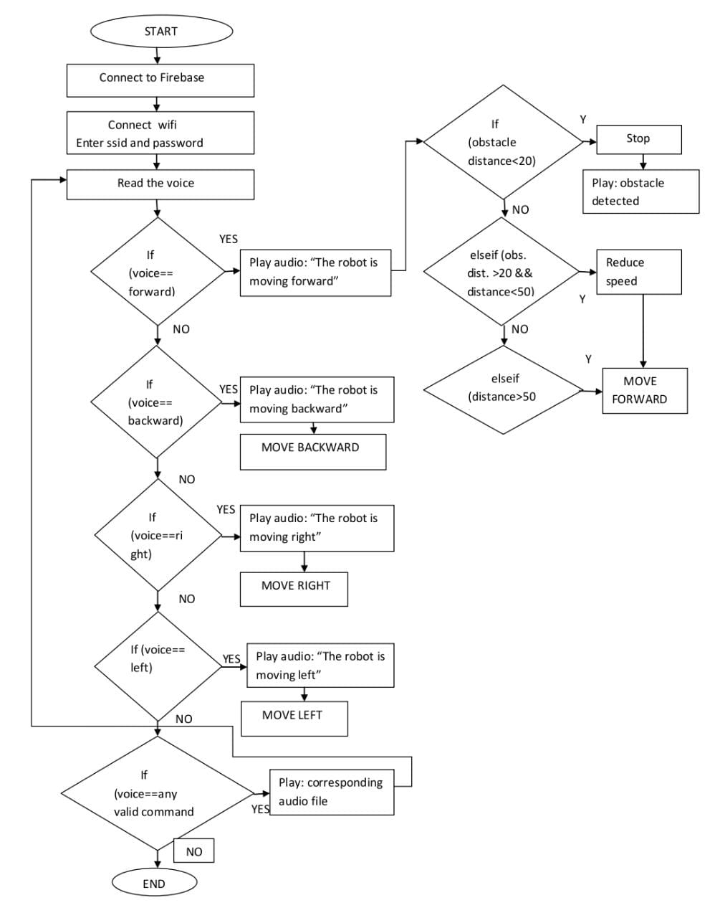

Slide 19
APPLICATIONS
• To support people with disabilities by executing the commands etc.
• The robot is useful in places where humans find difficult to reach but human voice reaches. E.g. in a small pipeline,in a fire-situations, etc.
• Robot application in industries.
• It is the one of the important stage of Humanoid robots.
• The robot can be used in toys.

Slide 20
REFERENCES
[1] . A. Chaudhry, M. Batra, P. Gupta, S. Lamba and S. Gupta, "Arduino Based Voice Controlled Robot," 2019 International Conference on Computing, Communication, and Intelligent Systems (ICCCIS), 2019, pp. 415-417, doi: 10.1109/ICCCIS48478.2019.8974532.
[2] R. L. Khan, D. Priyanshu and F. S. Alsulaiman, "Implementation of Human Voice Controlled Robotic Car," 2021 10th International Conference on System Modeling & Advancement in Research Trends (SMART), 2021, pp. 640-646, doi: 10.1109/SMART52563.2021.9676319.
[3] Xiaoling Lv, Minglu Zhang and Hui Li, "Robot control based on voice command," 2008 IEEE International Conference on Automation and Logistics, 2008, pp. 2490-2494, doi: 10.1109/ICAL.2008.4636587.
[4] Humayun Rashid,Iftekhar Uddin Ahmed, Sayed Bin Osnam, Qader Newaz, Md.Rasheduzzaman and S.M.Taslim Reza, “Design and implantation of Voice Controlled robot with human Interaction Ability”,Internatinal Conference on Computer,Communication,Chemical.Material and Electronic Engineering.
[5] S. Chakraborty, N. De, D. Marak, M. Borah, S. Paul and V. Majhi, "Voice Controlled Robotic Car Using Mobile Application," 2021 6th International Conference on Signal Processing, Computing and Control (ISPCC), 2021, pp. 1-5, doi: 10.1109/ISPCC53510.2021.9609396.

