Slide 1
What to expect from the session?
Review microservices and how it differs from monolithic and service-oriented architectures
Key microservices design principles
Demo
Q&A

Slide 2
Context
You are developing a server-side enterprise application. It must support a variety of different clients including desktop browsers, mobile browsers and native mobile applications. The application might also expose an API for 3rd parties to consume. It might also integrate with other applications via either web services or a message broker. The application handles requests (HTTP requests and messages) by executing business logic; accessing a database; exchanging messages with other systems; and returning a HTML/JSON/XML response. There are logical components corresponding to different functional areas of the application.

Slide 3
Evolution from Monoliths to
Microservices

Slide 4
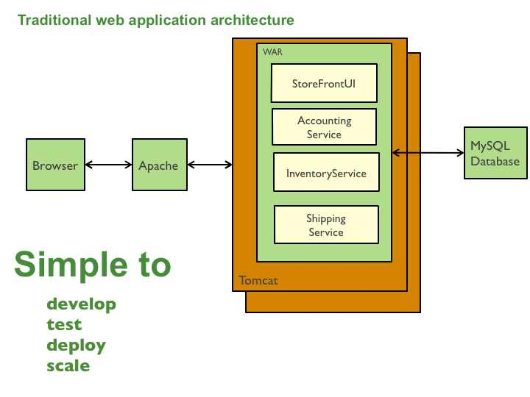
This e-commerce application is deployed as a single monolithic application. For example, a Java web application consists of a single WAR file that runs on a web container such as Tomcat.

Slide 5
DRAWBACKS of MONOLITHS
The large monolithic code base can be difficult to understand and modify.
Overloaded IDE and Web Container
New team members must quickly become productive
Continuous deployment is difficult
Scaling the application can be difficult
Requires a long-term commitment to a technology stack

Slide 6
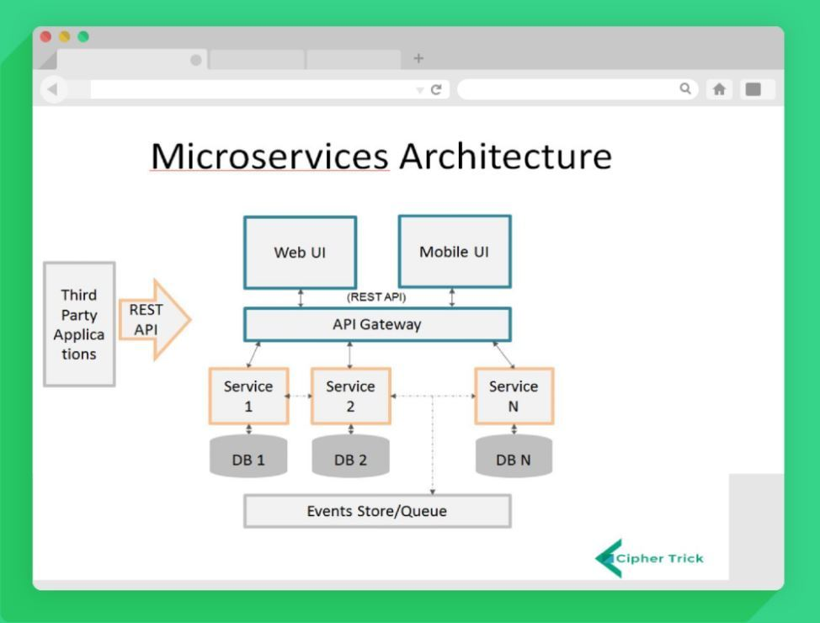

Slide 7
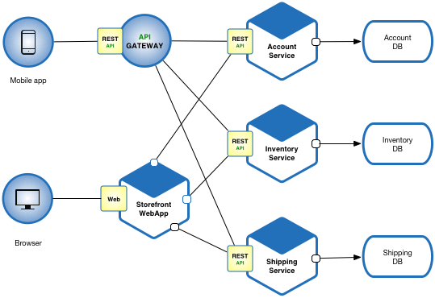
UI-Angular , ReactJS , HTML , CSS Account Service:- Java
Inventory Service:- .Net Core
Shipping Service:- .Net Core

Slide 8
MICROSERVICES
Benefits
Drawbacks
Enables the continuous delivery and deployment of large, complex applications.
Each microservice is relatively small.
Improved fault isolation.
Eliminates any long-term commitment to a technology stack.
Developers must deal with the additional complexity of creating a distributed system.
Deployment complexity.
Increased memory consumption.

Slide 9
Eureka Overview
Netflix Eureka architecture consists of two components, the Server and the Client.
The Server is a standalone application and is responsible for:
managing a registry of Service Instances,
provide means to register, de-register and query Instances with the registry,
registry propagation to other Eureka Instances (Servers or Clients).
The Client is part of the Service Instance ecosystem and has responsibilities like:
register and unregister a Service Instance with Eureka Server,
keep alive the connection with Eureka Server,
retrieve and cache discovery information from the Eureka Server.

Slide 10
ZUUL OVERVIEW
An API gateway
Load Shedding
Dynamic Routing

Slide 11
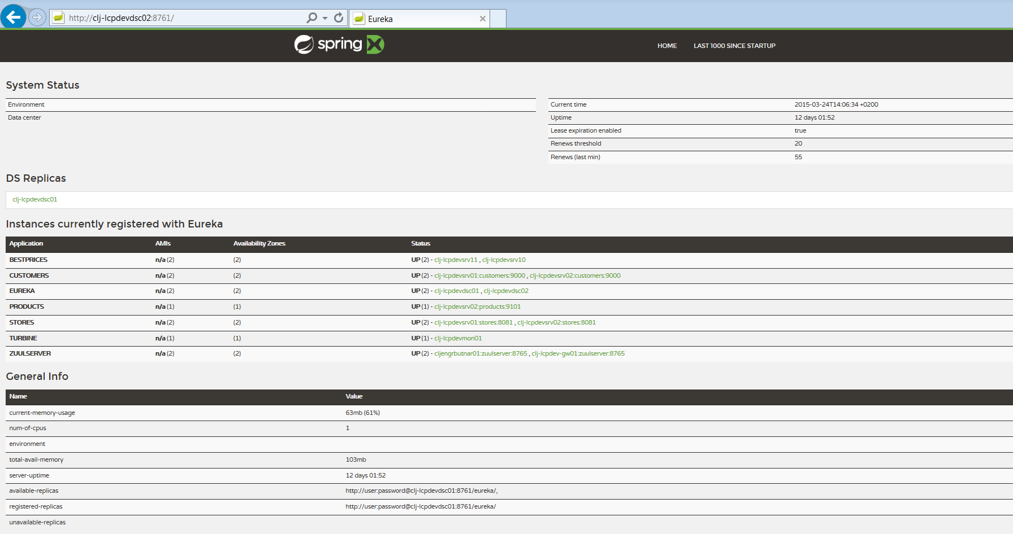

Slide 12
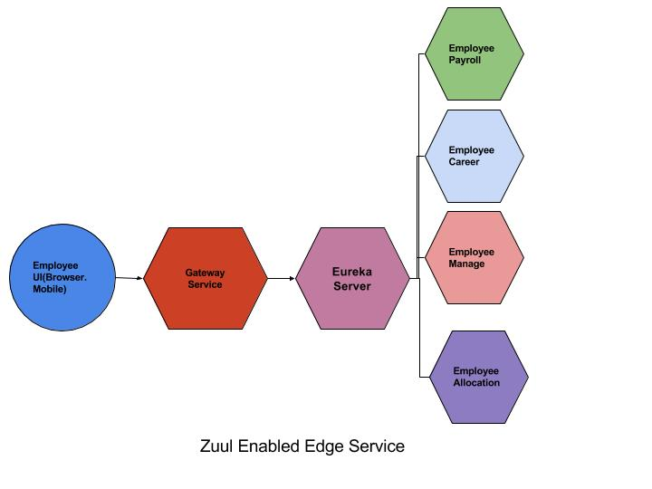

Slide 13
