Slide 1

Customer Shopping Behavior Analysis
Uncovering insights from 3,900 transactions across demographics, spending patterns, and product preferences.

Slide 2
Dataset at a Glance
3,900
18
Total Purchases
Features
37
$59.76
Missing Values
Avg. Purchase
Review Rating column only
Key features: demographics, purchase details, shopping behavior, subscription status.

Slide 3




Data Preparation in Python
Cleaning
Imputed missing Review Ratings using median per category; standardized columns to snake_case
Feature Engineering
Created age_group bins and purchase_frequency_days; dropped redundant promo_code_used
Database Integration
Loaded cleaned DataFrame into PostgreSQL for SQL analysis

Slide 4
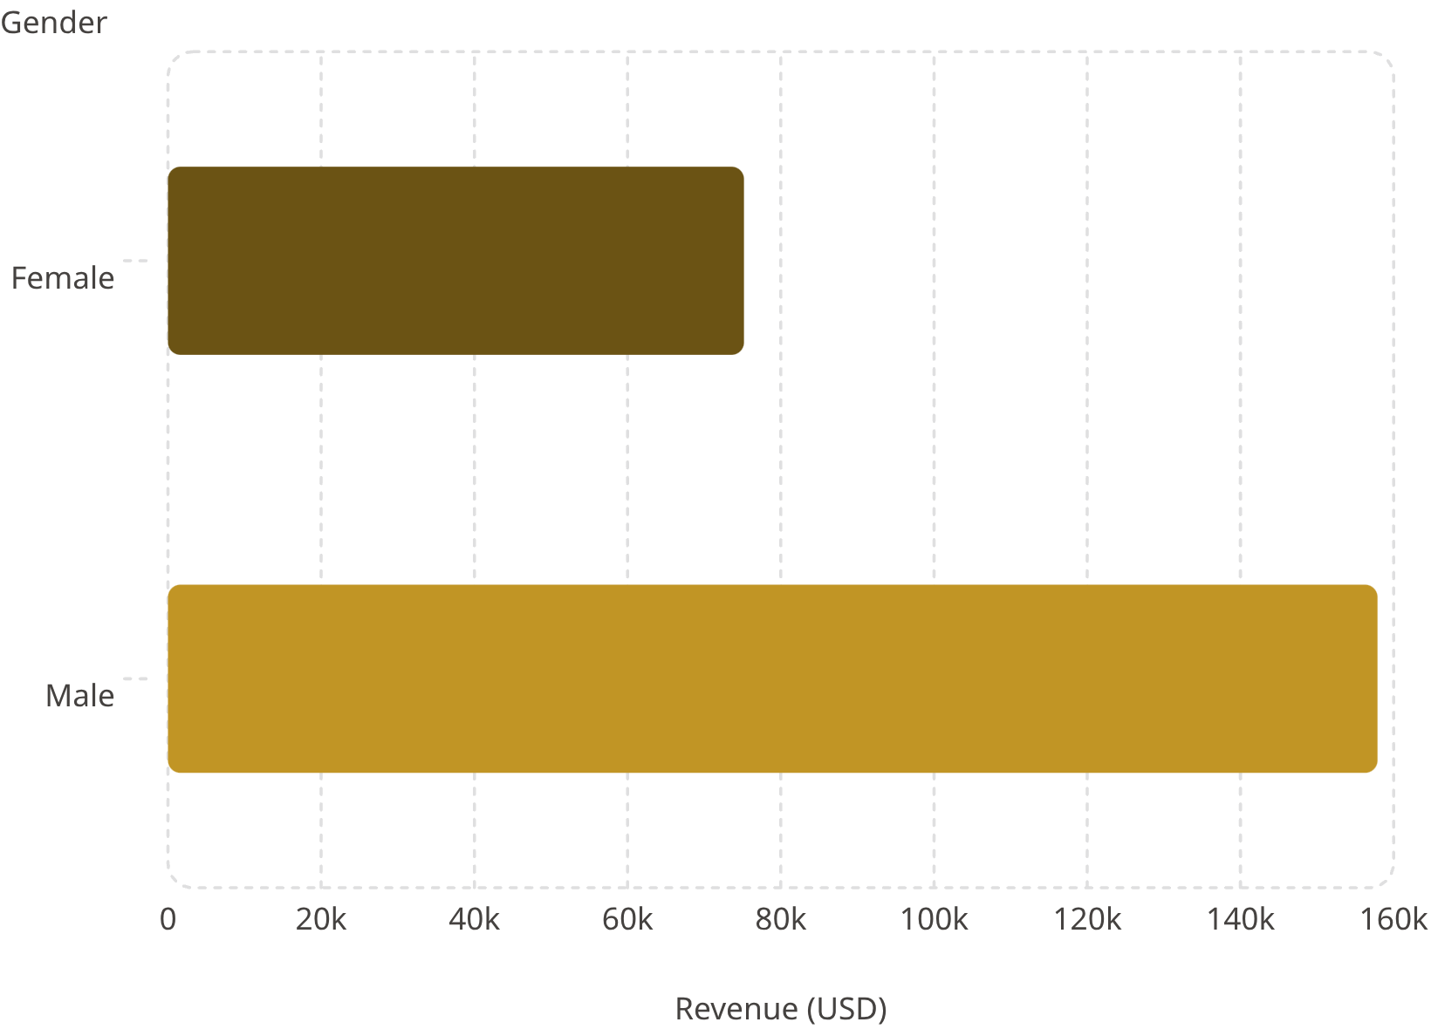
Revenue by Gender
Key Insight
Male customers generated 2.1x more revenue than female customers — $157,890 vs. $75,191.

Slide 5
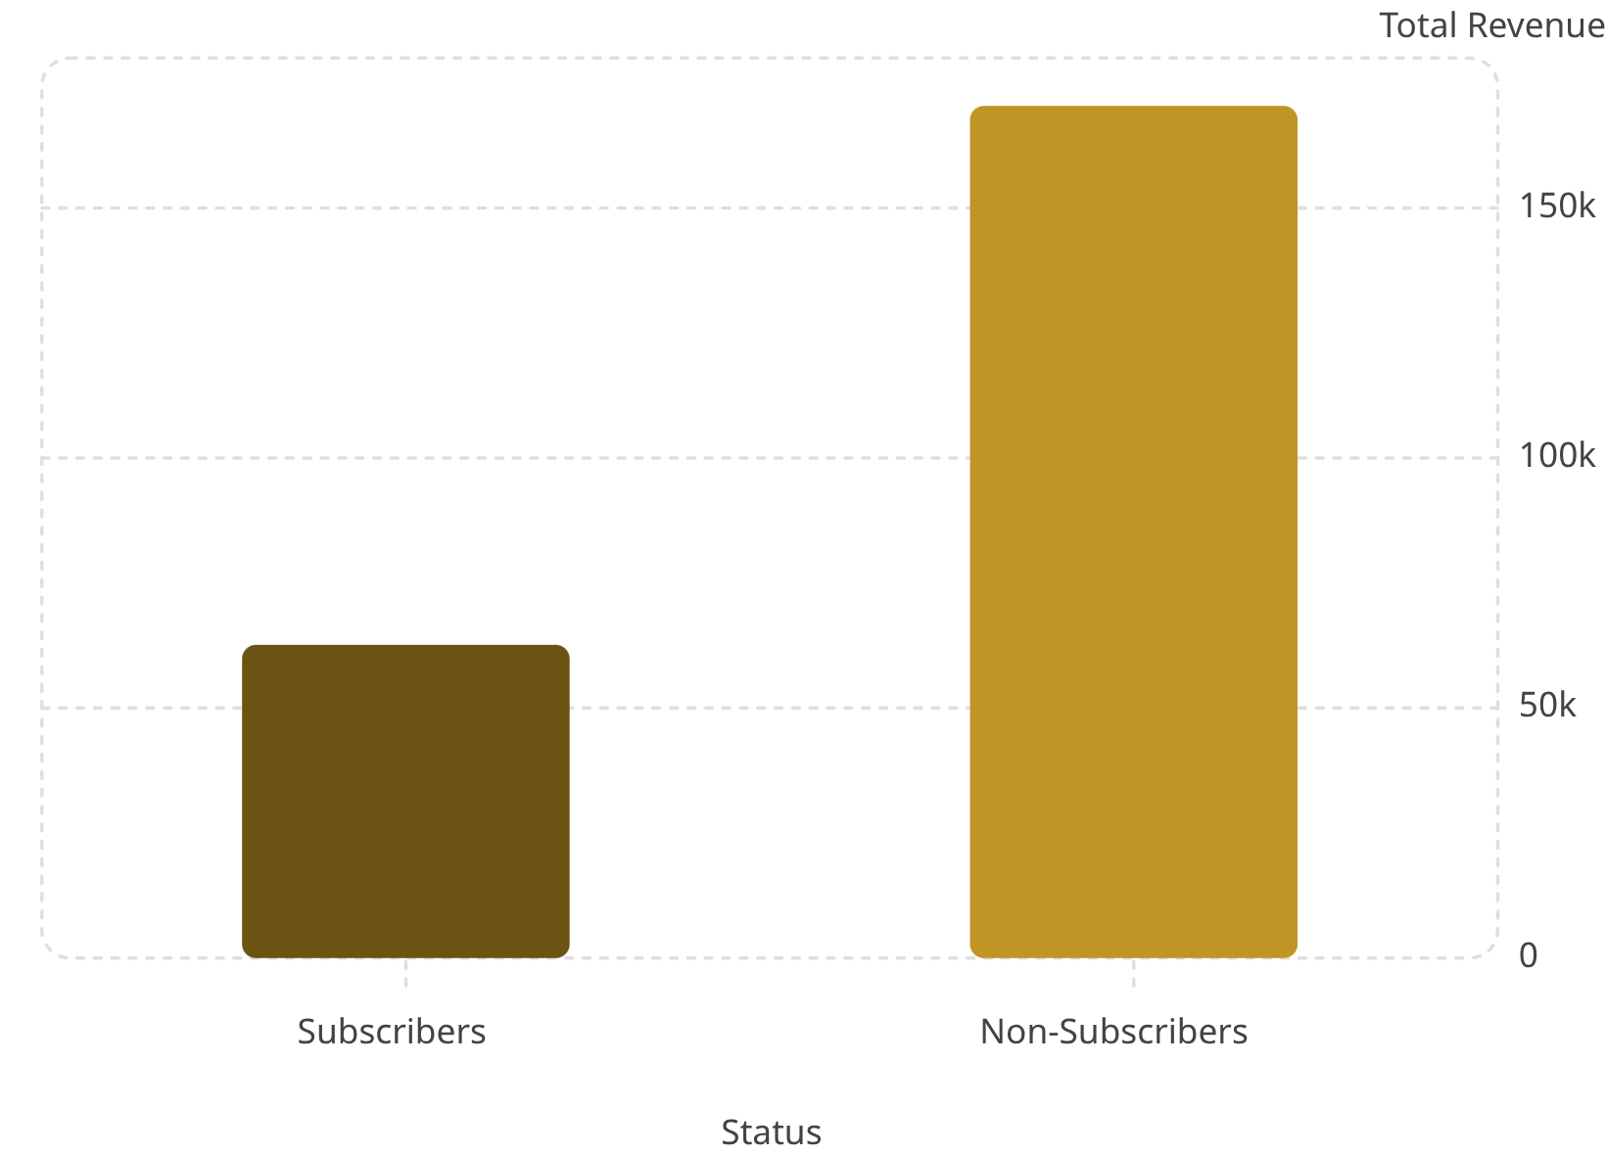

Subscribers vs. Non-Subscribers
Findings
Non-subscribers drive 73% of total revenue (2,847 customers), yet average spend is nearly identical: $59.49 vs. $59.87.
Only 27% of customers are subscribers — significant growth opportunity.

Slide 6
Top Products & Discount Dependence
Top 5 by Rating
Most Discount-Dependent
Gloves
Sandals
Hat
Sneakers
3.86★
3.84★
50.00%
49.66%
Boots
Hat
Coat
Sweater
3.82★
3.80★
49.07%
48.17%
Skirt
Pants
3.78★
47.37%

Slide 7
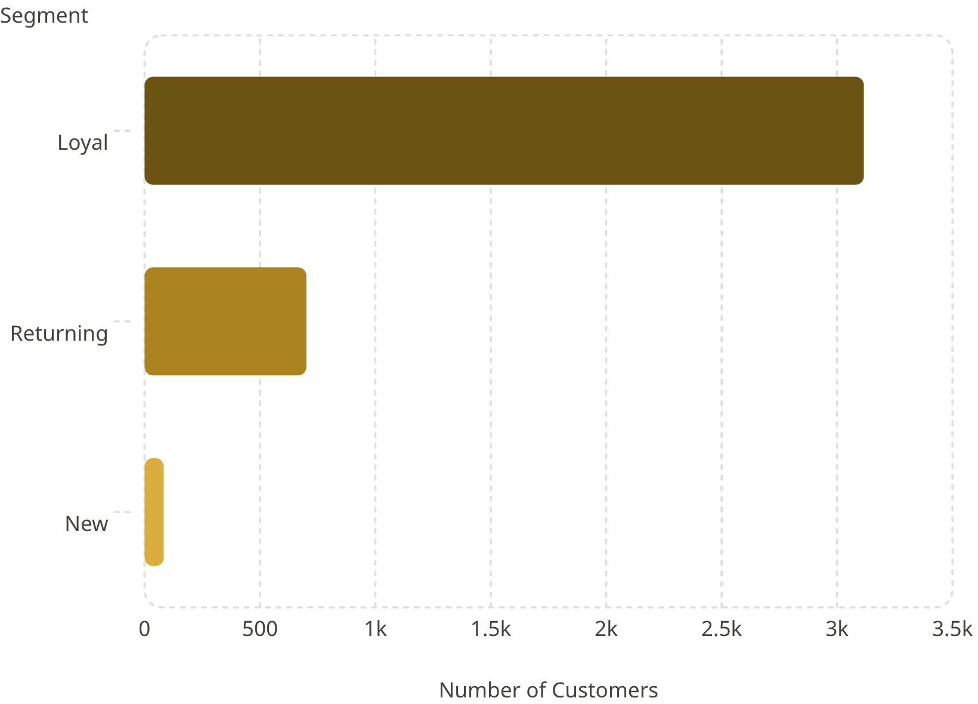
Customer Segmentation
Segment Breakdown
80% of customers are Loyal — a strong retention base.
Only 83 new customers identified; focus on acquisition needed.
958 repeat buyers (5+ purchases) are subscribed vs. 2,518 non-subscribers.

Slide 8
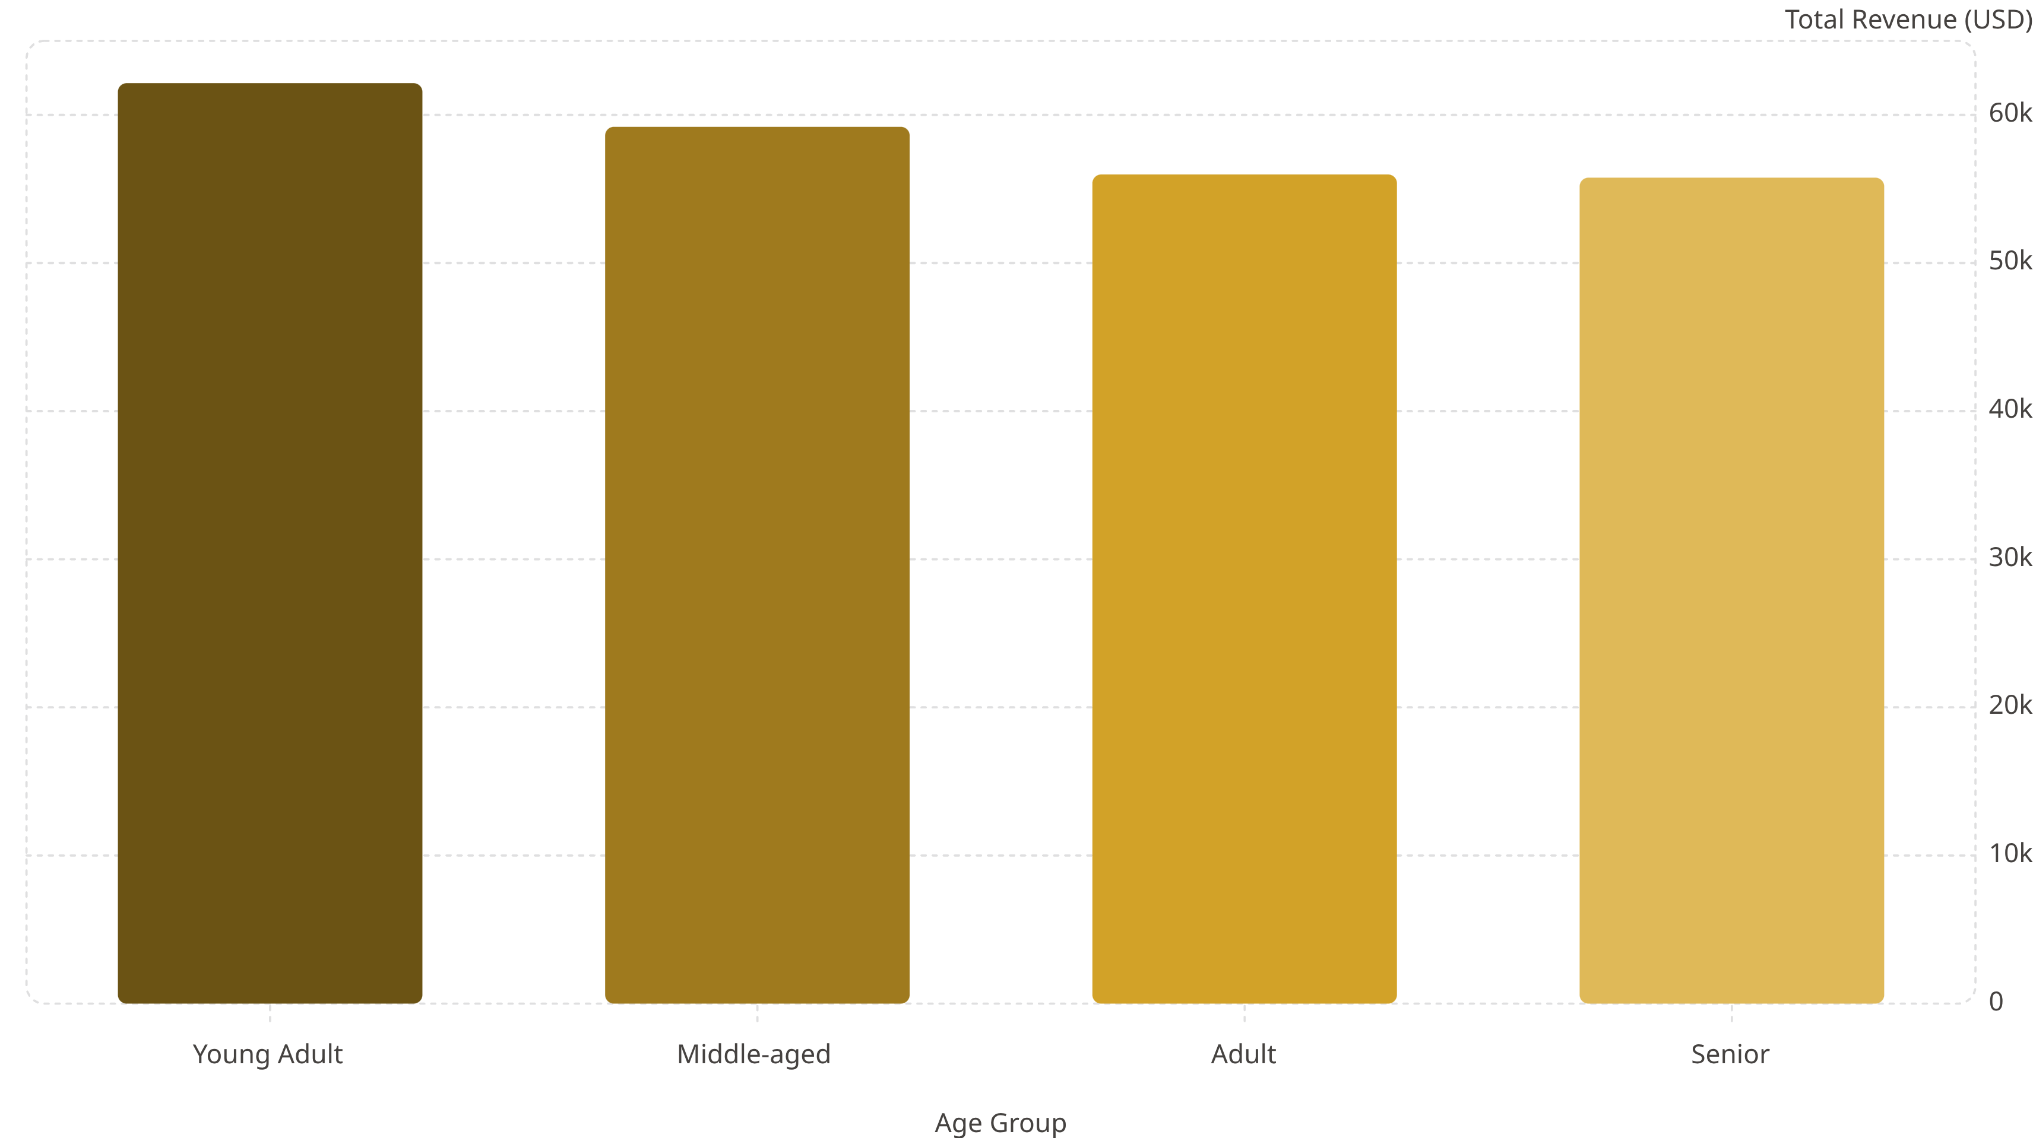
Revenue by Age Group
Young Adults lead revenue contribution at $62,143. Revenue declines slightly with age — targeted marketing by age group is warranted.

Slide 9
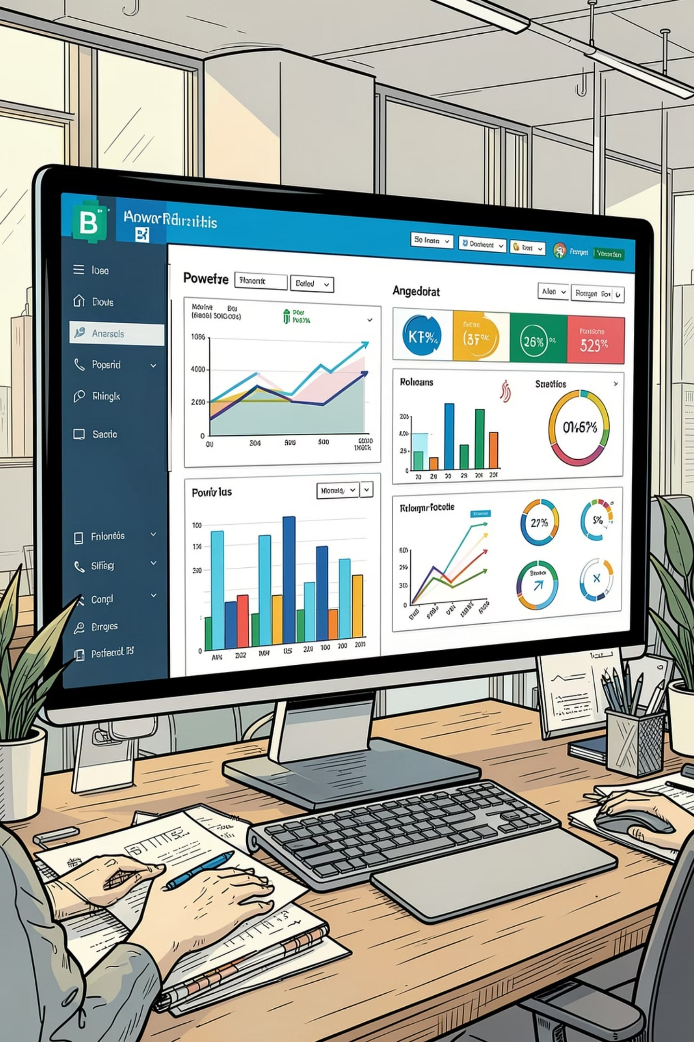
Power BI Dashboard
3.9K Customers
Total transactions tracked
$59.76 Avg.
Average purchase amount
3.75★ Rating
Average review score
27% Subscribers
Subscription penetration
Interactive filters: Gender, Category, Shipping Type, Age Group.

Slide 10





Business Recommendations
Boost Subscriptions
Promote exclusive subscriber benefits
Loyalty Programs
Reward repeat buyers to grow Loyal segment
Review Discount Policy
Balance sales lift with margin control
Targeted Marketing
Focus on high-revenue age groups & express-shipping users

