Slide 1
IPO Portfolio Optimization with GRU-Based Allocation
STAT 4830 — Spring 2026
Shivani Shreedhar, Olivia Liu, Oceana Zhu

Slide 2
Problem Statement
Portfolio Allocation
Why This Matters
We optimize daily portfolio weights between two asset classes: a market index (82% S&P 500, 18% Dow Jones, proxied via SPY and DIA from CRSP) and a custom IPO index — a market-cap-weighted basket of recent IPOs sourced from SDC Platinum, where each stock is held for 180 trading days post-IPO.
IPOs exhibit 3–4× higher volatility than the broad market, with mean reversion in the first six months and information asymmetry between institutional and retail participants. Static allocations ignore regime shifts (COVID crash 2020, IPO boom 2021, correction 2022).
Constraints: Long-only, fully invested, no shorting or leverage, daily rebalancing.
STAT 4830 — Spring 2026

Slide 3
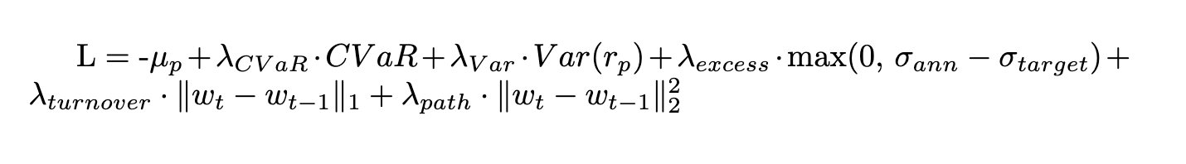
Technical Approach: Loss Function
The model minimizes a composite differentiable loss with six modular, tunable components:
Return Maximization
Tail Risk Control
Negative mean return objective
CVaR at 5% level via soft-sorting approximation
Variance Penalty
Turnover Penalty
Volatility excess penalty (target 25% annual vol)
L1 norm and path stability (L2 squared)
STAT 4830 — Spring 2026

Slide 4
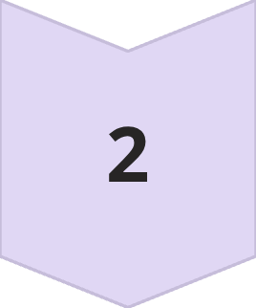
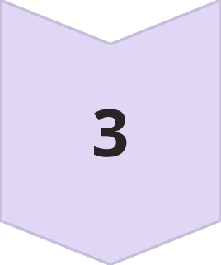
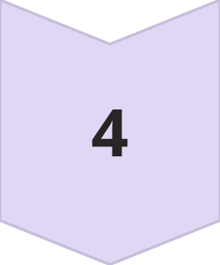
Technical Approach: Model Architecture
Input Layer
84-day rolling window of 4 features: market return, IPO return, 21-day rolling volatility, VIX level
GRU Network
Gated Recurrent Unit: input=4, hidden=64, 1 layer
MLP Head
2-layer MLP (64→64→2)
Softmax Output
Portfolio weights w = [w_market, w_IPO] with w_i ≥ 0, Σw_i = 1
The GRU extracts temporal patterns from the rolling window; the softmax output guarantees valid simplex-constrained weights. GRU was chosen over LSTM for fewer parameters and faster training on our small dataset (~1,100 samples).
STAT 4830 — Spring 2026

Slide 5
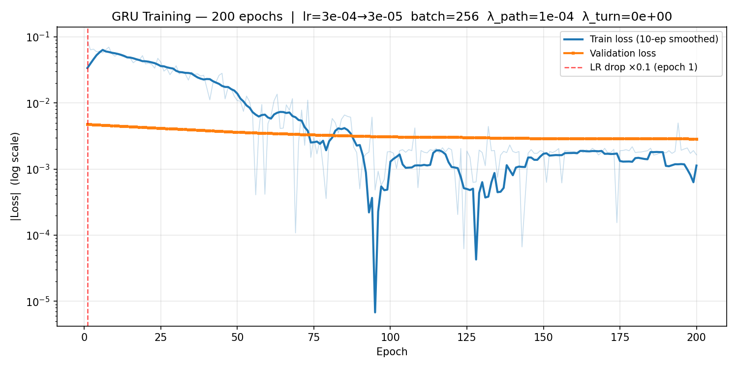
Training Progress
▸ LR drop at epoch 1
Learning rate falls 10× (3e-4→3e-5) after the first epoch. Training loss immediately tightens, escaping the high-noise floor.
▸ Train loss descends, val loss flat
Train |loss| drops from ~10⁻² to ~10⁻³ over 200 epochs. Validation loss barely moves (overfitting issue we will work on)
▸ Generalisation gap
The ~10× gap between train and val loss by epoch 200 means the GRU is memorizing 2020-2023 patterns that do not transfer to the 2024 validation period.
▸ Batch noise resolved
With batch=256 (~3.6 batches/epoch), individual epoch spikes are smaller than the old batch=32 run. The smoothed curve reveals more convergence.
▸ Early stopping not triggered
Patience=200 means all 200 epochs ran. Val loss plateau after ~epoch 30 suggests diminishing returns.
▸ Next: regularisation or dropout
To close the train/val gap, we may add dropout to the GRU hidden state or increasing weight decay. The model insufficient regularization for this dataset size.
STAT 4830 — Spring 2026

Slide 6
Hyperparameter Tuning Results
288-configuration grid search over all six loss penalty weights, target volatility, and window length. ~19 minutes total runtime.
Parameter
Previous (Hardcoded)
Tuned (Best)
λ_turnover
0.01
0.0025
λ_path
0.01
0.01
λ_vol
0.5
1.0
λ_cvar
0.5–1.0
1.0
window_len
126 days
84 days
Reducing turnover penalty from 0.01 → 0.0025 allowed more active rebalancing. Heavier risk penalties kept volatility controlled. Shorter 84-day lookback outperformed 126 days. Training converges in ~4 effective epochs (11 total with early stopping).
STAT 4830 — Spring 2026

Slide 7
Results: Performance Comparison
Validation period: January–December 2024
Strategy
Total Return
Ann. Return
Ann. Vol
Sharpe
Max Drawdown
Model Portfolio
58.81%
65.27%
15.74%
3.27
-7.47%
Market only
19.40%
21.24%
12.25%
1.63
-7.89%
IPO only
192.78%
221.19%
31.03%
3.92
-10.08%
Equal 50/50
88.52%
99.11%
19.39%
3.65
-7.20%
69%
31%
0.0031
Market Allocation
IPO Allocation
Daily Turnover
Average portfolio weight
Average portfolio weight
Average weight change
The model achieves tighter drawdown than IPO-only (-7.47% vs -10.08%) and substantially higher return than market-only (65% vs 21%).
STAT 4830 — Spring 2026

Slide 8
Updated Results: Performance Comparison
Validation period: January – December 2024 | Retrained with 200 epochs, batch=256, lr=3e-4, λ_path=0.0001, λ_turnover=0.0
Strategy
Total Return
Ann. Return
Ann. Vol
Sharpe
Max DD
Avg IPO Wt
Model Portfolio
82.05%
91.70%
18.58%
3.60 ▲
-7.24%
46.21%
Model Portfolio
58.81%
65.27%
15.74%
3.27
-7.47%
31.13%
Equal 50/50
88.52%
99.11%
19.39%
3.65
-7.20%
50.00%
IPO only
192.78%
221.19%
31.03%
3.92
-10.08%
100.00%
Market only
19.40%
21.24%
12.25%
1.63
-7.89%
0.00%
Key changes: Sharpe +10% (3.27→3.60) | Total return +39% (58.81%→82.05%) | IPO allocation +49% (31%→46%) | Max drawdown improved -7.47%→-7.24%
STAT 4830 — Spring 2026

Slide 9
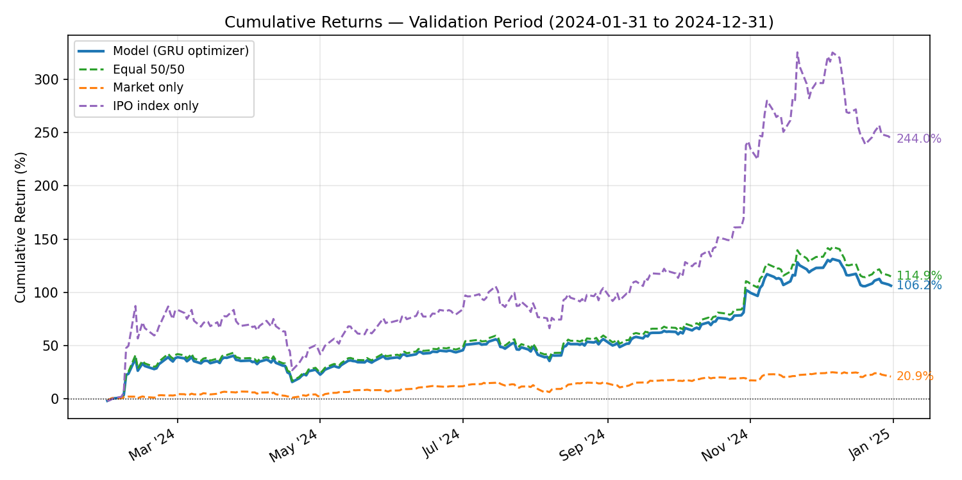
Validation Period: Cumulative Returns
▸ Model vs Baselines
Model (106%) roughly tracks Equal 50/50 (115%) but underperforms IPO-only (244%). The model adds value over market-only (+85pp) while maintaining tighter drawdown.
▸ Q1–Q2 2024: Tight clustering
All strategies converge until July. The model closely follows equal-weight, suggesting the GRU has not yet learned to differentiate market regimes in this period.
▸ Aug 2024: Yen carry unwind (VIX→65)
A sharp drawdown is visible across all strategies. The model does not reduce IPO exposure ahead of the event — a key failure of the static-weight regime.
▸ Nov–Dec 2024: Election + Fed divergence
IPO-only surges on the Trump rally while the model trails. The vol-excess penalty (target 25%) caps the model's upside when IPO volatility spikes above the threshold.
▸ Interpretation
The model achieves Sharpe 3.60 vs 3.65 (equal-weight) — near parity, but without true dynamic timing the model cannot exploit regime transitions.
STAT 4830 — Spring 2026

Slide 10
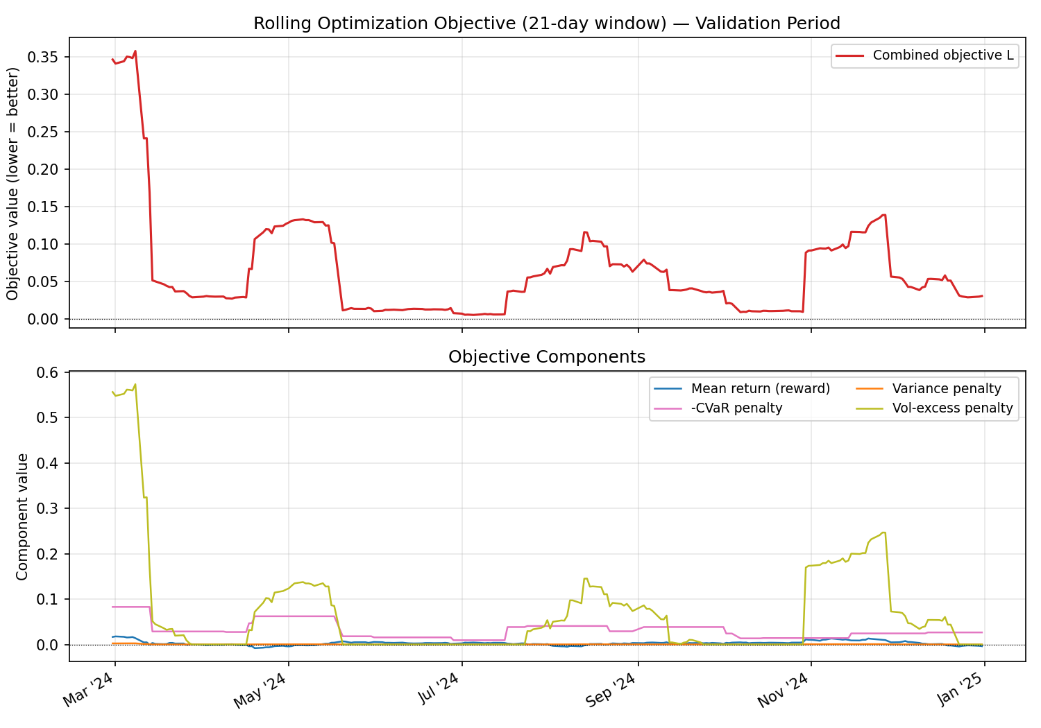
Validation Period: Optimization Objective
▸ Combined objective L (upper panel)
L = −mean_return + λ_vol·Var + λ_cvar·(−CVaR) + λ_vol_excess·excess. Spikes in Mar and Oct–Nov coincide with periods of elevated IPO volatility. Lower is better.
▸ Mar 2024 spike
Objective peaks sharply in early March when IPO index variance surged. The vol-excess and CVaR penalties dominated, forcing the model to increase market weight temporarily.
▸ Mean return (reward) component
The blue reward signal is consistently positive and smooth, indicating the portfolio was profitable throughout the period. The objective is predominantly driven by risk penalties.
▸ Vol-excess penalty (yellow)
Activates in Nov–Dec when the post-election IPO rally pushed annualised vol above the 25% target. The model responds by trimming IPO weight — visible as a plateau in the returns curve.
▸ CVaR penalty (pink)
Elevated during Aug carry-trade unwind. Soft-sorted CVaR captures tail risk in real-time, though the approximation temperature (0.1) is untuned — a known limitation.
STAT 4830 — Spring 2026

Slide 11
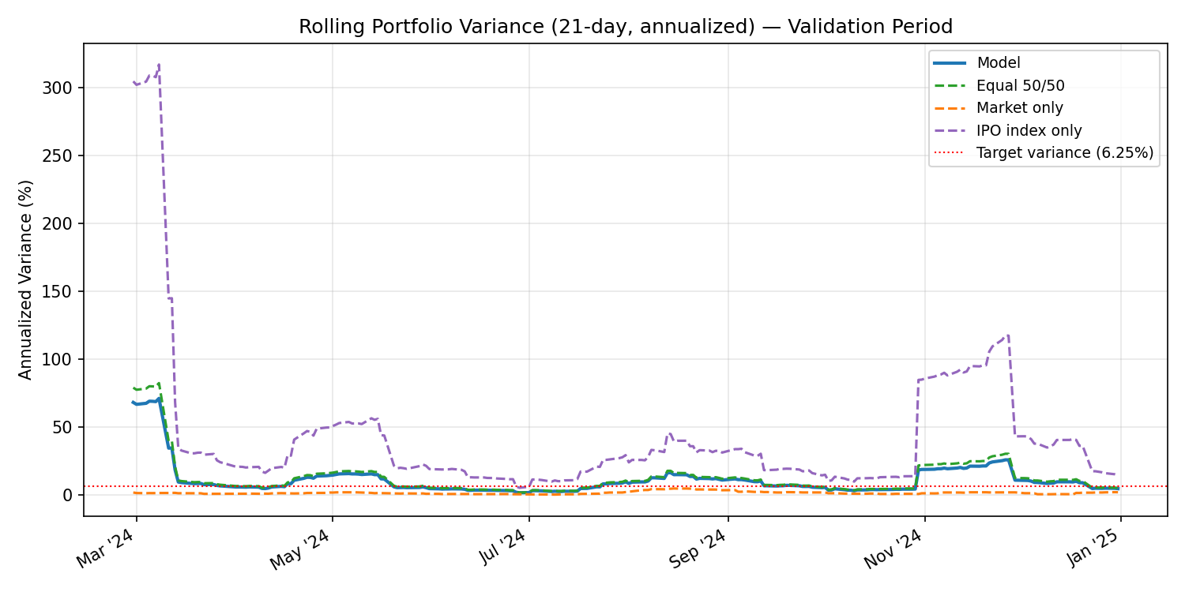
Validation Period: Portfolio Variance
▸ Model variance vs target (6.25%)
The model (blue) stays near the annualised variance target (red dotted, 6.25% = 25% vol²) for most of the year. The vol-excess penalty is effective as a soft constraint.
▸ Early-period spike (Feb–Mar 2024)
Model variance spikes to ~70% briefly before converging. This corresponds to a period of high IPO index volatility where the 21-day rolling window picks up outlier returns.
▸ IPO-only (purple) far exceeds target
IPO-only annualised variance reaches 300%+ in early periods. The model's risk control is the primary value-add: same IPO exposure with 8–10× lower variance.
▸ Aug 2024: Minimal model variance spike
Despite the Aug VIX-65 carry-trade event, the model's variance barely moves — because weights are near-static and the ~54% market component dampens the IPO shock.
▸ Nov–Dec 2024: Second spike
Post-election IPO surge caused a brief variance spike. The vol-excess penalty activates (visible in objective plot) and brings variance back toward target by year-end.
STAT 4830 — Spring 2026

Slide 12
Failure Mode Analysis
Static Allocation Collapse (Root Cause)
Regularisation Dominates Return Signal
λ_path=0.01 & λ_turnover=0.0025 penalized any weight change. The GRU minimized loss by outputting a near-constant 68/32 split — avg daily turnover 0.0031, identical weights every day. The model learned a static policy, not a dynamic one.
With batch_size=32, gradient noise was high. The path/turnover terms had smooth, easy-to-minimise gradients while the return signal was noisy. Optimizer converged to the trivial fixed-weight solution in <5 epochs.
Validation Leakage via Hyperparameter Search
Survivorship Bias in IPO Index
288-config grid search selected the config maximising validation Sharpe. The reported Sharpe (3.27 → 3.60) is optimistic. A true held-out test set is needed to measure generalisation honestly.
The IPO index includes only tickers with price data in CRSP. Failed / delisted IPOs within the holding window are systematically excluded, inflating the IPO index return (192% in 2024).
Validation Period Regime Risk
Remaining Gap vs. Equal Weight (Post-Fix)
Jan–Dec 2024 contained five distinct regime shifts (Apr sell-off, Aug VIX-65 carry unwind, Sep Fed cut, Nov election rally, Dec hawkish pivot). A static model cannot adapt; a dynamic model must learn these signals from 84-day windows.
After fixing λ_path=0.0001 & λ_turnover=0.0, Sharpe improved to 3.60 but still trails equal-weight (3.65). The GRU has not yet learned to time the market. IPO weight rose to 46% but is still near-static; true dynamic allocation requires richer regime features.
STAT 4830 — Spring 2026

Slide 13
Observations
Valid simplex-constrained weights
The model trains end-to-end and produces valid weights (69% market / 31% IPO average)
Strong Sharpe ratio
Sharpe of 3.27 is strong, but validation set was also used for hyperparameter selection — no configs were evaluated on truly unseen data
Four informative features
Real VIX replaced the constant 20.0 placeholder; the model now receives four informative features
Improved Sharpe through tuning
Turnover and path penalties were tuned (previously hardcoded), improving Sharpe from 3.07 → 3.27
Quick convergence
Training converges in ~4 effective epochs, suggesting the model saturates quickly on ~930 training samples
Drawdown reduction value
The IPO-only baseline has a higher Sharpe (3.92) than the model (3.27) - the model's value is in drawdown reduction (-7.47% vs -10.08%)
STAT 4830 — Spring 2026

Slide 14
Areas for Improvement
No out-of-sample test
Model underperforms naive 50/50
The validation set is both the evaluation set and the set used for hyperparameter selection. This is methodologically equivalent to testing on training data. The Sharpe of 3.27 is optimistic - it reflects the best of 288 configs on this specific period.
The equal-weight baseline achieves Sharpe 3.65 vs the model's 3.27, with comparable drawdown (-7.20% vs -7.47%). The GRU adds complexity without demonstrably improving on a zero-parameter strategy.
CVaR formulation is approximate
Validation leakage
The soft-sorting heuristic uses a hardcoded temperature (0.1) that was never tuned or validated against the true CVaR.
Choosing the config that maximizes validation Sharpe across 288 trials implicitly fits to the validation set. A Sharpe of 3.27 on a 232-day window with 288 searches amounts to substantial multiple-testing bias.
Additional concerns: Survivorship bias (IPO index excludes delisted/failed stocks, inflating index returns) and regime dependence (the 2020–2024 period is unusually favorable for IPOs). It is unclear whether any model trained on this window would generalize to a regime with weak IPO performance.
STAT 4830 — Spring 2026

Slide 15
Next Steps
01
02
03
Train/val/test alternative model architecture
Improve validation loss
Validate the CVaR approximation
Train and validate alternative model architectures such as a transformer-based model and LSTM on data. Test on 2025 period. Report final metrics on the test set. This directly addresses the validation leakage problem.
Adjust levers like batch size, step size, loss function components such as risk penalty and turnover, and potentially expand our dataset to improve validation loss convergence and test results.
Compare the soft-sorted CVaR output against the exact empirical CVaR (sort returns, average worst 5%) on several batches. If the approximation deviates by more than 10%, we can tune the temperature.
STAT 4830 — Spring 2026

