Slide 1
Offline GRU Policy Pipeline
Data Inputs
Market data, IPO metadata, prices, returns, VIX
Normalize + Pivot
Deduplicate and build daily IPO matrix
IPO Index Build
180-day mcap-weighted IPO return
Align + Features
Clip returns, add rolling_vol and VIX
Rolling Windows
X(N,126,F), R(N,2), dates
Chronological Split
Static train/val by time
GRU Policy
GRU -> last hidden -> MLP -> softmax
Weights Output
w=[market,IPO], simplex constrained
Composite Objective
Return/CVaR/vol/turnover/path/diversify
Optimize + Select
Adam + LR + clipping + early stop
Offline Outputs
Static policy weights path + validation performance summary
Color groups: data, preprocessing, model, training, outputs

Slide 2
Online GRU Policy Pipeline
Shared Features
Same cleaned feature pipeline as offline
Window Timeline
Build rolling windows and schedule
Per-Step History Slice
Expanding/fixed lookback to train_end
Warm-Start Update
Fine-tune current GRU for epochs_step
Gate Decision
Accept or revert candidate update
Per scheduled decision date
Update date?
If not, keep previous parameters
Train/Val Split
Chronological split
Candidate Metrics
val-loss delta and relative change
Threshold Check
Cadence or confidence gate
Action Inference
Predict allocation for current decision
Path Accounting
Realized return, turnover, costs, flags
Online Outputs
Online path + schedule log + diagnostics + update-benefit summary

Slide 3
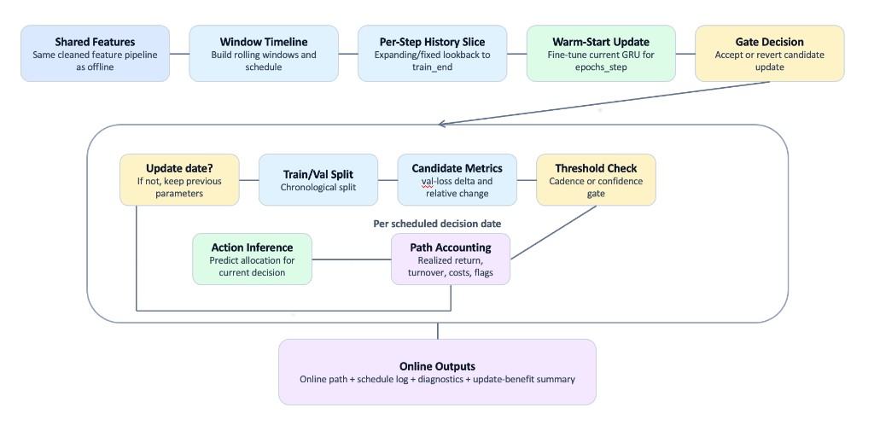
Threshold-check confirm not used in latest run
Online Pipeline — Actual Run Behavior (Latest)
Actual run notes: weekly updates (update_freq=W), epochs_step=2, warm-start fine-tuning, and no explicit hard accept/revert threshold confirmation gate in this run (updates applied on scheduled dates).

