Slide 1
Arduino

Slide 2
Content
What is microcontroller ?
What is Arduino ?
Types of Arduino Board
History of Arduino
Programming Enviorment
Advantages
Features
Applications
Final Thought
References

Slide 3
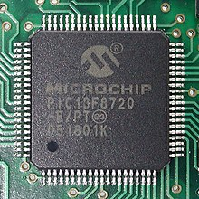
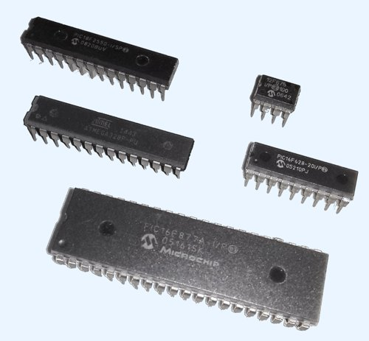
Microcontroller
It is a micro-computer. As any computer
it has internal CPU, RAM, IOs interface.
Famous microcontroller manufacture
are Microchip, Atmel, Intel, Analog
devices, and more.

Slide 4
What is Arduino?
Arduino is an Open-Source platform used for building electronics projects.
Arduino consist of both a physical programmable circuit board and a software, or IDE(Integrated Development Enviornment) that runs on your computer .
It is used to write and upload computer code to physical board.

Slide 5
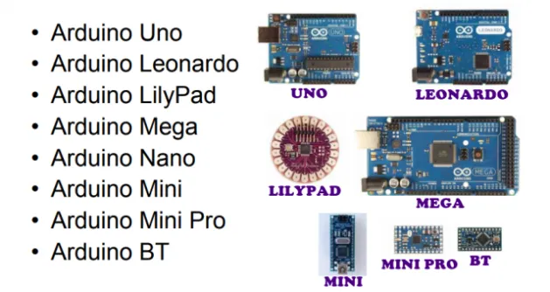
Types of Arduino Board

Slide 6
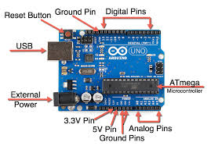
Arduino Uno

Slide 7
Brief History of Arduino
In 2005, a project was initiated to make a device for controlling student-built interactive design projects that was less expensive than other prototyping systems available at the time.
Founder Massimo Banzi and David Cuartielles named the project after Arduin of Ivrea and began producing boards in a small factory located in Ivrea.

Slide 8
Programming Enviornment
Thw Arduino Uno can be programmed with the Arduino software IDE(integrated development enviornment).
The Atmega328 on the Arduino Uno comes preburned with a Bootloader that allows you to upload new code to it without the use of an external hardware programmer.
You can also bypass the Bootloader and program the microcontroller through the ICSP(In-Circuit Serial Programming) header.
Arduino IDE works on windows, linux as well as Mac lion X platforms.

Slide 9
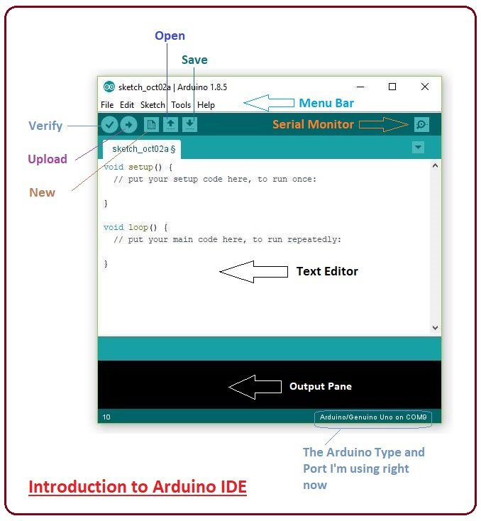
Arduino IDE

Slide 10
Advantages
Open Source.
Simplified and user-friendly programming language.
No additional programmer/burner hardware required for programming board.
Portable.
Low power consumption.

Slide 11
Features
Microcontroller ATmega328
Operating Voltage 5V and 3.3V
Input Voltage(recommended) 7-12V
Input Voltage(limits) 6-20V
Digital I/O Pins 14(of which 6 provide PWM output)
Analog Input Pins 6
DC Current per I/O Pin 40mA.
DC Current for 3.3V Pin50mA
Flash Memory 32KB(ATmega328) of which 0.5KB used by Bootloader.
SRAM 2KB(ATmega328)
EEPROM 1KB(ATmega328)
Clock Speed 16MHz

Slide 12
Application of Arduino
Home Automations.
Sensor prototyping
Robotics
ISP programming
Easy Wifi, GSM, Ethernet, Bluetooth, zigbee Connectivity

Slide 13
Final thoughts
Arduino is a cheap and versatile open source prototyping enviornment
It is basically desined for novice, non technical people
Programming language is simple.
Arduino has a terrific community support and documentation
Technical people can use Arduino for testing sensors or other prototyping work.

Slide 14
Where to learn Arduino?
http://www.arduino.cc/
http://learn.adafruit.com/category/learn-arduino
http://playground.arduino.cc/
Recommended books-Making Things Talk (by Tom lgoe), Getting Started With Arduino(by Massimo Banzil)

Slide 15
Thank You

