Slide 1
Trainee Onboarding Project
Web Scraping a popular website www.naukri.com and
extracting different types of data available there.

Slide 2
Agenda
Objective
Overview
Process Flow
Modules Description
Dashboard Snapshot
Use Cases
Scope
Demo

Slide 3
Overview
We can divide the project into 4 major parts.
1)Extract: Web Scraping via python [running on VM]
2)Load: Data movement from GCS to BQ [Cloud function]
3) Transform: DataFlow[Apache Beam)
4)Visualization: Data Studio

Slide 4
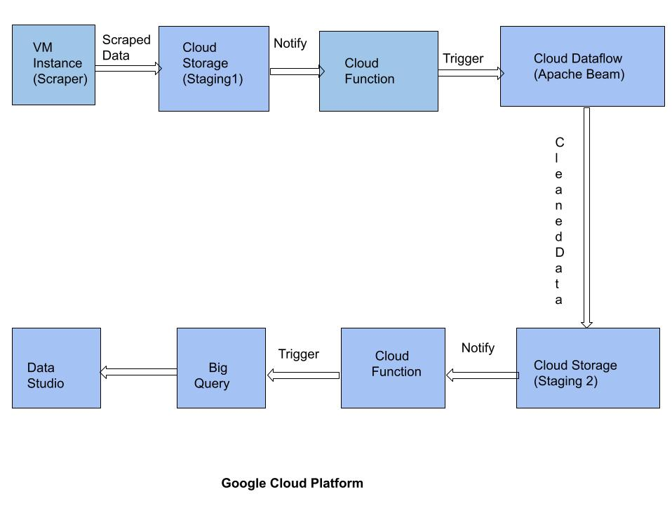
Process Flow

Slide 5

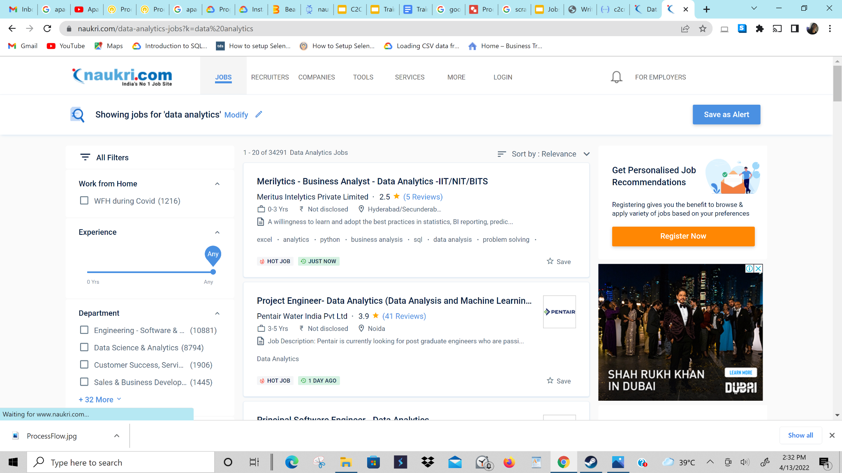

Data Collection Through Scraper
Scraped on VM
naukri.com
Scrapped csv file

Slide 6

Data Cleaning and transformation through Apache Beam
Scraped CSV file
Cleaned
CSV file

Slide 7
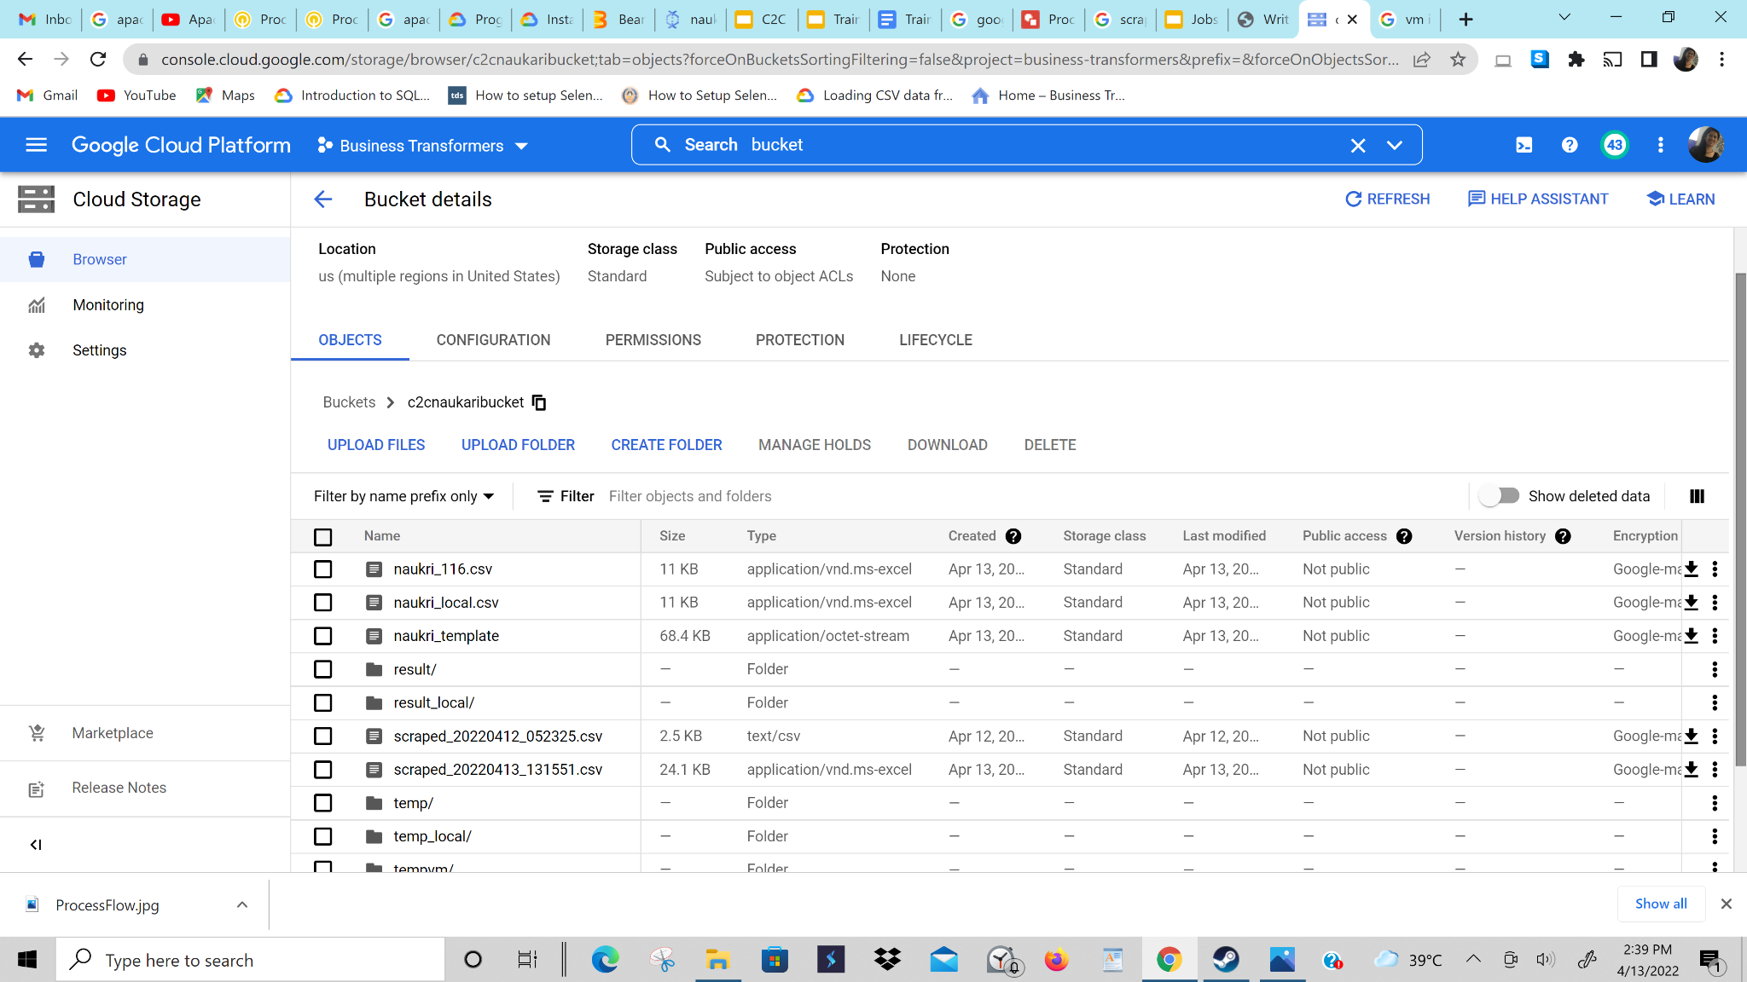
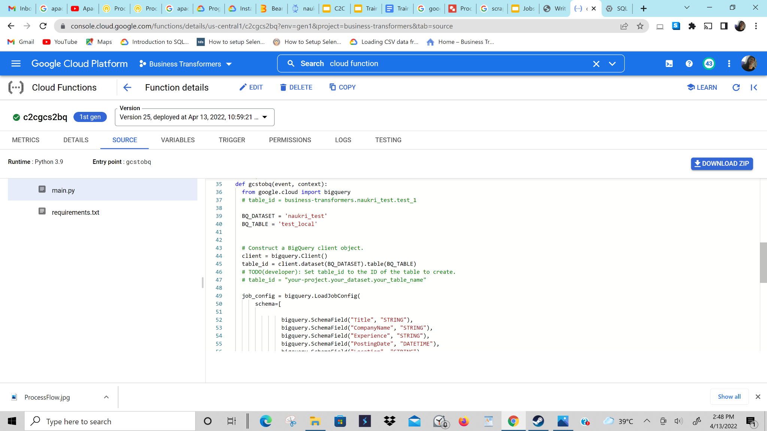
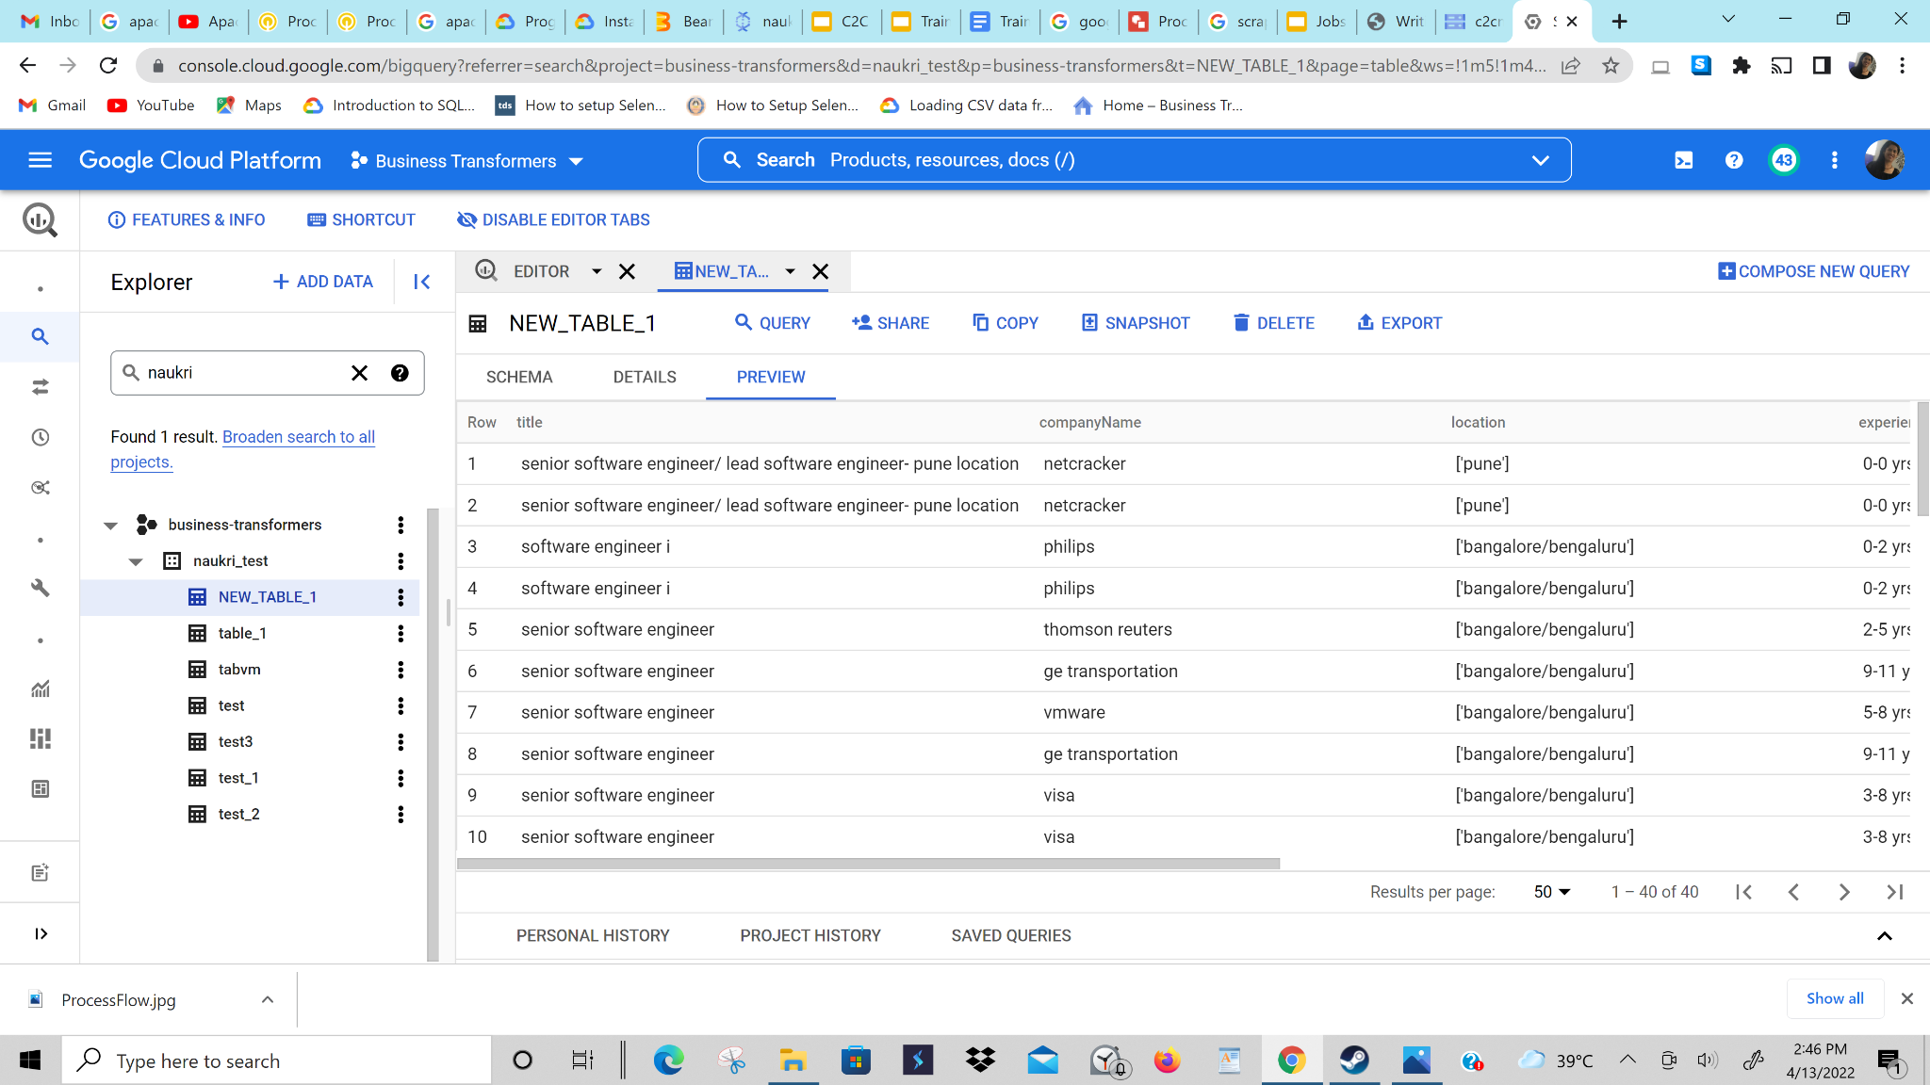
Data migration from GCS to BQ using cloud function
GCS bucket
Cloud Function
triggered
Data loaded to BQ

Slide 8
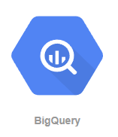

BQ to Data Studio
Data loaded to BQ
Data transformation in BQ
Data Studio for visualisation

Slide 9
Use Cases
For Freshers
Freshers get idea about what types of jobs are in demand.
For startups and organizations
Startups and organizations use this project as a reference to set their requirements

Slide 10
Future Scope
The scope of the project can be for scraping years of data of different types of jobs from a variety of websites.
We can scrape as much data as we want and can use the available tools on Google Cloud Platform to derive some more insights and useful information.
Similarly we can use this project to convert unstructured or data into something useful.

Slide 11


