Slide 1

CONTENTS
Introduction
About dataset
Problem Statement
Data cleansing
Data Modelling
Creating Dimension tables
Creating Fact table
Scenarios
conclusion

Slide 2

INTRODUCTION
Job vacancy Analysis is the process of gathering and analyzing information about the content and the human requirements of jobs.
This process is used to determine placement of jobs. ... Job vacancy analysis defines the jobs in different agencies.

Slide 3
ABOUT DATASET
Agency
No of Positions
Business Title
Civil Service Title
Level
Salary
Salary Frequency
Work Location
Division Work Unit
Posting Date

Slide 4
Need to analyze the data
To compare different Jobs in different Cities from the given data by performing ETL and generating reports.
Helps the candidates with different choices of jobs in different cities based on their various criteria.

Slide 5
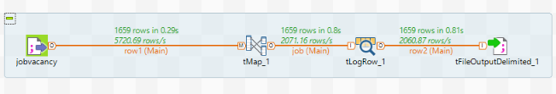
DATA CLEANSING
Data cleaning is the process of detecting and correcting (or removing) corrupt or inaccurate records from a record set, table, or database and refers to identifying incomplete, incorrect, inaccurate or irrelevant parts of the data and then replacing, modifying, or deleting the dirty or coarse data.
Replaced the Null Values

Slide 6
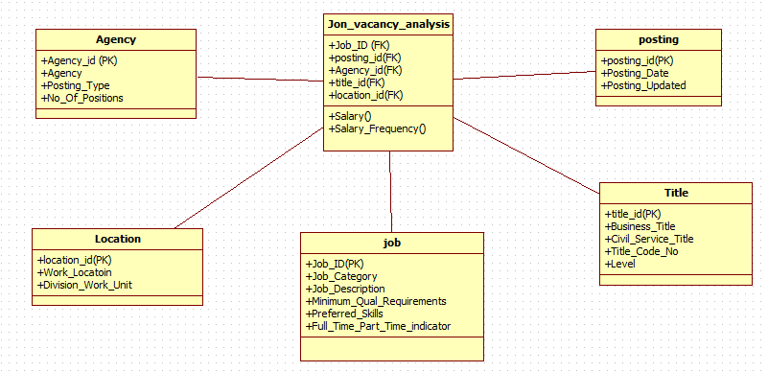
Data Modelling

Slide 7
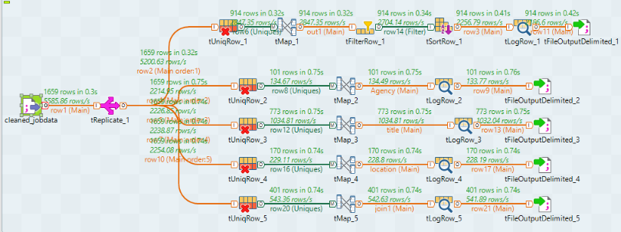
CREATING DIMENSION TABLES

Slide 8
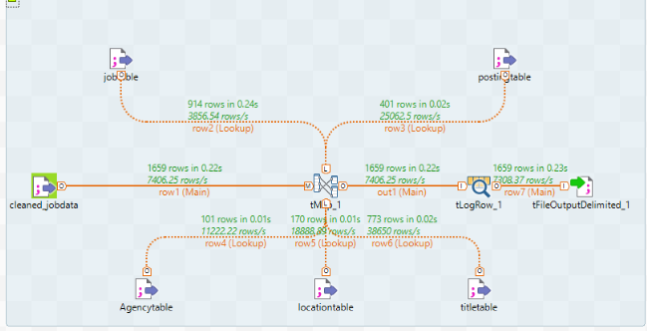
CREATING FACT TABLE

Slide 9
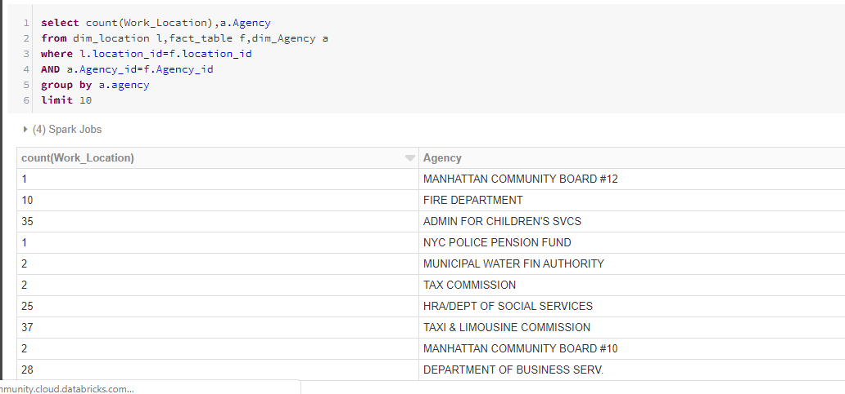
Scenario 1: count of work locations for different agencies

Slide 10
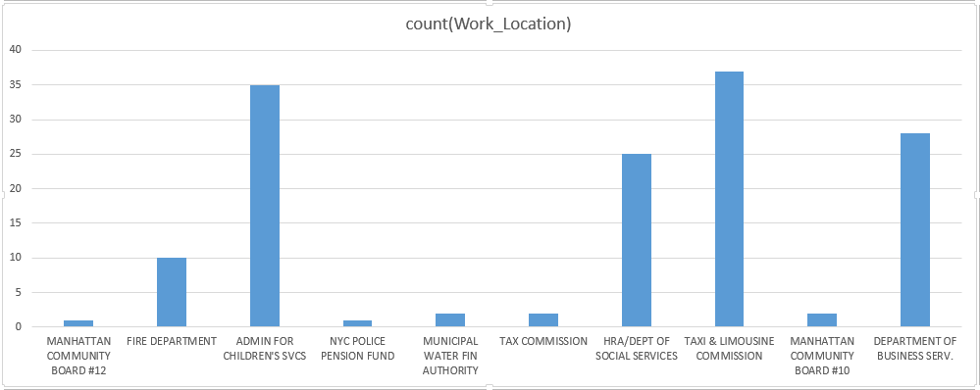
Graphical representation of count of work locations for different agencies

Slide 11
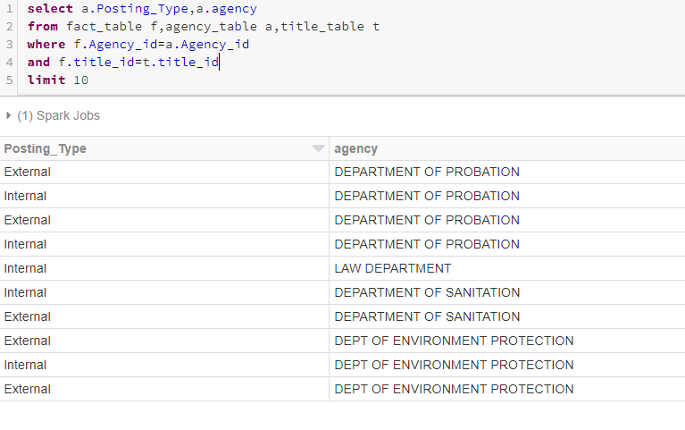
Scenario 2: Posting type for different agencies

Slide 12
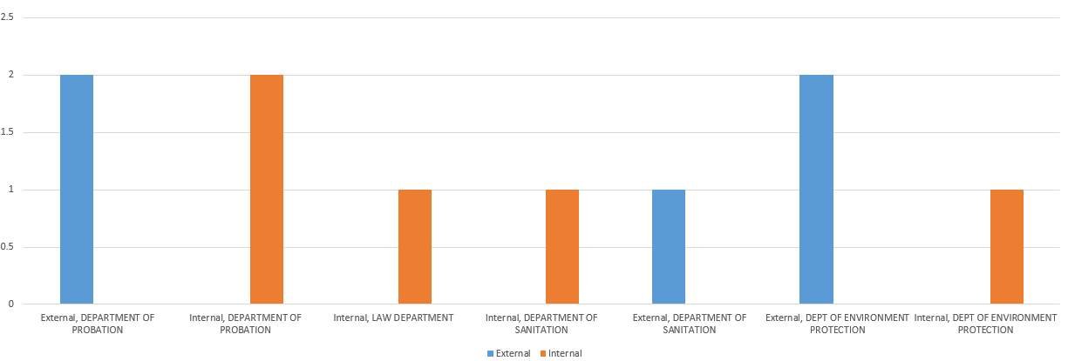
Graphical representation of posting type for different agencies

Slide 13
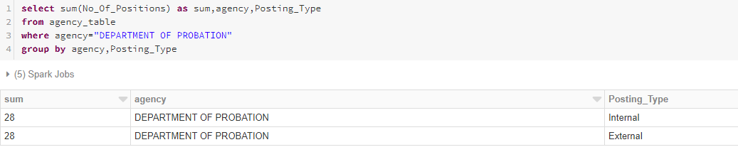
Scenario 3: Sum of Positions, Posting Type for Agency “Department of Probation”

Slide 14
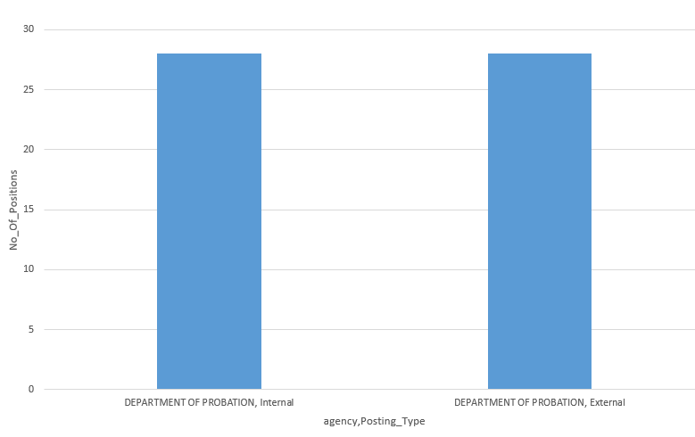
Graphical representation of Sum of Positions, Posting Type for Agency “Department of Probation”

Slide 15
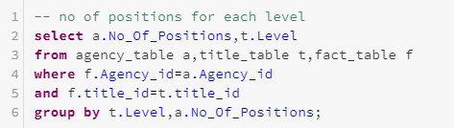
Scenario 4:
Number of positions for each level

Slide 16
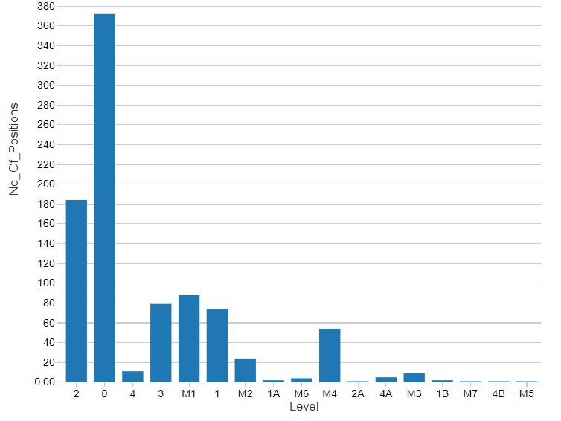
Graphical representation of number of positions for each level

Slide 17
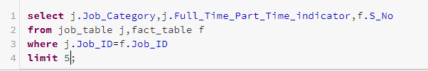
Scenario 5:
Count of full time and part time jobs for each job category

Slide 18
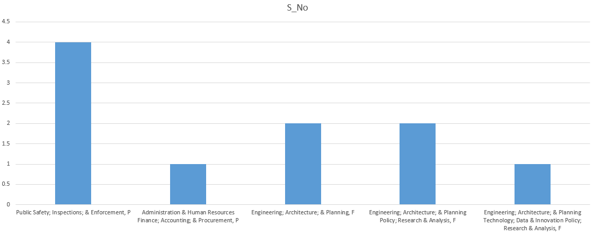
Graphical representation of Count of full time and part time jobs for each job category

Slide 19
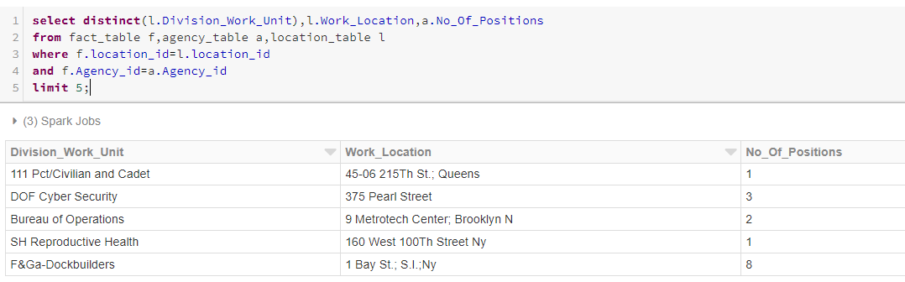
Scenario 6: No. of positions in each job location for different divisions of work

Slide 20
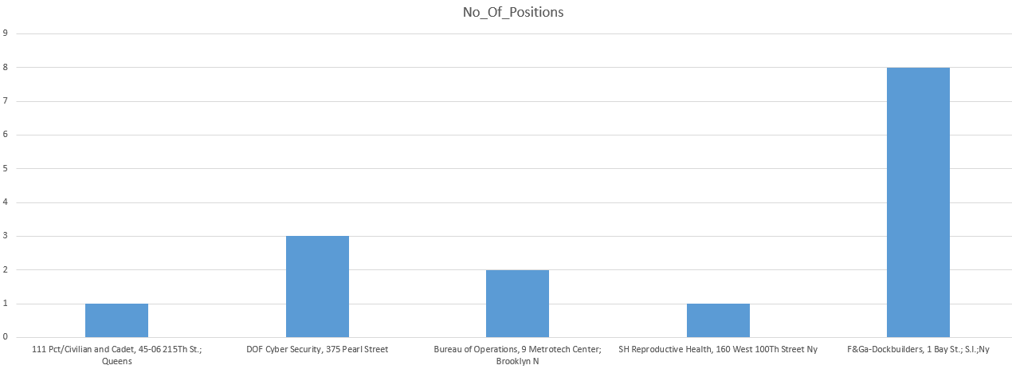
Graphical representation of No. of positions in each job location for different divisions of work

Slide 21
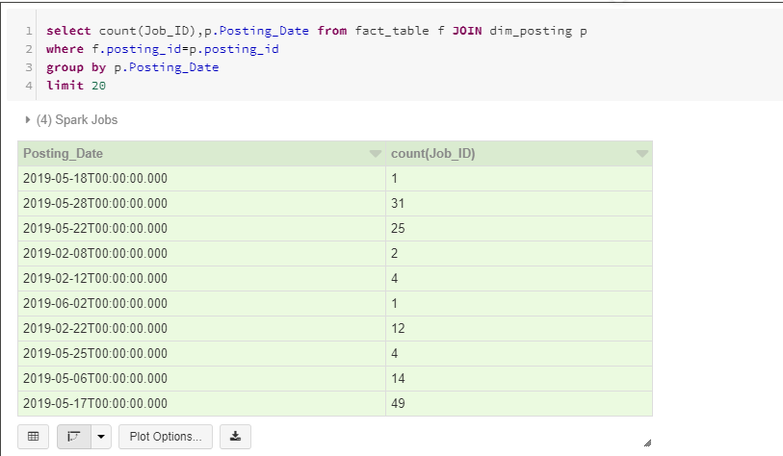
Scenario 7: No. of Jobs posted on each date

Slide 22
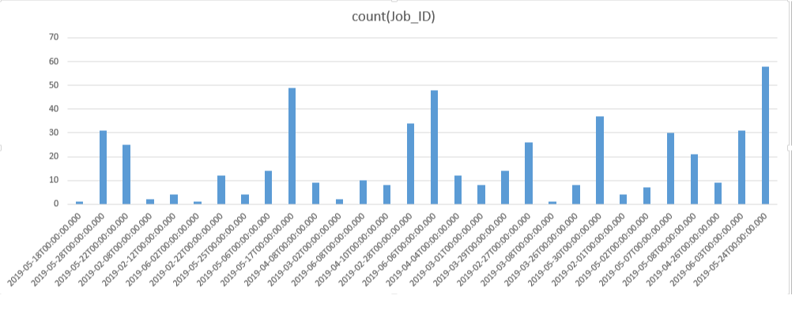
Graphical representation of No. of Jobs posted on each date

Slide 23

Scenario 8: Salary for each civil service title and its salary frequency

Slide 24
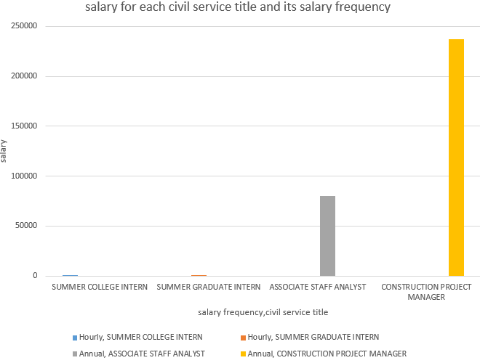
Graphical representation of Salary for each civil service title and its salary frequency

Slide 25
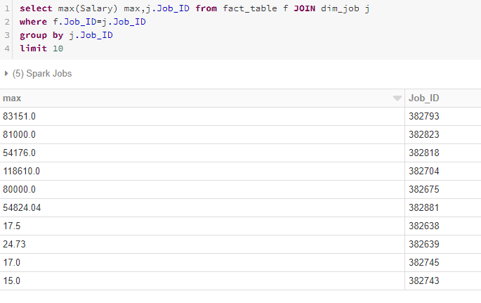
Scenario 9: Maximum Salary for each job

Slide 26
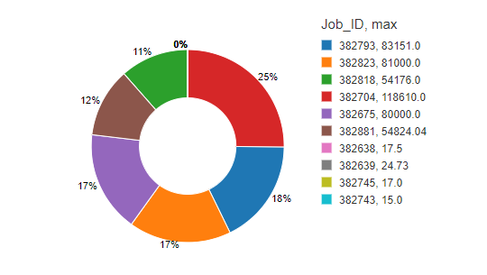
Graphical representation of maximum salary for job

Slide 27
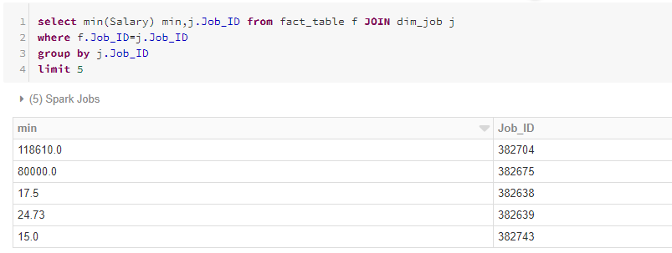
Scenario 10: Minimum Salary for each job

Slide 28
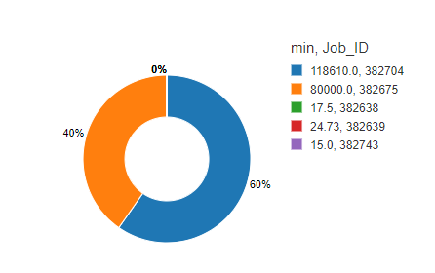
Graphical representation of Minimum Salary for each job

Slide 29
CONCLUSION
By the Job Vacancy Analysis we can know the Number of positions present at every Agencies at different Work location
We analyzed the salary for each salary frequency according to Job Category.

Slide 30


