Slide 1

Seasonal Agriculture
Performance Analysis
VOIS AICTE Batch 1 · 2026–2027
Major Project · Course: Data Visualization
4,000 farms · 8 crops · 8 states · 3 seasons
Shivani Chaudhary
College Name - Birla Institute of Technology and Science, Pilani – K. K. Birla Goa Campus
AICTE STU ID : STU6a6a3b03e36e41785346819

Slide 2

PROBLEM STATEMENT
Agricultural activities are influenced by seasonal variations in environmental conditions, farming practices, resource availability and market conditions. As a result, agricultural performance may differ from one season to another.
However, raw agricultural data does not clearly explain how agricultural performance changes across seasons or what patterns can be observed in different seasonal conditions.
The problem is to analyse the given agricultural dataset and investigate seasonal differences in agricultural performance by identifying meaningful patterns, trends, relationships and variations within the available data.

Slide 3
Project Description
The project analyses 4,000 Indian farm records across the three cropping seasons — Kharif (monsoon), Rabi (winter) and Zaid (summer) — spanning 8 crops, 8 states and 28 variables covering weather, soil, farming practice, output, water use and economics.
Approach
1. Data-quality audit — verified four arithmetic identities in the data, which allowed 32 missing yields to be reconstructed exactly rather than estimated.
2. Crop-relative yield — the key engineered feature. Sugarcane yields 48 t/ha and pulses 0.9 t/ha, so raw averages measure crop mix, not seasonal performance. Dividing each farm by its own crop median puts all 8 crops on one comparable scale.
3. Hypothesis testing — Kruskal-Wallis, pairwise Mann-Whitney with Bonferroni correction, and chi-square, with effect sizes reported alongside every p-value.
4. Robustness — the seasonal ranking is re-tested inside all 30 sub-groups (crop, state, district, irrigation method) to rule out a composition artefact.
5. Modelling — nested OLS models separate what the season label explains from what measurable growing conditions explain.
Headline result
Productivity falls 30 % from Kharif to Zaid and the ranking holds in 30 of 30 sub-groups. The cause is a rainfall optimum near 760 mm, not the calendar. Because cost per hectare is statistically identical in every season while revenue falls, loss-making farms rise from 42 % in Kharif to 65 % in Zaid.

Slide 4

WHO ARE THE END USERS?
Farmers and Farmer Producer Organisations (FPOs)
Which crop to sow in which season, and when the expected return will not cover the input cost.
Agricultural extension officers and Krishi Vigyan Kendras
Season-specific advisories — irrigation targets, nutrient balance and Kharif disease control.
State agriculture departments and policy planners
Where to direct irrigation subsidies, drainage investment and crop-diversification support.
Agri-input and irrigation companies
Evidence that drip systems hold up best in the water-scarce Zaid season.
Agricultural insurers and rural lenders
Season- and crop-level loss rates (42 % → 65 %) for pricing risk and structuring credit.
Agri-tech platforms and researchers
A reproducible baseline for seasonal benchmarking and yield-advisory products.

Slide 5

Technology Used
Language & environment
Python 3 · Jupyter Notebook
Data handling
pandas — cleaning, grouping, pivot tables
NumPy — vectorised computation, least-squares
Statistics
SciPy — Kruskal-Wallis, Mann-Whitney U,
ANOVA, chi-square, Spearman correlation
OLS regression implemented with NumPy
Visualisation
Matplotlib and Seaborn — a colour-vision-safe
palette validated to ΔE ≥ 9 separation
Analytical techniques applied
• Data-quality auditing via arithmetic identity checks
• Group-wise median imputation
• Normalisation to remove crop-scale confounding
• Non-parametric hypothesis testing
• Multiple-comparison (Bonferroni) correction
• Effect sizes: η², Cramér's V, P(A > B)
• Sub-group robustness testing (30 groups)
• Partial correlation to expose a confound
• Polynomial response-curve fitting
• Nested regression models for mediation
• Break-even / unit-economics analysis

Slide 6
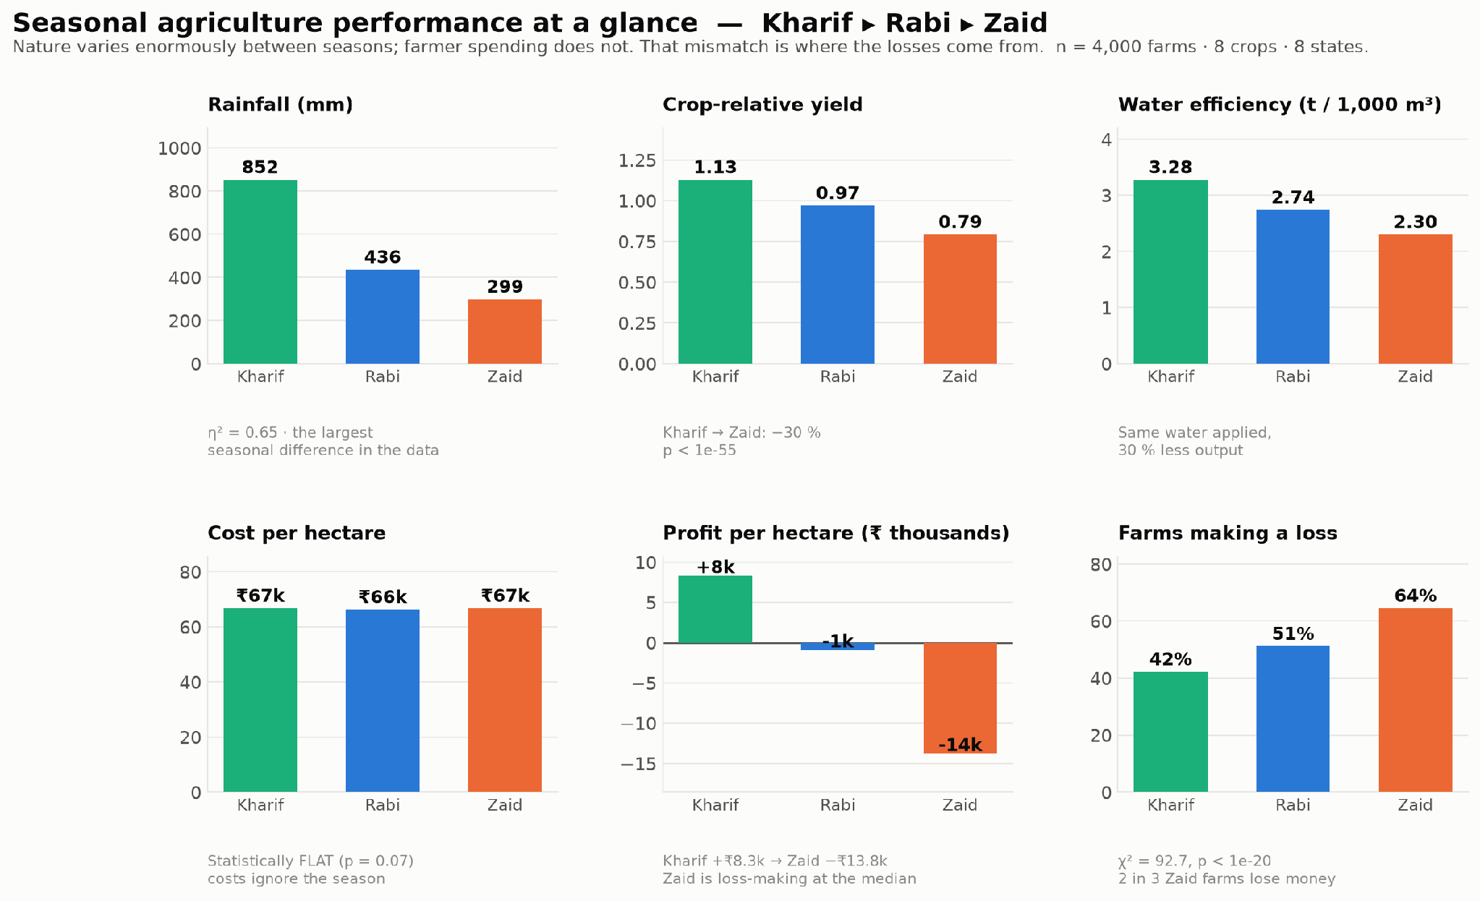
RESULTS
Seasonal performance at a glance
Six measures, three seasons — nature varies enormously, farmer spending does not
Rainfall differs 3× between seasons and yield falls 30 %, yet cost per hectare varies by under 1 %. That mismatch is where the losses come from.

Slide 7
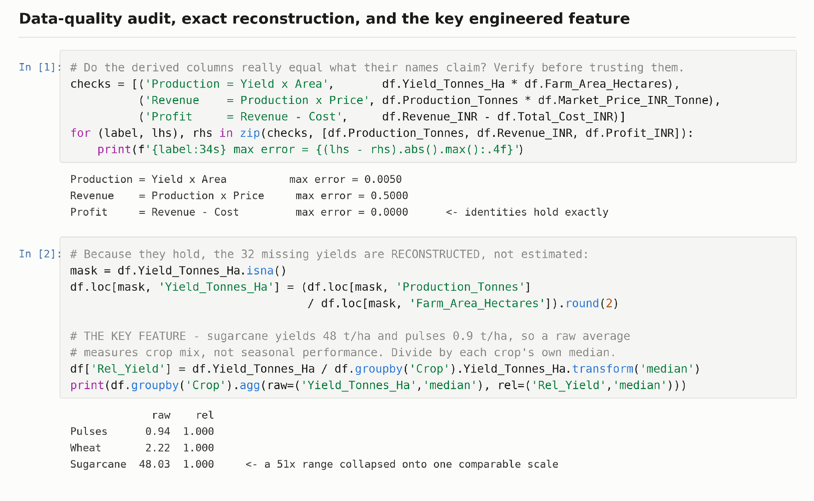
RESULTS
Data quality, cleaning and the key feature
Four arithmetic identities verified — so 32 missing yields were reconstructed, not guessed
Crop-relative yield collapses a 51× range between sugarcane and pulses onto a common 1.0 scale, so seasons compare fairly.

Slide 8
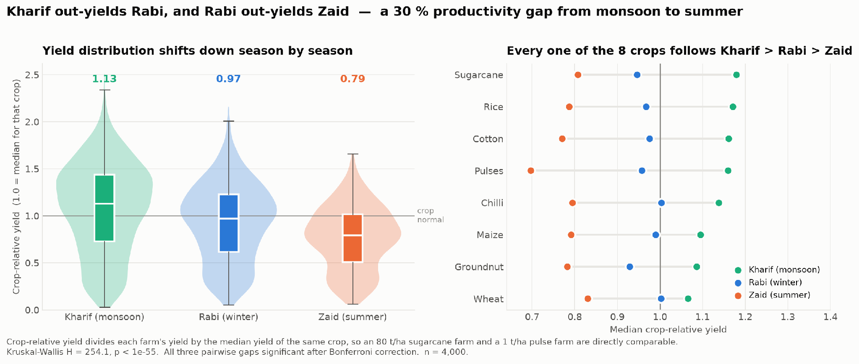
RESULTS
Productivity across seasons
Kharif 1.13 ▸ Rabi 0.97 ▸ Zaid 0.79 — a 30 % gap from monsoon to summer
Kruskal-Wallis H = 254, p < 1e-55. All three pairwise gaps survive Bonferroni correction; a Kharif farm out-yields a Zaid farm 70 % of the time.

Slide 9
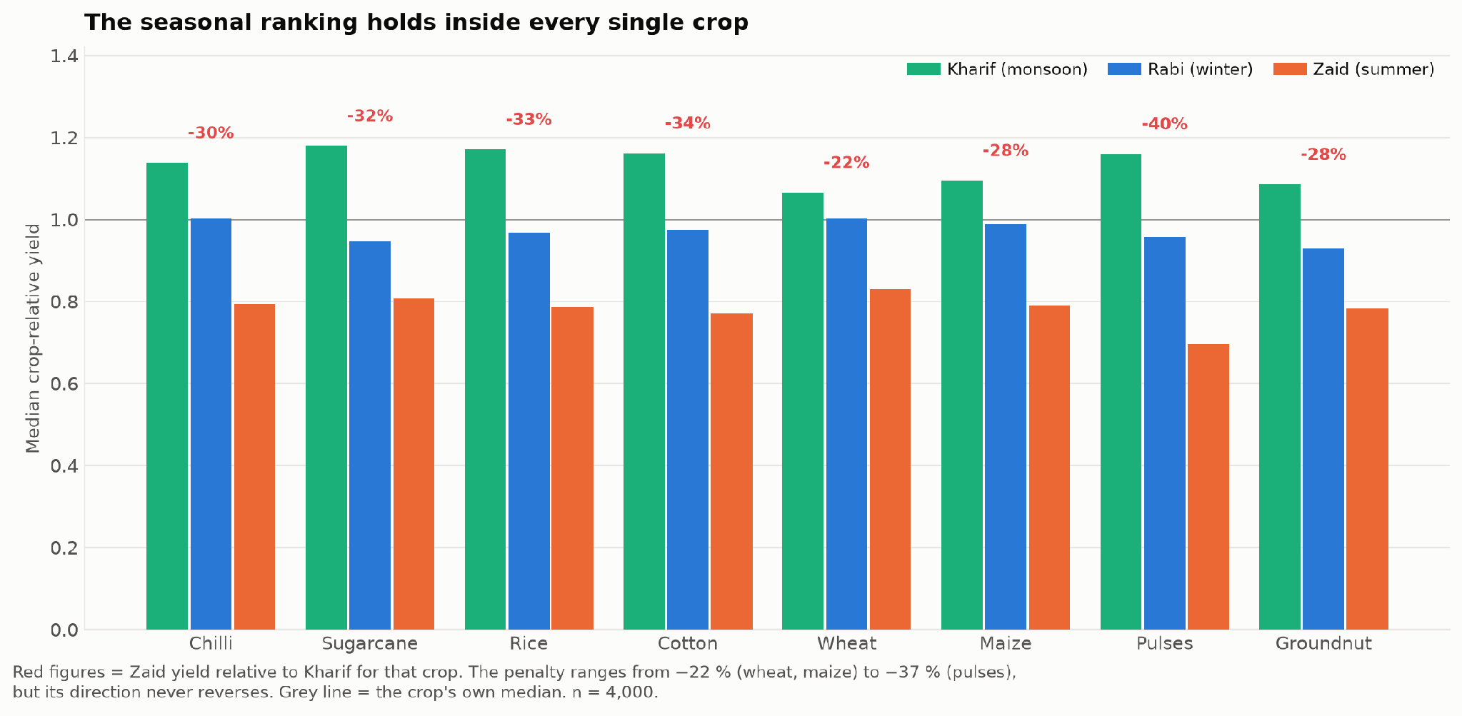
RESULTS
Is the ranking real, or a crop-mix artefact?
Kharif > Rabi > Zaid holds in 8/8 crops, 8/8 states, 10/10 districts, 4/4 irrigation methods
30 out of 30 independent sub-groups agree. The penalty size varies (pulses −37 %, wheat −22 %) but its direction never reverses — this is not Simpson's paradox.

Slide 10
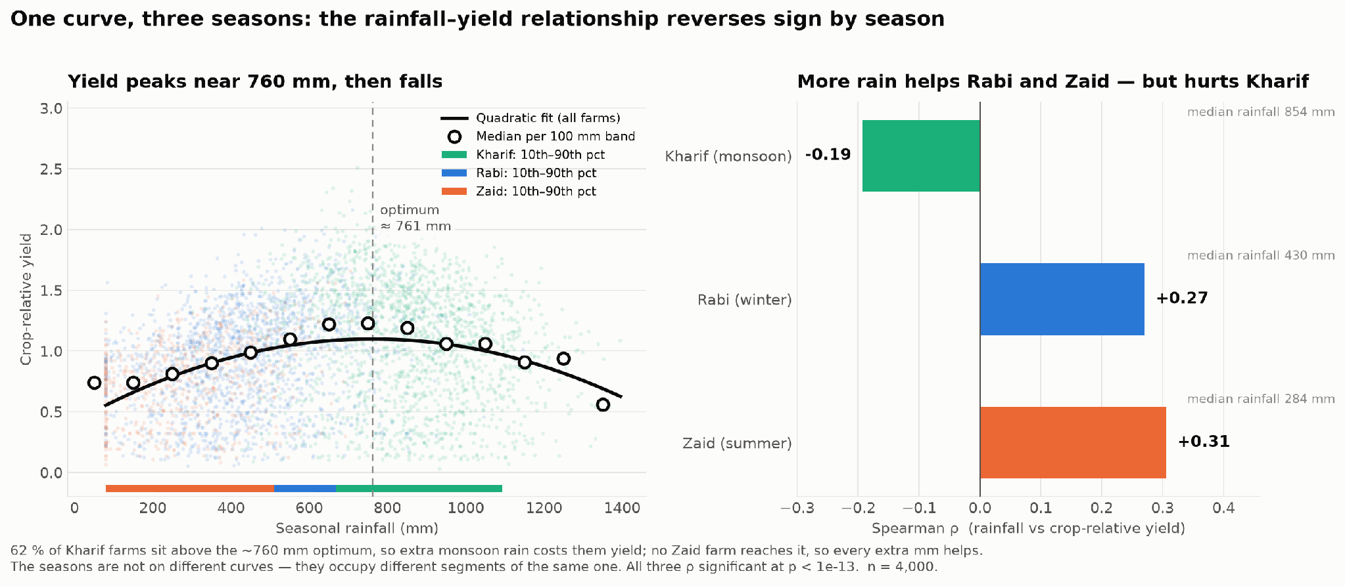
RESULTS
Why the gap exists
Water availability — not the calendar — is what actually moves yield
Yield peaks near 760 mm. 62 % of Kharif farms sit above the optimum, so extra rain costs them yield; no Zaid farm ever reaches it. Water supply — not the calendar — is the mechanism.

Slide 11
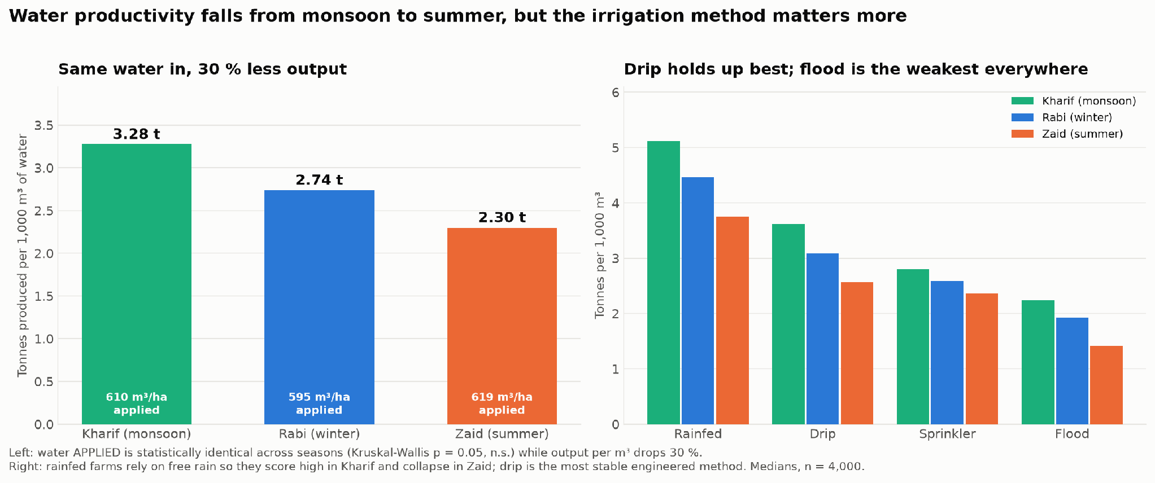
RESULTS
Resource usage and water efficiency
Identical inputs applied in every season, but 30 % less output per cubic metre
Fertiliser, N-P-K, pesticide, seed quality and water applied are statistically indistinguishable across seasons. Input behaviour is season-blind; output is not.

Slide 12
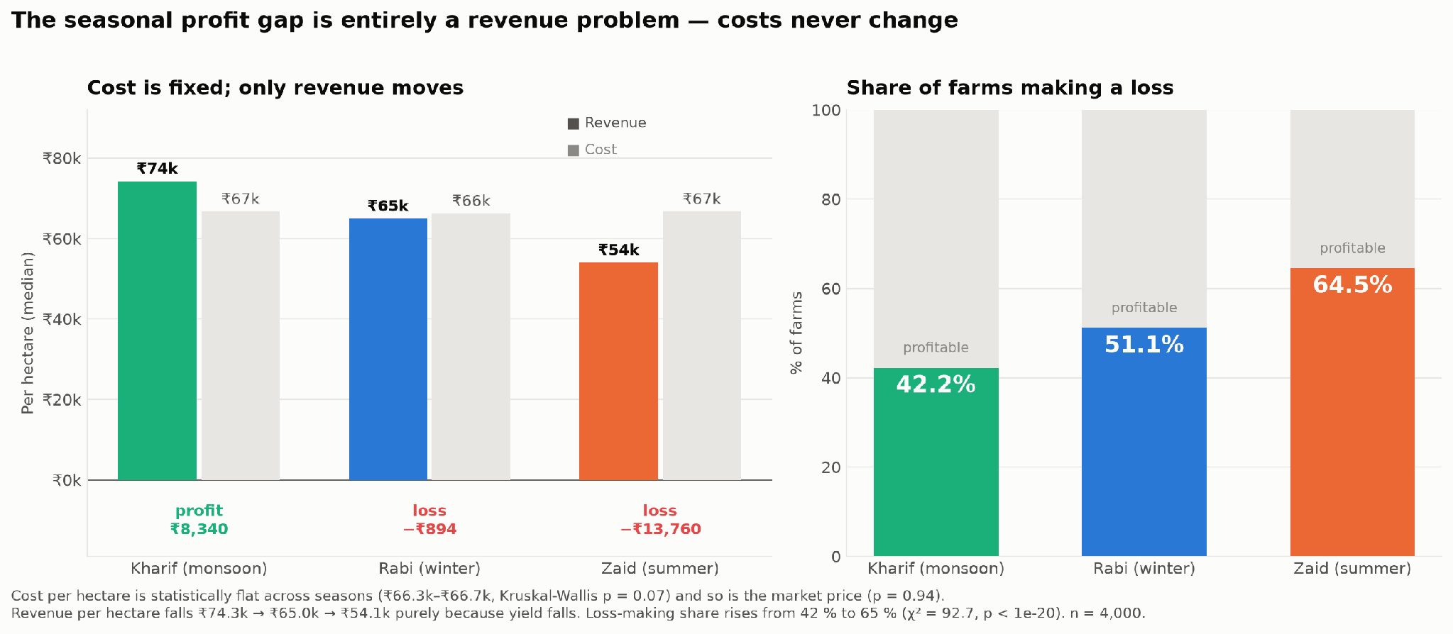
RESULTS
Economic outcomes
Farmers spend the same in every season; only what they earn back changes
Cost/ha (₹66.3k–₹66.7k, p = 0.07) and market price (p = 0.94) are flat. Loss-making farms rise from 42 % in Kharif to 65 % in Zaid (χ² = 92.7, p < 1e-20).

Slide 13
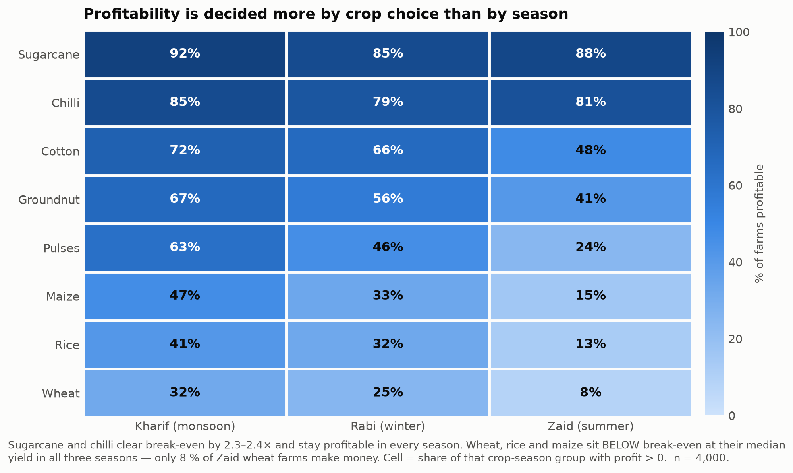
RESULTS
Break-even by crop and season
Wheat, rice and maize sit below break-even in all three seasons
Sugarcane and chilli clear break-even by 2.3–2.4× in every season. Wheat, rice and maize sit below break-even in all three — only 8 % of Zaid wheat farms make money.

Slide 14
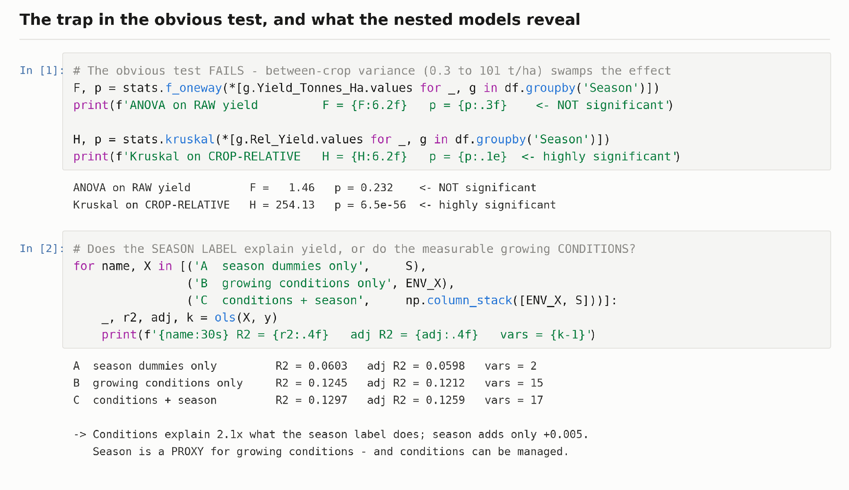
RESULTS
Modelling the drivers
Growing conditions explain twice what the season label does — season is a proxy
41 % of the Zaid penalty is mediated by measurable conditions — overwhelmingly rainfall — and conditions can be managed where a season cannot.

Slide 15
Future Scope
Extending the analysis
Add a time dimension. This dataset has no year or date, so no trend or forecast is possible. Multi-year data would turn seasonal differences into seasonal trends.
Predictive modelling. Random Forest / gradient boosting on yield and profit, with SHAP values to confirm the rainfall optimum non-parametrically.
Real geography. Join to genuine district coordinates and IMD rainfall grids to map where the 760 mm optimum is actually met.
Farm clustering. Segment farms by input strategy to find which combinations survive Zaid.
Turning it into a product
Season-aware advisory tool. Enter crop, district and irrigation method; return the expected break-even yield and a season-specific input budget.
Irrigation-gap dashboard. Flag farms below the 760 mm water target and quantify the yield recoverable by closing that gap.
Loss early-warning. A classifier for loss-making crop-season combinations, usable by lenders and insurers for risk pricing.
Live data integration. Connect IMD weather feeds and mandi price APIs to move from retrospective analysis to in-season decision support.

Slide 16
GitHub Link
https://github.com/shivanichaudhary2405/Seasonal-Agriculture-Performance-Analysis

Slide 17

VOIS Course Completion Certificate
Course name - Data Visualization

Slide 18
Thank you
Nature varies enormously between seasons; farmer spending does not.
That mismatch — not the weather alone — is what turns 42 % of Kharif farms into 65 % of Zaid farms making a loss.
Shivani Chaudhary · BITS Goa · AICTE STU ID: STU6a6a3b03e36e41785346819

