Slide 1
Hybrid Technique For Predicting Heart Disease
Project ID : 11
Project Incharge : Dr.K.Sagar
Project Mentor : Smt.G.Vanitha
K Shalini (1601-16-733-013)
C Shivani (1601-16-733-014)

Slide 2
OVERVIEW
Introduction
Objective
Literature Survey
Design
Proposed System
Results
Execution
Conclusions
References

Slide 3
Introduction
Heart disease(Cardiovascular disease) describes a range of conditions that affect your heart.
Cardiovascular disease generally refers to conditions that involve narrowed or blocked blood vessels that can lead to a heart attack, chest pain (angina) or stroke.
It is difficult to identify heart disease because of several contributory risk factors such as diabetes, high blood pressure,high cholesterol, abnormal pulse rate and many other factors.
An automated system in predicting heart disease in medical diagnosis would enhance medical care and it can also reduce costs.

Slide 4
Objective
To provide a better solution to improve the performance accuracy of heart disease prediction.
Prediction and classification of incidence of heart disease using all the machine learning techniques along with hybrid method.
Provided a combined approach with higher accuracy.
In this project,there is also implementation of deep learning and genetic algorithm.
And also performed the project on two different datasets i.e,Cleveland and Framingham.

Slide 5
Literature Survey
[1] Heart disease prediction system based on hidden naive bayes classifier
Dataset used cleveland and Tool used weka 6.4 to apply HNB
HNB is a more accurate classification compared to naive Bayes, with respect to attribute dependencies.
HNB is equivalent to a Bayesian classifier which avoids the intractable complexity and takes the influence from all features into account.
In hidden naïve bayes, a parent is created for each feature, which integrates the influences from other features.

Slide 6
Algorithm for hidden naïve bayes(HNB) is as follows
Input: A set of data base
Output: Hidden naïve bayes classifier
Step 1: For each value of c of class C
Step 2: Calculate probabilities P(C) from Database D
Step 3: For attributes Ai and Aj
Step 4: Compute P (ai|aj, c)from D
Step 5: Compute conditional mutual information MI=IP(Ai; Aj| C)and weights Wij from D
Drawback : HNB is a structure-extension-based algorithm and needs more training time .

Slide 7
[2] Human heart disease prediction system using data mining techniques
In this paper we are using three different data mining techniques namely – Decision Tree, Naïve Bayes and KNN.
We are using KNN as a new method for heart disease prediction and we are comparing it with other two techniques.
The main disadvantage of the KNN algorithm is that it is a lazy learner, i.e. it does not learn anything from the training data and simply uses the training data itself for classification
KNN is also a non-parametric learning algorithm because it doesn’t assume anything about the underlying data.

Slide 8
[3] Prediction of Heart Disease Using Neural Network
Dataset used here is Cleveland from uci repository.
The proposed heart disease prediction system which uses multilayer perceptron neural network was developed in MATLAB R2015a.
The designed ANN has three layers: namely an input layer, a hidden layer and an output layer.Input Layer was designed to contain 13 neurons.Hidden Layer was designed to contain 3 neurons.Output Layer was designed to contain 2 neurons.The accuracy of proposed model is 82%.

Slide 9
Some of the limitations of that work are:
Neural networks are black boxes.
It is computationally very expensive and time consuming to train with traditional CPUs.
Neural networks depend a lot on training data.

Slide 10
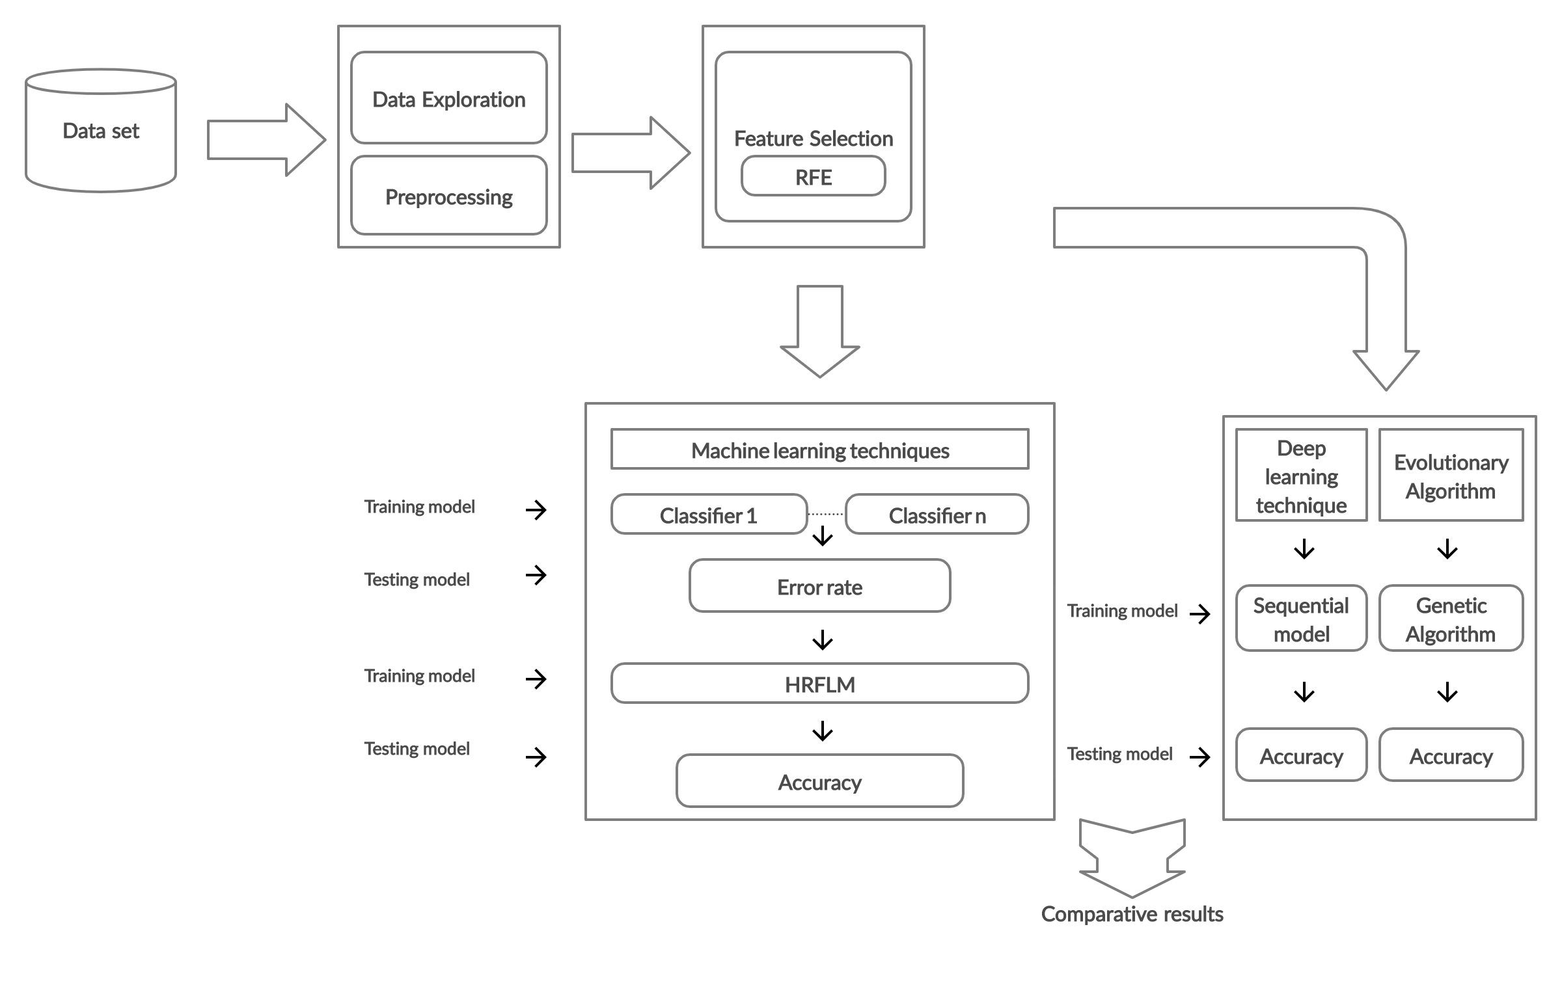
Design
Fig 1 Block Diagram

Slide 11
Proposed System
In this paper, we have combined Random Forest with a Linear model using hybrid technique to perform heart disease classiﬁcation.Since Random Forest and logistic Regression have got least error rate out of all machine learning classifiers applied on dataset.
Tool used is Jupyter notebook to perform heart disease classiﬁcation.
The notebook provides an easy-to-use visual representation of the dataset, working environment and building the predictive analytics.
The datasets used are Cleveland and Framingham which have 303 and 4240 instances respectively.

Slide 12
The project is divided into 3 steps :
Step 1
It involves data loading,preprocessing and feature extraction.
Data loading:
Importing all the necessary packages and then loading the dataset into a dataframe.
Data preprocessing:
Eliminating missing values from data set.

Slide 13
Binary classiﬁcation is done for the target attribute of the given dataset.
Feature Selection and Reduction [4]
Among the 13 attributes of the cleveland data set, two attributes pertaining to age and sex are used to identify the personal information.
The Recursive Feature Elimination (RFE) method is used for feature selection.
It works by recursively removing attributes and building a model on those attributes that remain.
It uses the model accuracy to identify which attributes or combination of attributes contribute the most to predicting the target attribute.

Slide 14
Step 2
Apply all the machine learning classifiers on the datasets :
Naive Bayes:
It is a kind of classifier which uses the Bayes Theorem. It predicts membership probabilities for each class such as the probability that given record or data point belongs to a particular class. The class with the highest probability is considered as the most likely class.
-

Slide 15
Logistic Regression:
It works by predicting the probability that Y belongs to a particular category by first fitting the data to a linear regression model, which is then passed to the sigmoid function
( f(x)=1/1+e^−x), which then outputs a value between 0 and 1 and can be interpreted as the probability. If the probability is above a certain predetermined threshold (P(Yes) > 0.5), then the model will predict Yes.
Decision Tree:
Starting with a dataset, measures the entropy to find a way to split the set until all the data belongs to the same class. There are several approaches to decision trees like ID3, C4.5 and many more.

Slide 16
Random Forest:
This ensemble classiﬁer builds several decision trees and incorporates them to get the best result.It is a learning method that operates by constructing multiple decision trees. The final decision is made based on the majority of the trees and is chosen by the random forest.
Support Vector Machine:
The algorithm creates a line or a hyperplane which separates the data into classes.It gets optimal hyperplane with help of margin.It works for non-linear problems by converting them into higher dimensions.

Slide 17
KNN
K-nearest neighbors (KNN) algorithm uses ‘feature similarity’ to predict the values of new data points which further means that the new data point will be assigned a value based on how closely it matches the points in the training set.
Ensemble method by voting classifier:[6]
It is a machine learning model that trains on an ensemble of numerous models and predicts an output class based on their highest probability of chosen class as the output.It simply aggregates the findings of each classifier passed into it and predicts the output class based on the highest majority of voting.

Slide 18
Boosting Methods :
It converts weak learners to strong learners
Two types -Adaboost and Gradient boosting
It first reads data,assigns weights to observations then it identifies misinterpretation (false prediction).After assigning the false prediction, along with a higher weightage, to the next learner and finally it iterates until it get the correctly classified output. Then for each above models calculate accuracy and error rate.
Both boosting methods working is same except how they identify shortcomings of weak learners. Adaboost uses high weighted data points while Gradient uses loss function.

Slide 19
Step 3
Find accuracy and classification error rate of all classifiers.
Combine models with low error rate.
Hybrid Random Forest with Linear model
The proposed hybrid approach is used combining the characteristics of Random Forest and Linear Method(Logistic Regression).

Slide 20
There are three steps in performing the hybrid technique
Finding out the output probabilities of each model.
With the help of log loss function, finding the optimized weight that perfectly combines the two models which has low classification error rate.
Using the optimized weight from the above step combining the two models with the help of weighted average and then performing the prediction.
Hybrid Random Forest with Linear model proved to be quite accurate in the prediction of heart disease.

Slide 21
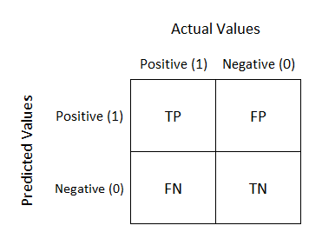
Performance Metrics
We calculated performance of different models using Accuracy, Error rate, Sensitivity, Specificity, Precision , F1_Score with the help of confusion matrix
Confusion Matrix

Slide 22
Accuracy = (TN+TP) / (TN+TP+FN+FP)
Classification Error Rate = 100 - Accuracy or (FN+FP)/(TN+TP+FN+FP)
Recall or Sensitivity = (TP)/(TP+FN)
Specificity = (TN) / (TN + FP)
Precision = (TP)/(TP+FP)
F1_score = (2*Precision*Recall)/(Precision+Recall)

Slide 23
Deep learning:[7]
In this project we used sequential model ,which is a linear stack of layers and added dense layers which are fully connected and then constructed the network architecture of deep learning model.
Genetic Algorithm:[8]
This algorithm reflects the process of natural selection where the fittest individuals are selected for reproduction in order to produce offspring of the next generation.It involves steps of selection,crossover and mutation.

Slide 24
EXECUTION

Slide 25
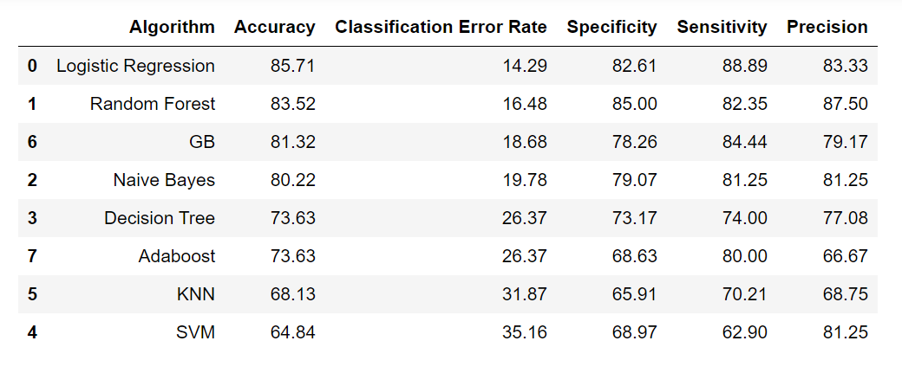
RESULTS
Since we got Logistic Regression and Random Forest with least error rate we combine those 2 models
Table 1 Performance metrics of ML classifiers
Above table shows performance metrics of all ML classifiers applied on cleveland dataset sorted in ascending order of error rate.

Slide 26
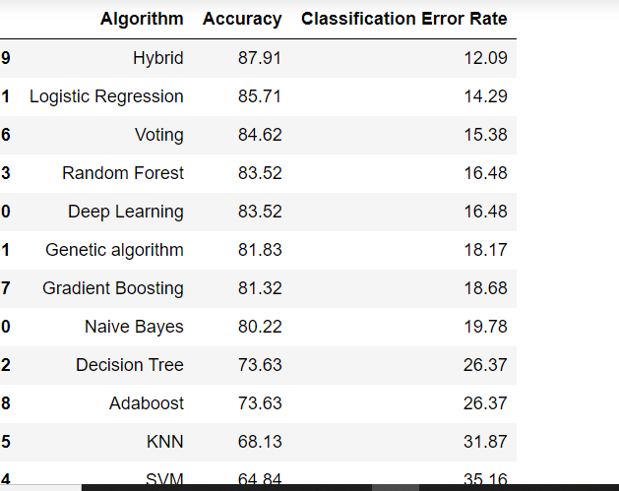
Table 2 shows accuracy and error rate of all algorithms applied on cleveland dataset sorted in ascending order of error rate.
We got HRLFM with highest accuracy of 87.91
Table 2 Results of various models

Slide 27
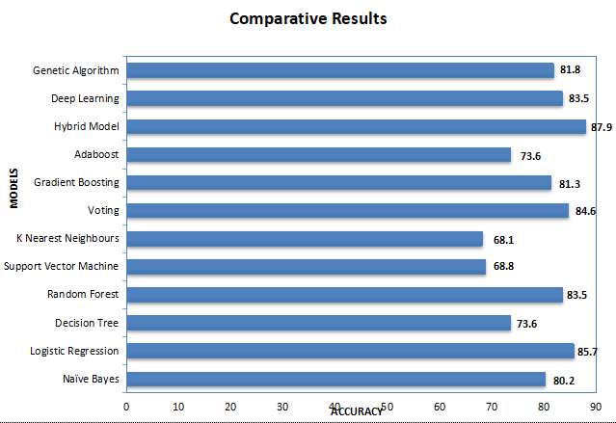
This bar plot shows the accuracy of all models applied on cleveland dataset
Figure 2 bar plot showing accuracy of all models

Slide 28
Conclusion
We would like to limit key features selected in dataset and consider only those features that majorly effect and make the the target/decision making easier to improve the accuracy.
We applied all machine learning classifiers,deep learning model and genetic algorithm on datasets for better accuracy.
By combining two models we got more accuracy than individual model accuracies.

Slide 29
References
[1] M. A. Jabbar , Shirina Samreen , “ Heart disease prediction system based on hidden naïve bayes classifier “ , https://ieeexplore.ieee.org/document/8053261
[2] Abhishek Rairikar, Vedant Kulkarni, Vikas Sabale, Harshavardhan Kale, Anuradha Lamgunde “ Heart disease prediction using data mining techniques”, 2017 International Conference on Intelligent Computing and Control (I2C2), IEEE, Coimbatore, India, March 2017
[3] A.T.Sayad, P. P. Halkarnikar, “Diagnosis of heart disease using neural network approach”, M. Tech, Fourth Semester, Department of Technology, Shivaji University, Kolhapur, India , Volume- 2, Issue-3, July-2014.
[4] “ Feature Selection using RFE “, https://scikit-learn.org/stable/modules/generate/ sklearn.feature_selection.RFE.html

Slide 30
[5] Avinash Golande, Pavan Kumar T, “ Heart Disease Prediction Using Effective Machine Learning Techniques “, International Journal of Recent Technology and Engineering (IJRTE), ISSN: 2277-3878, Volume-8, Issue-1S4, June 2019
[6] “Ensemble Voting Classifier”, https://scikit-learn.org/stable/modules/generated/ sklearn.ensemble.VotingClassifier.html
[7] Eijaz Allibhai, “ Deep learning model using Keras ” https://towardsdatascience.com/ building-a-deep-learning-model-using-keras-1548ca149d37
[8] “Genetic Algorithm in machine learning”, https://dkopczyk.quantee.co.uk/genetic- algorithm/

Slide 31
Questions??

Slide 32
Thank you

