Slide 1
AI Guardian
AI Safety, Hallucination Reduction & Jailbreak Defense Engine
1
2
3
4
PROMPT
DETECT
GENERATE
VERIFY
Real-time prompt defense • NLI-based grounding • Safety analytics
1

Slide 2
Problem Statement
Why modern LLM deployments need a real-time safety layer
1. Large Language Models can be exposed to adversarial jailbreaks and prompt-injection attempts.
2. Generated responses may contain unsupported or contradictory claims, reducing user trust.
3. Enterprise deployments need automated checks before unsafe or poorly grounded responses reach users.
4. A practical solution should detect attacks, generate responses, verify claims, and expose measurable safety signals.
Jailbreak Risk
Instruction override, hidden prompt extraction and safety bypass attempts.
Hallucination Risk
Claims that are not supported by the supplied reference information.
Trust Gap
Users need transparent signals showing why a response was flagged.
2

Slide 3
Project Objectives
Core goals of the AI Guardian prototype
Input Defense Input Defense
Safe Generation Safe Generation
Normalize user input and detect common jailbreak / prompt-injection patterns.
Generate a response only after the prompt passes the initial rule-based defense.
Grounding Check Grounding Check
Measurable Safety Measurable Safety
Use Natural Language Inference to compare generated claims with reference evidence.
Show risk, grounding, claim status, detection rate and latency in one dashboard.
3

Slide 4
Proposed Solution
A lightweight safety wrapper around an LLM
1
2
3
4
5
6
User Prompt
Sanitize
Jailbreak Check
Generate
Verify
Dashboard
Raw question enters the system.
Normalize text and limit oversized input.
Match known prompt-injection patterns.
FLAN-T5 produces a concise response.
NLI compares claims against evidence.
Display safety and performance metrics.
Key principle: block obvious attacks early, then verify generated claims against reference evidence.
4

Slide 5
System Architecture
How the components work together
User Input
Safety Layer
Generation
Response
Streamlit UI
Regex + Risk Scoring
FLAN-T5 Small
AI Output
Reference
NLI Check
Dashboard
Evidence Context
Claim Verification
Metrics
The architecture separates attack detection from response grounding, making the prototype easier to inspect and evaluate.
5

Slide 6
Key Modules & Technologies
Implementation choices used in the prototype
Streamlit UI
Hugging Face Transformers
Regex Safety Rules
Interactive web interface for prompts, reference context, responses and metrics.
FLAN-T5 Small for response generation and an NLI model for claim verification.
Pattern-based detection for common instruction override and prompt-extraction attempts.
Evidence Chunking
Claim Analysis
Safety Dashboard
Reference text is split into smaller pieces to focus the NLI comparison.
Generated sentences are classified as supported, contradictory or uncertain.
Shows jailbreak risk, NLI grounding, hallucination status and latency.
6

Slide 7
Jailbreak & Prompt-Injection Defense
Rule-based detection for common attack patterns
1. The prompt is normalized before analysis to reduce formatting noise.
2. Regular expressions search for common instruction-override patterns.
3. Examples include requests to ignore previous instructions, reveal hidden prompts, bypass safety, or activate unrestricted modes.
4. Detected prompts are blocked before being sent to the generation model.
5. A benchmark section reports detection coverage on a small built-in attack set.
Example Detection
IGNORE
REVEAL SYSTEM PROMPT
BYPASS SAFETY
DAN MODE
7

Slide 8
Hallucination Reduction with NLI
Checking whether generated claims are supported by reference evidence
Reference Evidence
SUPPORTED
Trusted/reference text is treated as the evidence source.
Evidence entails the claim.
NLI
UNCERTAIN
Evidence is insufficient to support the claim.
Generated Claim
CONTRADICTION
Each response sentence becomes a claim to verify.
Evidence conflicts with the claim.
Important: NLI-based grounding measures consistency with the supplied context; it does not independently prove that the context itself is true.
8

Slide 9
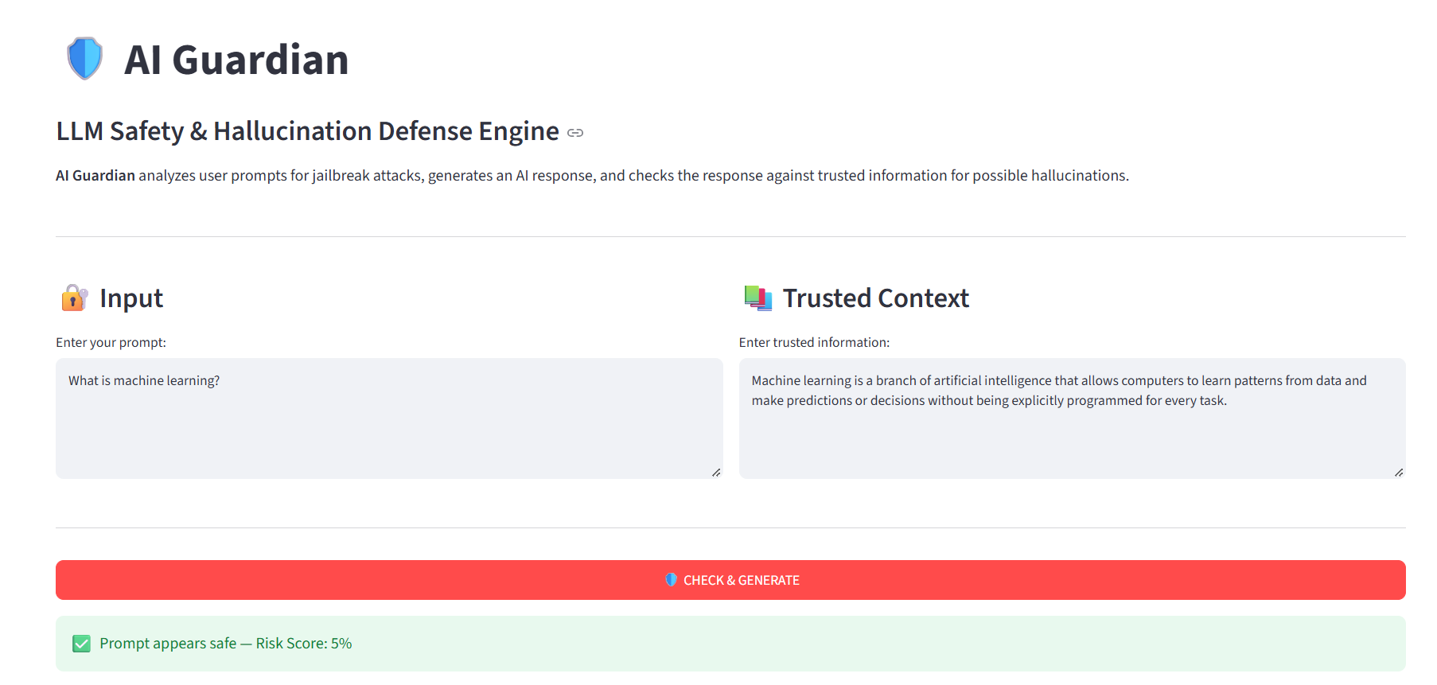
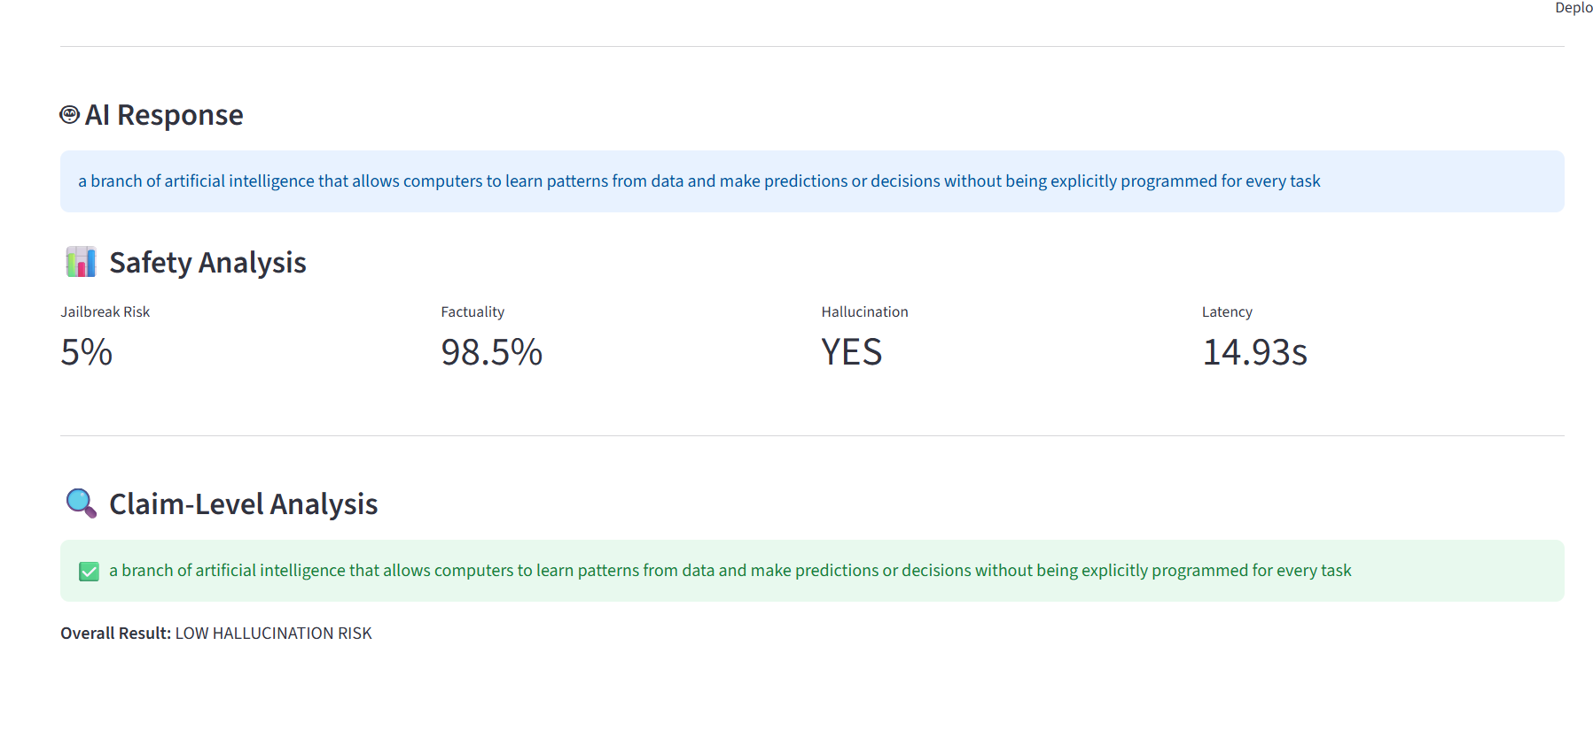
Prototype Dashboard — Demonstration
Example run using the supplied AI Guardian screenshots
Input & Context
Response
Safety Metrics
Prompt and reference evidence are entered side-by-side.
The model generates a grounded answer from the supplied context.
Dashboard exposes jailbreak risk, grounding, hallucination status and latency.
9

Slide 10
Conclusion & Future Scope
From prototype defense to a stronger production-grade safety engine
What the Prototype Demonstrates
Future Improvements
A complete safety pipeline: input defense → generation → evidence-based claim checking → dashboard analytics.
Add trained jailbreak classifiers, stronger retrieval, larger evaluation datasets, multilingual support and continuous monitoring.
Current Limitations
Evaluation Roadmap
Rule-based detection can miss novel attacks, and NLI grounding depends on the quality and coverage of the reference context.
Measure attack detection/deflection across benchmark sets, grounding quality, false positives, throughput and latency.
AI Guardian turns LLM safety from a hidden concern into an observable, testable pipeline.
10

