Slide 1
Introduction
How is speech recognition done?
Hidden Markov model(HMM)
Deep Neural Networks(DNN)
Convolution Neural Networks(CNN)

Slide 2
Deep Neural Networks
A deep neural network (DNN) is an artificial neural network(ANN) with multiple hidden layers between the input and output layers.
DNNs can model complex non-linear relationships.
The first (bottom) layer of the DNN is the input layer and the topmost layer is the output layer

Slide 3
Convolutional Neural Network
a convolutional neural network (CNN) is a class of deep, feed-forward artificial neural networks.
CNNs use relatively little pre-processing compared to other image classification algorithms. This means that the network learns the filters.
This independence from prior knowledge and human effort in feature design is a major advantage.

Slide 4
CNN layers
Pooling
Connectivity
Weight sharing

Slide 5
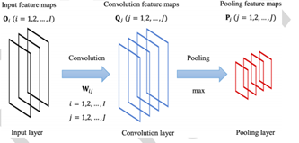
CNN Layers

Slide 6
Pooling-
combines the outputs of neuron clusters at one layer into a single neuron in the next layer.The purpose of the pooling ply is to reduce the resolution of feature maps.
Connectivity-
Fully connected layers connect every neuron in one layer to every neuron in another layer.
Weight sharing-
CNNs share weights in convolutional layers, which means that the same filter is used for each receptive field in the layer; this reduces memory footprint and improves performance

Slide 7
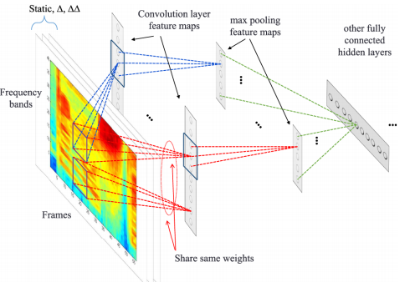
Regular CNN that uses so-called full weight sharing .

Slide 8
Benefits of CNN
Locality in the units of the convolution ply allows more robustness .
locality reduces the number of network weights to be learned.
Weight sharing can improve model robustness and reduce over fitting .
Pooling is helpful in handling small frequency shifts that are common in speech signals

