Slide 1
Loan Default Prediction

Slide 2
Introduction
One of the application industry of Data Science is in Financial Sector
Banking has improved its analysis for determining the likelihood of risk using factors including client profiling, historical purchases, and transactional activity.
Every day, several loan applications are sent to banks. The primary asset used by banks to increase their profitability is a loan.
We would be using the client’s demographic ( do they own a car? , do they own a house?, what’s the family status, how many kids they have?) to determine, if a loan is granted then they would be a repayer or a defaulter.

Slide 3
Data Cleaning

Slide 4
Data Cleaning
Check total Missing Values
Eliminate columns having more than 50% of missing data
Check Outliers
Check if remaining columns have any missing values.
Check Negative Values
Check which numeric columns may have negative mean
Check unknown values for categorical data
Check if any existing columns have unknown values
Check for outliers
Replace both with mean/median
Replace it with the mode of the column providing it doesn’t add bias to the dataset
Change their values to absolute values

Slide 5
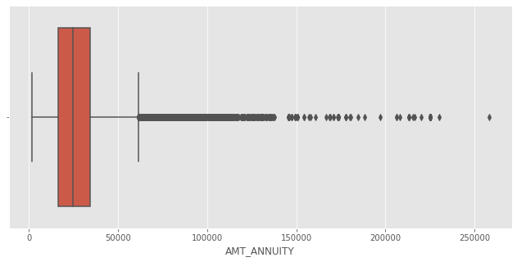
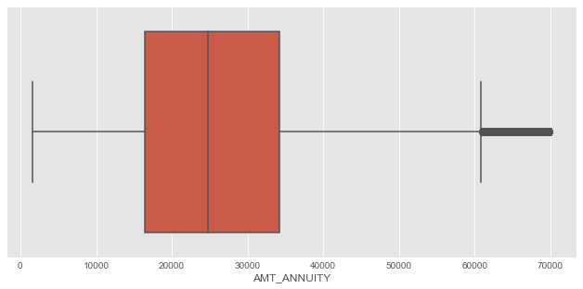
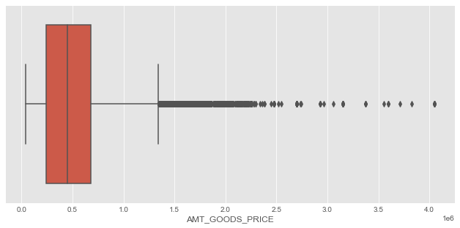
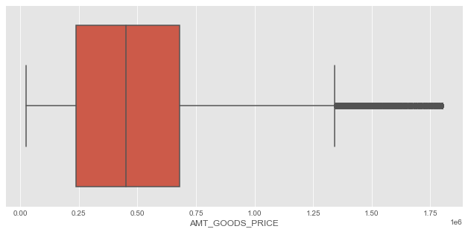
Outliers - Example

Slide 6
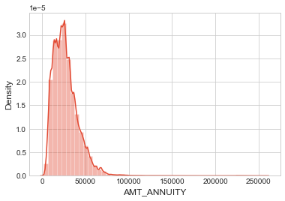
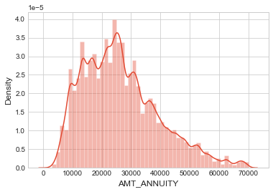
Skew - Example

Slide 7
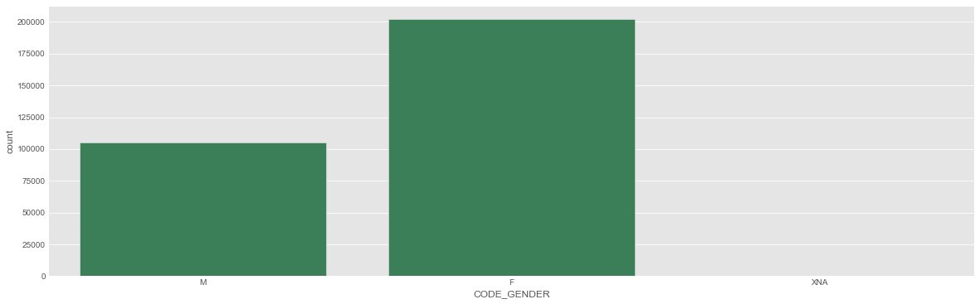
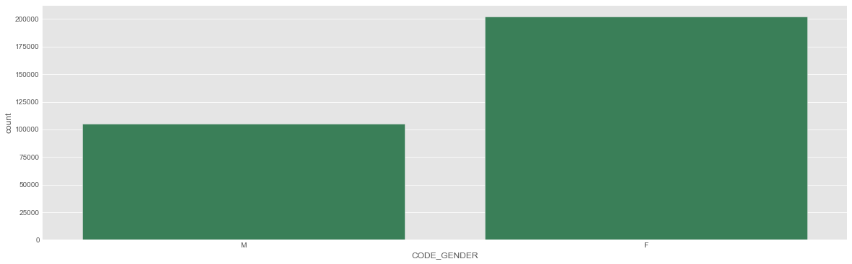
Unknown Values - Example

Slide 8
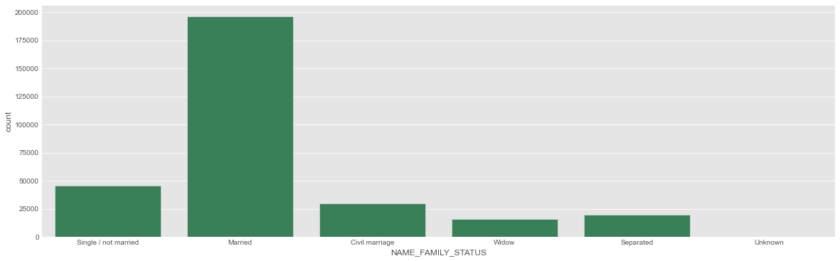
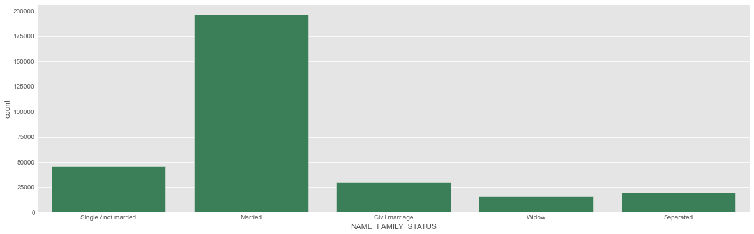
Unknown Values - Example

Slide 9
Data Manipulation
Used get_dummies()
It converts each unique element present in the object to a column heading.
The function iterates over the object that is passed and checks if the element at the particular index matches the column heading.
If it does, it encodes it as a1.
Otherwise, it assigns it as a 0.
Manipulated total of 8.66% of the categorical data

Slide 10
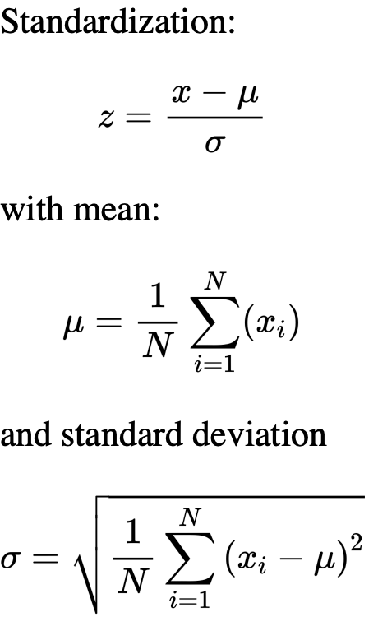
Standard Scalar
Used StandardScaler()
Variables that are measured at different scales do not contribute equally to the model fitting & model learned function and might end up creating a bias
The main idea is o normalize/standardize features of , individually, before applying any machine learning model

Slide 11
Implementation

Slide 12
Models
Gaussian Naive Bayes
Assumes that the data follows gaussian distribution
Based on Bayes Theorem
SVM
Each data item is plotted as a point in n-dimensional space
n here is the value of each feature
KNN
KNN identifies nearest neighbor by proximity (example: Euclidean distance) and assigns the label of the neighbor to the data point in consideration
Parsing of Data
Learning from Data
Making informed Decision

Slide 13
Models Performance
Gaussian Naïve Bayes
Train Accuracy :
70.34%
Test Accuracy:
68.88%
SVM
Train Accuracy:
91.14%
Test Accuracy:
92.12%
KNN
Train Accuracy:
91.55%
Test Accuracy:
91.54%
Parsing of Data
Learning from Data
Making informed Decision

Slide 14
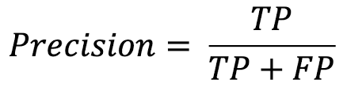
Models Precision
Gaussian Naïve Bayes
Train Precision:
0.72
Test Precision:
0.70
SVM
Train Precision:
1.0
Test Precision:
1.0
KNN
Train Precision:
0.99
Test Precision:
0.99
Parsing of Data
Learning from Data
Making informed Decision

Slide 15
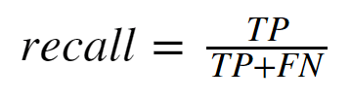
Models Recall
Gaussian Naïve Bayes
Train Recall:
0.93
Test Recall:
0.94
SVM
Train Recall:
1.0
Test Recall:
0.91
KNN
Train Recall:
0.99
Test
Recall:
0.99
Parsing of Data
Learning from Data
Making informed Decision

Slide 16
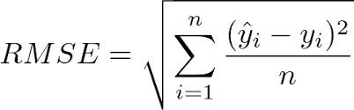
Models RMSE
Gaussian Naïve Bayes
RMSE:
0.55
SVM
RMSE:
0.28
KNN
RMSE:
0.29
Parsing of Data
Learning from Data
Making informed Decision

Slide 17
Conclusion
Amongst the three models Naïve Bayes gives a prediction with lower accuracy percent for test and train while Support Vector Machine and K-Nearest Neighbor are comparable.
The accuracy for training dataset using SVM was 91.14% while for KNN was 91.55%. Hence, KNN proved to provide slight better accuracy than SVM.
On the contrary, accuracy for testing dataset using SVM was 92.12% while for KNN was 91.54% .Hence, SVM proved to provide slight better accuracy than KNN.
While determining the Precision and Recall, SVM had a better score than KNN and the root mean square error of SVM was also better than KNN.
Hence, even though SVM and KNN are closely comparable, we consider SVM as a better algorithm for the project and dataset considering all matrices.

Slide 18
Thank You

