Slide 1
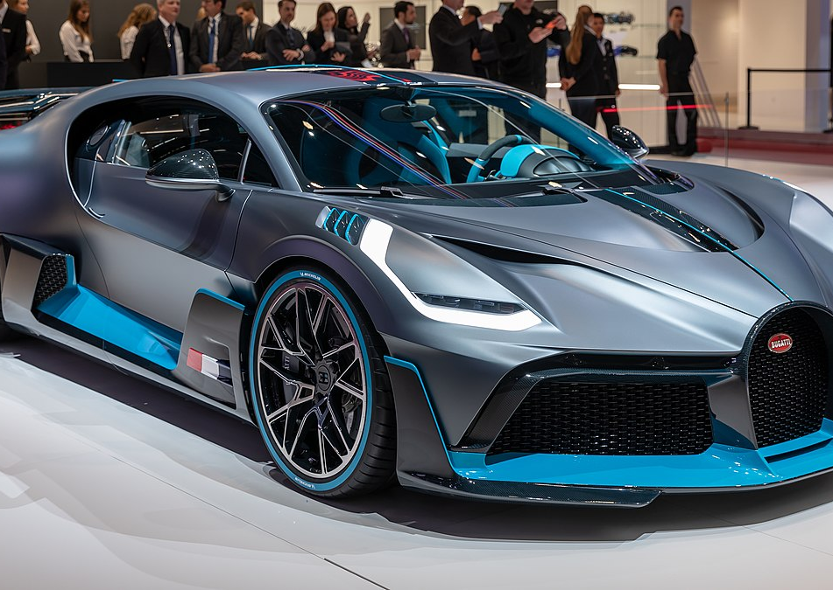
Car Price Prediction
Shivani Singh
UNI id: ss6973

Slide 2
Step by step workflow diagram
Stage 7
ML models comparison: Regression,
Random Forest, XG Boost
Stage 5
Feature Selection
features such as 'length_inches', 'engine_displacement', 'maximum_seating', 'wheelbase_inches', 'horsepower', and 'fuel_tank_volume_gallons' were important predictor variables for the models
Stage 3
Exploratory data Analysis
Correlated independent variables >0.7 dropped to avoid multicollinearity
Stage 1
Data Exploration
19 numerical columns
25 categorical columns
07
05
03
01
08
06
Stage 8
Hyperparameter Tuning
to improve model RMSE
Best RMSE from Random forest : 2,865.87
04
Stage 6
Train-test Split
80:20
02
Stage 4
Feature engineering and Label Encodings
Extracted month from 'listed_date.'
Processed 'power' and 'torque' columns
Categorical data target encoded and Boolean data into 1 and 0
Stage 2
Data Preprocessing
Missing data imputation-median
Columns >45% missing values dropped

Slide 3
Areas for improvement
1
Utilizing Free Text - 'Description' Column:
Could utilize “description column” using NLP techniques on the text reviews data
01
Check Target variable skewness and Improved data preprocessing
2
02
Linear Regression is sensitive to outliers; price is positively skewed; Skewness can affect coefficients
There were a lot of columns which had >40% missing values which was dropped, could better preprocess it and retain them
3
Improve Hyper parameter Tuning
03
Could have helped in optimally balancing the overfit and underfit
Learning rate adjustment for XG Boost
Tuning tree specific parameters like max-depth, child weight
04
Cross Validation
4
5
Additional Ensemble Methods:
05
Can use k-fold cross validation techniques for model selection
Cross Validation could also help in decreasing the test error by avoiding chances of overfitting
One idea is to build multiple bagging models on different subsets of training data(bootstrap samples) and then aggregate the predictions

Slide 4
THANK YOU

