Slide 1
PROJECT TITLE
“RESTAURANT MANAGEMENT SYSTEM”
SUBMITTED BY:SHIVANI GOEL(CS-A)
ROLL NO:1803210140
SUBMITTED TO:MR.PRIYANSH &MR.ROHIT
RASTOGI

Slide 2
MOTIVATION
Primarily, the motivation for doing this project is the interest to develop something in an interesting area of research. Also, the teachers motivated me to do a project by our own so as to get more knowledge regarding the language we are working on . The results that we have achieved after doing the project has surely improved our knowledge and motivated us to do more research on the project to make it more better and reliable.

Slide 3
PROJECT OBJECTIVE:
1-The system is designed to handle all the primary information and calculate the information about administration as well as customer.
2-This project is made more friendly as it is easy to handle in various activities such as record updating , maintenance and searching.
3-The searching of the record has been made quite simple as any of the detail can be obtain by simple keying the identification of the given record.

Slide 4
Scope Of The Project:
1-This project will help the management to know about customers order details.
2-This will allow administration to know about its its employees .
3-This project will deduce the time and labour work.
4-This will help in generating financial statements fast and accurately.
5-This will help in accessing data whenever.
6-Help in providing efficient staff management.

Slide 5
Software and Hardware Requirements
SERVER:
Processor : intel core i3
Speed : 1.7 GHz Memory
Capacity : 4 GB
SOFWARE:
Operating System : Windows 10
Programming Language : C
Editor : Code blocks

Slide 6
Proposed Methods
Algorithm
First, make the main menu which has three options i.e administration ,customer then exit.
Then if enter 1 for administration , there will be six choices.
Choices are add the new record , search the record ,delete record ,view record ,view previous order placed.
This administration function will help to calculate all the records and the orders placed.
If enter 2 for customer ,there will be three choices .
Choices are vegetarian, non vegetarian .
If you will press enter 4 …EXIT.

Slide 7
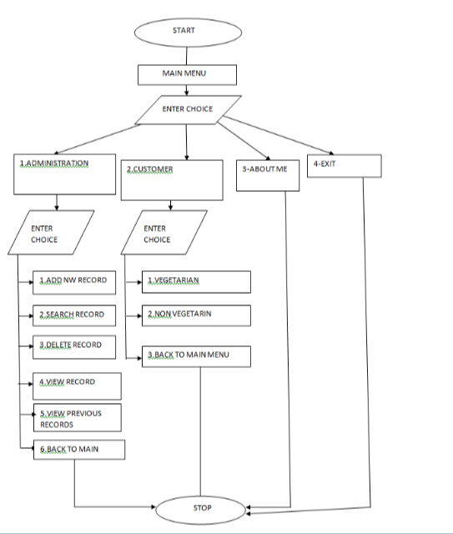
Flow Diagram

Slide 8
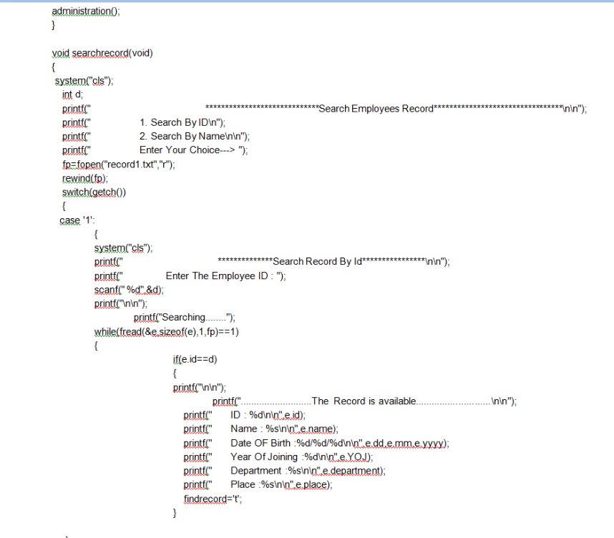
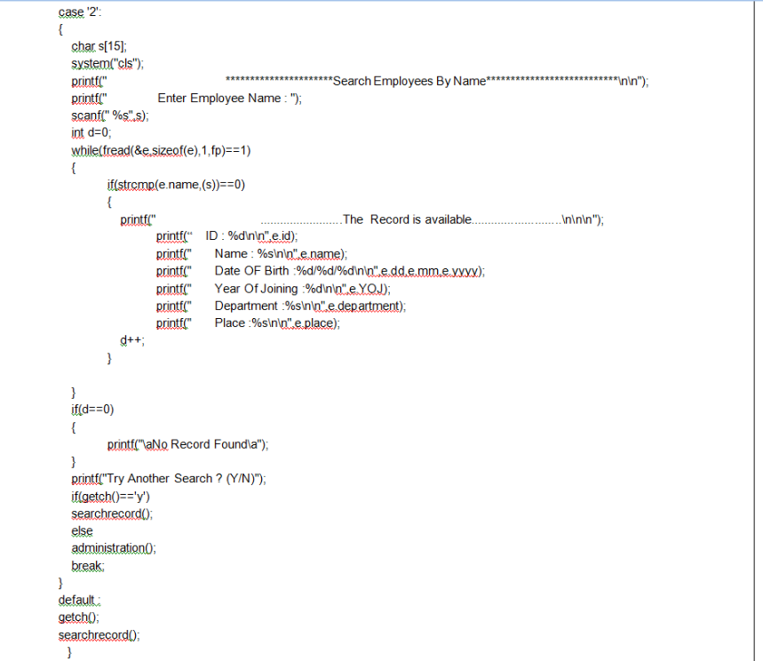
Code:

Slide 9
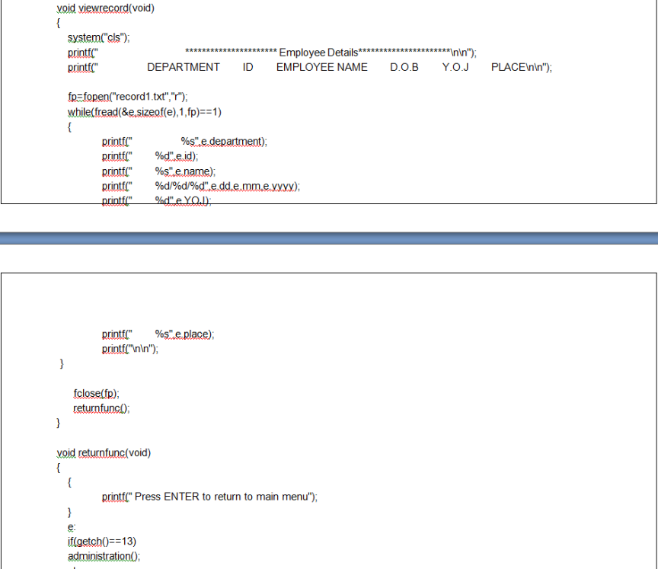

Slide 10
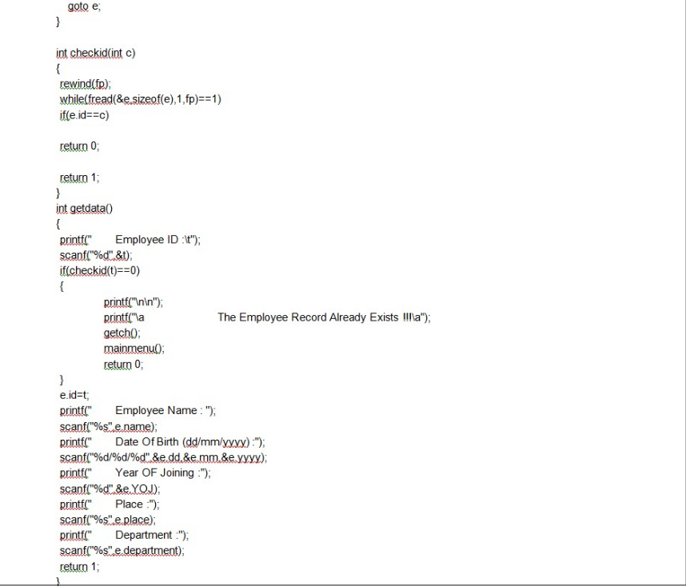

Slide 11
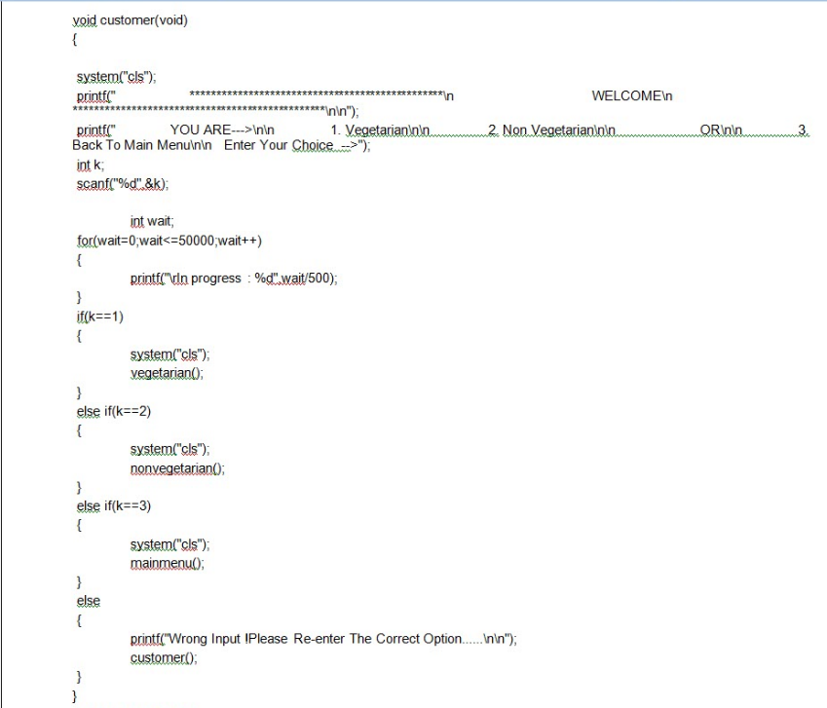

Slide 12
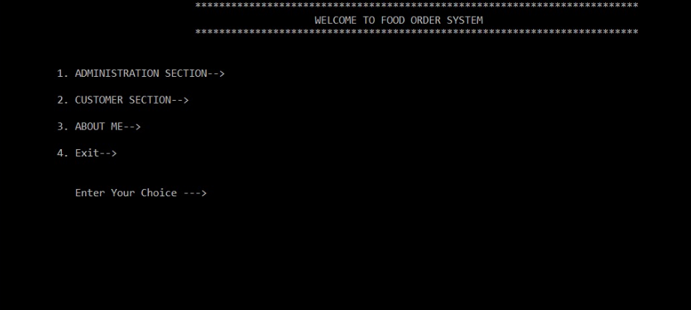
Deliverables

Slide 13
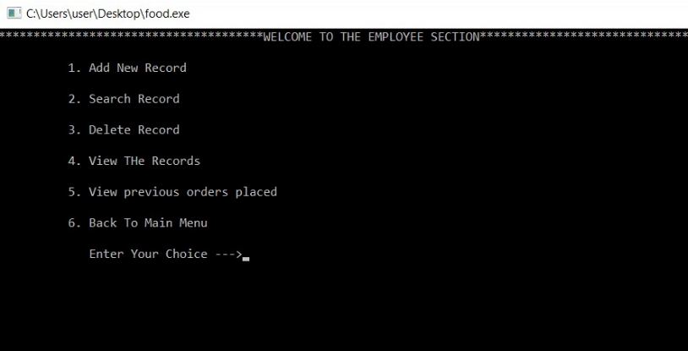

Slide 14
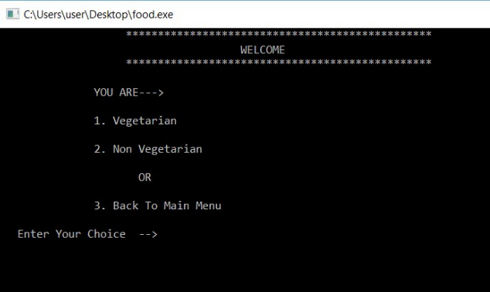

Slide 15
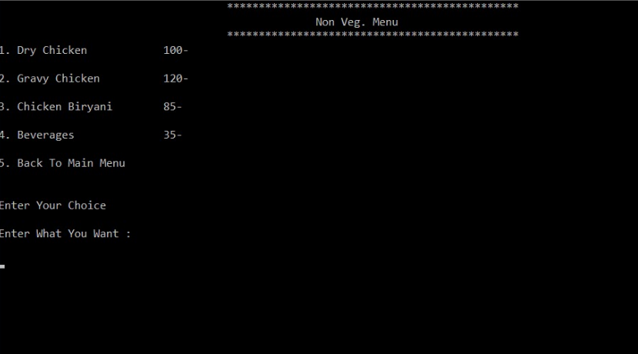

Slide 16
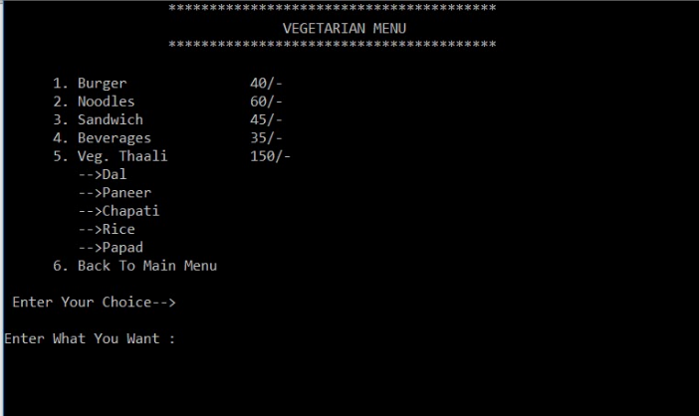

Slide 17
Stakeholders
Administration
customer
vegetarian
Non-vegetarian

Slide 18
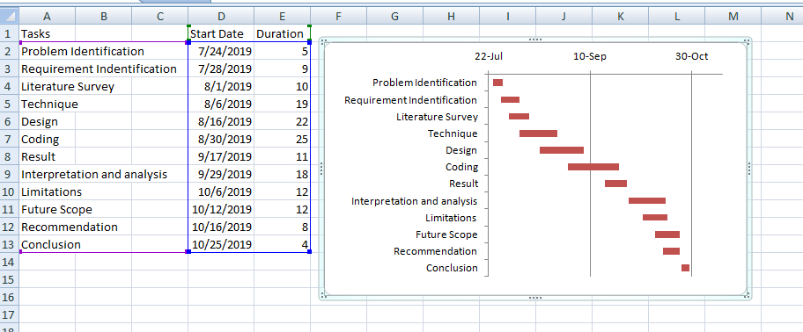
Gantt Chart

Slide 19
References
https://www.geeksforgeeks.orghtt
https://www.ibm.com/support/knowledgecenter/en/ssw_ibm_i_73/dm/rbal3cpyfcmds.htm

