Slide 1
IIT-MADRAS BUSINESS DATA MANAGEMENT
CAPSTONE PROJECT
Case Study of “kamal grocery store”
(GrocerAnalytics: Grocery Insights Deep Dive)
By: Shivani Gupta 22f2000957
(22f2000957@ds.study.iitm.ac.in)

Slide 2
CONTENTS
Executive Summary
Introduction to Business
Data Collection & Cleaning
Data collection & cleaning steps
Data Analysis
Analysis done in respect to the challenges
Findings
Recommendations
Important Insights about business
Solutions / Recommendations for business

Slide 3
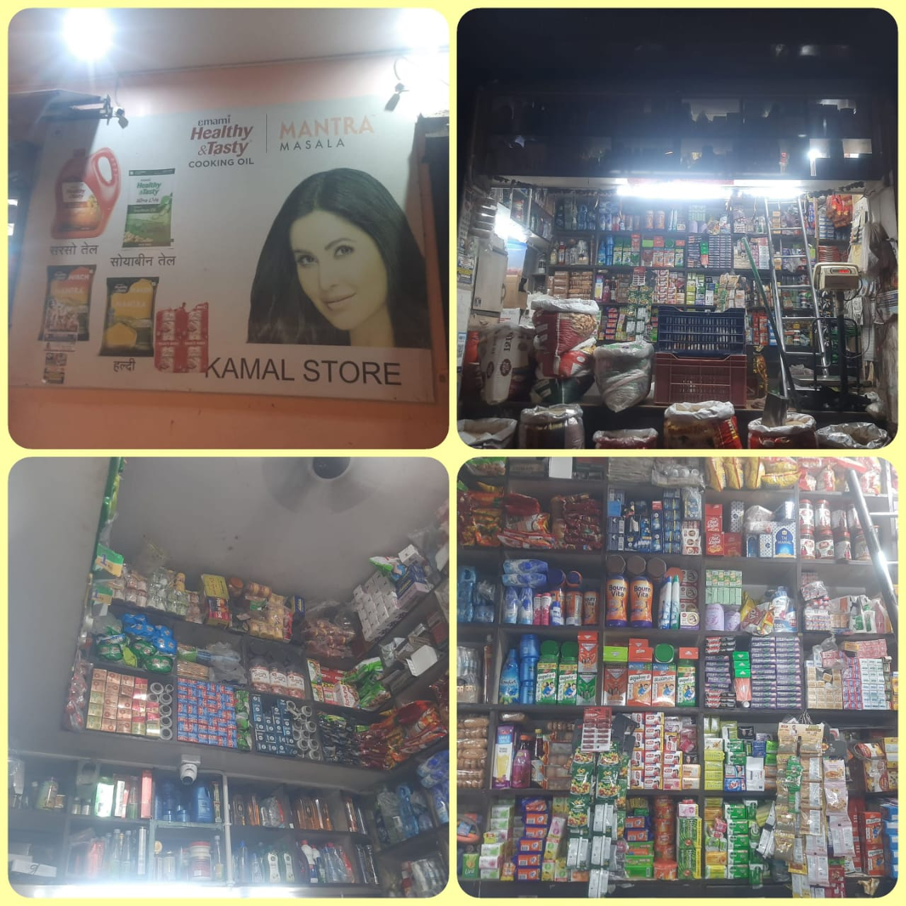
Introduction to Business
The business from where I collected data is a medium-sized retailer grocery shop, started by “Mr. Kamal Gupta” in early 2014
The business deals primarily in grocery products such as Atta, Dal, Rice, Sugar, Nuts, Masala, Besan, Elaichi and many more
Unfortunately, the shop has been facing challenges in terms of Profit, Sales & Inventory Management

Slide 4
Data Collection and Cleaning
I collected data from a bill book and previous records, but since it's from an unorganized business, the data is in an unorganized manner.
I extracted data for 15 products from a long list
The collected data for analysis was “Primary data”, mostly in an informal way, as it was from an unorganized business
To clean the data, I used an Excel spreadsheet. Additionally, I used Excel for all my data manipulation and analysis

Slide 5
Data Analysis - Sales
Average Daily Revenue | ₹ 25,846
Std. Deviation | ₹1327.74
Min Revenue | ₹23,443
Max Revenue | ₹29,018
Range | ₹5,575
Chakki Atta, Cooking Oil, Ghee, Refined, Raw Rice, Makhana, Arhar Dal, Chole & Cashew contribute approx. 80% to total revenue
Chakki Atta, Cooking Oil & Ghee are the main revenue generating SKU’s

Slide 6
Data Analysis - Purchases
Elaichi and Sela Rice are significantly lower in price, indicating these might be budget or niche products with different market dynamics.
Ghee and Makhana shows a significant increase in its purchase price, indicating potential seasonal demand or supply constraints or premium product with high production costs or demand.
Other SKUs, such as Moong Dal and Arhar Dal, show minor price fluctuations, indicating possible market variability or supply chain adjustments.
The purchase volume remains consistent at 60 units throughout the observed period, despite the increase in purchase price from ₹420 to ₹470.
There is no consistent pattern of buying behaviour.

Slide 7
Data Analysis – Profit/Loss
Ghee, Makhana & Cashew are the SKU’s that holds maximum profit generating capacity
Ghee (5%), Makhana (10%) & Cashew (6%) profit margin % needs to be improved to maximize its Net Profit
Makhana, Ghee, Cooking Oil, Cashew, Urad Dal, Chole & Arhar Dal contribute approx. 80% to total profit

Slide 8
Data Analysis – Inventory
Raw Rice, Sela Rice, Moong Dal, Cooking Oil, and Elaichi have stock levels significantly higher than their average sales, indicating potential overstocking.
ABNORMALITIES !!
Yes, the owner’s claim of inventory overstock is correct.

Slide 9
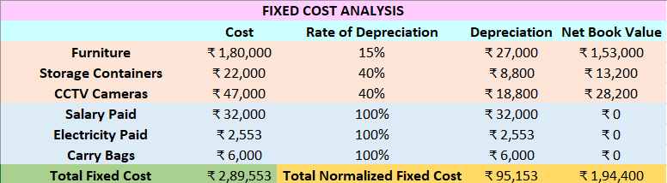
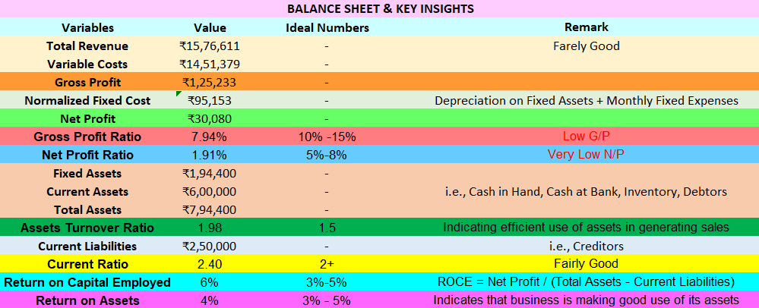
Findings – P/L & Insights

Slide 10
Solutions / Recommendations
Solutions to tackle with the business challenges
Increase sales of High-Profit items (e.g., Ghee, Cashew & Makhana)
Implement Effective Pricing Strategies
Optimize Financial Health
Adjust Inventory Re-order Level Before High Sales Periods
Optimize Inventory Levels (e.g., Raw Rice, Sela Rice, Moong Dal, Cooking Oil & Elaichi)
Enhance Shop Display & Visual Merchandising
THANKYOU

