Slide 1
Water Quality Prediction
P188-Group 5

Slide 2
Group Members
Abhishek Kumar Sahu Ere
Chittaluri Karthik
Shaik Nusrath
Karnati Sree Vaishnav
Shivani Suresh Guttipratiwar
Mekala Venkatesh

Slide 3
Objective
Access to safe drinking-water is essential to health, a basic human right and a component of effective policy for health protection. This is important as a health and development issue at a national, regional and local level. In some regions, it has been shown that investments in water supply and sanitation an yield a net economic benefit, since the reductions in adverse health effects and health care costs outweigh the costs of undertaking the interventions.

Slide 4
Technologies used
Python
Pandas
Matplotlib
Sea-born
Scikit-learn
Scipy

Slide 5
About Dataset
pH value
Hardness
Solids
Chloramines
Sulfate
Conductivity
Organic_carbon
Trihalomethanes
Turbidity
Potability

Slide 6
Procedure

Slide 7
Implementing with more parameters selection
Future Selection,
Fitting the model
Loading the dataset
Imputation
EDA
Future selection
Implementing Hyper-parametrs
output
Load data
Model Validation
Null places detection
Outliers handlings
plots,graphs
LogisticRegression(), DecisionTreeClassifier(), GaussianNB(), RandomForestClassifier(),
svm.LinearSVC(),
XGBClassifier()
Higher accuracy

Slide 8
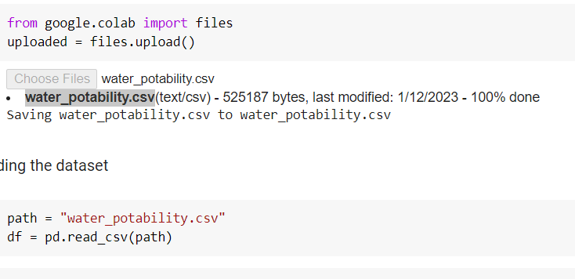
Load Data
Load the data set using Google colab

Slide 9
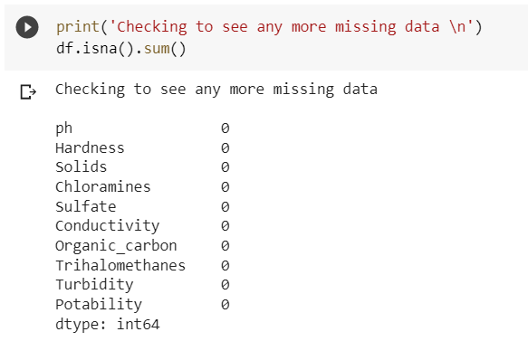
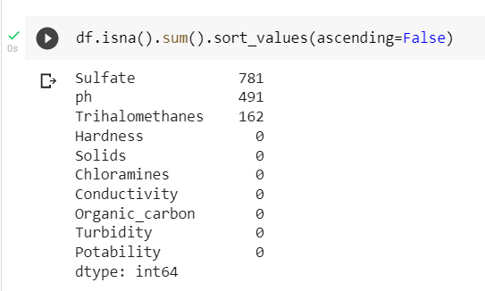
Imputation
Checking null values and cleaning them by removing
After Imputation

Slide 10
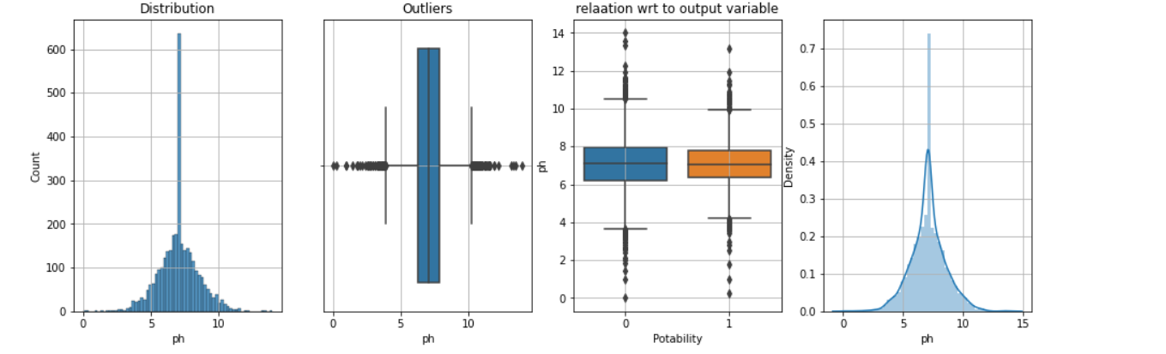
EDA-Exploratory Data Analysis
Box plot
Pie Chart
Histogram
Skewness

Slide 11
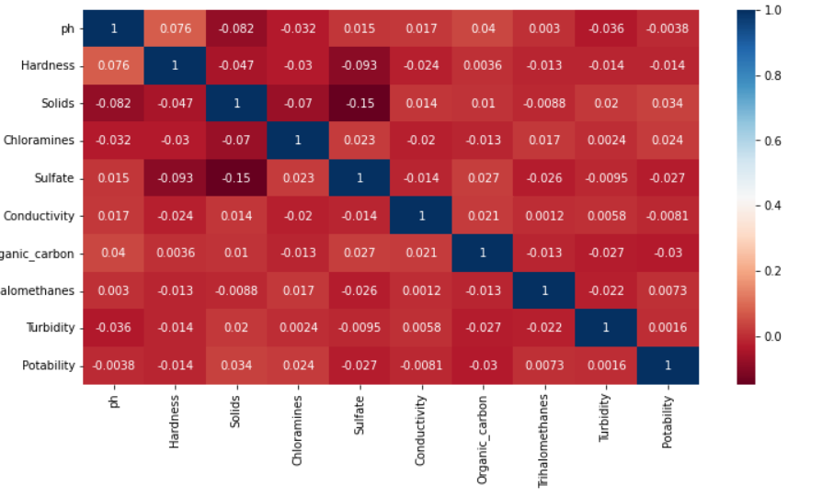
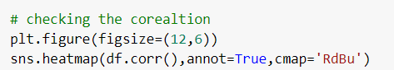
Correlation
It can extract key problems from a given set of features, which can later cause significant damage during the fitting model.
Heatmap:
A heat map represents these coefficients to visualize the strength of correlation among variables.

Slide 12
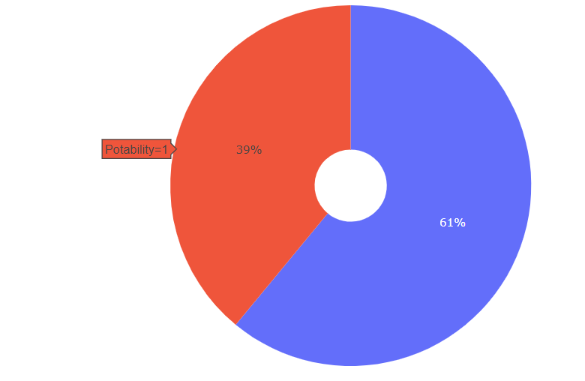
Pie Chart
Pie charts can be used to show percentages
of a whole, and represents percentages at a set point in time

Slide 13
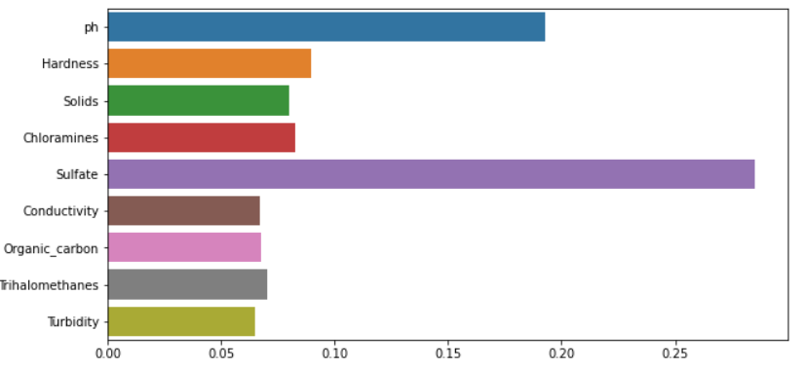
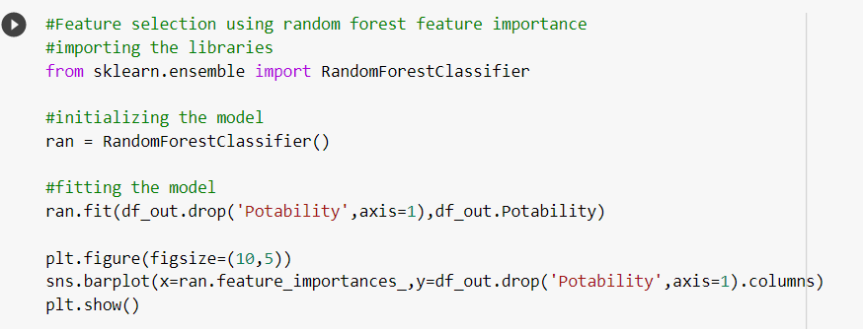
Future Selection
Fitting the Model With Various Technologies

Slide 14
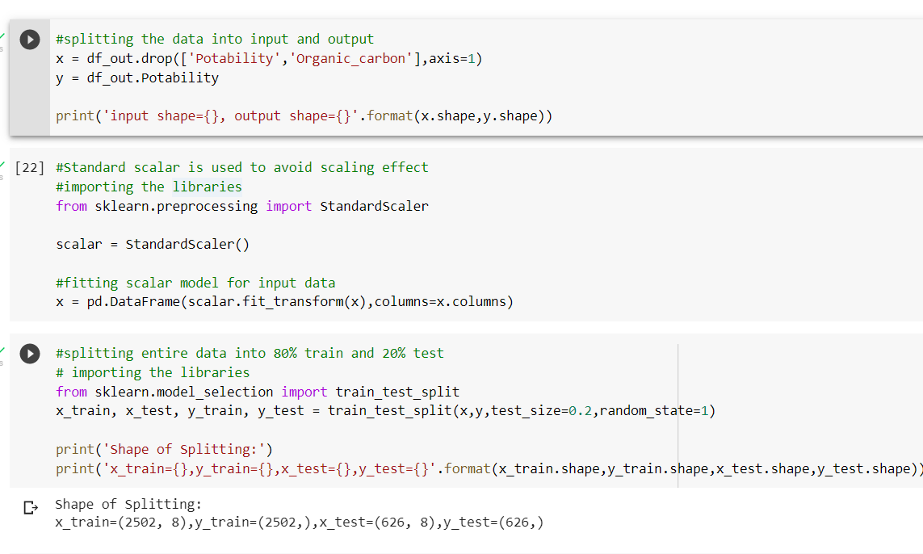
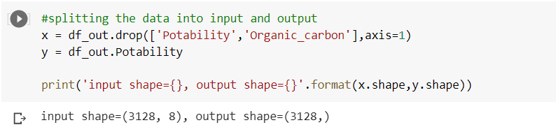
Splitting Data

Slide 15
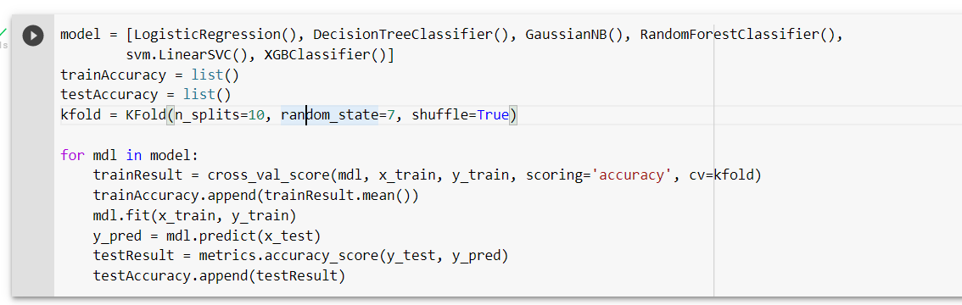
Model Selection
LogisticRegression()
DecisionTreeClassifier()
GaussianNB()
RandomForestClassifier()
svm.LinearSVC()
XGBClassifier()

Slide 16
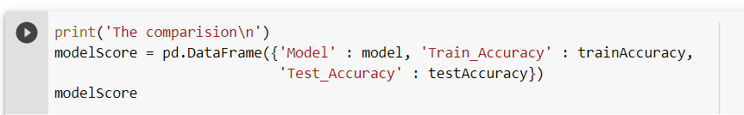
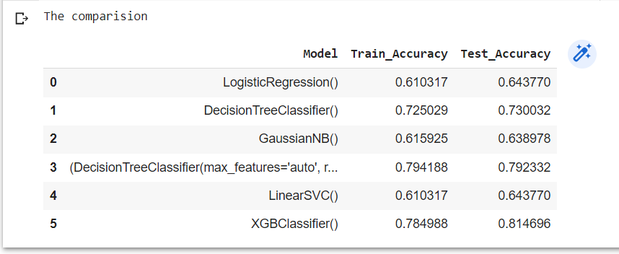
Model Output

Slide 17
Output
S.no | Train_Accuracy | Test_Accuracy | Model
1 | LogisticRegression() | 0.610317 | 0.643770
2 | DecisionTreeClassifier() | 0.725029 | 0.730032
3 | GaussianNB() | 0.615925 | 0.638978
4 | Random forest classifier()r | 0.794188 | 0.792332
5 | LinearSVC() | 0.610317 | 0.643770
6 | XGBClassifier() | 0.784988 | 0.814696

Slide 18
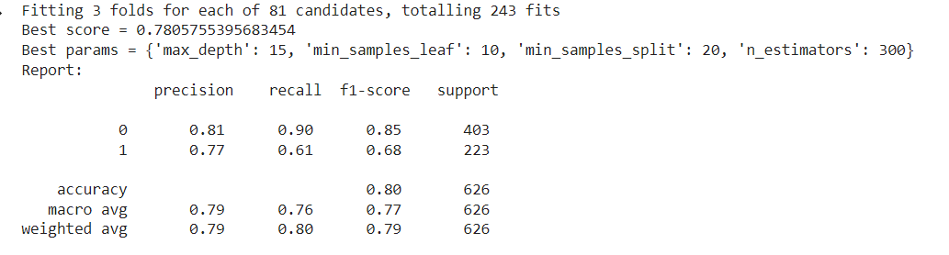
Hyper-Parameters
Parameters for Random forest classifier:
'max_depth':[15,20,25],
'min_samples_leaf':[10,20,30],
'min_samples_split':[10,20,30],
'n_estimators' : [200,250,300]

Slide 19
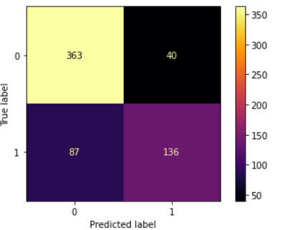
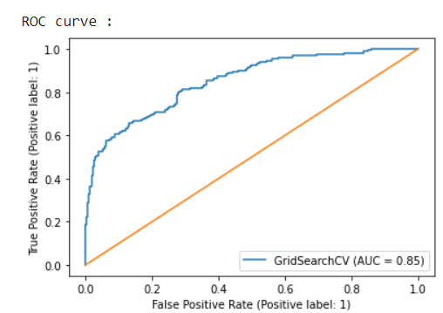
Confusion matrix:
Roc Curve:
accuracy score of the model: 0.7971246006389776

Slide 20
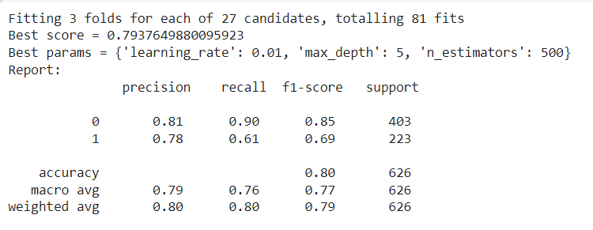
Parameters for XGB classifier:
'max_depth':[5,10,15],
'learning_rate':[0.001,0.01,0.1],
'n_estimators':[350,400,500

Slide 21
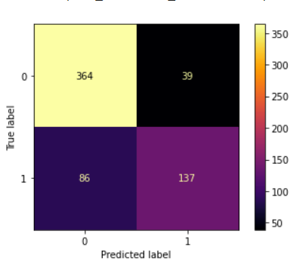
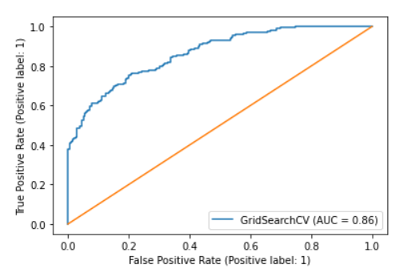
Confusion matrix:
ROC curve:
accuracy score of the model: 0.8003194888178914

Slide 22
Best Model
Random Forest classifier:
Accuracy :79.71%
XGB classifier:
Accuracy:80.03%
The Best Model to fit the data is XGB classifier

Slide 23
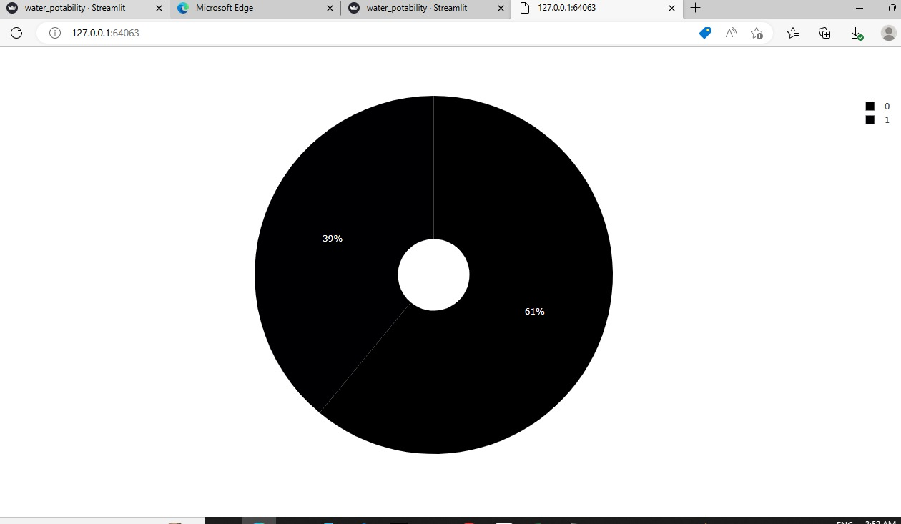
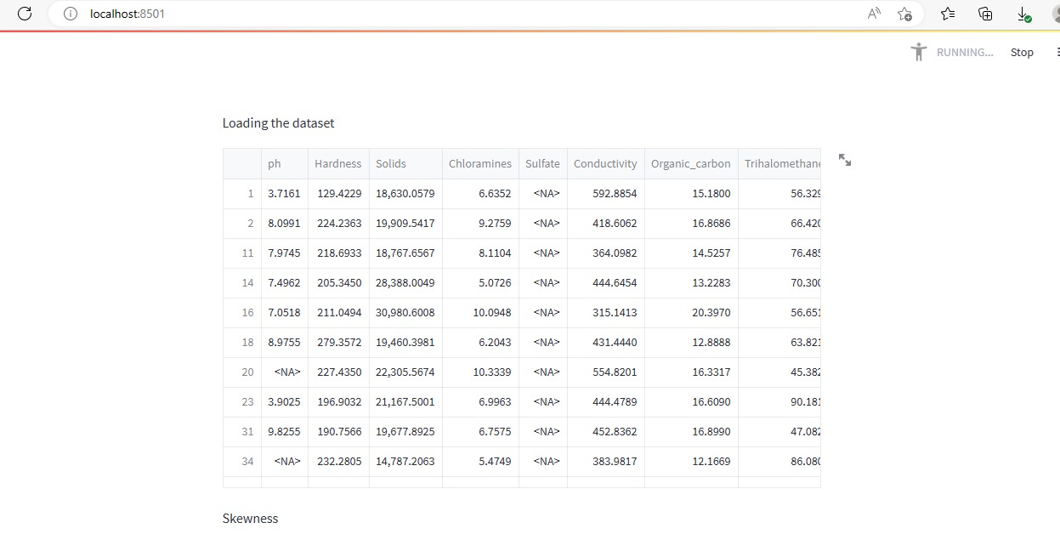
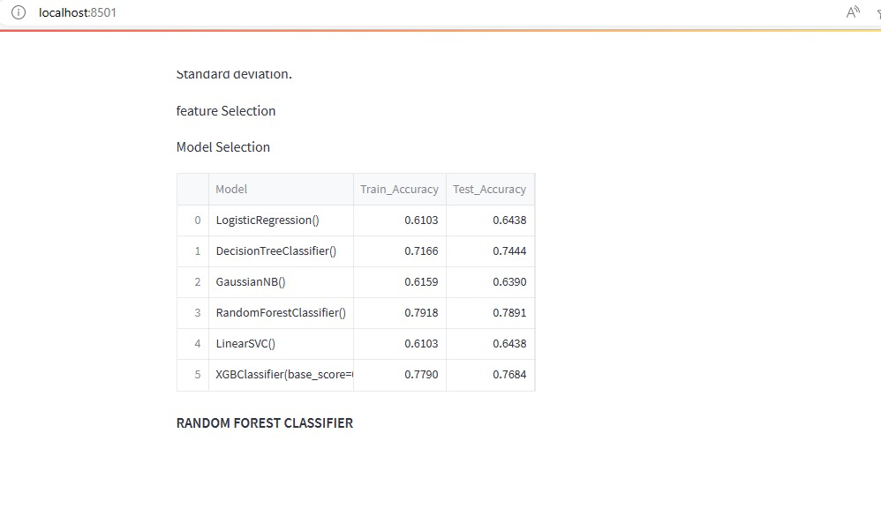
Deployment:
Using Streamlit

Slide 24
Challenges faced:
Missing data mechanism:data can be missing at random, missing completely at random, or missing not at random.
Choice of imputation method:methods available, including mean imputation, median imputation, regression imputation, and multiple imputation.
Quality of imputed data :imputed data can introduce bias or increase the variance of the results.
Data leakage: imputing missing values can result in data leakage, where information from the test set is used to impute missing values in the training se
Complex relationships:imputing missing values based on the mean or median may not be appropriate, as the relationships between the variables may change over time.

Slide 25
Thank You

