Slide 1
Make My Trip-Cabs
Shivani Konnegari SinglePointSolutions Software Developer Intern

Slide 2
Objectives
Manual Testing Automation Testing CICD Mobile Testing
- Test Plan -Login Functionalities - Git - Android SDK
- Test Case - Page Object Model - GitHub - Android Studio
- Test Case Review - Data Driven Testing - Jenkins - Appium
- Defect report - Allure Reports -Vysor
- HTML reports - ABD & APK

Slide 3



Setups
●
Selenium Python
Pycharm
Pytest
Node js
Allure reports
unittest
4.26.1
2024
8.3.4
10.9.0

Slide 4

Manual Testing
Manual testing is a software testing approach where testers manually evaluate software or application quality without the help of automated testing tools or test scripts. Testers interact with the system like how an end user would identify bugs, defects, and issues in the software that create friction in user experience.
Test Deliverables
Test Plan
Test Case
Defect Report

Slide 5
Features
Ride Booking Process
Ride Tracking and Navigation
Cancellation and Refunds Payment and Pricing
Push Notifications

Slide 6
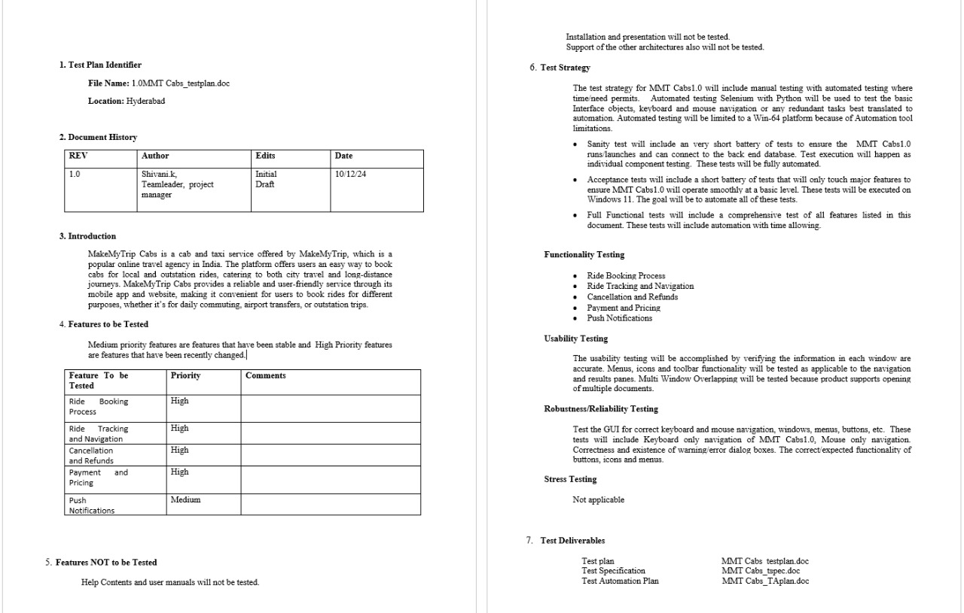
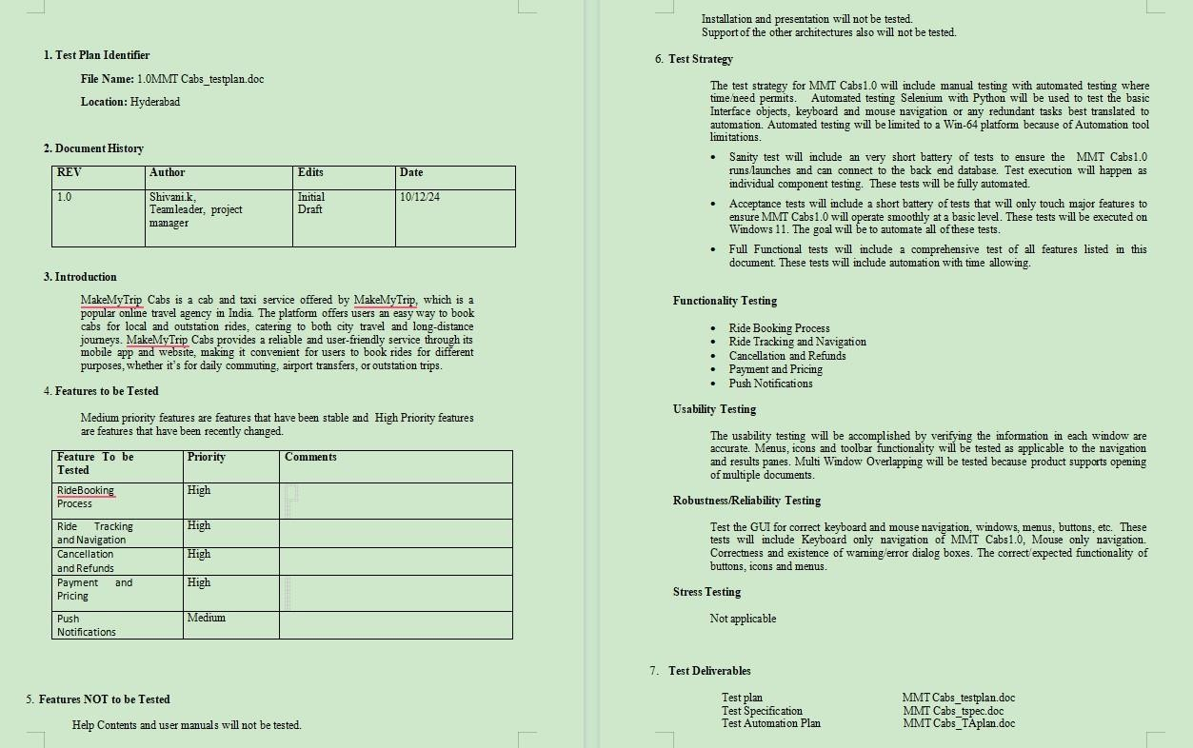
Test Plan Document

Slide 7

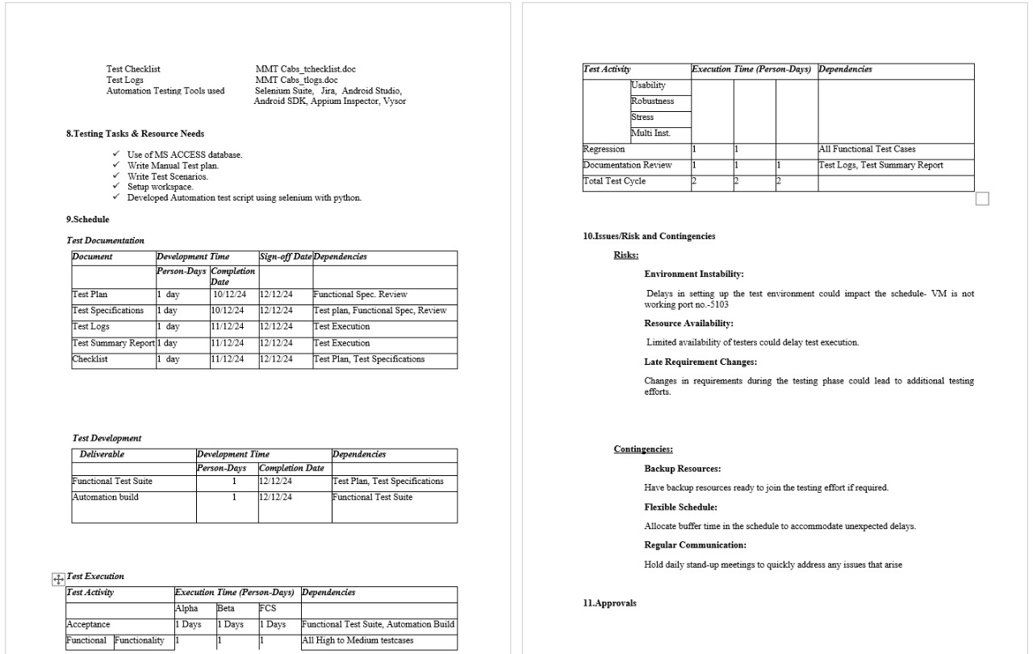
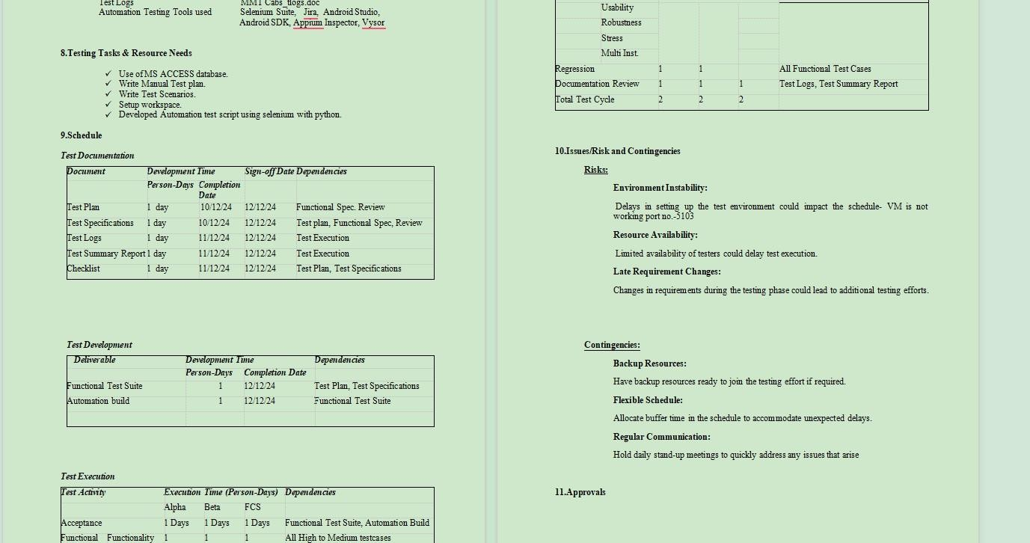

Slide 8
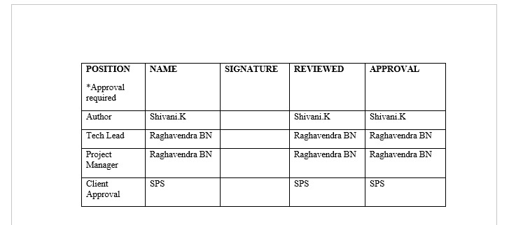
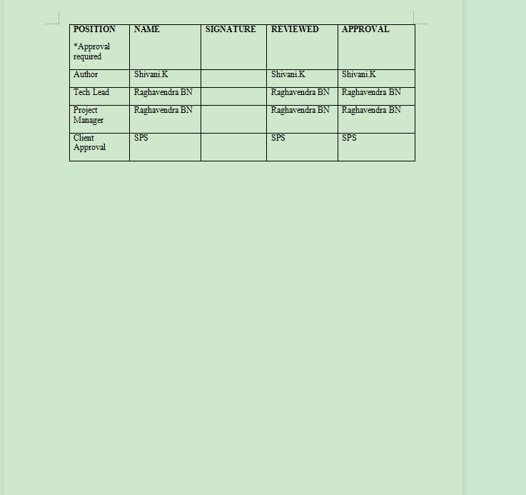

Slide 9

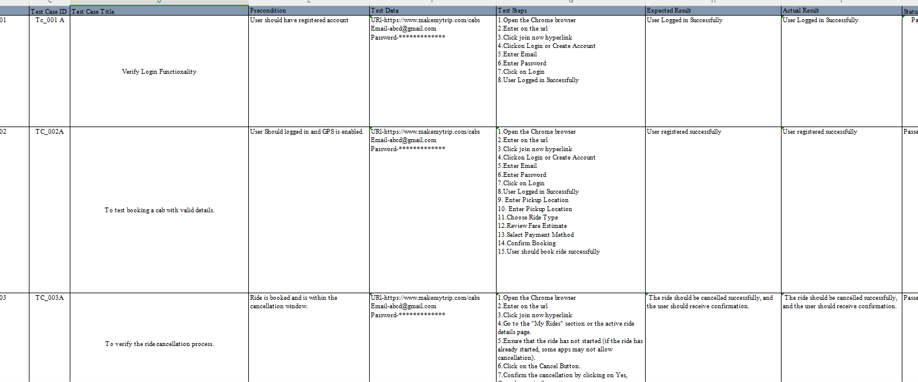
Test Case Document

Slide 10

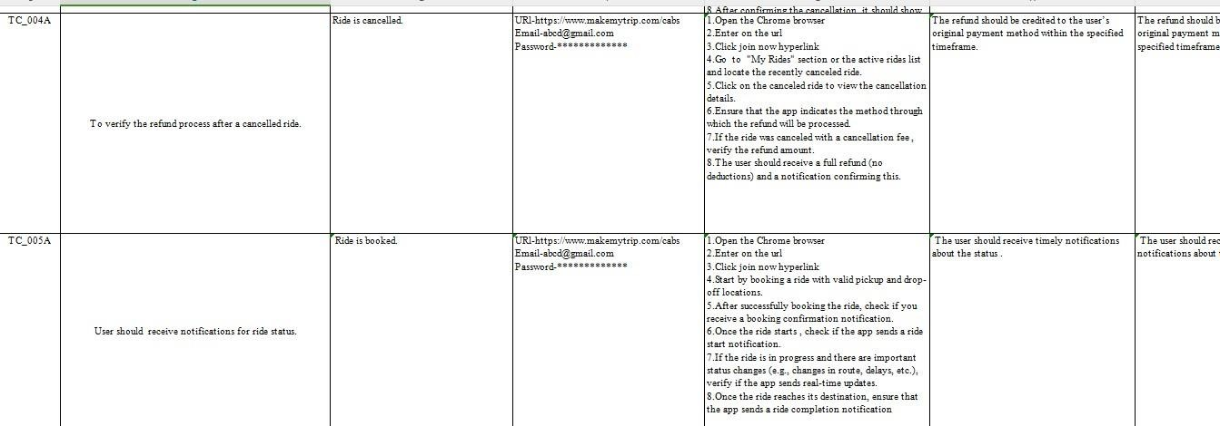

Slide 11
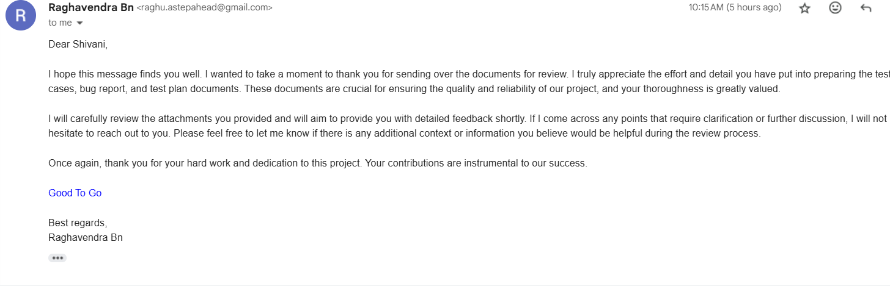
Test Case – Peer Review

Slide 12
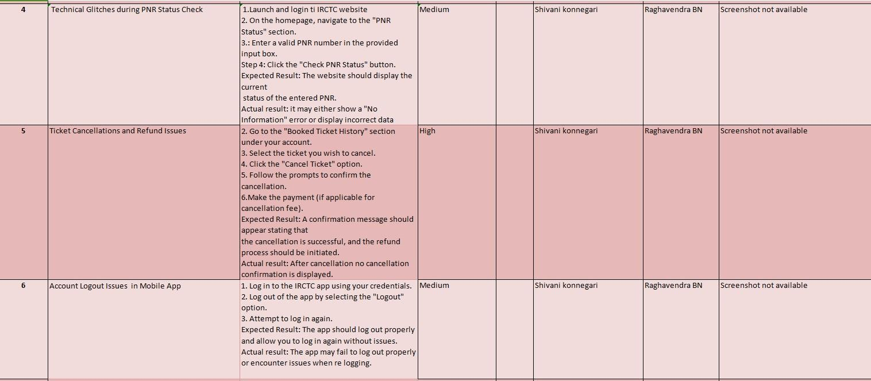
Defect Report

Slide 14

Automation Testing
&
Page Object Model
Automation testing involves using
The Page Object Model (POM) is a design pattern in automation testing that creates an object repository for web UI elements. It enhances test maintenance and reduces code duplication by encapsulating the page elements and actions in separate classes, making the tests more readable and easier to manage.
software tools to execute pre-
scripted tests on a software
application before it is released into
production. This helps in identifying
defects, ensuring the software
behaves as expected, and improving efficiency by reducing manual testing efforts.

Slide 15

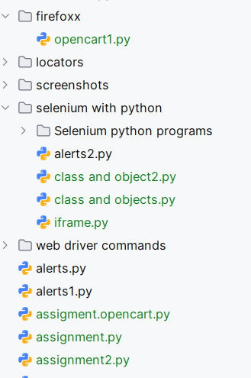
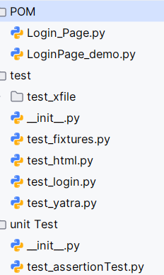
Folder Structure

Slide 16


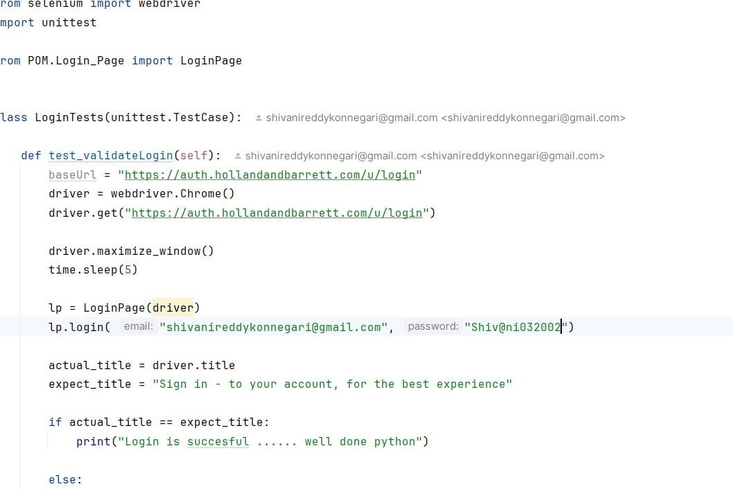
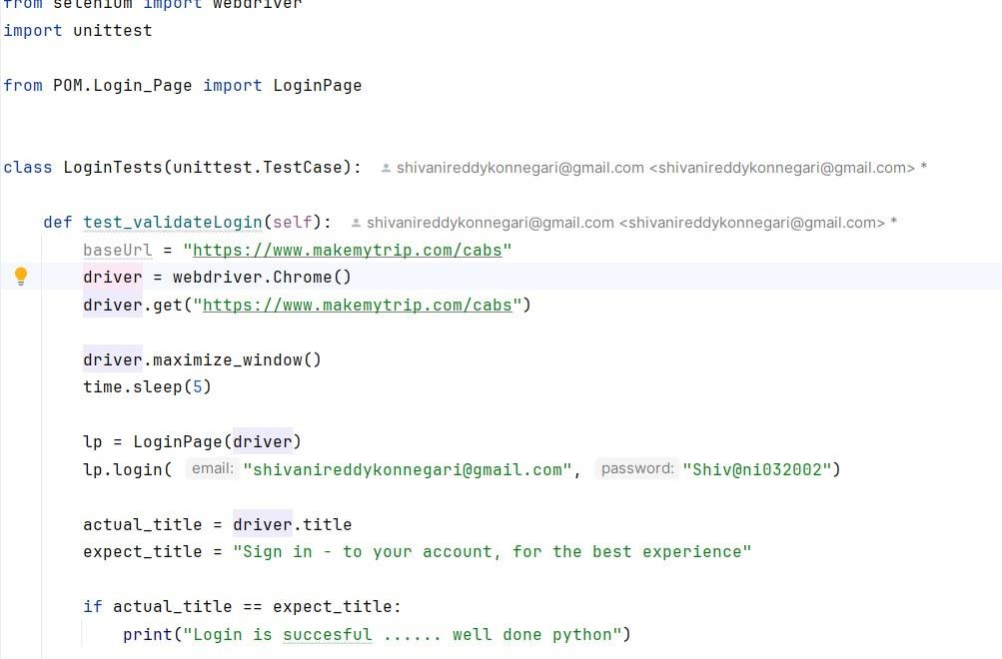

Pom.xml file

Slide 17
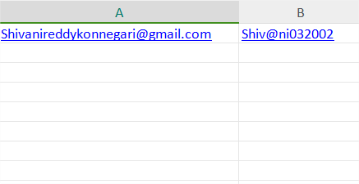
Login xlsx

Slide 18
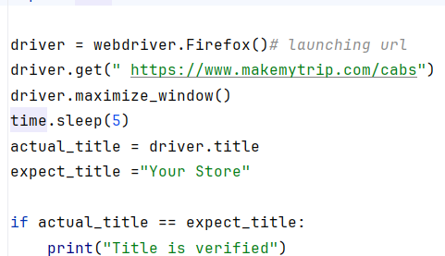
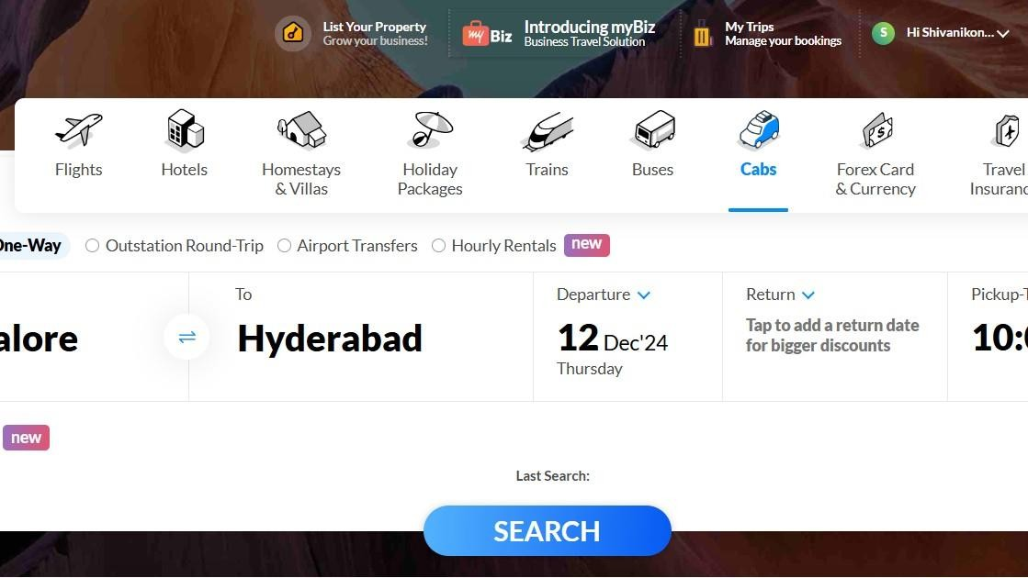
LoginTest.Python
Micron Confidential
Micron Confidential

Slide 19

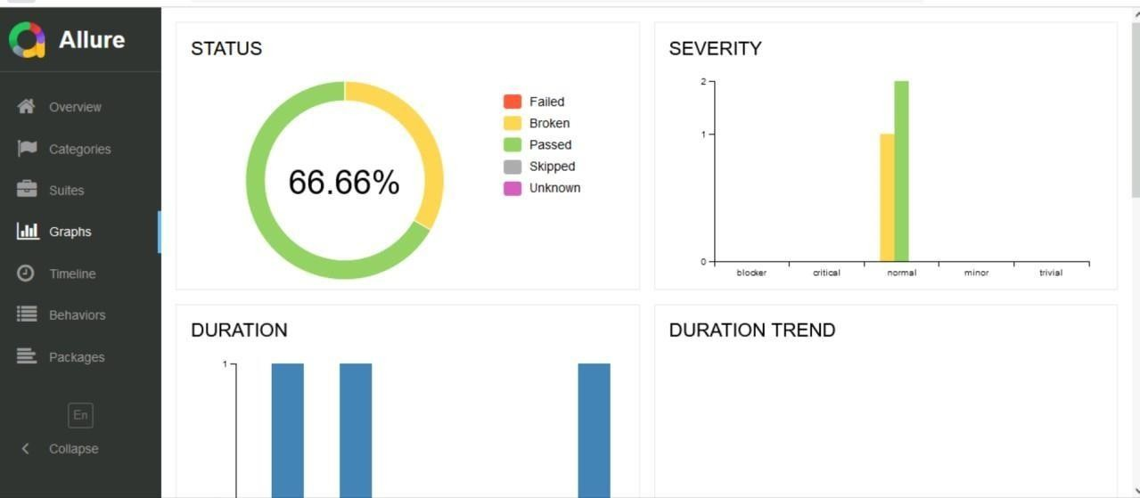
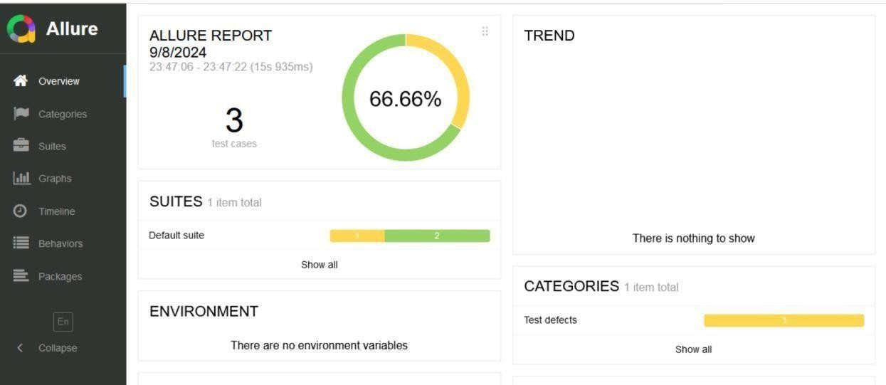
Allure Report

Slide 20
Mobile Testing
Mobile testing is the process of evaluating a mobile application to ensure it meets quality standards and provides a good user experience. It involves testing the app's functionality, usability, performance, compatibility, and security across different devices, operating systems, and network conditions..

Slide 21
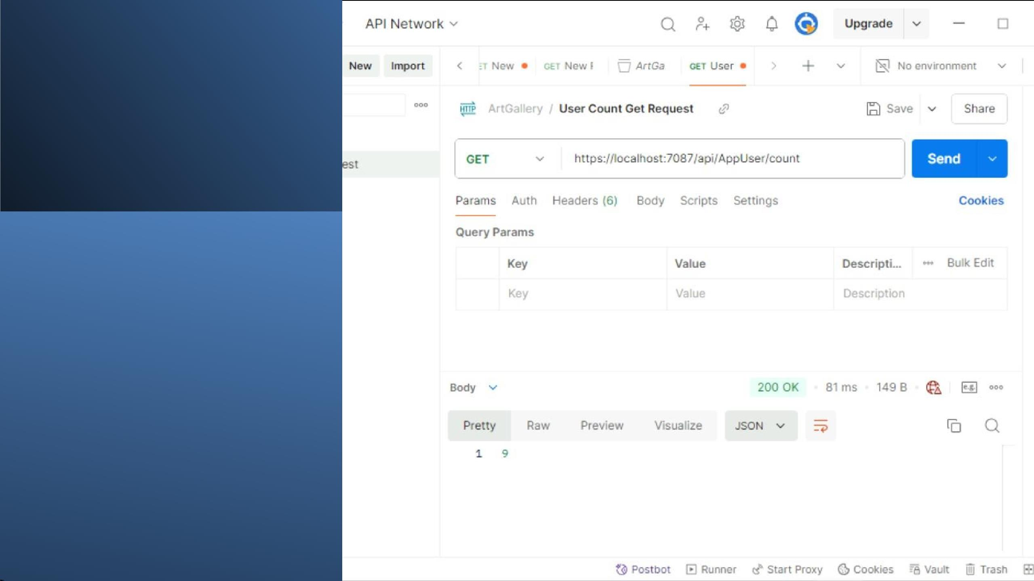


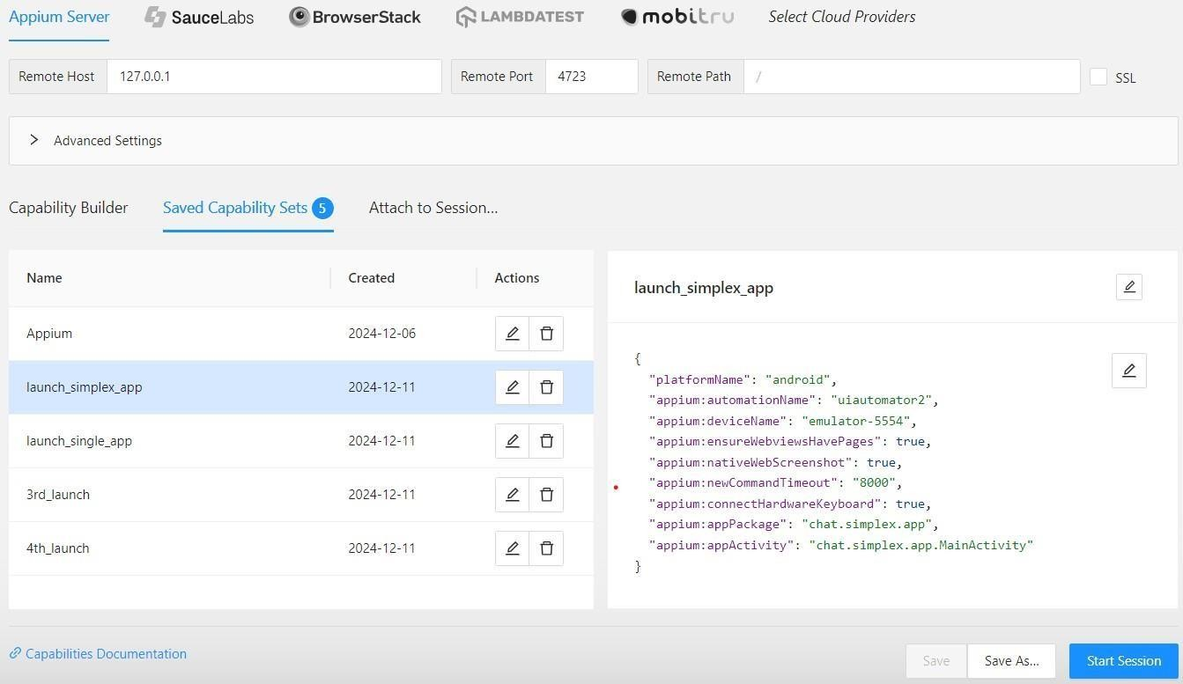
Appium
in
m

Slide 22
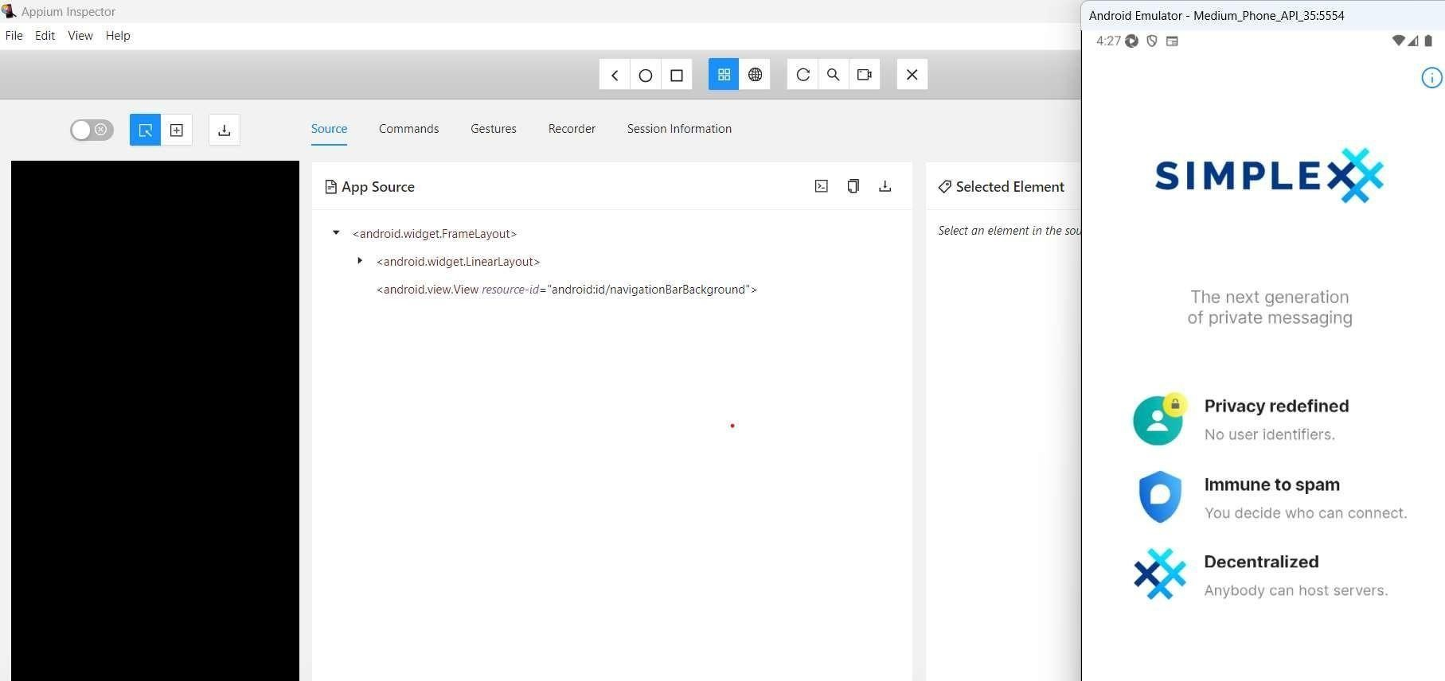
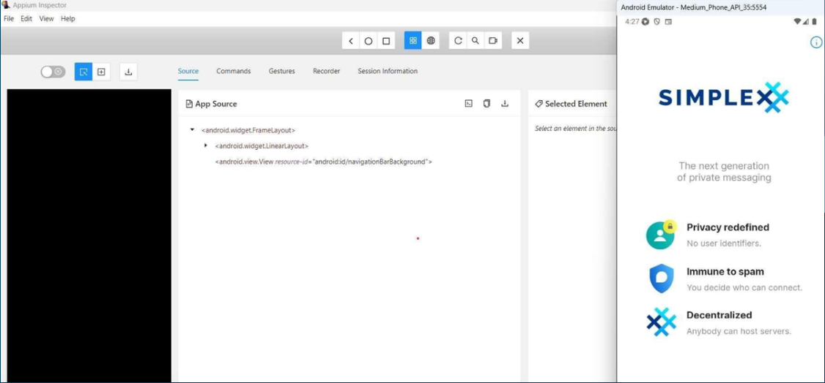
Output in emulator-5554

Slide 23
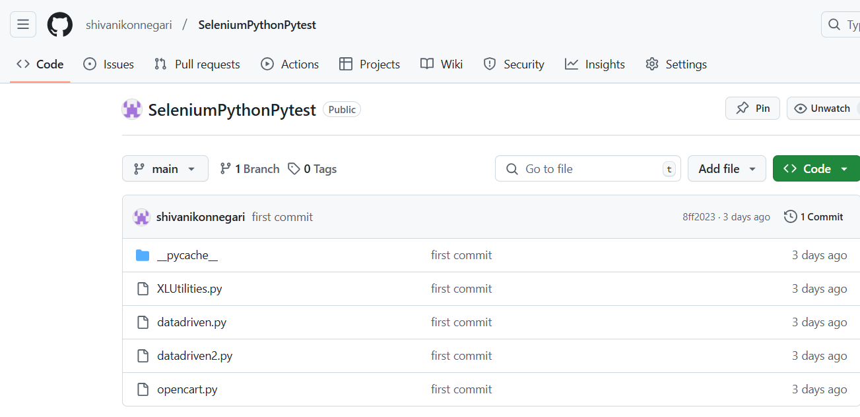
Github

Slide 24
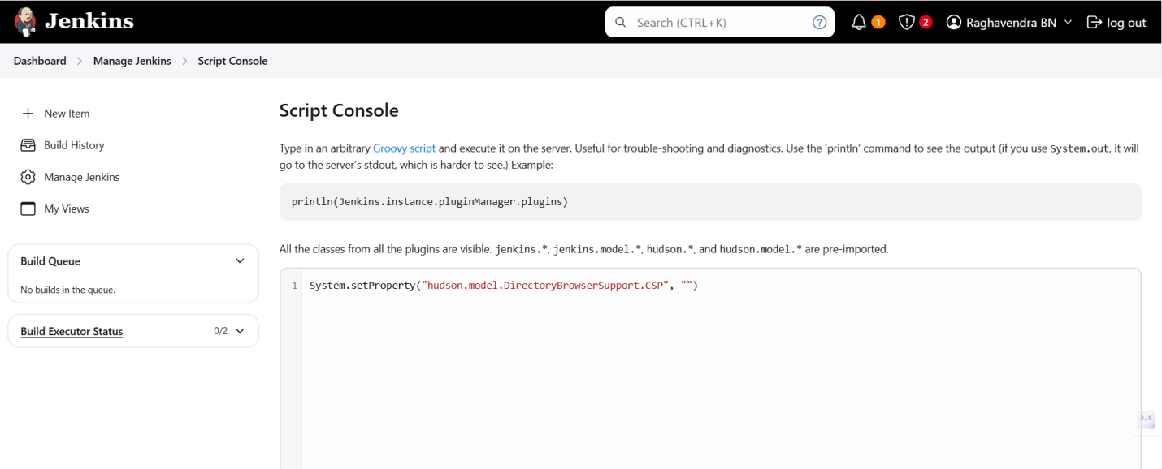
Jenkins

Slide 25
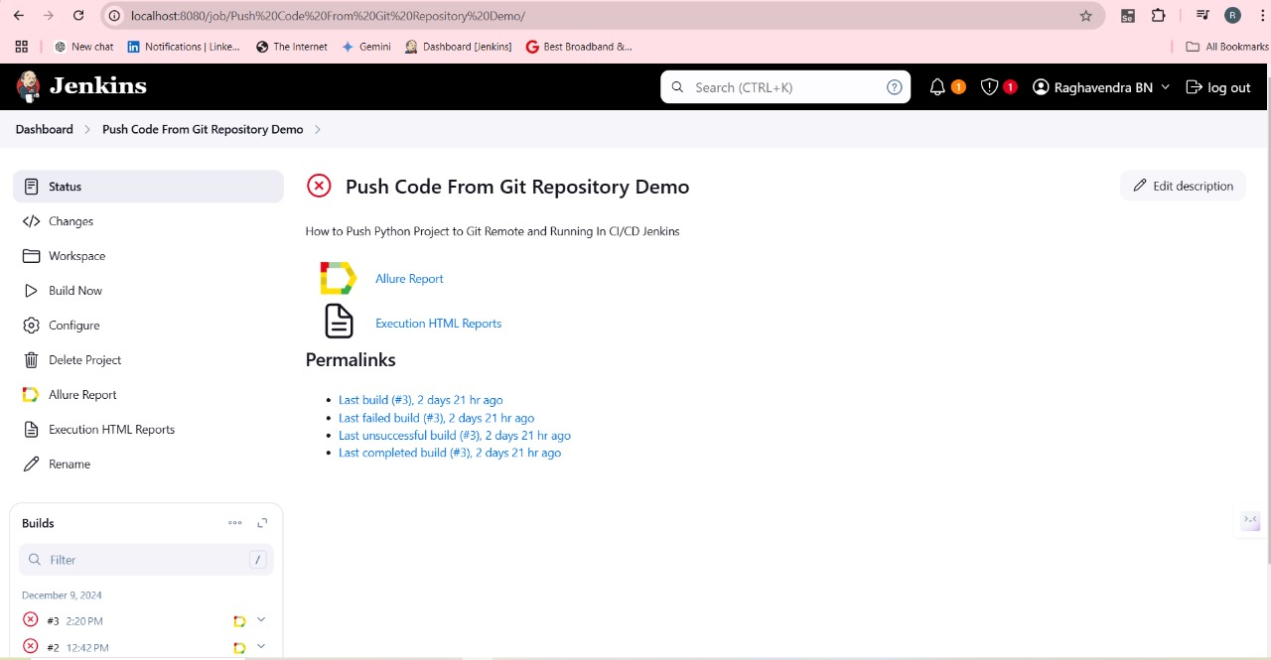
Push code from Git

Slide 26
Thank You

