Slide 1
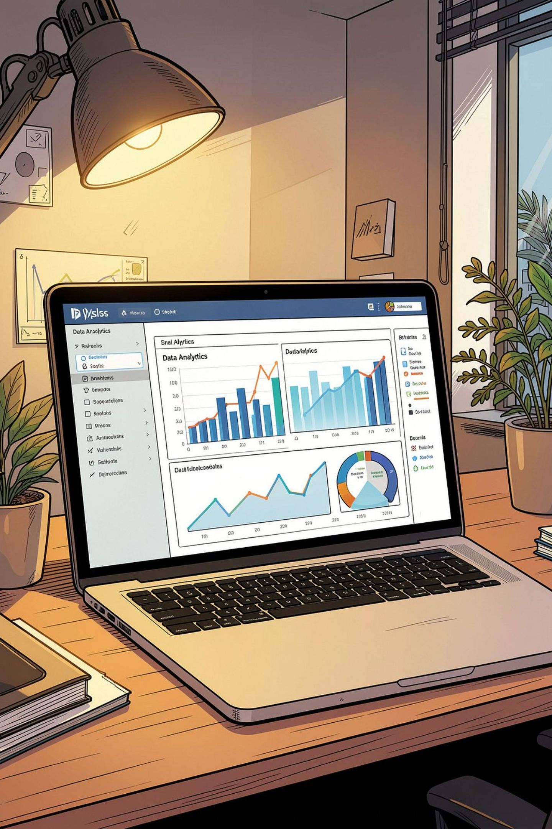
Customer Shopping Behavior — Snapshot
3,900 purchases · 18 features · goal: uncover spending patterns, segments, product & subscription insights

Slide 2
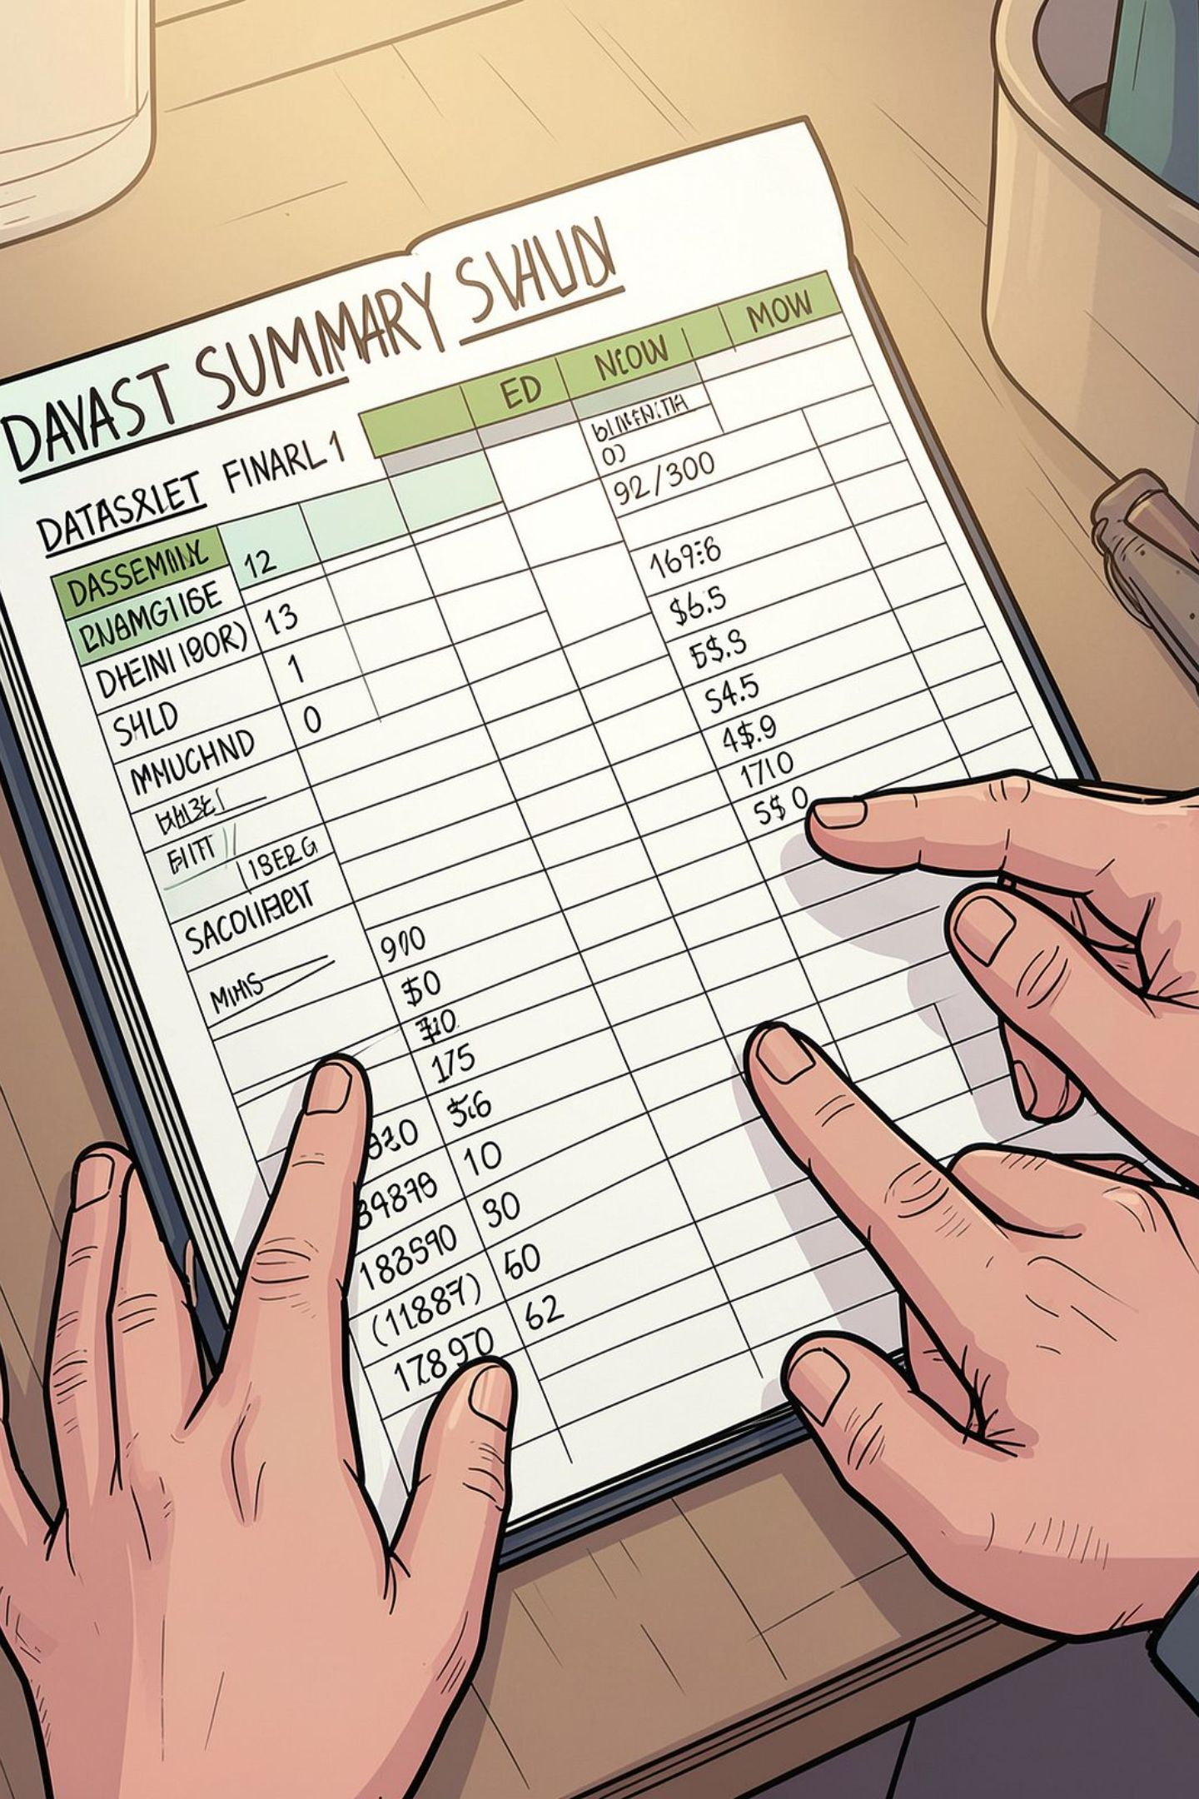
Dataset Summary
Rows / Columns
Key features
3,900 rows · 18 columns
Demographics, purchase details, behavior, subscription
Missing data
37 missing values in Review Rating

Slide 3
Data Preparation (Python)
01
02
03
Load & Explore
Clean
Standardize
pandas: df.info(), .describe()
Imputed review ratings by category median
Renamed columns to snake_case
04
05
Feature engineering
Prep for DB
age_group, purchase_frequency_days
Dropped promo_code_used; load to MySQL

Slide 4
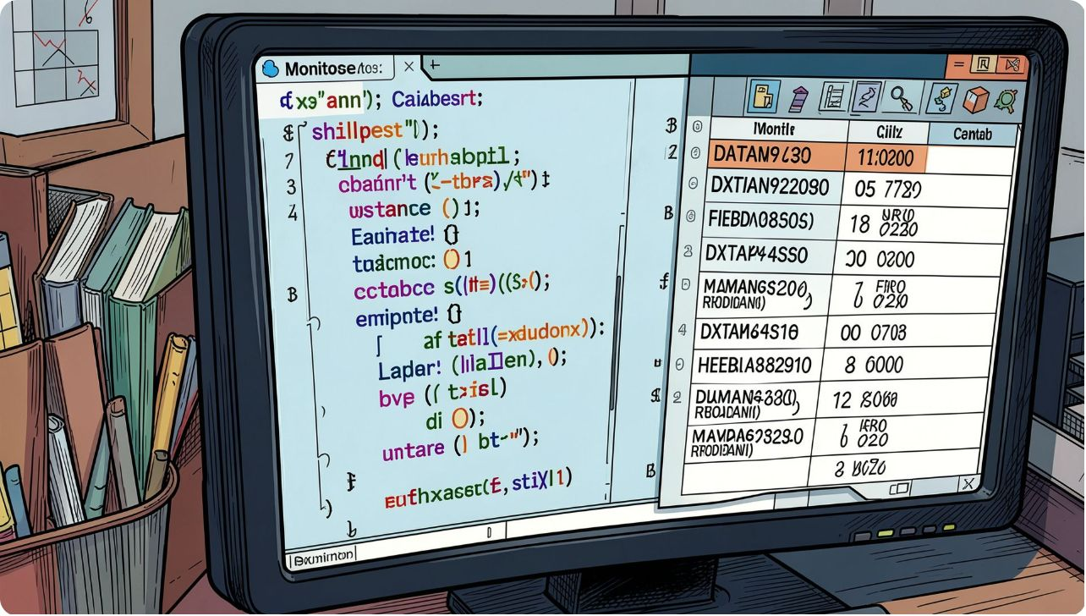
SQL Analysis — Key Questions
Revenue by gender
High-spend discount users
Top products by rating
Shipping type comparison
Subscribers vs non-subscribers

Slide 5

Revenue by Gender
Male
Female
$157,890 total revenue
$75,191 total revenue

Slide 6
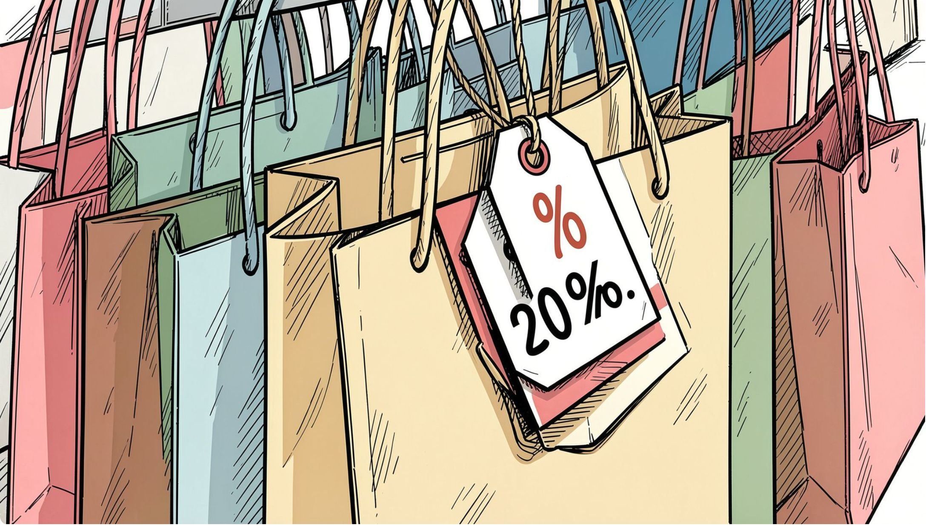

Discounts & High Spenders
Identified customers using discounts but spending above average. Example purchases: 64, 73, 90, 85, 97, 68, 72.
Balance promotions with margin control

Slide 7

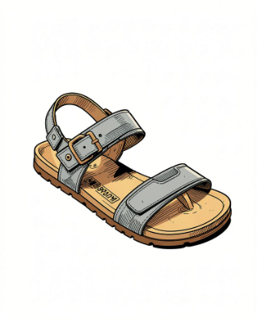

Top Products & Discount Dependence
Gloves
Sandals
Boots
Avg rating 3.86 · high-ranked
Avg rating 3.84
Avg rating 3.82
Top discount-rate products: Hat 50%, Sneakers 49.66%, Coat 49.07%, Sweater 48.17%, Pants 47.37%

Slide 8
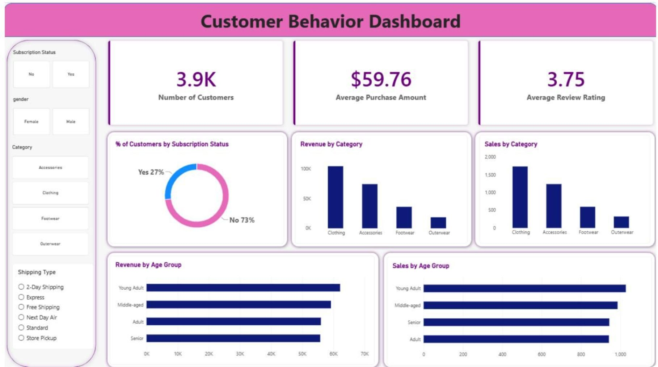
Power BI Dashboard
Interactive visuals: subscription donut (Yes 27% / No 73%), revenue & sales by category, age-group revenue/sales, key KPIs: 3.9K customers · $59.76 avg purchase · 3.75 avg rating

Slide 9

Loyalty Programs
Encourage repeat customers
Boost Subscriptions
Targeted Marketing
Increase short-term revenue
Personalize long-term engagement
Short-term to long-term actions to grow revenue and retention

Slide 10

Business Recommendations
Boost Subscriptions
Loyalty Programs
Review Discounts
Promote exclusive subscriber benefits
Reward repeat buyers; move to Loyal segment
Balance sales lift with margins
Product Positioning
Targeted Marketing
Feature top-rated & best-sellers
Focus on high-revenue age groups & express-shipping users

