Slide 1

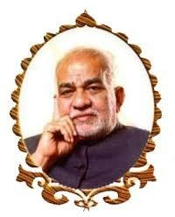
Hotel Management System
BVRIT HYDERABAD College of Engineering for Women Department of Computer Science and Engineering
Under the Guidance of
Name: K.Neha
Designation: Assistant Professor
Team No: 13
Names with roll numbers :
K.Deekshitha : 22WH1A0590
K.Triveni : 22WH1A05A5
H.Shivani : 22WH1A05B2

Slide 2
Agenda
Introduction
Problem Statement
Abstract
Data Model
Overview of Fields & Relationships
Technologies
Project Overview (Screen Shots)

Slide 3

Salesforce is all about Low Code – No Code

Slide 4
PROBLEM STATEMENT
The objective is to develop an application in salesforce that helps Hotels to face numerous challenges in managing their operations efficiently while delivering exceptional guest experiences.
This project aims to address specific problems faced such as operational inefficiencies Guest Experiences, Data Management Resource management, Revenue Optimization.

Slide 5
ABSTRACT
The Hotel Management System project on Salesforce is a comprehensive solution designed to streamline the operations of a hotel or hospitality business. The system is built on the Salesforce platform, leveraging its robust features and scalability to meet the diverse needs of hotel management.Guest profiles are maintained in the system, allowing hotels to personalize services and track guest preferences. Overall, the Hotel Management System project on Salesforce aims to enhance the guest experience, improve operational efficiency, and drive revenue growth for hotels and hospitality businesses.

Slide 6
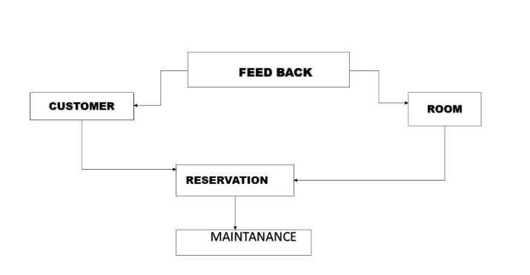
DATA MODEL

Slide 7
FIELDS
Customer:
*First Name
*Last Name
*Phone number
*Email
*VIP status
*Pincode
*City
RESERVATION:
*Reservation ID
*Reservation Status
*Check-in date
*check-out date
*No of Guests
ROOM :
*Room number
*capacity
*Room Type
*Availability Status
*price
MAINTANANCE :
*Task name
*Status
*Due date
*Payment Status

Slide 8
RELATIONSHPS
Room-Reservation:
(Master detail relationship)
Reservation - Room:
(Lookup relationship)
Feedback - Customer:
(Lookup relationship)
Feedback - Room:
(Lookup relationship)
Maintanance – Room:
(Lookup relationship)
Reseration – Customer:
(Lookup relationship

Slide 9
RECORD TYPES
Salesforce record types are ways to group records within a specific object. These are typically focused on what will make the most sense to the end user.
Created two record types for Customer Object :
1)Standard Customer
2)VIP Customer
*These record type helps us in different ways for example, VIP Customer might have additional fields for special preferences, exclusive offers, or loyalty program details.
*Different page layouts can be assigned to VIP and Standard Customers. VIP Customers can have a more detailed page layout with fields relevant to their special status.

Slide 10
TOOLS AND TECHNOLOGIES
Salesforce platform :
The foundation of any Salesforce application, providing the infrastructure and services necessary to build and deploy your application.
Salesforce App Builder :
A point-and-click tool to create custom pages for Lightning Experience and mobile apps.
Salesforce Object Manager:
Used to create and manage custom objects, fields, and relationships between objects.
Lightning Experience :
A modern user interface for Salesforce that provides a more interactive and intuitive user experience.

Slide 11
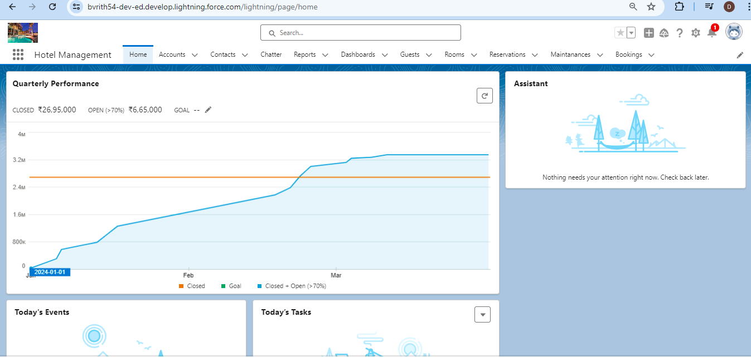
PROJECT OVERVIEW

Slide 12
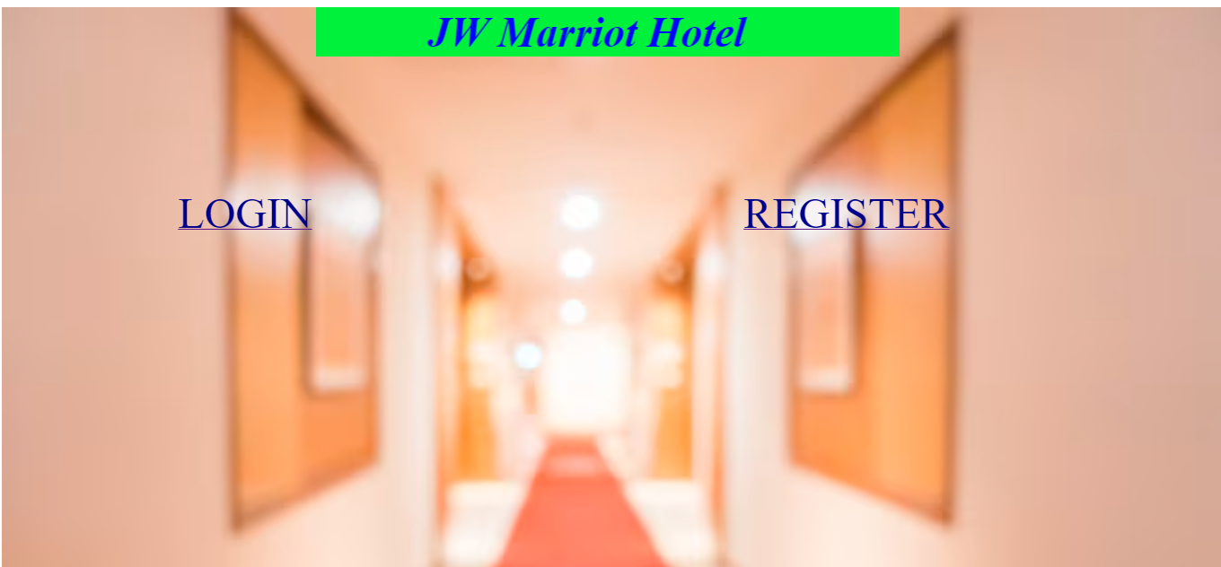
HOME PAGE

Slide 13
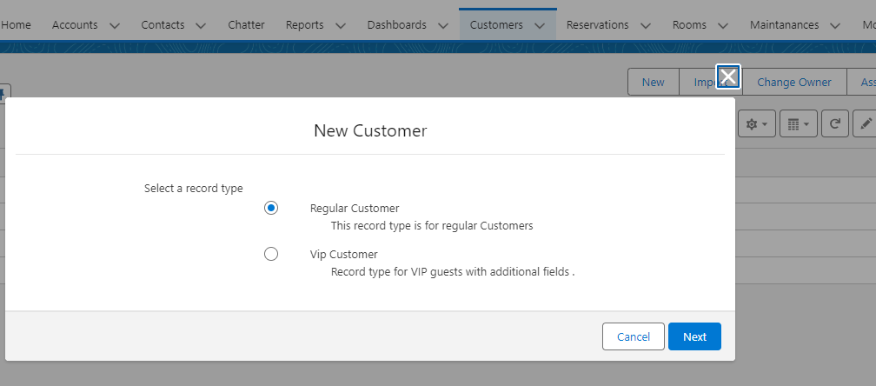
RECORD TYPE(screen shot)

Slide 14
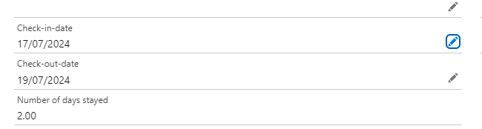
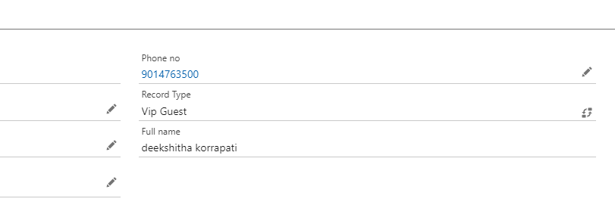
FORMULA FIELD
Created a field named as no of days to calculate no of days stayed a guest stayed in hotel using simple logic.
Created a field named as Fullname to show full name of guest.

Slide 15
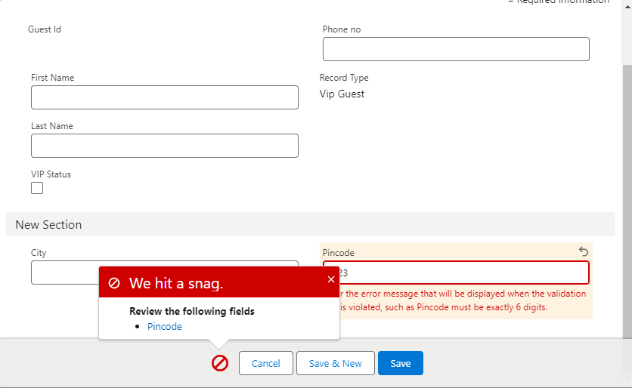
VALIDATION RULE
Here we created a validation rule on pincode using formula logic.If length of pincode is less than 6 then it will generate error.

Slide 16

THANK YOU

