Slide 1

Capston Project
Hotel Booking Analysis
Submitted By :- Harsh Durugkar
Shivangini Gupta
Rajesh Khangar

Slide 2
Contents
01
Our Agenda & Problem Statement
05
What we need to find out ?
02
Work of Flow
06
Exploratory Data Analysis
03
Data Review
07
Discuss on Insights to be found
04
Types of data in Dataset

Slide 3
01
PART ONE
Agenda & Problem Statement

Slide 4
1) We Have a DataSet of Hotel Booking and we discuss about this dataset as well as cover some querry
with analysing.
2) In Analysing the data we work with Hotel Booking DataSet, in this dataset include the information
such as resort hotel vs city hotel , booking cancellation , types of customers , meal of customers ,
agent information & other information .
3) Hotel Industry is Highly Traffic Industry with Lakh of People with Lakh of Data and with collecting
and maintain the information for analysing , give big benifit to Hotel Industry.
4) The main target behind this project is to explore and then analyze the data for discover important factors
and find out the insights to solve out problem in Hotel Management , So they easily observe advantages
& weakness and perform campaigns to boost there bussiness as well as Performance.

Slide 5
02
PART TWO
Work of Flow

Slide 6
Here is the Simple Work of Flow we use for our Project :-
2) Data Cleaning and Fix Missing Value
1) Collecting & Understanding of Data
Work of Flow
3) Exploratory Data Analysis (EDA)

Slide 7
03
PART THREE
Data Review

Slide 8
Data Review
In the Given Hotel Booking Dataset there are 119390 number of rows and 32 number of columns.
So let’s understand every columns which is contain in dataset :--
1) hotel :- In this column contain two categorical data which is Resort Hotel & City Hotel .
2) is_cancelled :- In this column value show the cancellation type. If the booking was cancelled
Value indicate 1 & 0 indicates not cancelled.
3) lead_time :- Data show the time between reservation and actual arrival .
4) arrival_date_year :- Data show Year of arrival date .
5) arrival_date_month :- Data show Month of arrival date .
6) arrival_date_week_number :- Data of Week number of year for arrival date .
7) arrival_date_day_of_month :- Day of arrival date .
8) stays_in_weekend_nights :- Total Number of weekend nights .
9) stays_in_week_nights :- Total Number of week nights .
10) adults : - Total Number of adults .

Slide 9
Data Review
11) children :- Total Number of children in Hotel .
12) babies :- Total Number of babies in Hotel .
13) meal :- Type of meal booked by a Customers .
14) country :- Country of origin of Customers .
15) market_segment :-Designation of market segment . (TA/TO) .
16) distribution_channel :- Booking distribution channel.(T/A/TO) .
17) is_repeated_guest :- is a repeated guest or not. (1) means yes & (0) means not.
18) previous_cancellations :- Number of previous bookings that were cancelled by
the customer prior to the current booking .
19) previous_bookings_not_canceled :- Number of previous bookings not cancelled by
the customer prior to the current booking
20) reserved_room_type :- Code of room type reserved.
21) assigned_room_type : Code for the type of room assigned to the booking.
22) booking_changes : Number of changes made to the booking from the moment the booking
was entered on the PMS until the moment of check-in or cancellation

Slide 10
Data Review
23) deposit_type :- Values of No Deposit, Non Refund , Refundable.
24) agent :- Values of ID of the travel agent that made the booking.
25) company :- Contain ID of the company or entity that made the booking .
26) days_in_waiting_list :- Number of days the booking was in the waiting list before it
was confirmed to the customer.
27) customer_type :- Data Contain types of customer & Contract,Group,transient,Transient party.
28) adr :- Average Daily Rate as defined by dividing the sum of all lodging transactions by the total
number of staying nights.
29) required_car_parking_spaces :- Data of Number of car parking spaces required by the customer
30) total_of_special_requests :- Data of Number of special requests made by the customer
31) reservation_status :- Reservation status.
32) reservation_status_data :- Date of reservation status.

Slide 11
04
PART FOUR
Types of Data in Dataset

Slide 12
Types of data
Binary Values
Numeric Data
is_canceled
is_repeated_guest
arrival_date_year
children
babies
adults
stays_in_week_nights
stay_in_weekend_nights
arrival_date_day_of_month
arrival_date_week_of_number
booking_changes
total_of_specail_request
required_car_parking_spaces
adr
company
agents
days_in_waiting_list
Categorical Data
Dataset
hotel
arrival_date_month
meal
country
market_segment
distribution_channel
reserved_room_type
assigned_room_type
deposite_type
customer_type
reservation_status

Slide 13
05
PART FIVE
What we need to find out ?

Slide 14
What we need to find out ?
1. How Many Booking Were Cancelled?
2. What is the booking ratio between Resort Hotel and City Hotel?
3. What is the percentage of booking for each year?
4. Which is the most busy month for hotel?
5. From which country most guest come?
6. How Long People Stay in the hotel?
7. Which was the most booked accommodation type (Single, Couple, Family)?
8. How many guests repeated in hotel ?
9. Types of Customers ?
10. Meal Plan Of Customers.
11. Which agent makes highest no. of bookings ?
12. Which is the most preferred room type by the customers ?
13. Which Hotel type has the highest ADR ?

Slide 15
06
PART SIX
Exploratory Data Analysis ( EDA )

Slide 16
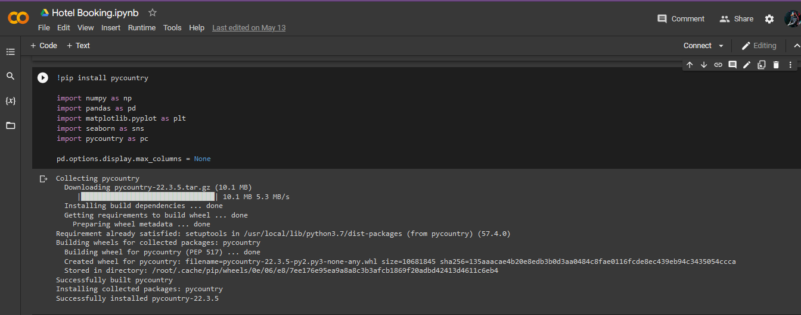
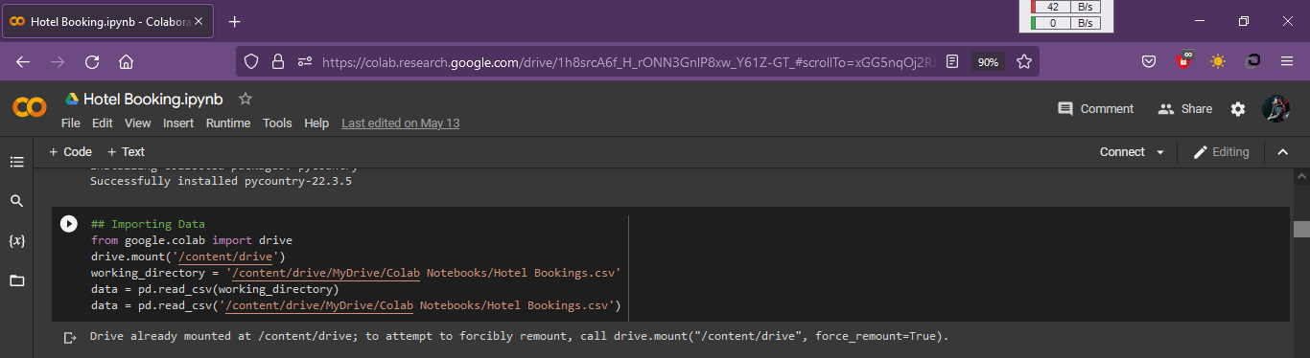
EDA
1 ) We Import all required library in code so we take advantages of library to solve out our problem . If in future we need more library so we import in this colab. Currently we add numpy , pandas , matplotlib , seaborn, pycountry etc.
2)Then we add our Data-Set file i.e excel file in it . Our Data-Set file is in google drive so we import google drive to link with that file & we import google drive then we give location of our file then call file with pandas library with the function of pd.read_csv() .This function read file excel file.

Slide 17
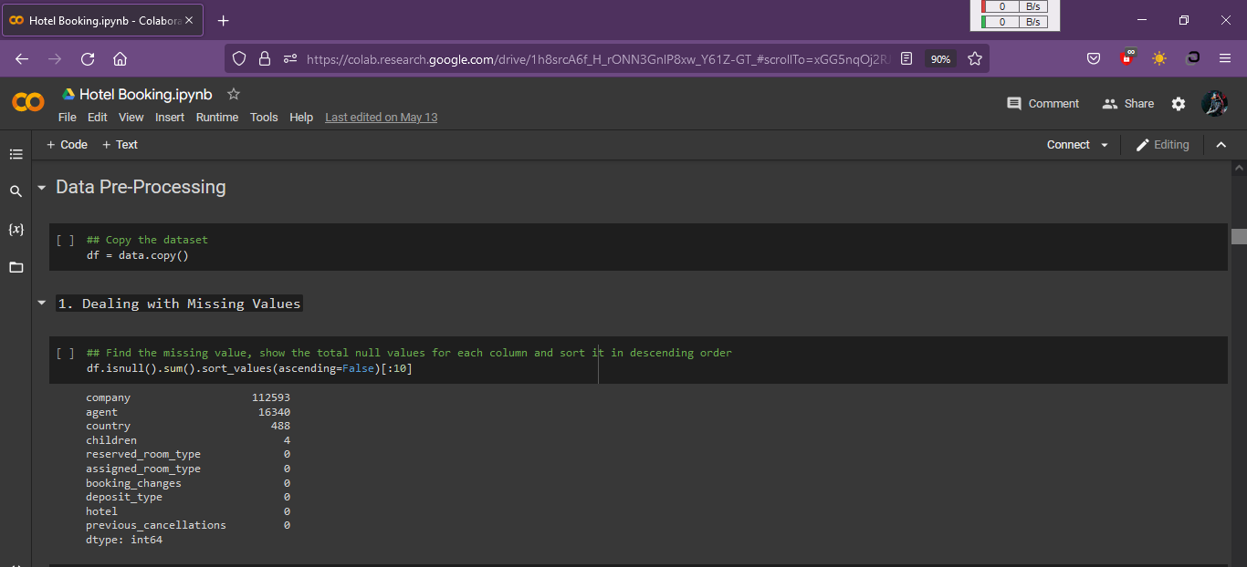
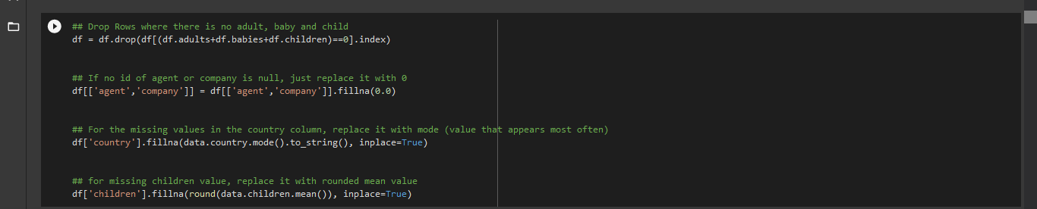
EDA
3) Lets Check Missing Value in Dataset & Then Target Every missing value to fill & make data complete.

Slide 18
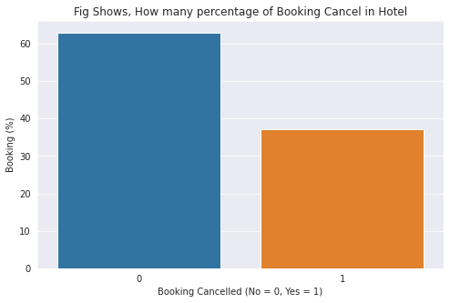
EDA
1) How Many Booking Were Cancelled ?
KEY INSIGHTS
According to visualization , There are near 37% Booking Cancelled By Customers & remaining 63% of Booking is Safe.

Slide 19
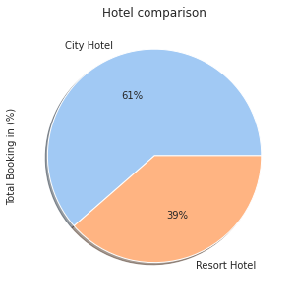
EDA
2. What is the booking ratio between Resort Hotel and City Hotel ?
KEY INSIGHTS
According to visualization , There are 61% of Booking done in City Hotel & remaining 39% of Booking done in Resort Hotel.
So, City Hotel capture more customers than the Resort Hotel.

Slide 20
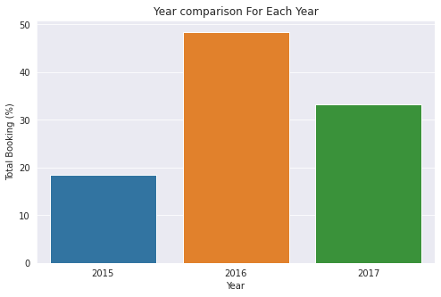
EDA
3. What is the percentage of booking for each year ?
KEY INSIGHTS
Bar Chart Show the Total % of Booking done in Each Year.
In Visualiztion we see that in 2015 Booking done by nearly 19% adn in 2016 48% Booking & in 2017 Booking done 33% .
So 2016 is Successful Year For Hotel Booking.

Slide 21
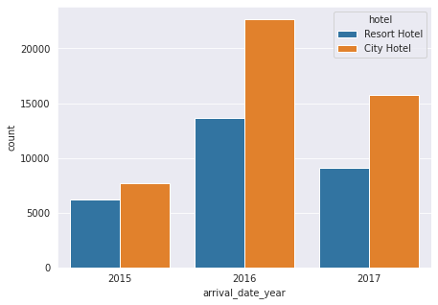
EDA
Let's separte it by hotel
KEY INSIGHTS
After Comparing the Booking with City vs Resort Hotel. We see City Hotel is most successful for booking in 2015 , 2016 & 2017 with the comparision of Resort Hotel.

Slide 22
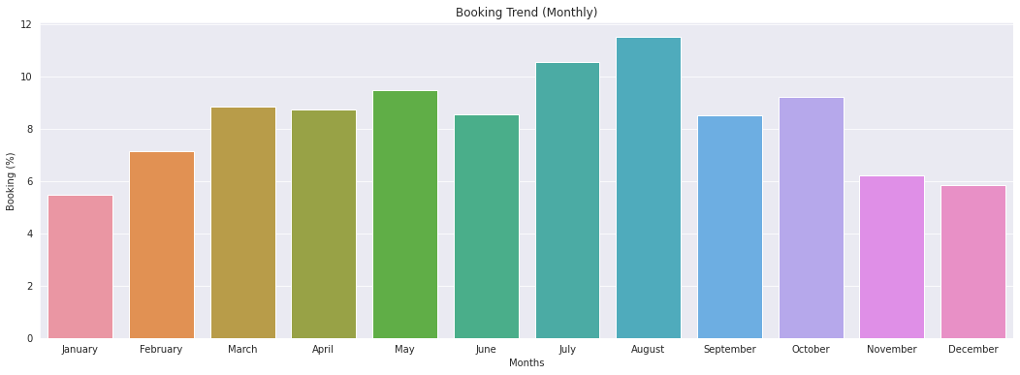
EDA
4) Which is the most busy month for hotel ?
KEY INSIGHTS
Here is , According to visualization , There are August Month is most busy month for Hotel & July is 2nd most busy month for hotel & then May , october & so on..

Slide 23
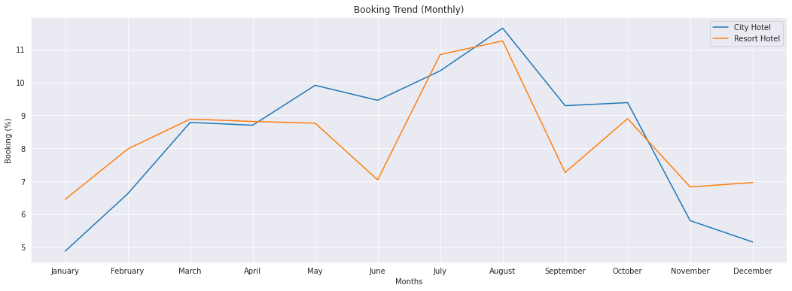
EDA
Compare Busy Month for Hotel Between Resort vs City
KEY INSIGHTS
Here city Hotel is busy month than Resort in May, June, Aug, Sep, oct month and in Jan, Feb, Mar, april, july, nov & dec month busy for resort hotel more than city hotel.

Slide 24
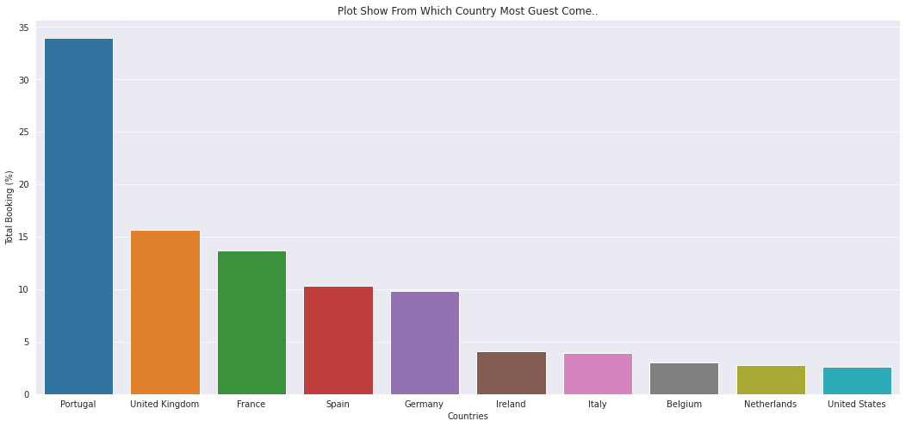
EDA
5) From which country most guest come ?
KEY INSIGHTS
Most Guest come from Portugal. Nearly 34% Guest come from portugal and united kingdom 2nd highest country with near 16% & France is in 3rd position with near 14% of guest.

Slide 25
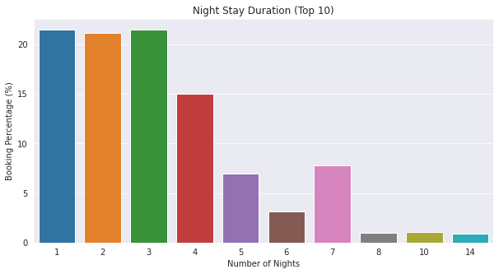
EDA
6) How Long People Stay in the hotel ?
KEY INSIGHTS
In visualization we see most of people choose 3 Night in hotel. Near 22.5% of people choose 3 night & 22% of people choose 1 night & 21% people choose 2 nights.

Slide 26
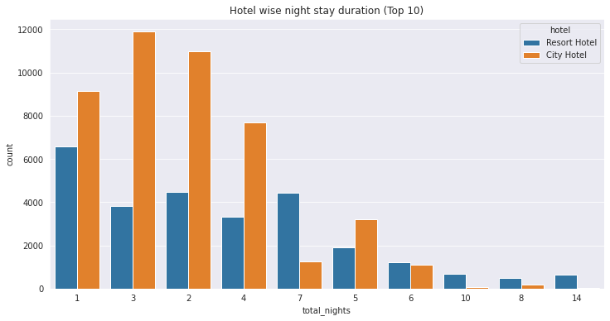
EDA
Compare Hotel wise night stay duration resort vs city
KEY INSIGHTS
Here is City hotel is more guest for 1, 2, 3, 4 & 5 nights than the resort hotel.
In resort hotel people love to stay with 6, 7, 8, 10 & 14 nights.

Slide 27
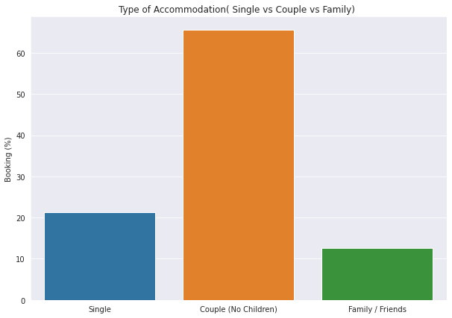
EDA
7) Which is the most booked type of accommodation (Single, Couple, Family) ?
KEY INSIGHTS
Here is mostly Couple book hotel more than single & Family/Friends members.
Ratio of couple for booking hotel is near 66% and for single is 22% and Family/Friends with 12% .

Slide 28
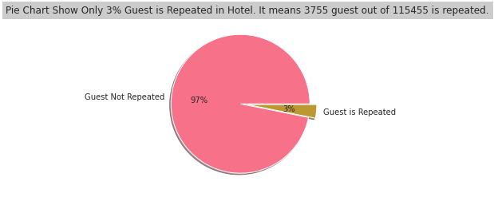
EDA
8) How many guests repeated in hotel ?
KEY INSIGHTS
Here is only 3% of guest repeated in hotel and remaining 97% of guest not repeated.

Slide 29
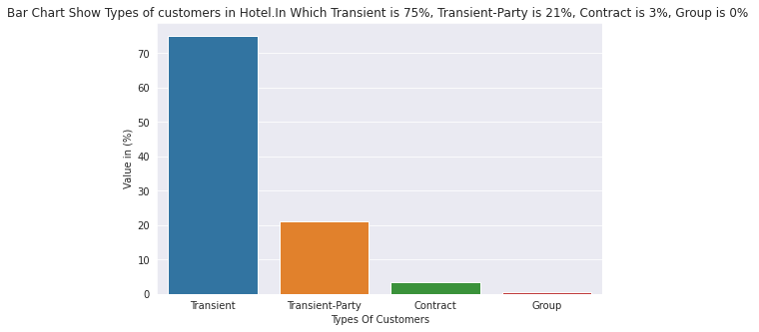
EDA
9) Types of Customers ?
KEY INSIGHTS
Transient Customer is mostly visited customer more than Transient-party , contract & Group.

Slide 30
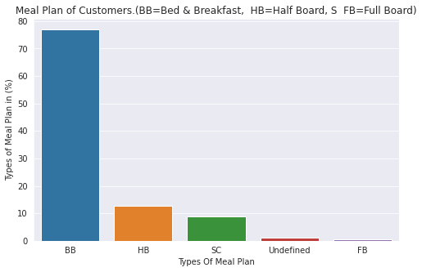
EDA
10) Meal Plan of Customers ?
KEY INSIGHTS
BB is mostly demanded type of meal according to guest data .
Here is BB means Bed & Breakfast.
The ratio of BB is nearly 77% & HB is 12.5% & SC is 9.5%. Remaining is Undefined type of meal.

Slide 31
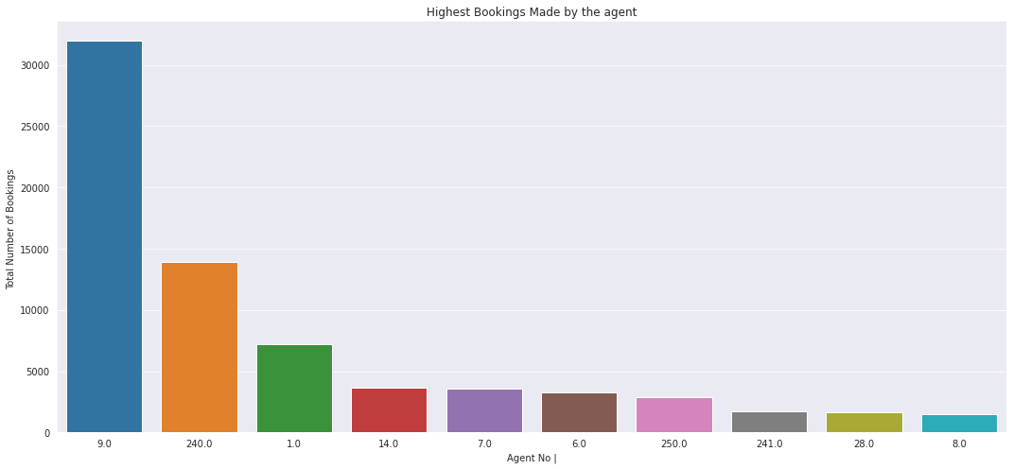
EDA
11) Which agent makes highest no. of bookings ?
KEY INSIGHTS
Agent no 9 is make most number of booking with above 32000. Agent no 240 is in the 2nd position who has make booking more than 14000.

Slide 32
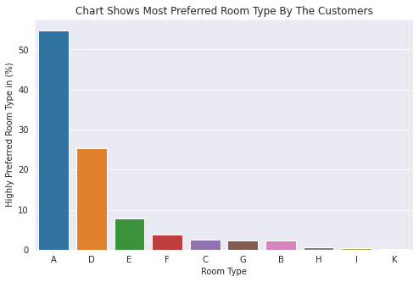
EDA
12) Which is the most preferred room type by the customers ?
KEY INSIGHTS
‘A’ type of room most preferred by customers compare of others room types & ‘D’ type of room 2nd most choice by customer & ‘ E ’ is in 3rd position.

Slide 33
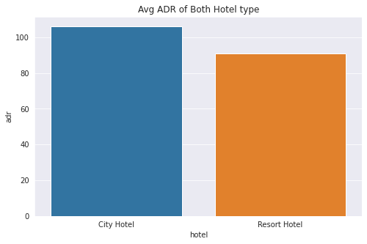
EDA
13) Which Hotel type has the highest ADR ?
KEY INSIGHTS
Here is we see in visualization City Hotel is more ADR Than Resort Hotel. City hotel is with nearly 105 of adr & Resort is 85 of adr.
More adr(average daily rate) means more revenue.
so it means city hotels are generating more revenues than the resort hotels.

Slide 34
07
PART SEVEN
Discuss on Insights to be found

Slide 35
Discuss on Insights to be found
1) There are near 37% Booking Cancelled By Customers & remaining 63% of Booking is Safe.
2) There are 61% of Booking done in City Hotel & remaining 39% of Booking done in Resort Hotel.
3) There are in 2015 Booking done by nearly 19% adn in 2016 48% Booking & in 2017 Booking done 33% .
So 2016 is Successful Year For Hotel Booking.
We see City Hotel is most successful for booking in 2015 , 2016 & 2017 with the comparision of Resort Hotel.
4) There are August Month is most busy month for Hotel & July is 2nd most busy month for hotel .
If we compare , city Hotel is busy month than Resort in May, June, Aug, Sep, oct month and in Jan, Feb, Mar
april, july, nov & dec month busy for resort hotel more than city hotel.
5) Most Guest come from Portugal. Nearly 34% Guest come from portugal and united kingdom 2nd highest
country with near 16% & France is in 3rd position with near 14% of guest.

Slide 36
Discuss on Insights to be found
6) In visualization we see most of people choose 3 Night in hotel. Near 22.5% of people choose 3 night & 22%
of people choose 1 night & 21% people choose 2 nights. With comparision City hotel is more guest for 1, 2, 3, 4
& 5 nights than the resort hotel. In resort hotel people love to stay with 6, 7, 8, 10 & 14 nights.
7) Couple book hotel more than single & Family/Friends members.
Ratio of couple for booking hotel is near 66% and for single is 22% and Family/Friends with 12% .
8) only 3% of guest repeated in hotel and remaining 97% of guest not repeated.
9) Transient Customer is mostly visited customer more than Transient-party , contract & Group.
10) BB is mostly demanded type of meal according to guest data . Here is BB means Bed & Breakfast.
The ratio of BB is nearly 77% & HB is 12.5% & SC is 9.5%. Remaining is Undefined type of meal.

Slide 37
Discuss on Insights to be found
11) Agent no 9 is make most number of booking with above 32000. Agent no 240 is in the 2nd position who has make booking more than 14000.
12) ‘A’ type of room most preferred by customers compare of others room types & ‘D’ type of room 2nd most choice by customer & ‘ E ’ is in 3rd position.
13) In visualization City Hotel is more ADR Than Resort Hotel. City hotel is with nearly 105 of adr & Resort is 85 of adr. More adr(average daily rate) means more revenue. so it means city hotels are generating more revenues than the resort hotels.

Slide 38
Capston Project
Hotel Booking Analysis
Thank You

