Slide 1
Software Engineering Unit 2 Presentation
Yet Another Diet Assistant
Shailesh Karki
Mahesh Attarde
Arrabotu Sheetal Reddy

Slide 2
Introduction
Programming language: C++
.NET framework used for UI
Flat files used for data storage

Slide 3
System overview
An easy to use diet planning application
Add/remove/edit/combine/search food items
Maintain log of food consumed
Maintain user profile(gender, height, weight)
Determine target calorie intake using user profile

Slide 4
Problems
Performance and storage penalty associated with infinite undo depth
Files do not provide primitives for editing
Implementing design patterns confusing at times

Slide 5
GoF Design Patterns used
Composite
Iterator
Adapter
Memento
Strategy

Slide 6
Composite Pattern
Combine simple food to form a composite food
Need to keep track of all the component/simple food
Need to be able to add/remove components from composite food
Need to be able to treat composite food just like simple food
Self implemented data editing functionality in flat files

Slide 7
Iterator Pattern
To iterate over simple food items that form a composite
To iterate over log data(linear)
External iterators used

Slide 8
Adapter Pattern
Need to be able to import food data from different websites
Need to be able to import food data from local files
Need an adapter to interface them and import them in format required by the program
Cannot speculate every possible source so a limited number of adapters to be made available.

Slide 9
Memento Pattern
Need to be able to undo commands to an indefinite depth
Large storage costs
Attempt to reduce memory requirement by reducing duplication

Slide 10
Strategy Pattern
Need to provide several strategies to calculate target calories
Each strategy uses different algorithm for calculation
Provide an interface from which users can select an algorithm

Slide 11
Why strategy and not template?
Requirement states change in logic of objects manipulation
Template method modifies logic of entire class!

Slide 12
Diet Goal Profile Calculation
Calculate target intake calorie for a “day”
User Defined method for calculation
View for [between timespan]
# Calorie consumed
# Target calorie intake
Negative for calorie Available
Positive for calorie Excess

Slide 13
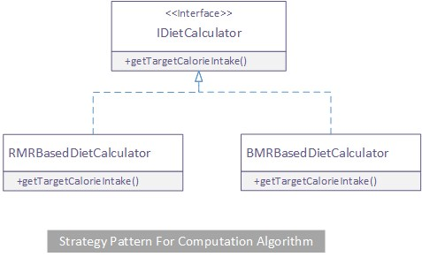
Diet goal profile calculation

Slide 14
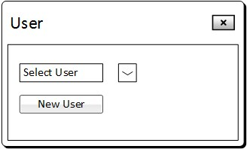
GUI

Slide 15
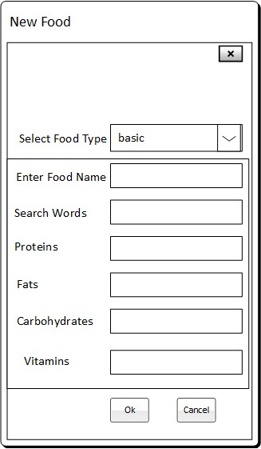
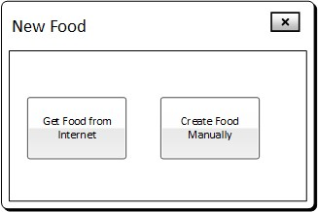
GUI

Slide 16
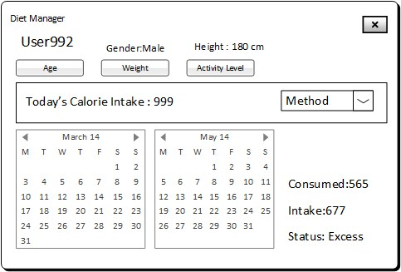
GUI

