Slide 1

Medical Data Analysis
Guided by: Professor Sanjay Saxena
By,
Shivani Prasad
Master of Technology
IIIT Bhubaneswar

Slide 2
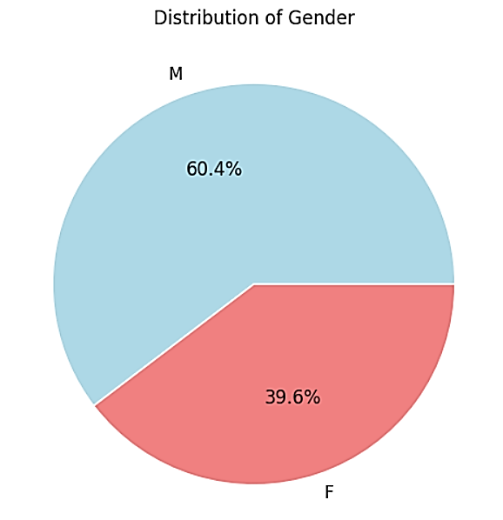
Gender (Categorical)
This bar chart depicts gender distribution in the dataset.
It counts gender categories for easy comparison.

Slide 3
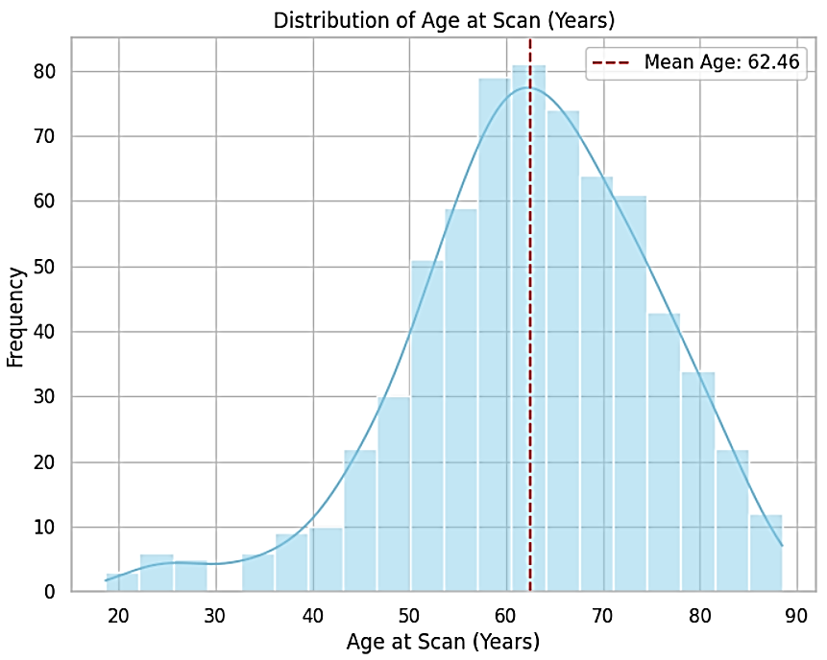
Age at scan years (Numerical)
This histogram visualizes the distribution of ages at the time of scanning.
It helps to understand the age distribution of the individuals in the dataset.

Slide 4
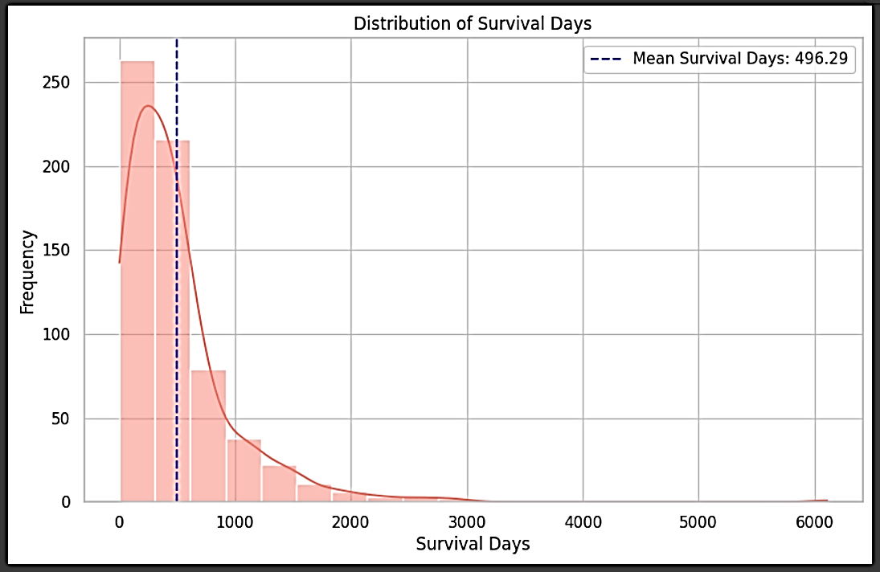
Survival from surgery days UPDATED (Numerical)
This histogram displays the distribution of survival days from the surgery date.
It provides insights into the survival duration of the patients in the dataset.

Slide 5
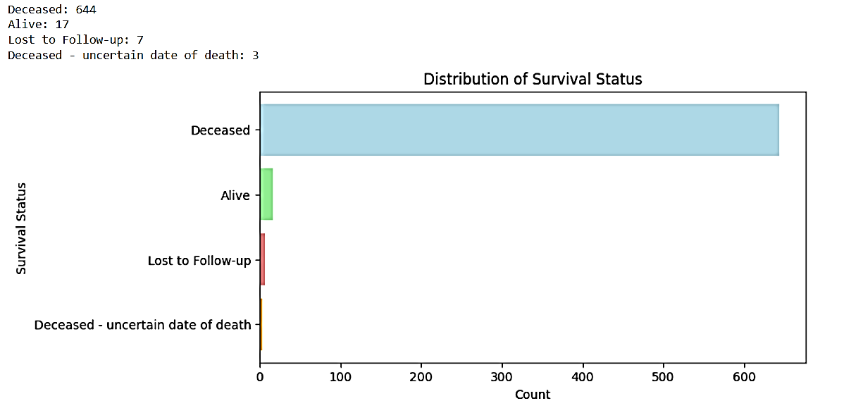
Survival Status (Categorical)
This bar chart shows the distribution of survival status categories.
It gives an overview of the survival outcomes of the patients.

Slide 6
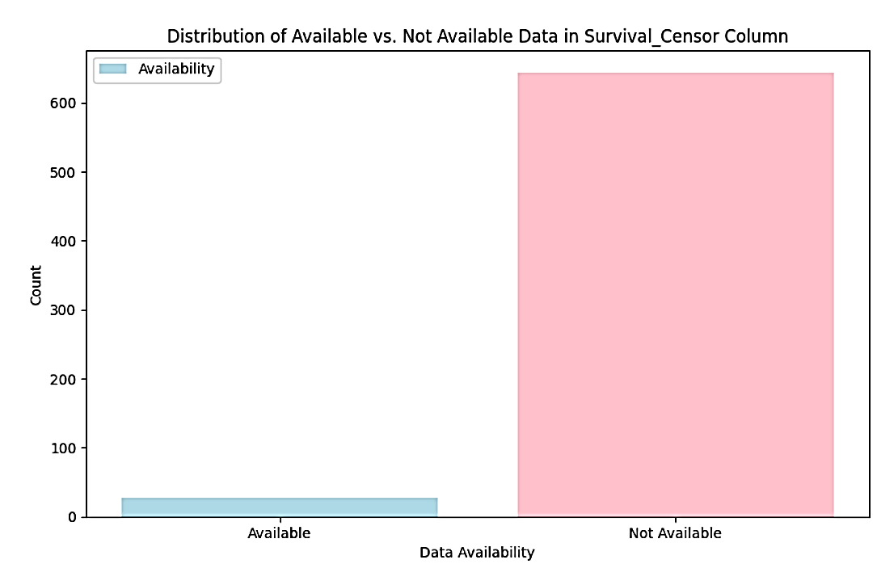
Survival Censor (Categorical)
This bar chart visualizes the distribution of survival censoring categories.
It indicates whether the survival data is censored or not for each patient.

Slide 7
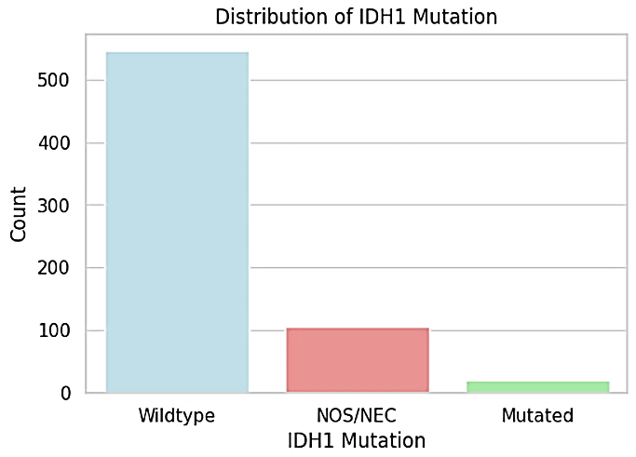
IDH1 (Categorical)
This bar chart displays the distribution of IDH1 mutation categories.
It provides insights into the prevalence of IDH1 mutations among patients.

Slide 8
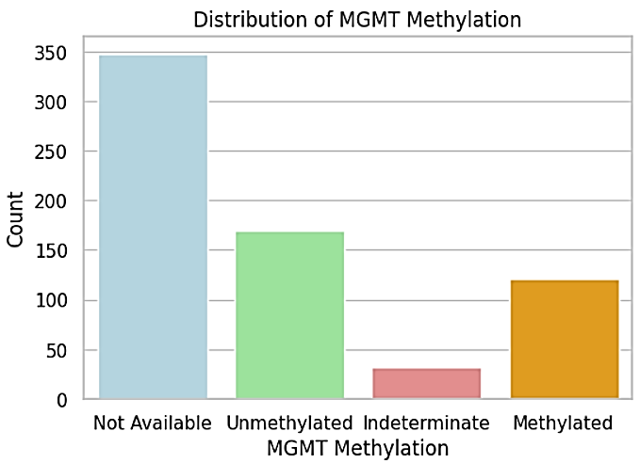
MGMT (Categorical)
This bar chart shows the distribution of MGMT methylation categories.
It helps understand the methylation status of the MGMT gene among patients.

Slide 9
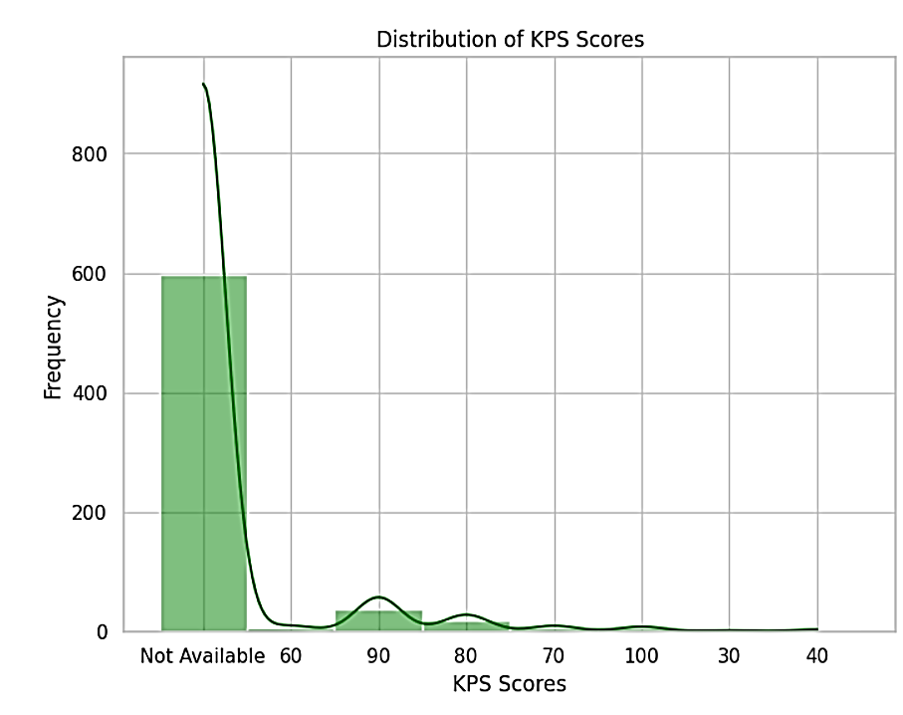
KPS (Numerical)
This histogram visualizes the distribution of Karnofsky Performance Status (KPS) scores.
It provides insights into the functional status of patients at the time of assessment.

Slide 10
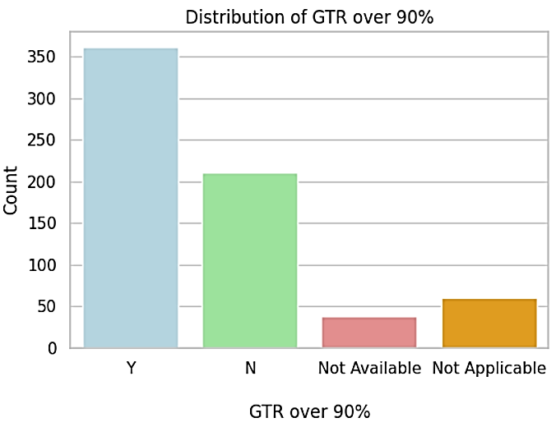
GTR over90percent (Categorical)
This bar chart displays the distribution of gross total resection (GTR) over 90% of categories.
It indicates whether patients underwent extensive surgical resection.

Slide 11
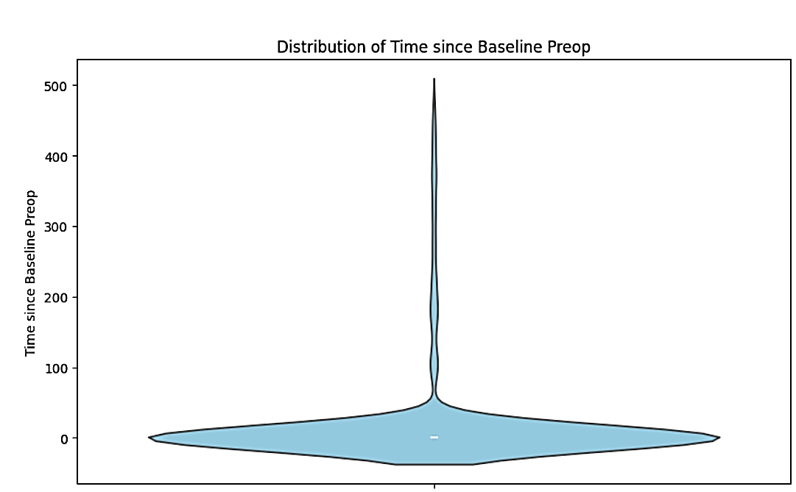
Time since baseline preop (Numerical)
Distribution Representation: Violin plot illustrates probability density of "Time_since_baseline_preop" values.
Central Tendency Display: The thick line indicates interquartile range (IQR) and median.
Density Variation: Width shows data density; wider sections signify higher density.
Insightful Analysis: Helps detect patterns and skewness in variable distribution.
It helps understand the duration between baseline assessment and preoperative period.

Slide 12
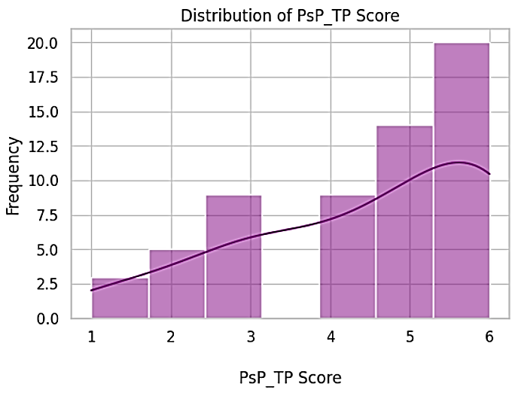
PsP TP score (Numerical)
This histogram visualizes the distribution of PsP_TP scores.
It provides insights into the scoring system used for predicting progression in glioblastoma patients.

Slide 13
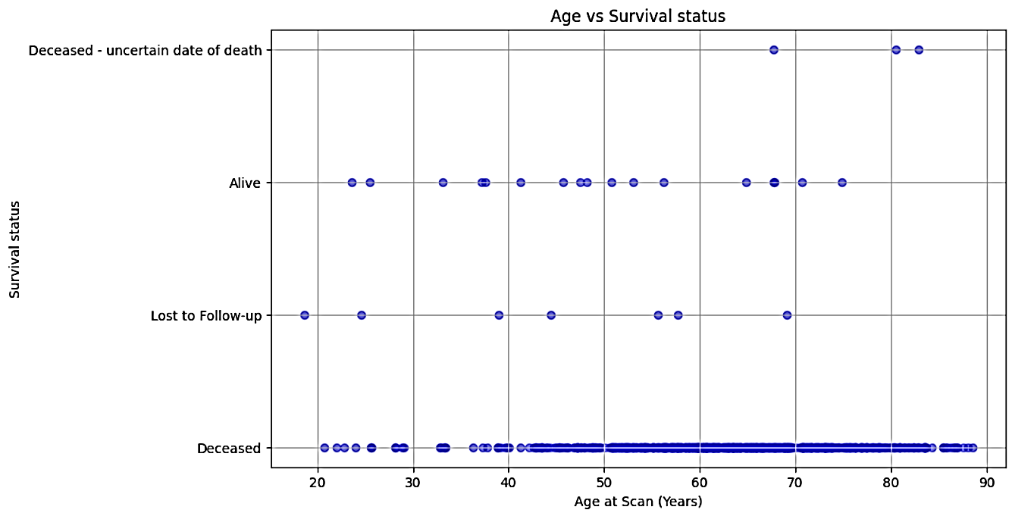
Age versus survival status
Older patients with brain tumours tend to have lower survival rates.
This trend is especially strong for younger patients (under 40).
However, for ages 40-85, the decline in survival with age is less severe.
This doesn't prove age directly causes lower survival rates.

Slide 14
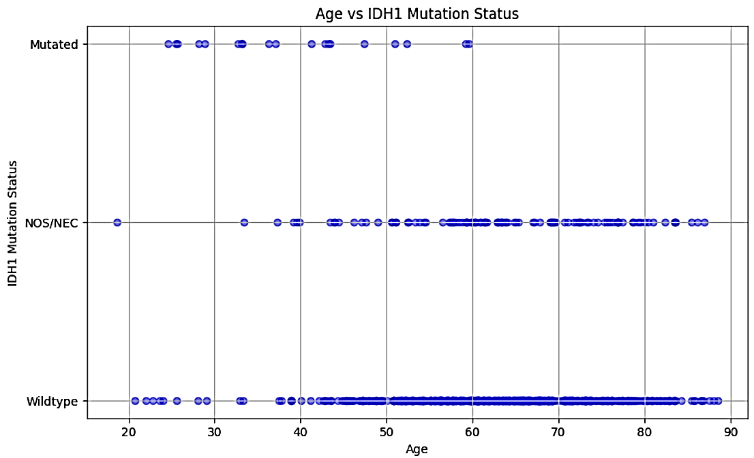
Age versus IDH1
Younger patients might have a higher chance of IDH1 mutations (more data points towards "Mutated" on the Y-axis at younger ages on the X-axis).
Conversely, older patients might have lower mutation rates (more data points on "Wildtype" or "NOS/NEC" for older ages).

Slide 15
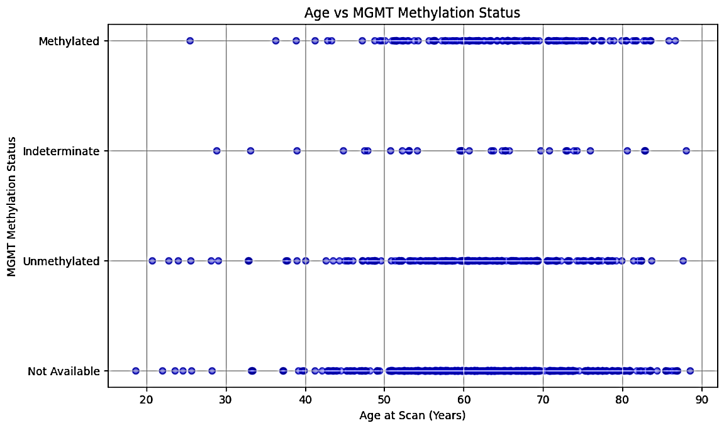
Age versus MGMT
Correlation: Older glioblastoma patients are more likely to have lower MGMT methylation levels, indicating unmethylated MGMT status.
Research Needed: Further investigation is required to confirm findings and understand underlying reasons.

Slide 16
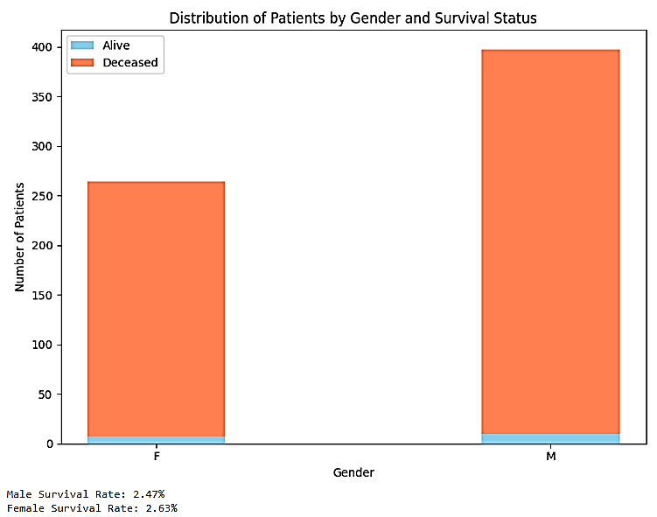
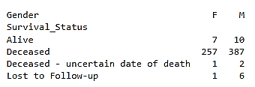
Gender versus survival status
Equal Gender Representation: Similar bar heights for each IDH1 mutation status imply comparable occurrence rates between males and females.
Consider Sample Size: The graph's findings may be influenced by a small sample size, potentially skewing the results.
Other Influences: Factors beyond gender, unexplored in this analysis, could impact IDH1 mutation status, warranting further investigation.

Slide 17
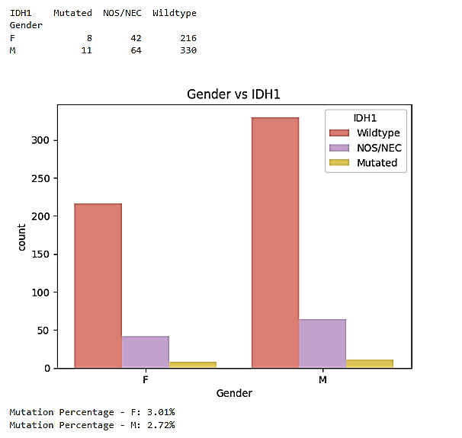
Gender versus IDH1

Slide 18
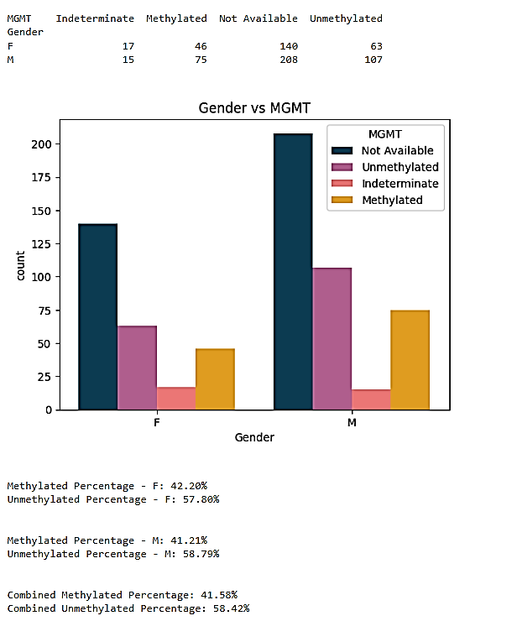
Gender versus MGMT

Slide 19
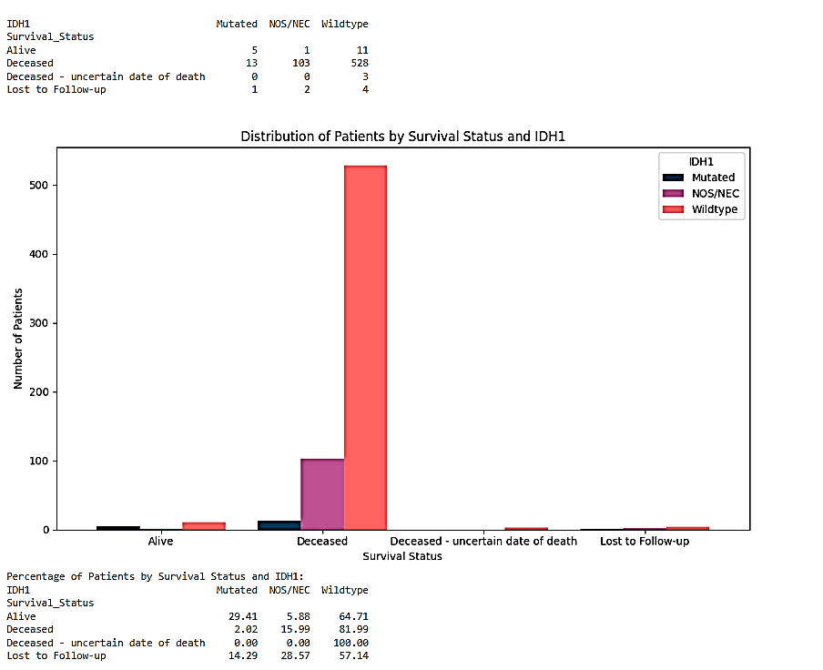
Survival status versus IDH1

Slide 20
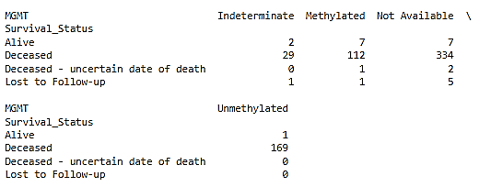
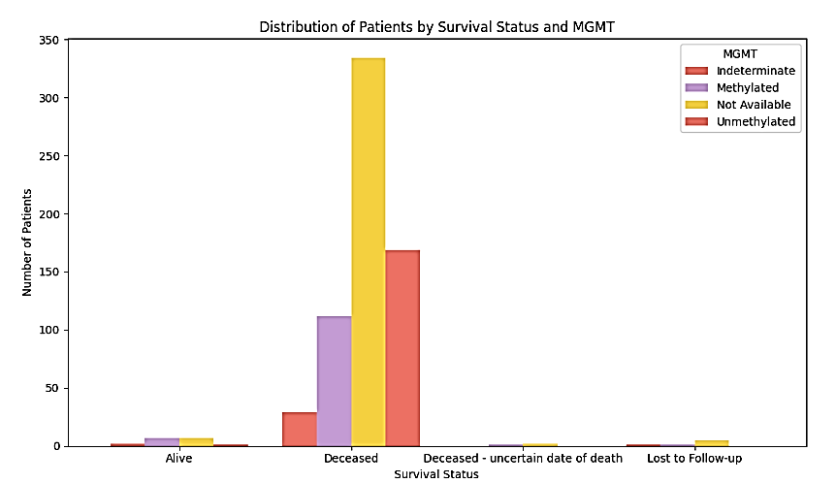
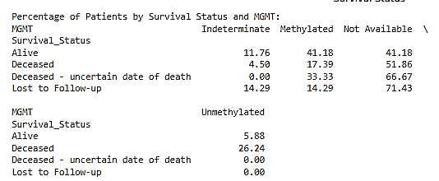
Survival status versus MGMT

Slide 21
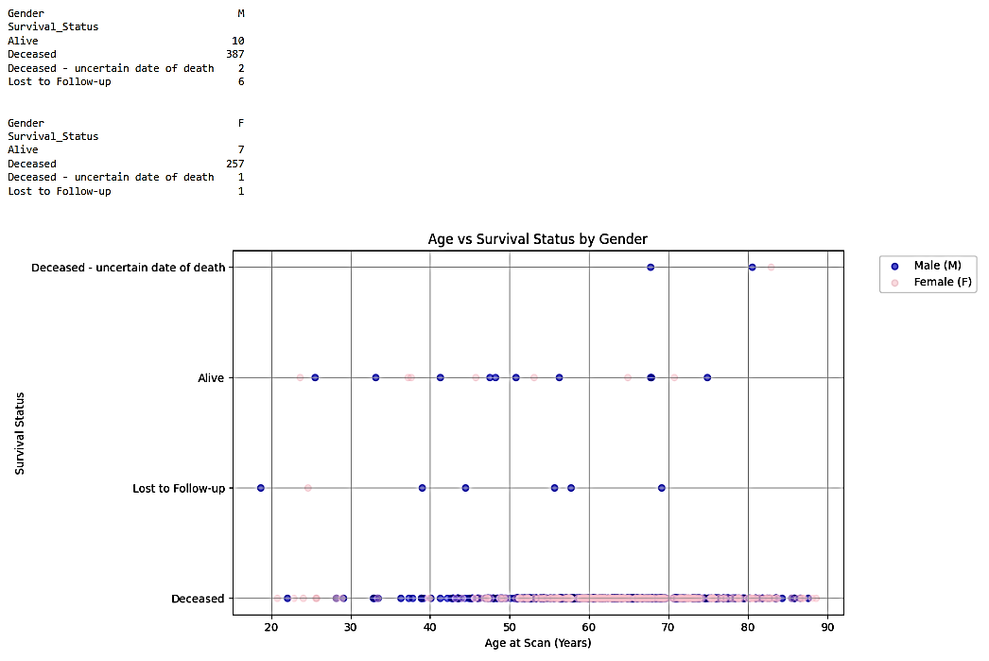
Age and Gender with Survival
High Mortality: Both genders exhibit a predominant occurrence of death ("Deceased").
Low Survival: Survival rates are generally low, with few survivors in both genders.
Similarity in Patterns: Despite potential gender differences, survival patterns remain consistent.
Gender Disparity: While there may be slight differences, both genders show comparable survival outcomes.

Slide 22
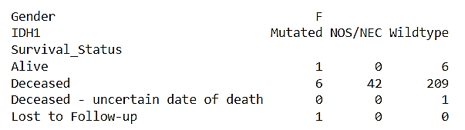
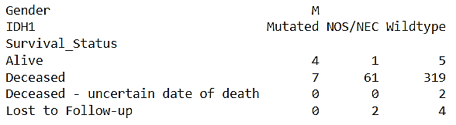
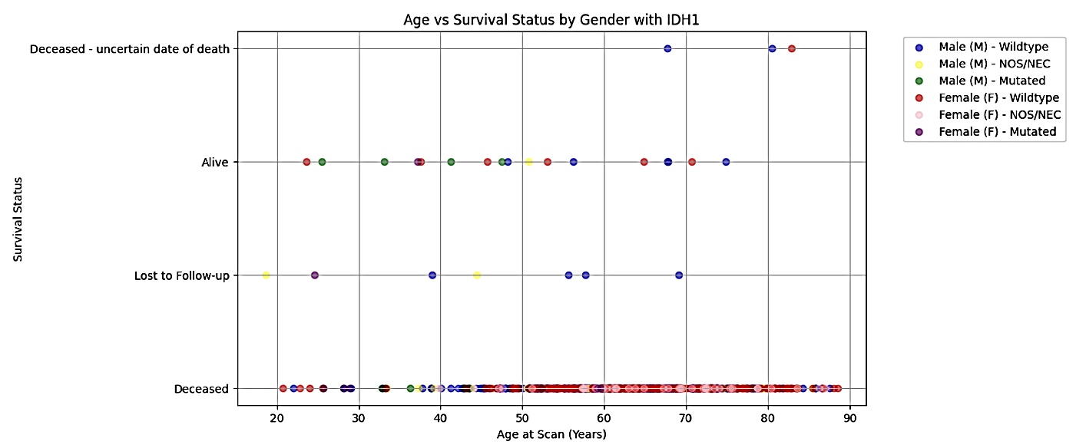
Age vs Survival Status by Gender with IDH1

Slide 23
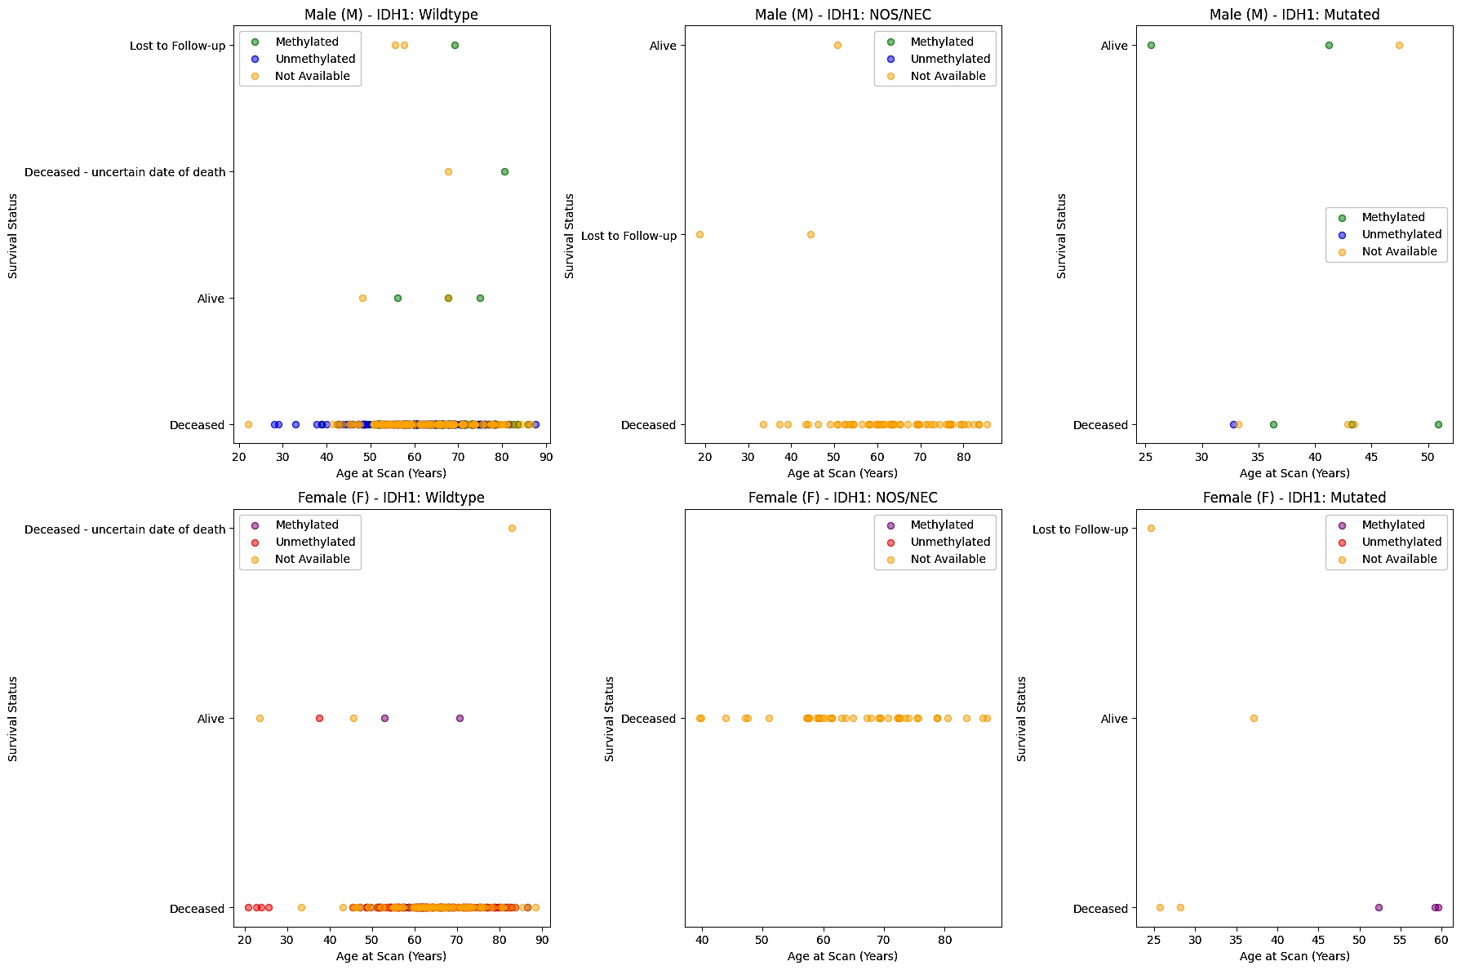
Age vs Survival Status by Gender with IDH1 and MGMT

Slide 24
Age vs Survival Status by Gender with IDH1 and MGMT

Slide 25
Conclusion
Age and IDH1 Mutation Correlation: Younger patients are more likely to have IDH1 mutations, while older patients are more likely to have the wildtype variant.
MGMT Methylation and Treatment Response: MGMT methylation improves treatment response, whereas unmethylated MGMT is linked to higher resistance.
Gender and Survival Patterns: Despite potential gender differences, survival trends remain consistent across male and female patients.

