Slide 1

Pancreatic Cancer Detection Using Machine Learning Algorithms
A Seminar Report Presented By,
Shivani Prasad
A123008
Department of Computer Science and Engineering
International Institute of Information Technology Bhubaneswar
March, 2024

Slide 2

Content
Introduction
Motivation
Aim & Objective
Literature Survey
Dataset
Proposed model
Algorithms used
Result and analysis
Conclusion
Future Scope

Slide 3
Introduction
Pancreatic cancer is a deadly disease, boasting a mere 10% survival rate over five years.
Early detection is crucial for improving survival rates.
Machine learning (ML) offers hope for early detection by analyzing vast amounts of data.
ML can detect subtle indications of pancreatic cancer, enhancing current detection methods.
Improved detection through ML can lead to timely treatment and increased survival rates.
ML has the potential to save more lives by overcoming the challenges posed by pancreatic cancer.

Slide 4
Motivation
Difficulty in early detection due to the deep-seated location of the pancreas.
Early tumours are not visible or palpable during regular physical exams.
Lack of noticeable symptoms until cancer has advanced or spread.
Increased risk for individuals with a family history of pancreatic cancer.
Early detection is crucial for improving treatment effectiveness.

Slide 5
Aim And Objective
Aim
The aim is to develop a system that accurately identifies the presence or absence of pancreatic cancer, enabling early detection, improving treatment outcomes, and ultimately saving lives.
Objective
Develop an accurate, early detection system that minimizes false positives/negatives. The model should be robust, interpretable, scalable, and integrated into clinical practice to improve patient outcomes by identifying cases early.

Slide 6
Literature Survey
Paper Title | Insights | Methods Used | Result
A combination of urinary biomarker panel and PancRISK score for earlier detection of pancreatic cancer: A case–control study [2] | The paper presents a urinary biomarker panel to detect pancreatic cancer earlier, along with a PancRISK score to stratify patients at risk. | The analysis was performed according to a prespecified plan. All analyses were performed using R version 3.5.1. | A urinary biomarker panel detects early-stage pancreatic cancer with 85% accuracy.
Early diagnosis of pancreatic cancer by machine learning methods using urine biomarker combinations [1] | In the paper, ensemble learning algorithms like LightGBM, AdaBoost, and GBC were found to be more effective in detecting pancreatic cancer. | Machine learning classifiers: LightGBM, AdaBoost, GBC Ensemble learning methods were used for classification. | Machine learning classifiers were used to detect pancreatic cancer. Ensemble learning models were more successful in classifying healthy controls and patients with PDAC.
PAD: A Pancreatic Cancer Detection based on Extracted Medical Data through Ensemble Methods in Machine Learning [4] | The paper discusses the use of ensemble approaches in machine learning to analyze pancreatic tumors for early detection of pancreatic cancer. | Ensemble approaches in machine learning Naive Bayes and Random Forest algorithms | Classification accuracy: 88.6% Error rate: 11.4%
Table 1: Papers for Literature Survey

Slide 7
Literature Survey
Paper Title | Insights | Methods Used | Result
Comparing Decision Tree and Logistic Regression for Pancreatic Cancer Classification [6] | The paper compares Decision Tree and Logistic Regression for pancreatic cancer classification, but not for detection. | Decision Tree Logistic Regression | Decision Tree: 100% accuracy. Logistic Regression: 92.68% accuracy.
Pancreatic Cancer Prediction through Convolutional Neural Networks [7] | The paper discusses the use of deep learning methods, including convolutional neural networks, for the detection of pancreatic cancer. | Deep learning methods using convolution neural networks Other machine learning algorithms | The paper explores deep learning for pancreatic cancer prediction to develop a more accurate and affordable identification method.
Construction of a convolutional neural network classifier developed by computed tomography images for pancreatic cancer diagnosis. [3] | The paper discusses the construction of a convolutional neural network (CNN) classifier for pancreatic cancer diagnosis using computed tomography (CT) images. | Construction of a convolutional neural network (CNN) classifier Evaluation of the approach using 10-fold cross validation | The overall diagnostic accuracy of the binary classifier was 95.47% on plain scans. The sensitivity for detecting cancers in the head was highest in the arterial phase.
Table 2: Papers for Literature Survey

Slide 8
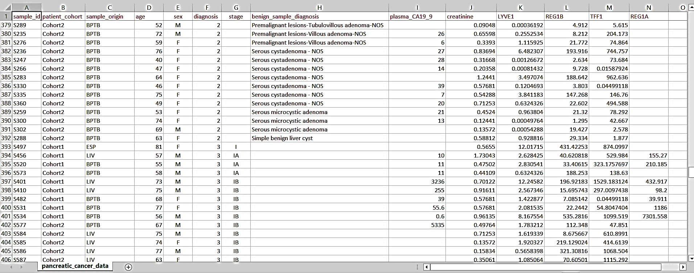
Dataset
A generic dataset is used for the proposed system, taken from the Kaggle repository. [5]
Figure 1: Dataset

Slide 9
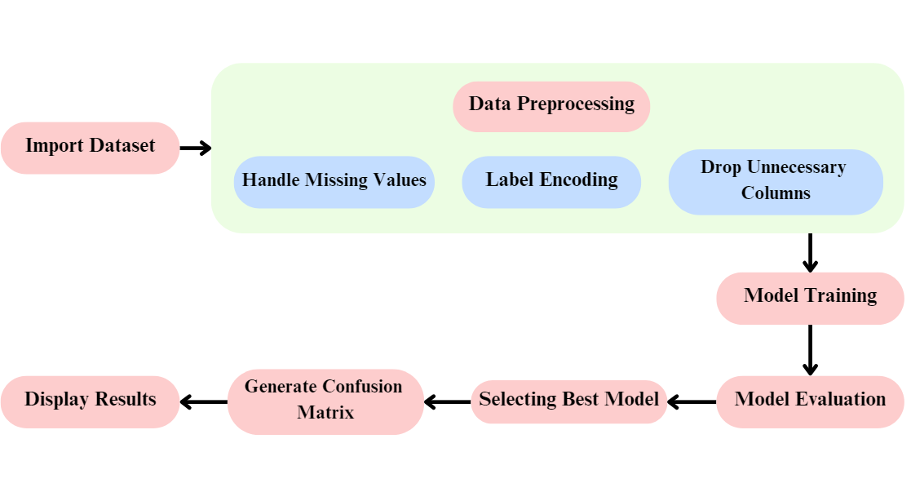
Proposed Model
Figure 2: A strategic Roadmap

Slide 10
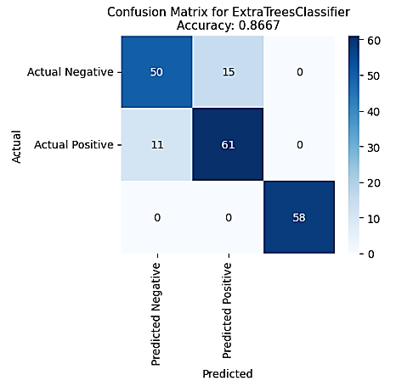
Algorithms Used
ExtraTreesClassifier (RandomForestClassifier)
Random Forest: Ensemble method constructing multiple decision trees and aggregating their predictions.
ExtraTreesClassifier: Extension of Random Forest with random subset training and splits to reduce overfitting.
TN
FP
FN
TP
Figure 3: ExtraTreesClassifier

Slide 11
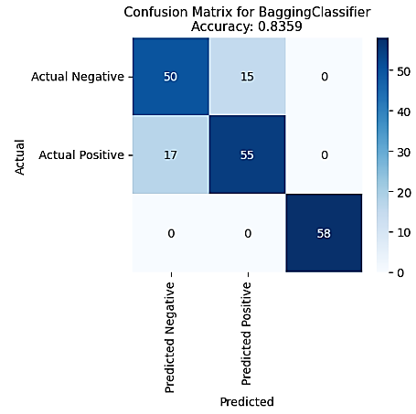
Algorithms Used
BaggingClassifier (AdaBoostClassifier)
Bagging: Technique training multiple models independently and combining predictions.
AdaBoost: Boosting algorithm sequentially combining weak learners to focus on difficult examples.
TN
FP
FN
TP
Figure 4: BaggingClassifier

Slide 12
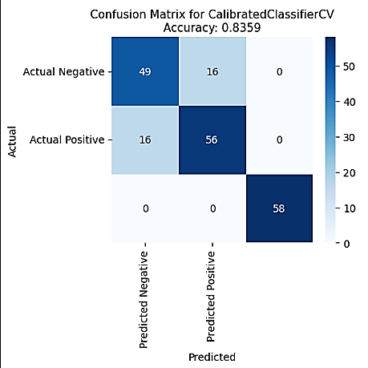
Algorithms Used
CalibratedClassifierCV (LinearSVC)
LinearSVC: Linear classifier using Support Vector Machine techniques to find the best hyperplane.
CalibratedClassifierCV: Method to calibrate predicted probabilities for more reliable decision-making.
TN
FP
FN
TP
Figure 5: CaliberatedClassifierCV

Slide 13
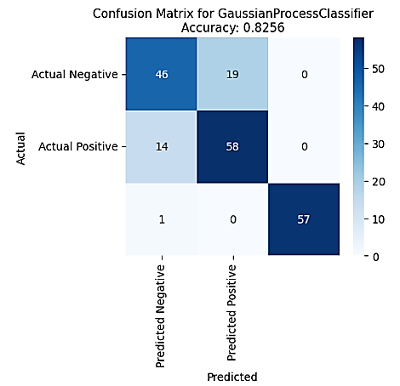
Algorithms Used
GaussianProcessClassifier (LogisticRegression)
Logistic Regression: Linear model for binary classification using Logistic function.
GaussianProcessClassifier: Probabilistic classifier based on Gaussian processes, modelling input-output relationship with multivariate Gaussian distribution.
TN
FP
FN
TP
Figure 6: GaussianProcessClassifier

Slide 14
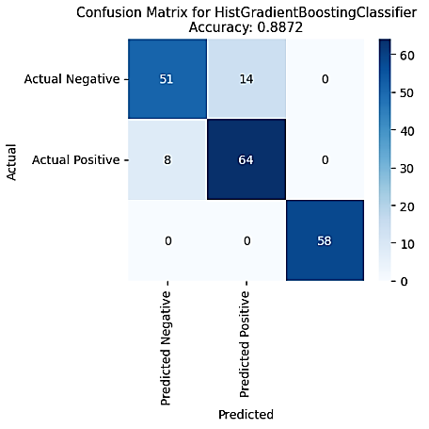
Algorithms Used
HistGradientBoostingClassifier (GradientBoostingClassifier)
TN
FP
Gradient Boosting: Ensemble technique using weak learners (typically decision trees) to optimize loss function in a stage-wise manner.
FN
TP
HistGradientBoostingClassifier: Variant using histograms for faster training, suitable for large datasets.
Figure 7: HistGradientBoostingClassifier

Slide 15
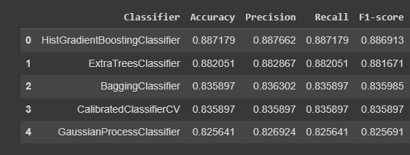
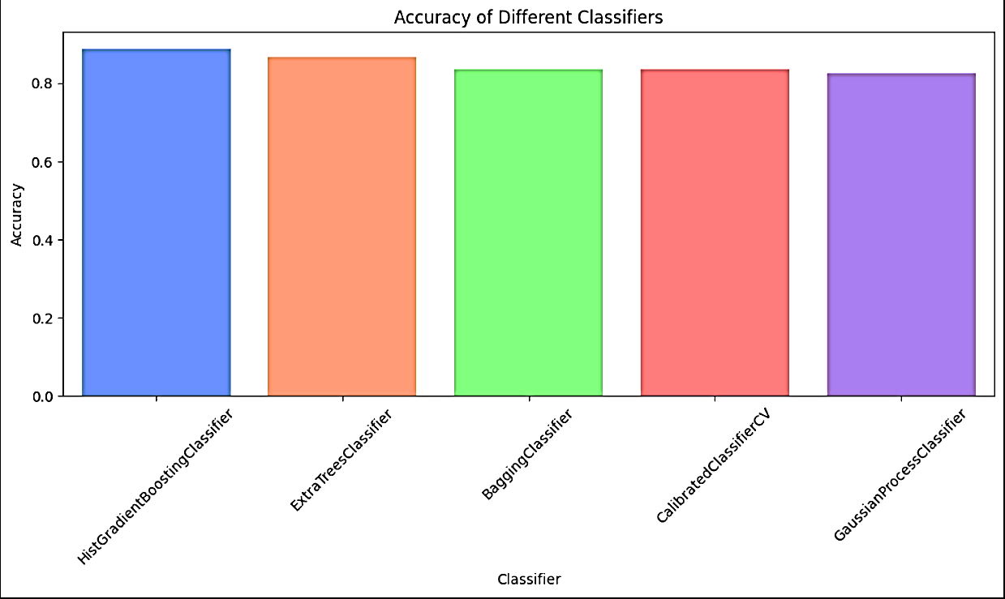
Result & Analysis
Accuracy of different Classifiers
Accuracy
Figure 8: All the classifiers and their calculations
HistGradientBoostingClassifier
ExtraTreesClassifier
BaggingClassifier
CaliberatedClassifierCV
GaussianProcessClassifier
Classifiers
Figure 9: Accuracy comparison graph

Slide 16
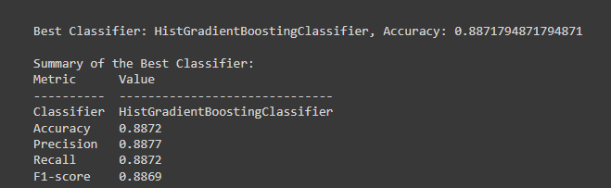




Result & Analysis
Figure 10: Best Classifier
Accuracy$= \frac{\text{Total} \text{Number} \text{of} \text{Predictions}}{\text{Number} \text{of} \text{Correct} \text{Predictions}\text{​ }}$
Recall$= \frac{\text{True} \text{Positives}}{\text{True} \text{Positives}\text{ + }\text{False} \text{Negatives} }$
Precision$= \frac{\text{True} \text{Positives}}{\text{True} \text{Positives} \text{+} \text{False} \text{Positives} }$
F1 Score$=2 \text{×} \frac{\text{Precision} \text{×} \text{Recall}}{\text{Precision} \text{+} \text{Recall}\text{​ }}$

Slide 17
Result & Analysis
The HistGradientBoostingClassifier demonstrates the highest accuracy among the classifiers evaluated. With an accuracy of 0.8872, it performs well in correctly predicting the diagnosis of pancreatic cancer cases based on the dataset features.
Precision: The precision score of 0.8877 indicates that the classifier has a high proportion of correct positive predictions among all predicted positive instances.
Recall: The recall score of 0.8872 suggests that the classifier effectively captures a high proportion of actual positive instances in the dataset.
F1-score: With an F1-score of 0.8869, the classifier achieves a balanced performance between precision and recall, considering both false positives and false negatives.
Overall, the HistGradientBoostingClassifier demonstrates robust performance across multiple evaluation metrics, making it a reliable choice for diagnosing pancreatic cancer based on the provided dataset.

Slide 18
Conclusion
The HistGradientBoostingClassifier is the top classifier with the highest accuracy and balanced precision and recall.
The dataset and selected features accurately predict pancreatic cancer diagnosis using ML algorithms.
Refining the models could improve cancer diagnosis and treatment insights..

Slide 19
Future Scope
Enhance feature selection for better extraction of pertinent information in analysis and prediction.
Utilize advanced machine-learning techniques for accurate predictions.
Integrate diverse data sources, improving insights and decision-making across various areas.

Slide 20
Reference
1. ACER, İREM, et al. “Early Diagnosis of Pancreatic Cancer by Machine Learning Methods Using Urine Biomarker Combinations.” Turkish Journal of Electrical Engineering and Computer Sciences, vol. 31, no. 1, Jan. 2023, pp. 112–25, https://doi.org/10.55730/1300-0632.3974.
2. Debernardi, Silvana, et al. “A Combination of Urinary Biomarker Panel and PancRISK Score for Earlier Detection of Pancreatic Cancer: A Case–Control Study.” PLOS Medicine, vol. 17, no. 12, Dec. 2020, p. e1003489. PLoS Journals, https://doi.org/10.1371/journal.pmed.1003489.
3. Ma, Han, et al. “Construction of a Convolutional Neural Network Classifier Developed by Computed Tomography Images for Pancreatic Cancer Diagnosis.” World Journal of Gastroenterology, vol. 26, no. 34, Sept. 2020, pp. 5156–68. www.wjgnet.com, https://doi.org/10.3748/wjg.v26.i34.5156.
4. P, Santosh Reddy, and Chandrasekar M. “PAD: A Pancreatic Cancer Detection Based on Extracted Medical Data through Ensemble Methods in Machine Learning.” International Journal of Advanced Computer Science and Applications (IJACSA), vol. 13, no. 2, 2, 51/28 2022. thesai.org, https://doi.org/10.14569/IJACSA.2022.0130218.
5. Pancreatic Cancer Disease Detection-87% Accuracy. https://kaggle.com/code/anishsamantaray/pancreatic-cancer-disease-detection-87-accuracy. Accessed 10 Mar. 2024.
6. Setiawan, Qisthina Syifa, et al. “Comparing Decision Tree and Logistic Regression for Pancreatic Cancer Classification.” 2020 International Conference on Decision Aid Sciences and Application (DASA), 2020, pp. 623–27. IEEE Xplore, https://doi.org/10.1109/DASA51403.2020.9317036.
7. Suneetha, M., et al. “Pancreatic Cancer Prediction through Convolutional Neural Networks.” 2023 7th International Conference on Intelligent Computing and Control Systems (ICICCS), 2023, pp. 602–07. IEEE Xplore, https://doi.org/10.1109/ICICCS56967.2023.10142618.

Slide 21
Thank You

