Slide 1
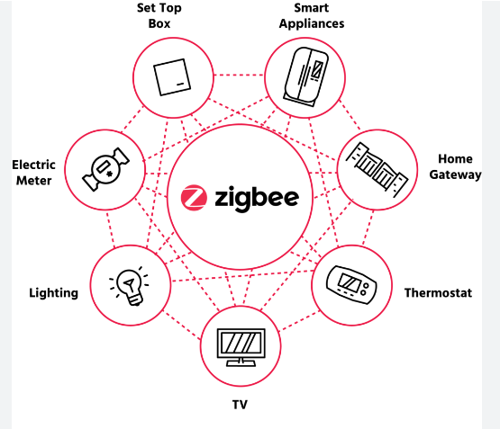
Zigbee

Slide 2
Introduction
Zigbee is a wireless technology developed as an open global standard to address the unique needs of low cost, low-power wireless IoT networks.
The Zigbee standard operates on the IEEE 802.15.4 physical radio specification
It operates in unlicensed bands including 2.4 GHz, 900 MHz and 868 MHz
The specification is a packet-based radio protocol intended for low-cost, battery-operated devices.
The protocol allows devices to communicate in a variety of network topologies and can have battery life lasting several years.

Slide 3
Features
➢ Support for multiple network topologies such as point-to-point, point-to-multipoint and mesh networks
➢ Low duty cycle – provides long battery life
➢ Low latency
➢ Direct Sequence Spread Spectrum (DSSS)
➢ Up to 65,000 nodes per network
➢ 128-bit AES encryption for secure data connections
➢ Collision avoidance, retries and acknowledgements

Slide 4
Zigbee Architecture
Zigbee architecture is also called Zigbee stack. It consists of two layers as the foundation on which Zigbee is built. They are
➢ Foundation Layers
➢ Application and Interface Section

Slide 5
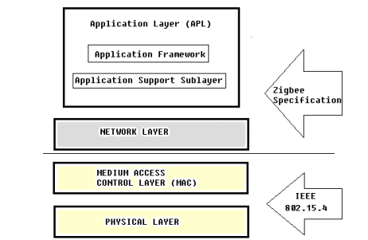

Slide 6
Foundation Layers
a. Physical Layer: The physical and electrical characteristics are defined by the Physical Layer. The functions of physical layer are:
➢ Activation and deactivation of transmission and reception.
➢ Channel selection and its assessment.
➢ Sending and receiving of packets.
b. MAC Layer: This layer provides interface between the physical and network layers. It defines how multiple 802.15.4 radios operating in the same area will share the airwaves. The various functions of MAC Layers are:
➢ Beacon generation and management.
➢ CSMA-CA (Carrier Sense Multiple Access with Collision Avoidance) is implemented.
➢ Data frame validation and acknowledgement.
➢ Data transfer for upper layers.

Slide 7
Application and Interface Section
a. Network Layer:
Network Layer provides interface between MAC layer and the application layer. It is responsible for routing and establishing different topology networking. The functions of network layer are as follows:
➢ Initiation of a network
➢ Assigning node addresses
➢ Configuring of new devices
➢ Providing secured transmission
b. Application Layer:
The Application Layer in Zigbee architecture consists of sub layers namely:
➢ Application Support Sub Layer: Filters packets for end devices, checks for duplicity of packets, maximize the chance of successful transmission, automatic check for timer expiry and maintaining binding tables.
➢ Application Framework: Implementation of end points, managing and handling data requests and confirmations.

Slide 8
Zigbee Working
A typical Zigbee network contains three different types of devices: a coordinator, routers, and end devices. These devices work with each to deliver messages and instructions from the central coordinator out to the individual end devices.

Slide 9
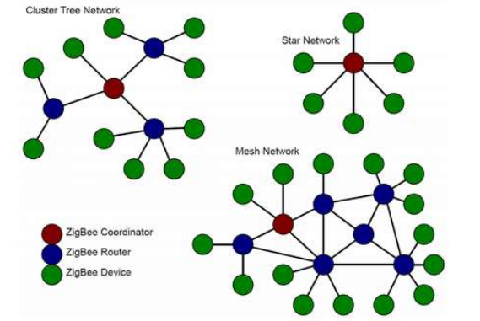

Slide 10
Advantages of Zigbee Technology
High node support: The Zigbee technology can support thousands of nodes together. It can support 65000 nodes under a single network.
Suitable for devices with low power: The Zigbee technology is suitable for devices with low power. Since it does not require much bandwidth, small smart devices which are battery-operated, object tags, sensors, etc., are suitable for this technology. It also acts as an alternative for Wi-Fi and Bluetooth technologies.
Range: Zigbee is a mesh network. Hence, just like mesh networking, Zigbee has a network whose transmission range can be expanded. It provides better stability compared to a single router, Wi-Fi or Bluetooth.
Flexible: The structure of the Zigbee technology is very flexible. It has an easy process for installation, and it is less expensive as well.
Monitoring: The Zigbee technology can be monitored and controlled easily. Since it is mainly used for home appliances, it is easy to maintain it with the help of a remote.

Slide 11
Disadvantages of Zigbee Technology
Channel noise: Zigbee technology is very prone to network interferences. This is because of overcrowding and channel noise of the network.
The transmission rate is low: The technology used in Zigbee is of low bit rate since it is designed for transmissions of low rate of data.
Security and compatibility: Zigbee technology has a lot of security threats. Since it is prone to interferences, intentional interferences can cause loss of services provided by the network, theft of data from a node, theft of an entire node. The hacker can also get access to a node and even control it in an unauthorized process. It also has compatibility issues.
Expensive: Implementation of a Zigbee technology can be expensive. There are various reasons for it. The size of the network and the range of the network affect the cost of implementation of Zigbee.

Slide 12
Applications of Zigbee Technology
Home Automation
Security Systems
Meter Reading Systems
Light Control Systems
HVAC Systems
Consumer Electronics
Gaming Consoles
Wireless Mouse
Wireless Remote Controls
Industrial Automation
Asset Management
Personnel Tracking
Livestock Tracking
Healthcare
Hotel Room Access
Fire Extinguishers

