Slide 1
FLOOD RISK MODELLING
Samhita Kanaparthy (2018121005)
Shivani Chepuri (2018122004)

Slide 2
Purpose:
Identify at-risk infrastructure and population.
Develop stronger preparedness measures for future flood events.
Planning flood mitigation measures.
For the sustainable planning of land and urban areas.
Motivation:
Intensity and damage created by some floods in India exposes the lack of capacity within institutions to respond to hydro- meteorological events in the country.
Eg. Kerala in July ’19 and Bihar in August ’19

Slide 3
Objectives:
A study of vulnerability and risk due to floods in particular to a geographical location, by doing Risk Assessment.
To develop a prototype that provides the assessment of flood consequences.
Vulnerability or Damage Analysis due to floods.
Software Requirement:
QGIS

Slide 4
Data Requirements:
Satellite Images (.TIF) of a location. Land use and Land cover data for some implementations.
Source website: EarthExplorer, etc
Input: Tentatively, we choose “Visakhapatnam” district (Andhra Pradesh State), as the area for risk analysis. We consider data of for a duration of 4 years (between 14th Oct 2010 - 14th Oct 2014)
Output: Analysis of the processed input which can give us the measure of risk in the disaster.

Slide 5
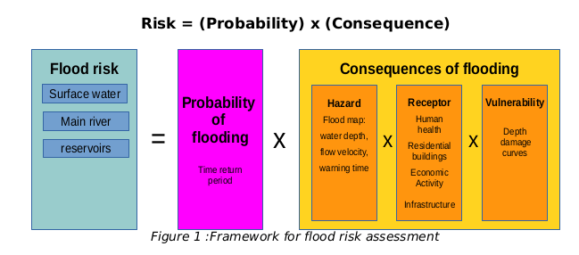
Flood Risk Assessment Framework

Slide 6
Implementation Details:
Probability of Flooding: Historical assessment of floods in an area
Hazard Assessment: Calculation of variable parameters of floodwater, eg. Depth.
Receptors/Exposure: Land use data processing
Vulnerability Assessment: Estimation of depth–damage curve/function
Generation of Flood Risk and Vulnerability/Damage maps

Slide 7
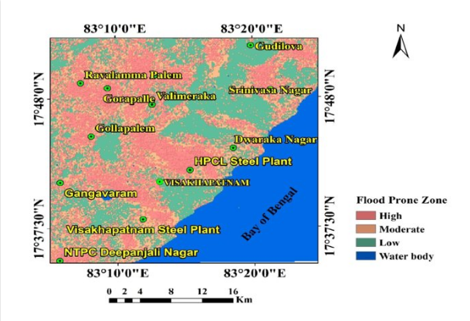
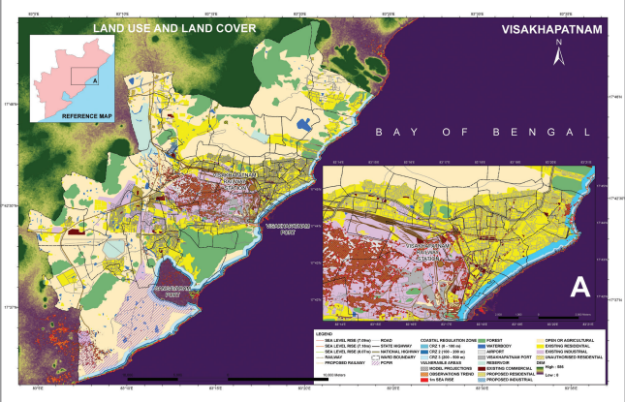
**These are images from internet

Slide 8
Work Done:
Decided the factors which can be estimated for risk assessment
Finalized the Framework for modelling
Started with Hazard estimation
Getting used to QGIS software
Generation of flood maps and Calculation of water depth

Slide 9
Applications:
Development of strategic flood risk management plans
Identifying the most appropriate areas to undertake development
Informing public about flood hazards
Emergency planning and evacuation
Asset management plans
Flood forecasting and warning systems

Slide 10
Thank you..

