Slide 1
Music Genre Classification
Aditi Sharma (MT20100)
Shivani Mishra (MT20062)

Slide 2
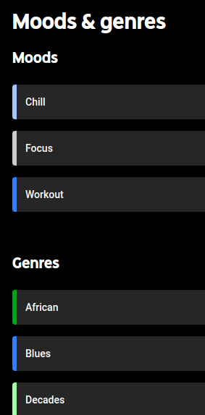
Introduction
The aim of this project was to compare machine learning algorithms in their ability to automatically classify song excerpts into the correct musical genre.
Use of music classification helps us understand creations in greater context and makes it easier to identify patterns, recommend new music to one another, and find creations that are the most satisfying to our individual tastes.
Music genres can greatly enhance our personal listening enjoyment and allow us to recognize and honor the creativity of the hardworking artists .
Our aim focuses over improving and redesigning existing ML models for better Music genre classification.

Slide 3
Existing Work
Lansdown, Bryn. (2019). Machine Learning forMusic Genre Classification.
Uses a neural network, a support-vector machine, a random forest and a gradient boosting machine.
Bahuleyan, Hareesh.(2018).Music GenreClassification using Machine Learning Techniques.
Uses deep learning approach wherein a CNN model is trained end-to-end and utilizes hand- crafted features, both from the time domain and frequency domain.
Silla Jr, Carlos N., Celso AA Kaestner, andAlessandro L. Koerich. ”Automatic music genreclassification using ensemble of classifiers.”
Uses ensemble approach, which combines the multiple feature vectors, provides better accuracy than using single classifiers and any individual music segment.
Ali,Muhammad Asim,and Zain AhmedSiddiqui. ”Automatic music genres classification using machine learning.
Uses best machine learning algorithm that predict the genre of songs using k-nearest neighbor (k-NN) and Support Vector Machine (SVM).

Slide 4
Work done after midsem
Data Collection
Songs were collected for five genres, namely- pop, rock, blues, RnB and Hip-Hop and then split into chunks of different length to analyze the effect of length of a sample on the relevant information it contains.
Separate test dataset created.
Feature Extraction
Following features were extracted and experimented with to check and carry out useful information.
Time Domain Feature - Zero Crossing Rate (ZCR), Root Mean Square Energy (RMSE), Tempo
Frequency Domain Features - MFCC, Chroma features, Spectral centroid, Spectral roll-off
Models tested on different length data
Logistic Regression (LR)
Support Vector Machine (SVM)
7-KNN
Decision Tree
Ensemble
Neural Network

Slide 5
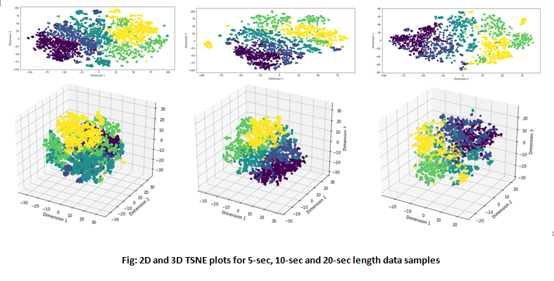

Slide 6
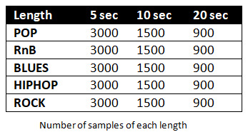
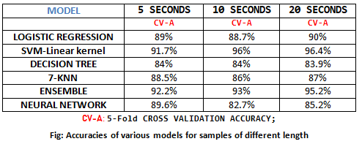
Major Work:
Important features identified out of a large number of possible features. This was done by analyzing the effect of various features on the classification of song.
Dataset created for samples of length 5 sec, 10 sec and 20 sec to analyze the effect of length on classification.
Application of various ML models on the dataset.
Comparison of performance of the applied models (given in the table)
Choosing the best performing model- SVM and Ensemble

Slide 7
FUTURE WORK
1. Collection of more data which may improve performance of used models.
2. Expanding the dataset to include more genres and sub genres which would increase the capacity to classify greater varieties of songs.
3. Analyzing the effect of presence and absence of vocals on the classification.
4. Making an end-to-end pipeline for better user experience

