Slide 1


SRPINT 1
Group: 7
Project Name: MakeMyTrip

Slide 2

Group Members:
Shikha Sharma
Shivani Bharti
Shivani Sagar
Shubhangi Patil
Smiral Bandal
Shilpa Sahare

Slide 3
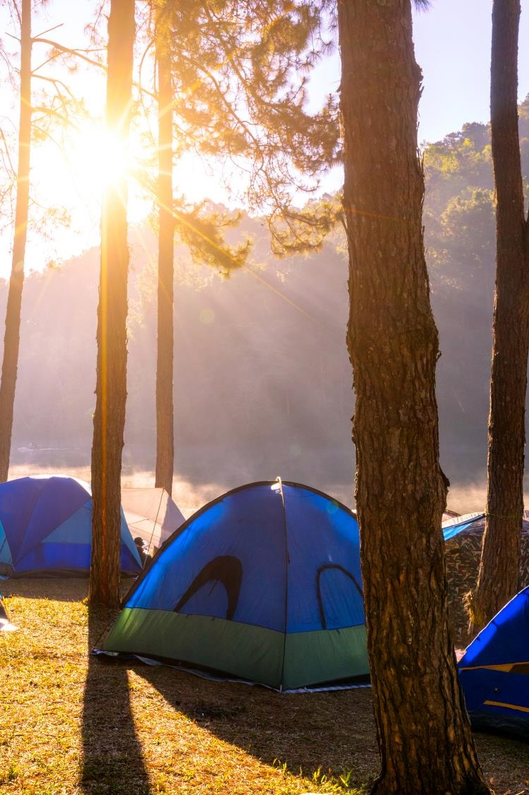
Contents:
About the Project
Role of testers in each Module
Process of Testing
Timeline
Functionalities
Epics and User Stories
Test Scenario
Test Cases
Defect Reporting
Requirement Traceability matrix
Challenges faced and overcome

Slide 4

About the Project:
MakeMyTrip is an Indian online travel company. The company provides online travel services including airline tickets, domestic and international holiday packages, hotel reservations, rail, and bus tickets.
Their mission is to provide customers a one stop shop for all their travel needs.
The Main Modules Tested for MakeMyTrip are:
Verify Home page functionality.
Verify sign in / login functionality.
Verify the Flights booking page functionality.
Verify the Hotels booking page functionality.
Verify the Train booking page functionality.
Verify Confirm booking functionality.

Slide 5
Roles of Tester in each Module:
MODULE | TESTER
Home Page Functionality | Shikha Sharma
My Account Functionality | Shilpa Sahare
Hotel Booking Functionality | Shivani Bharti
Flight Booking Functionality | Shivani Sagar
Train Booking Functionality | Shubhangi Patil
Confirm Booking Functionality | Smiral Bandal

Slide 6
Timeline:
Day 1
Divide the modules and write down the functionalities
Day 2
Write epics and user stories for each module
Day 3
Test case design and execution
Design Requirement Traceability matrix
Day 4
Evaluation
Day 5

Slide 7
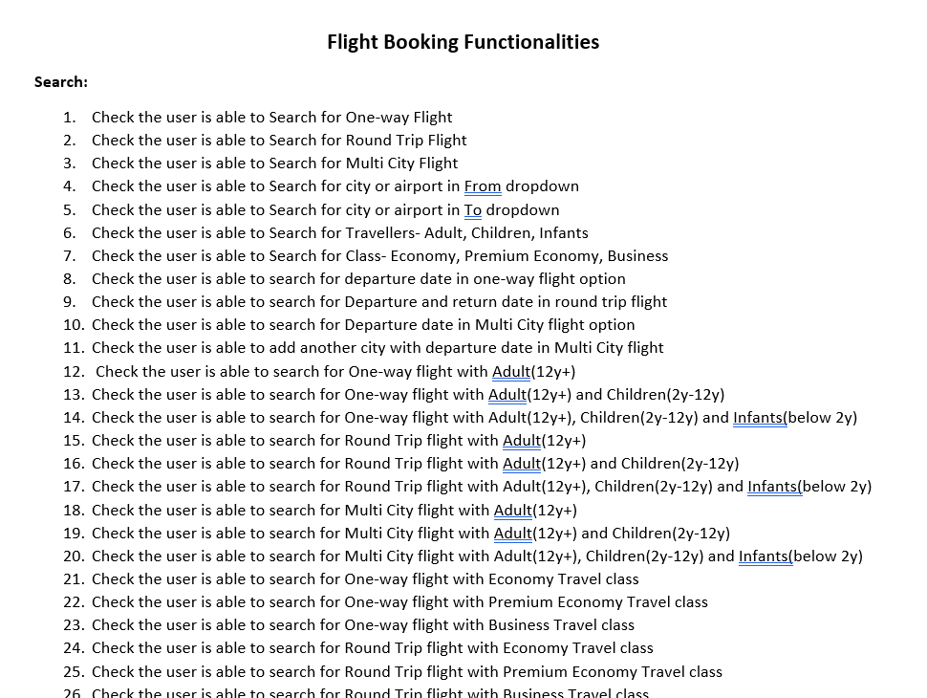
Functionalities:

Slide 8
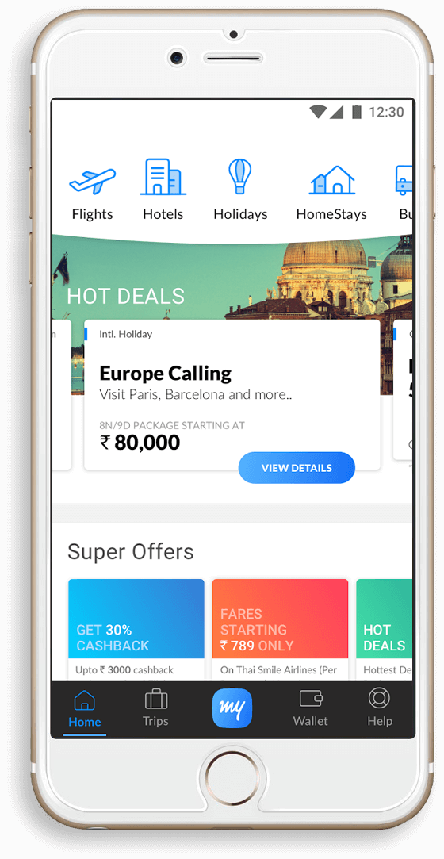
Epics and User Stories:
Epic :
An epic is a large chunk of work that you cannot deliver during one sprint.
Instead you can break it down into smaller, more specific units called User stories.
User Stories :
User stories are the smallest units of work in an agile framework.
Several similar user stories makeup an epic.

Slide 9
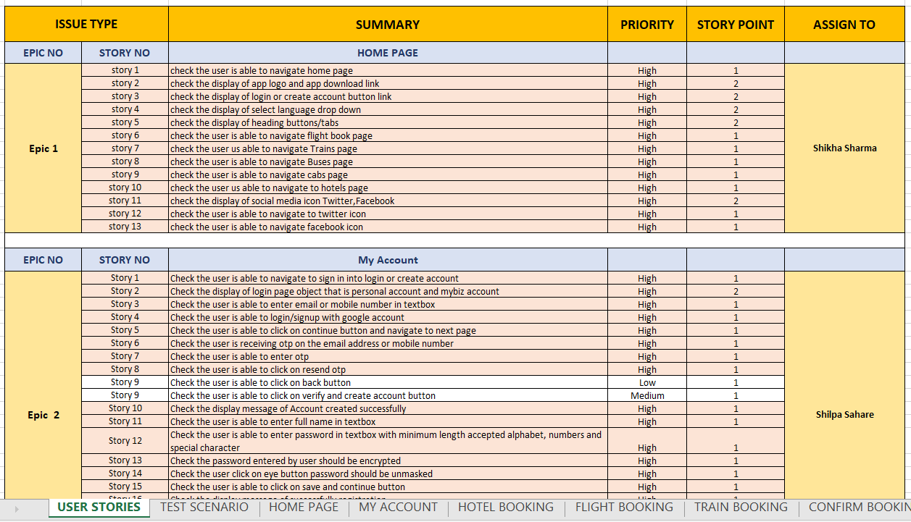

Slide 10

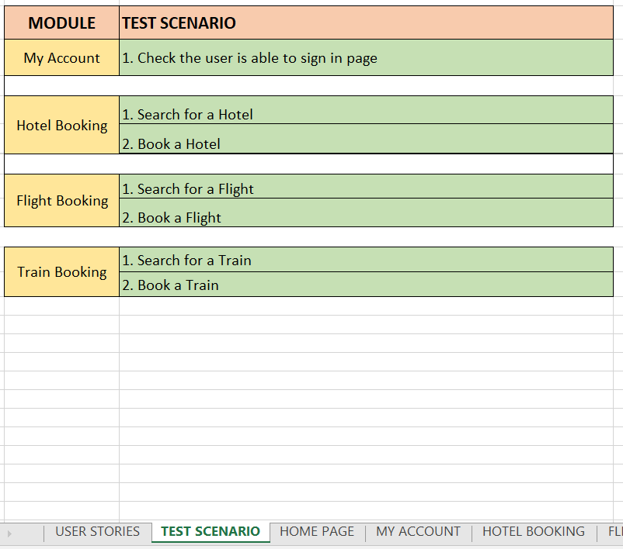
Test Scenario:

Slide 11
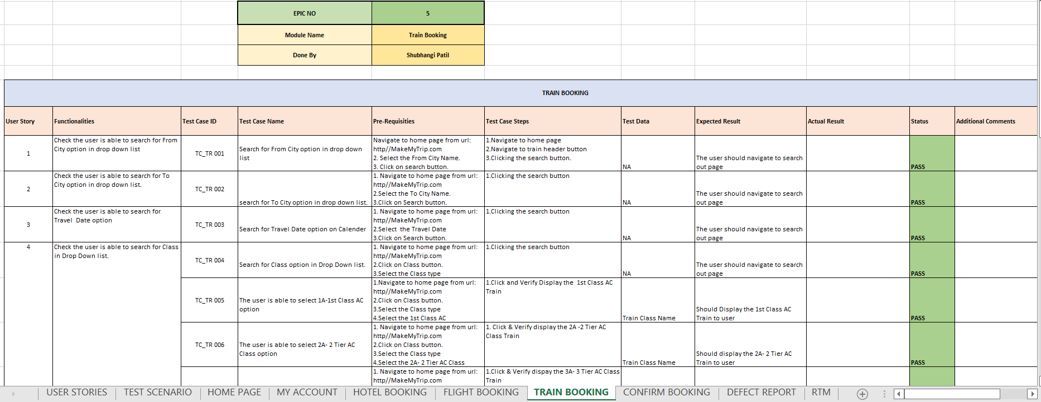
Test Cases:

Slide 12
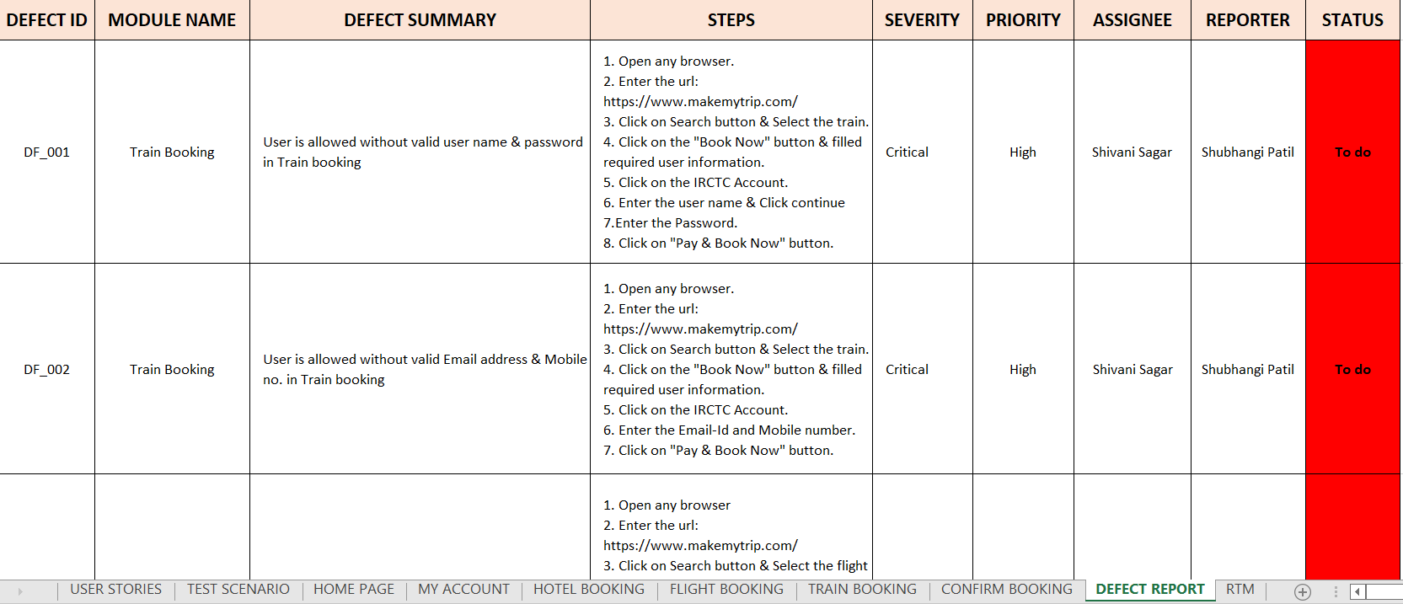
Defect Report:

Slide 13
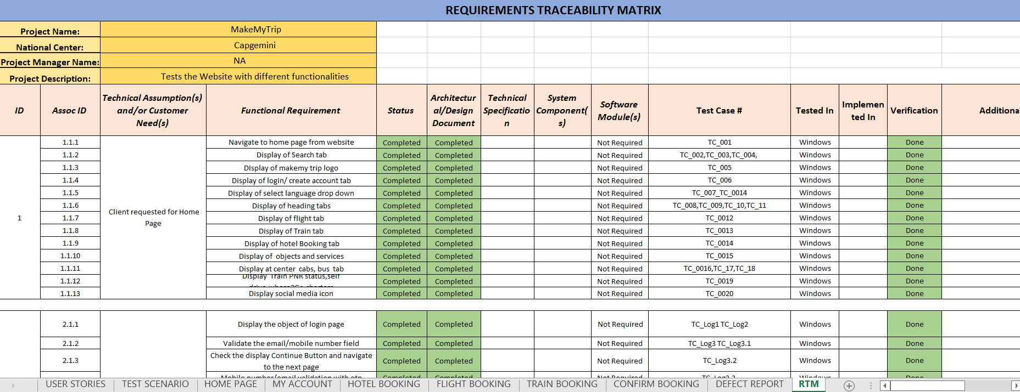
Requirement Traceability Matrix:

Slide 14
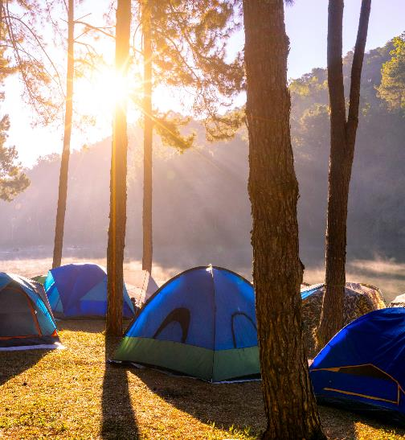


Challenges Faced:
In MakeMyTrip project we faced issues like some times website are not worked when we launch.
We face difficulty while writing the test cases at beginning.
How did we Overcome:
Under the guidance of our trainer “Naresh Sir” we overcame this challenge and with some research we are able to make our project well organized with correct Test cases of each Module functionality.

Slide 15
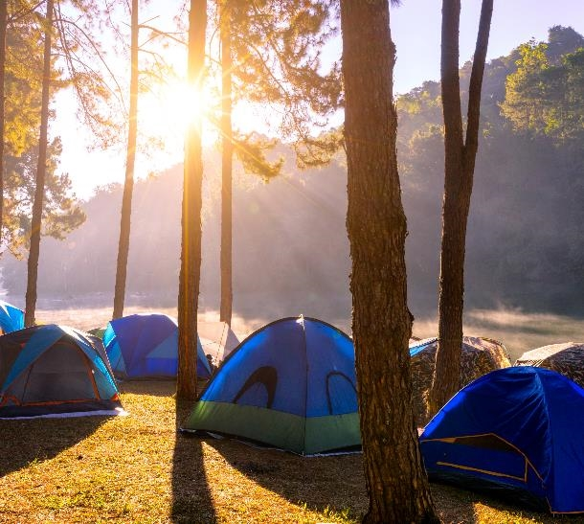



Thank you

