Slide 1
NETWORK PROGRAMMING
Prepared By
Anisha Bhandari
Prakriti Niraula
Sulav Khadka
Yojana Subedi

Slide 2
WHAT IS NETWORK PROGRAMMING?

Slide 3
JAVA PROGRAMMING PRIMITIVES
Connection-oriented Networking
Connectionless Networking
Multicast Connectionless Networking
URL-Based Programming
Remote Method Invocation(RMI)

Slide 4
Connection-oriented Networking
For connection oriented, there are two classes of sockets objects:
“Socket” and “ServerSocket”. Some of the constructors are:-
Socket(InetAddress, int) – creates a socket and connects it to the specified
port on the host at specified IP address
Socket(String, int) – creates a socket and connects it to the specified port on the host named in String

Slide 5
Connectionless Networking
Java provides a separate type of socket class for this purpose: the DatagramSocket. Constructors are:-
DatagramSocket () - This constructor creates a socket and binds it to any available port on the local machine
DatagramSocket (int) - This constructor creates a socket and binds it to the specified port on the local machine
DatagramSocket (int, InetAddress) This constructor creates a socket and binds it to the specified port/interface combination on the local machine

Slide 6
Multicast Connectionless Networking
Java provides a MulticastSocket class for this purpose as a subclass of Datagram Socket, of particular interest are the methods joinGroup and leaveGroup, which allow the system to join and leave a particular multicastgroup, and the methods getTTL and setTTL, which handle the datagram's time-to-live attribute

Slide 7
URL-Based Programming
In general terms, URLbased programming allows the programmer to focus on the concepts associated with actually handling a remote object. The constructors are:-
URL(String)- allows the creation of a URL object by specifying a complete URL specification
URL(String, String, int, String)- allows the creation of URL object by separately specifying the protocol, host name, port and file name
URL(URL, String)- allows the creation of URL by specifying its path relative to an existing URL object

Slide 8
Remote Method Invocation(RMI)
At a very high level, RMI requires the development of two components : a Java object that implements a method through a remote interface, and a Java object that remotely invokes that method. These two objects maybe on the same machine or on different machines

Slide 9
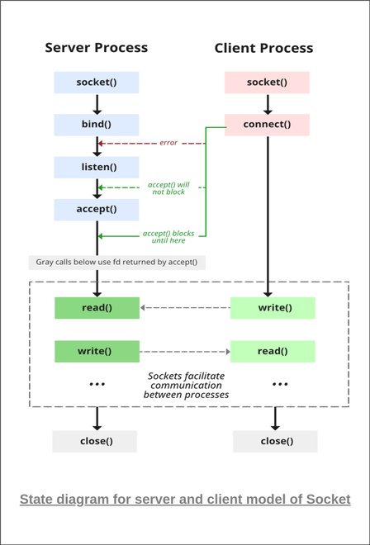
Client Server Model

Slide 10
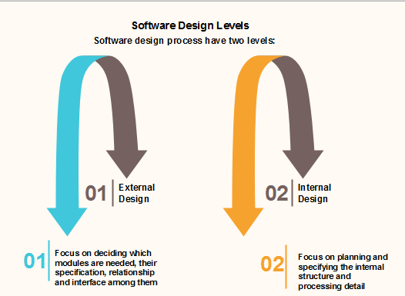
Software Design

Slide 11
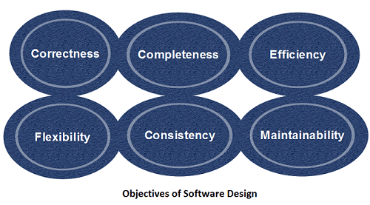
Objectives of Software Design

Slide 12
ANY QUERIES?

Slide 13
THANK YOU

