Slide 1



VYBE
Wear Your Vibe
MKTM503 · CONTINUOUS ASSESSMENT REPORT
Brand the Unbranded
Student Name | Registration Number
Shivani Sethi | 12613604
Praharsha Reddy | 12605370
Glimina C Morais | 12602119
Kunal | 12604088
Approx. 15 September – 15 October 2026
Group target: ₹20,000
₹5,000 per person · 4 members
Notes:
VYBE is the four-member T-shirt venture for Marketing Management I (MKTM503), BrandSell. The user stated an approximate start of 15 September 2026 and a deadline of 15 October 2026. The user requested editable student name and registration fields. Faculty in the tracker: Dr. Arpit Tiwari. Section: Q1P2652. The tracker’s old submission-date cell says 25 September 2026; the user’s latest deadline takes precedence. Source for the structure: CA Report Format 24-9-2026.pptx.

Slide 2
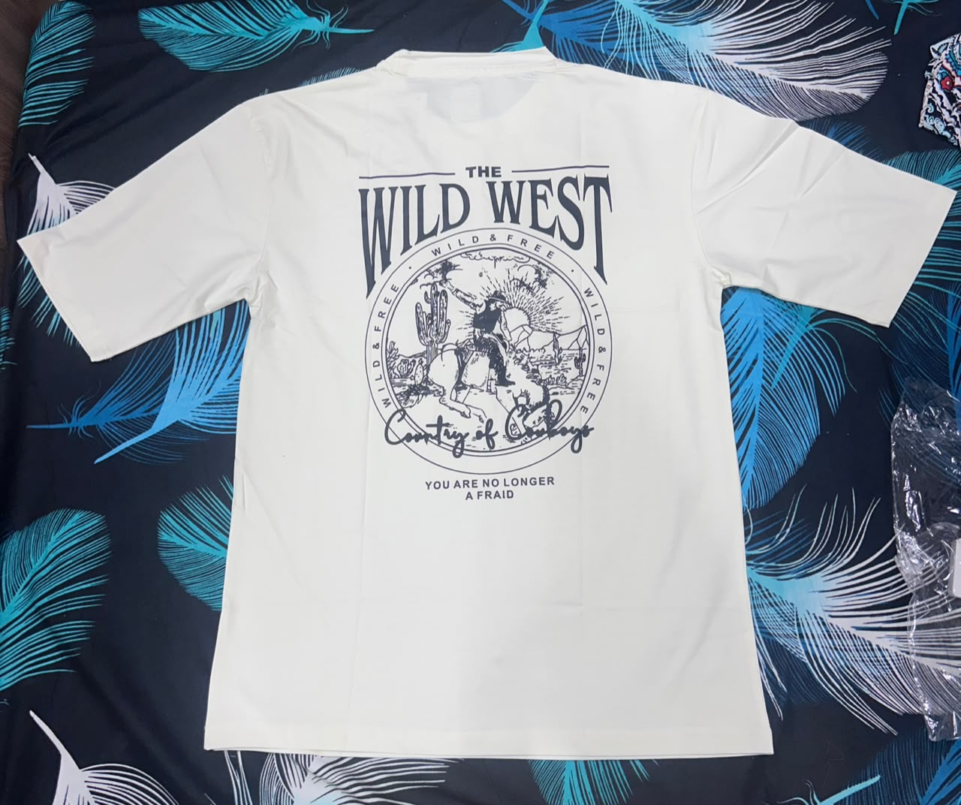
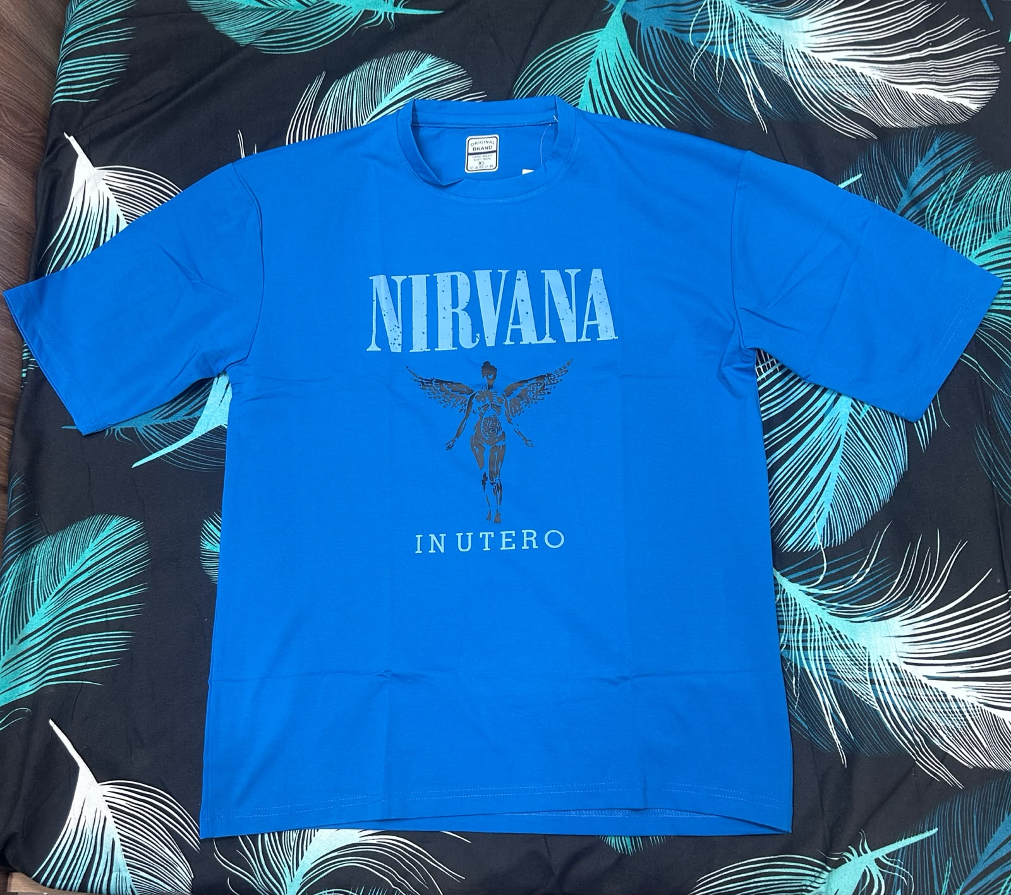
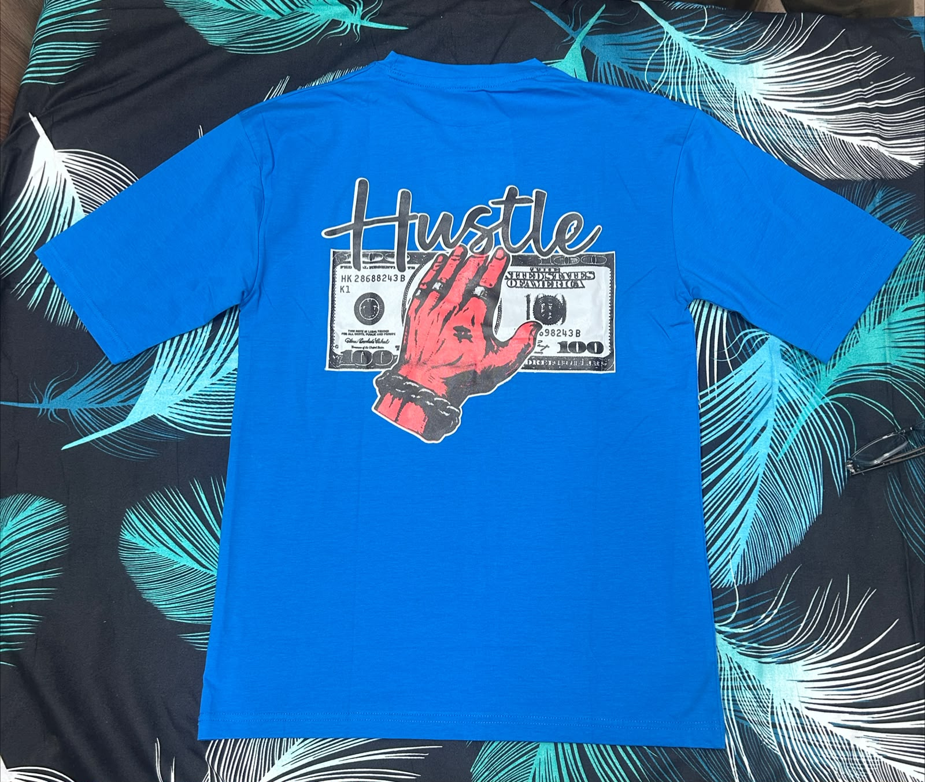
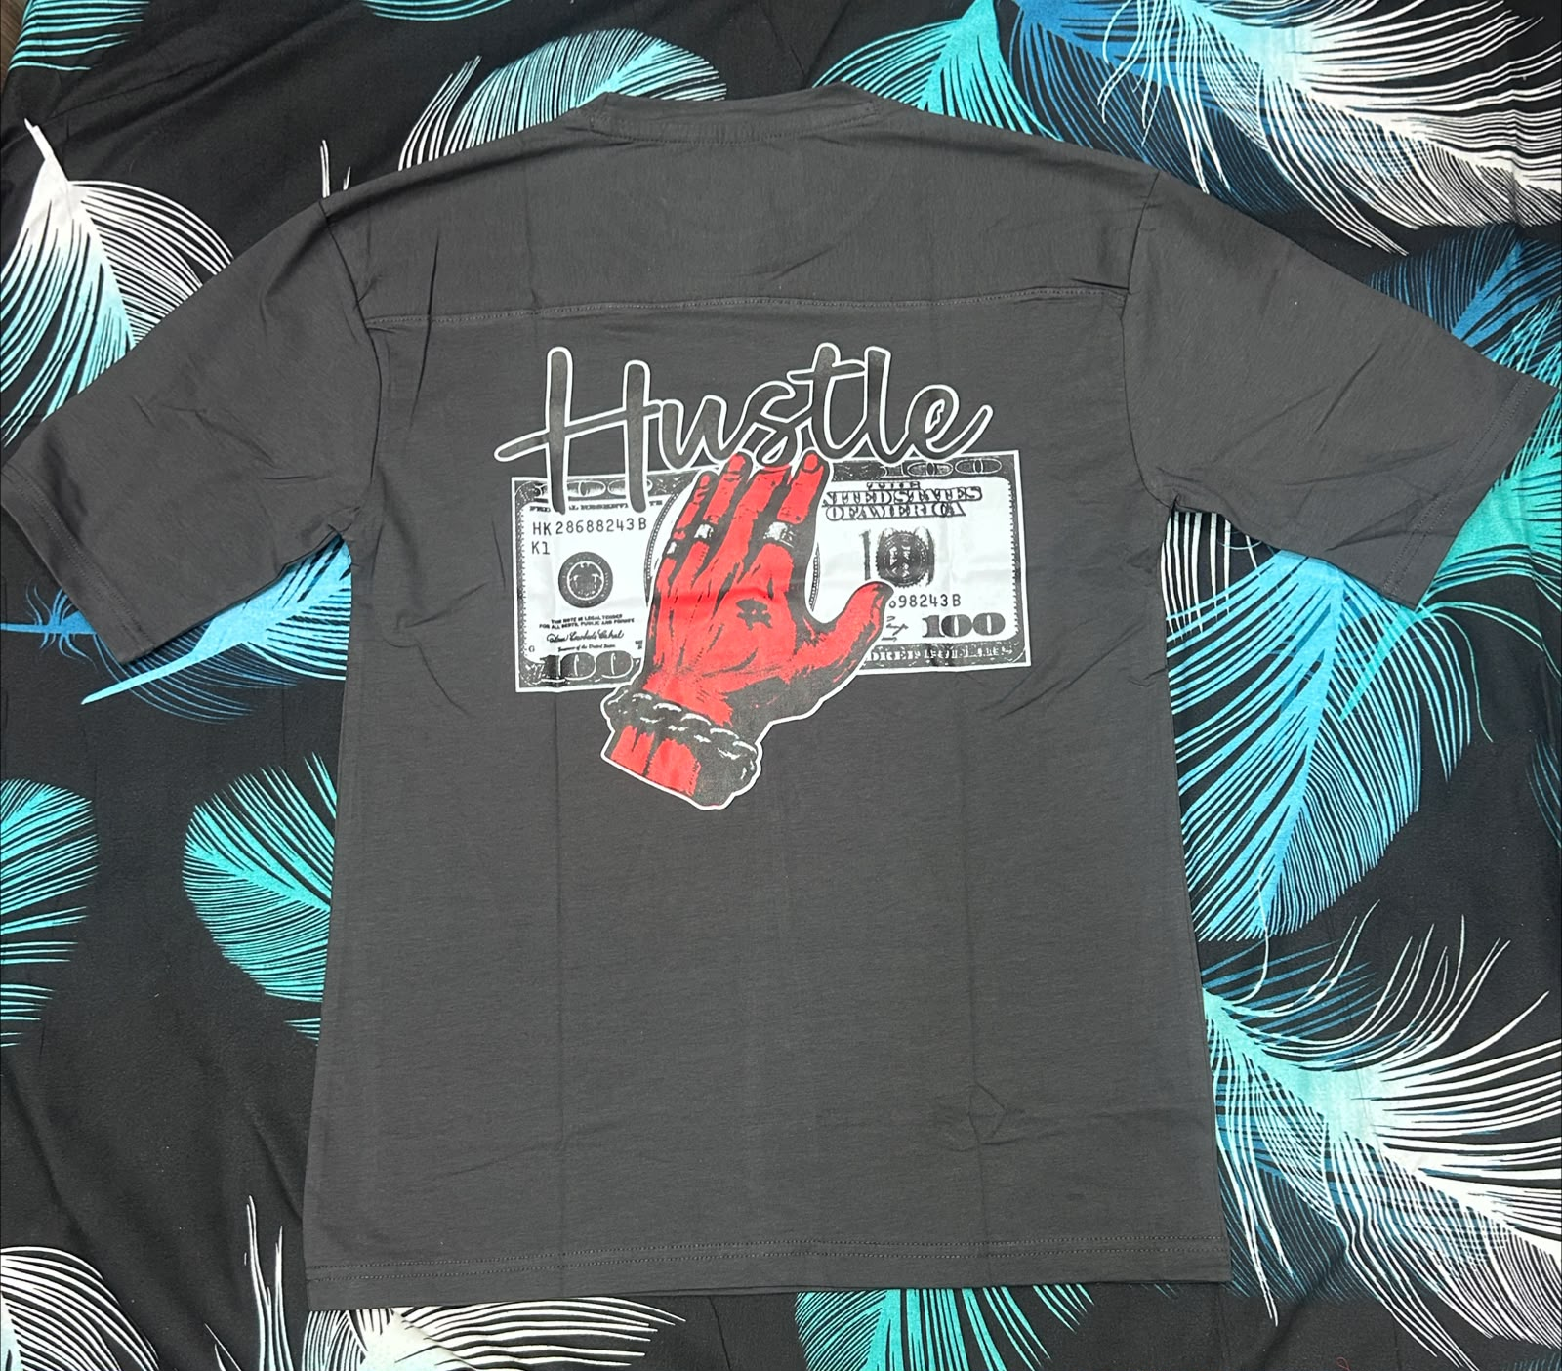
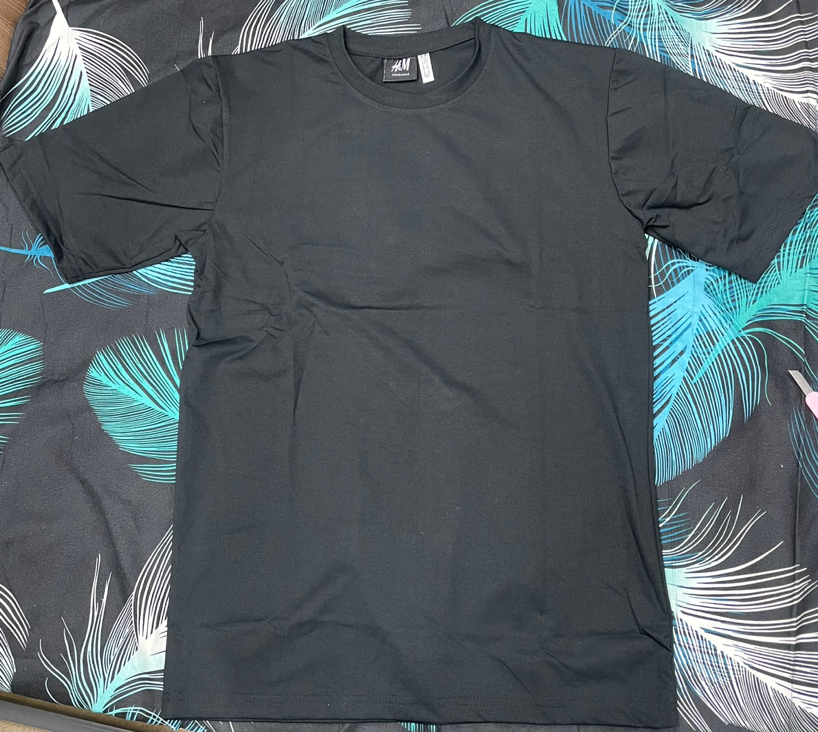
02 — THE PRODUCT
Branded Product
VYBE
Plain and printed T-shirts
Recorded prices: ₹250–₹500
Wild West print
Nirvana print
Hustle print in blue
Hustle print in charcoal
Plain charcoal T-shirt (actual product)
MKTM503 · Brand the Unbranded — CA Report
02 / 12
Notes:
Source: MKTM503 Financial Tracker 1 (1)(1).xlsx, Daily Record rows 6:88 and 6:13 (expenses), Consolidated Statement C13:C26, supplied 15 October 2026. The report uses all entries from this final tracker. Sales total INR 36,850 across 80 entries and 104 T-shirts. Plain: 39 units and INR 12,650. Printed: 65 units and INR 24,200. Mixed orders split by the stated quantities at their recorded per-unit rate. Initial T-shirt stock INR 5,040 plus restock INR 3,200 gives stock cost INR 8,240. Transportation entries of INR 400, 400, 40, 50 and 1,000 total INR 1,890. Packing is INR 500. Total recorded expenses = 8,240 + 1,890 + 500 = INR 10,630. Reported net profit = 36,850 - 10,630 = INR 26,220. Reported net margin = 26,220 / 36,850 = 71.1533243%, displayed as 71.15%. Calculations agree with the workbook consolidated statement. This is the recorded project result. B11 contains an INR 300 sale dated 16 October, after the user’s 15 October deadline. H10 contains an INR 50 expense dated 20 October and H11 an INR 1,000 expense dated 6 September. Confirm those dates against the original records. K84 and K86 repeat the same reference for two INR 400 printed T-shirt entries. Verify whether one combined payment supports both rows or an entry is duplicated. Both rows remain in the reported totals. The workbook has 80 populated proof-reference cells and 79 unique references. The Group Information submission date remains 25 September, while the Consolidated Statement report date and user deadline are 15 October 2026. The report uses the user’s project period of approximately 15 September to 15 October 2026. Four contiguous tracker blocks total INR 7,450 / 23 units, INR 9,200 / 23, INR 13,150 / 41, and INR 7,050 / 17. The group has not explicitly assigned member names to those row blocks, so those labels remain editable. Cash sales do not count under the teacher’s template.
Actual product photographs supplied by the team on 15 October 2026: WhatsApp Image 2026-10-14 at 10.42.49 PM (2).jpeg; WhatsApp Image 2026-10-14 at 10.42.42 PM.jpeg; WhatsApp Image 2026-10-14 at 10.42.47 PM.jpeg; WhatsApp Image 2026-10-14 at 10.42.48 PM.jpeg; WhatsApp Image 2026-10-14 at 10.42.49 PM.jpeg.

Slide 3
03 — STP ANALYSIS
15 MARKS
Segmentation, Targeting & Positioning
Intended customer segment and positioning
01
Segmentation
Working segment: LPU students and young adults who wear casual T-shirts. The range serves buyers who want everyday basics or graphic styles at accessible prices. Buyer demographics were not recorded.
02
Targeting
Focus on buyers seeking everyday basics or graphic styles within a ₹250–₹500 budget. Recorded purchases of both types support offering plain and printed options.
03
Positioning Statement
For budget-conscious young adults, VYBE is the casual T-shirt brand that helps them express their style because it offers plain and printed options at recorded prices of ₹250–₹500.
04
Customer Need
Plain styles meet the need for versatile everyday clothing. Printed styles offer a way to show personal taste. Recorded purchases of both types support offering a choice within the range.
MKTM503 · Brand the Unbranded — CA Report
03 / 12
Notes:
This slide provides a proposed marketing interpretation for the group to validate. No demographic survey, campus sales location, customer income, allowance or age data was supplied. The 18–28 age range is an explicitly proposed segment and must not be presented as measured buyer demographics. The budget band comes from recorded sales rates, not a willingness-to-pay survey.
Source: MKTM503 Financial Tracker 1 (1)(1).xlsx, Daily Record rows 6:88 and 6:13 (expenses), Consolidated Statement C13:C26, supplied 15 October 2026. The report uses all entries from this final tracker. Sales total INR 36,850 across 80 entries and 104 T-shirts. Plain: 39 units and INR 12,650. Printed: 65 units and INR 24,200. Mixed orders split by the stated quantities at their recorded per-unit rate. Initial T-shirt stock INR 5,040 plus restock INR 3,200 gives stock cost INR 8,240. Transportation entries of INR 400, 400, 40, 50 and 1,000 total INR 1,890. Packing is INR 500. Total recorded expenses = 8,240 + 1,890 + 500 = INR 10,630. Reported net profit = 36,850 - 10,630 = INR 26,220. Reported net margin = 26,220 / 36,850 = 71.1533243%, displayed as 71.15%. Calculations agree with the workbook consolidated statement. This is the recorded project result. B11 contains an INR 300 sale dated 16 October, after the user’s 15 October deadline. H10 contains an INR 50 expense dated 20 October and H11 an INR 1,000 expense dated 6 September. Confirm those dates against the original records. K84 and K86 repeat the same reference for two INR 400 printed T-shirt entries. Verify whether one combined payment supports both rows or an entry is duplicated. Both rows remain in the reported totals. The workbook has 80 populated proof-reference cells and 79 unique references. The Group Information submission date remains 25 September, while the Consolidated Statement report date and user deadline are 15 October 2026. The report uses the user’s project period of approximately 15 September to 15 October 2026. Four contiguous tracker blocks total INR 7,450 / 23 units, INR 9,200 / 23, INR 13,150 / 41, and INR 7,050 / 17. The group has not explicitly assigned member names to those row blocks, so those labels remain editable. Cash sales do not count under the teacher’s template.

Slide 4
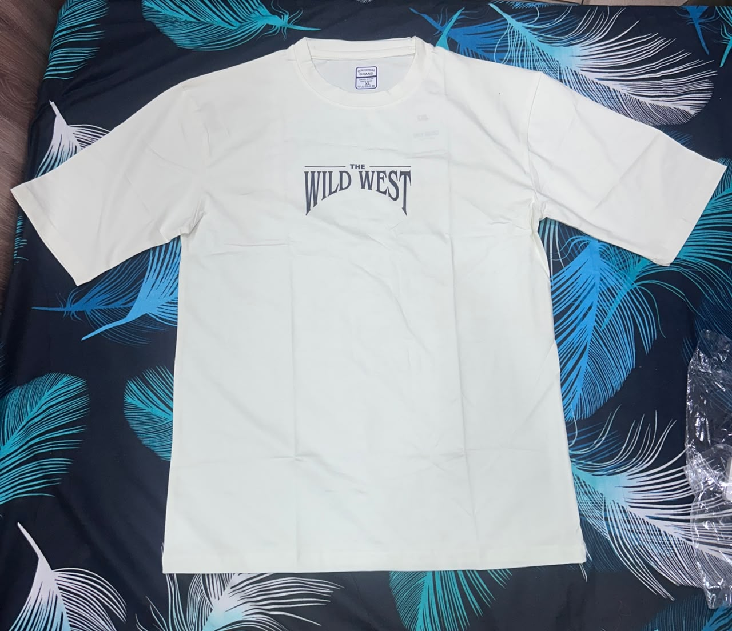
03 — STP ANALYSIS
15 MARKS
Segmentation, Targeting & Positioning
Recorded product mix: 104 T-shirts across all four tracker blocks
Printed styles account for 62.5% of recorded units.
Plain styles account for 37.5%. Both ranges generated sales.
Actual printed T-shirt, front design
MKTM503 · Brand the Unbranded — CA Report
04 / 12
Notes:
Source: MKTM503 Financial Tracker 1 (1)(1).xlsx, Daily Record rows 6:88 and 6:13 (expenses), Consolidated Statement C13:C26, supplied 15 October 2026. The report uses all entries from this final tracker. Sales total INR 36,850 across 80 entries and 104 T-shirts. Plain: 39 units and INR 12,650. Printed: 65 units and INR 24,200. Mixed orders split by the stated quantities at their recorded per-unit rate. Initial T-shirt stock INR 5,040 plus restock INR 3,200 gives stock cost INR 8,240. Transportation entries of INR 400, 400, 40, 50 and 1,000 total INR 1,890. Packing is INR 500. Total recorded expenses = 8,240 + 1,890 + 500 = INR 10,630. Reported net profit = 36,850 - 10,630 = INR 26,220. Reported net margin = 26,220 / 36,850 = 71.1533243%, displayed as 71.15%. Calculations agree with the workbook consolidated statement. This is the recorded project result. B11 contains an INR 300 sale dated 16 October, after the user’s 15 October deadline. H10 contains an INR 50 expense dated 20 October and H11 an INR 1,000 expense dated 6 September. Confirm those dates against the original records. K84 and K86 repeat the same reference for two INR 400 printed T-shirt entries. Verify whether one combined payment supports both rows or an entry is duplicated. Both rows remain in the reported totals. The workbook has 80 populated proof-reference cells and 79 unique references. The Group Information submission date remains 25 September, while the Consolidated Statement report date and user deadline are 15 October 2026. The report uses the user’s project period of approximately 15 September to 15 October 2026. Four contiguous tracker blocks total INR 7,450 / 23 units, INR 9,200 / 23, INR 13,150 / 41, and INR 7,050 / 17. The group has not explicitly assigned member names to those row blocks, so those labels remain editable. Cash sales do not count under the teacher’s template.
Unit shares: printed = 65 / 104 = 62.5%. Plain = 39 / 104 = 37.5%. These are shares of units sold, rather than unique customer counts. Product photograph: WhatsApp Image 2026-10-14 at 10.42.43 PM.jpeg.

Slide 5
04 — OPPORTUNITY
10 MARKS
Product Selection & Opportunity Justification
Sales tracker includes all four members
01
Product Introduction
We sold plain and printed T-shirts under VYBE. The final tracker records ₹8,240 for initial stock and restocking. The product photographs show the plain colours and printed styles in our range.
02
Demand Evidence
The final tracker records 80 sales entries, 104 T-shirts and ₹36,850 in sales. Both plain and printed ranges generated orders. Recorded revenue exceeds the ₹20,000 group target by ₹16,850.
03
Competitor / Substitute Mapping
Two online substitutes are a Decathlon Domyos basic T-shirt and an H&M printed T-shirt. The next slide compares their listed prices and material descriptions with VYBE.
04
Why Your Product Wins
VYBE offers both plain and graphic styles in the recorded ₹250–₹500 band. Its printed prices fall below the selected H&M listing. The Decathlon basic competes closely on price.
05
Price Viability
The tracker records purchases at ₹300, ₹350, ₹400 and ₹500 per unit. Four printed units sold at ₹250 each. These transactions show willingness to pay at the recorded prices.
MKTM503 · Brand the Unbranded — CA Report
05 / 12
Notes:
Source: MKTM503 Financial Tracker 1 (1)(1).xlsx, Daily Record rows 6:88 and 6:13 (expenses), Consolidated Statement C13:C26, supplied 15 October 2026. The report uses all entries from this final tracker. Sales total INR 36,850 across 80 entries and 104 T-shirts. Plain: 39 units and INR 12,650. Printed: 65 units and INR 24,200. Mixed orders split by the stated quantities at their recorded per-unit rate. Initial T-shirt stock INR 5,040 plus restock INR 3,200 gives stock cost INR 8,240. Transportation entries of INR 400, 400, 40, 50 and 1,000 total INR 1,890. Packing is INR 500. Total recorded expenses = 8,240 + 1,890 + 500 = INR 10,630. Reported net profit = 36,850 - 10,630 = INR 26,220. Reported net margin = 26,220 / 36,850 = 71.1533243%, displayed as 71.15%. Calculations agree with the workbook consolidated statement. This is the recorded project result. B11 contains an INR 300 sale dated 16 October, after the user’s 15 October deadline. H10 contains an INR 50 expense dated 20 October and H11 an INR 1,000 expense dated 6 September. Confirm those dates against the original records. K84 and K86 repeat the same reference for two INR 400 printed T-shirt entries. Verify whether one combined payment supports both rows or an entry is duplicated. Both rows remain in the reported totals. The workbook has 80 populated proof-reference cells and 79 unique references. The Group Information submission date remains 25 September, while the Consolidated Statement report date and user deadline are 15 October 2026. The report uses the user’s project period of approximately 15 September to 15 October 2026. Four contiguous tracker blocks total INR 7,450 / 23 units, INR 9,200 / 23, INR 13,150 / 41, and INR 7,050 / 17. The group has not explicitly assigned member names to those row blocks, so those labels remain editable. Cash sales do not count under the teacher’s template.

Slide 6
04 — OPPORTUNITY
10 MARKS
Product Selection & Opportunity Justification
Specific online substitutes · reference listings retrieved 14 October 2026
Option | Price per T-shirt | Quality / material evidence | Availability
VYBE plain | ₹300–₹400 | Actual product photographs supplied. Fabric specification not recorded. | Sales recorded during the project. Size and delivery details not recorded.
VYBE printed | ₹250–₹500 | Actual product photographs supplied. Fabric specification not recorded. | Sales recorded during the project. Size and delivery details not recorded.
Decathlon Domyos Sportee, grey | ₹299 | Listed as a cotton fitness T-shirt. Physical quality not tested. | Online listing. Size and local delivery availability vary.
H&M Regular Fit Printed, Black/Shush! | ₹699 | Listed as lightweight cotton jersey. Physical quality not tested. | Online listing with an availability check.
VYBE’s printed range costs less than this H&M example. The ₹299 Decathlon basic shows the need to compete through style choice as well as price.
Reference prices can change. Product specifications and availability differ.
MKTM503 · Brand the Unbranded — CA Report
06 / 12
Notes:
Online benchmark sources, retrieved 14 October 2026: Decathlon, Men’s Fitness Cotton T-Shirt 100 Sportee – Grey, ID 960565, listed INR 299, https://www.decathlon.in/p/960565/men-s-fitness-cotton-t-shirt-100-sportee-grey . H&M, Regular Fit Printed T-shirt, Black/Shush!, article 0684021211, indexed official product listing at INR 699 and described as lightweight cotton jersey, https://www2.hm.com/en_in/productpage.0684021211.html . H&M’s value is a reference price from the indexed official listing and should be checked before final submission. These are specific adult T-shirt substitutes, not brand-wide price averages. No physical quality test or local stock verification was performed. VYBE fabric details remain unconfirmed.
Source: MKTM503 Financial Tracker 1 (1)(1).xlsx, Daily Record rows 6:88 and 6:13 (expenses), Consolidated Statement C13:C26, supplied 15 October 2026. The report uses all entries from this final tracker. Sales total INR 36,850 across 80 entries and 104 T-shirts. Plain: 39 units and INR 12,650. Printed: 65 units and INR 24,200. Mixed orders split by the stated quantities at their recorded per-unit rate. Initial T-shirt stock INR 5,040 plus restock INR 3,200 gives stock cost INR 8,240. Transportation entries of INR 400, 400, 40, 50 and 1,000 total INR 1,890. Packing is INR 500. Total recorded expenses = 8,240 + 1,890 + 500 = INR 10,630. Reported net profit = 36,850 - 10,630 = INR 26,220. Reported net margin = 26,220 / 36,850 = 71.1533243%, displayed as 71.15%. Calculations agree with the workbook consolidated statement. This is the recorded project result. B11 contains an INR 300 sale dated 16 October, after the user’s 15 October deadline. H10 contains an INR 50 expense dated 20 October and H11 an INR 1,000 expense dated 6 September. Confirm those dates against the original records. K84 and K86 repeat the same reference for two INR 400 printed T-shirt entries. Verify whether one combined payment supports both rows or an entry is duplicated. Both rows remain in the reported totals. The workbook has 80 populated proof-reference cells and 79 unique references. The Group Information submission date remains 25 September, while the Consolidated Statement report date and user deadline are 15 October 2026. The report uses the user’s project period of approximately 15 September to 15 October 2026. Four contiguous tracker blocks total INR 7,450 / 23 units, INR 9,200 / 23, INR 13,150 / 41, and INR 7,050 / 17. The group has not explicitly assigned member names to those row blocks, so those labels remain editable. Cash sales do not count under the teacher’s template.

Slide 7

05 — BRAND IDENTITY
15 MARKS
Brand Identity, Story & Physical Expression
01
Brand Name & Logo
VYBE. Tagline: “Wear Your Vibe”. The hanger icon connects the identity directly to clothing and personal style.
02
Colour Palette
Logo red: #CB102C. Cream: #FCFCF1. The red mark stands out against the plain cream background.
03
Brand Story
Four students started VYBE for BrandSell. We brought plain and printed T-shirts under one identity, with everyday style and personal expression at its centre.
04
Packaging & Labelling
The tracker records ₹500 for packing. Original stock photographs show clear protective packaging and supplier labels. Finished VYBE packaging was not documented.
05
Sustainability
Fabric composition and packaging recyclability are unverified. Material and sustainability claims require supplier confirmation.
MKTM503 · Brand the Unbranded — CA Report
07 / 12
Notes:
Brand identity source: Red Minimalist Clothing Brand Logo.png. Original artwork is embedded, with only surrounding whitespace cropped in the slide frame. Dominant exact logo colours are RGB (203,16,44) and (252,252,241). The brand story combines user-provided project facts with editable brand articulation, not a claim about a pre-existing founder narrative. Product photos show visible supplier labels and clear plastic packaging. No manufacturing ownership, local sourcing, fabric composition or recyclability claim has been verified.

Slide 8
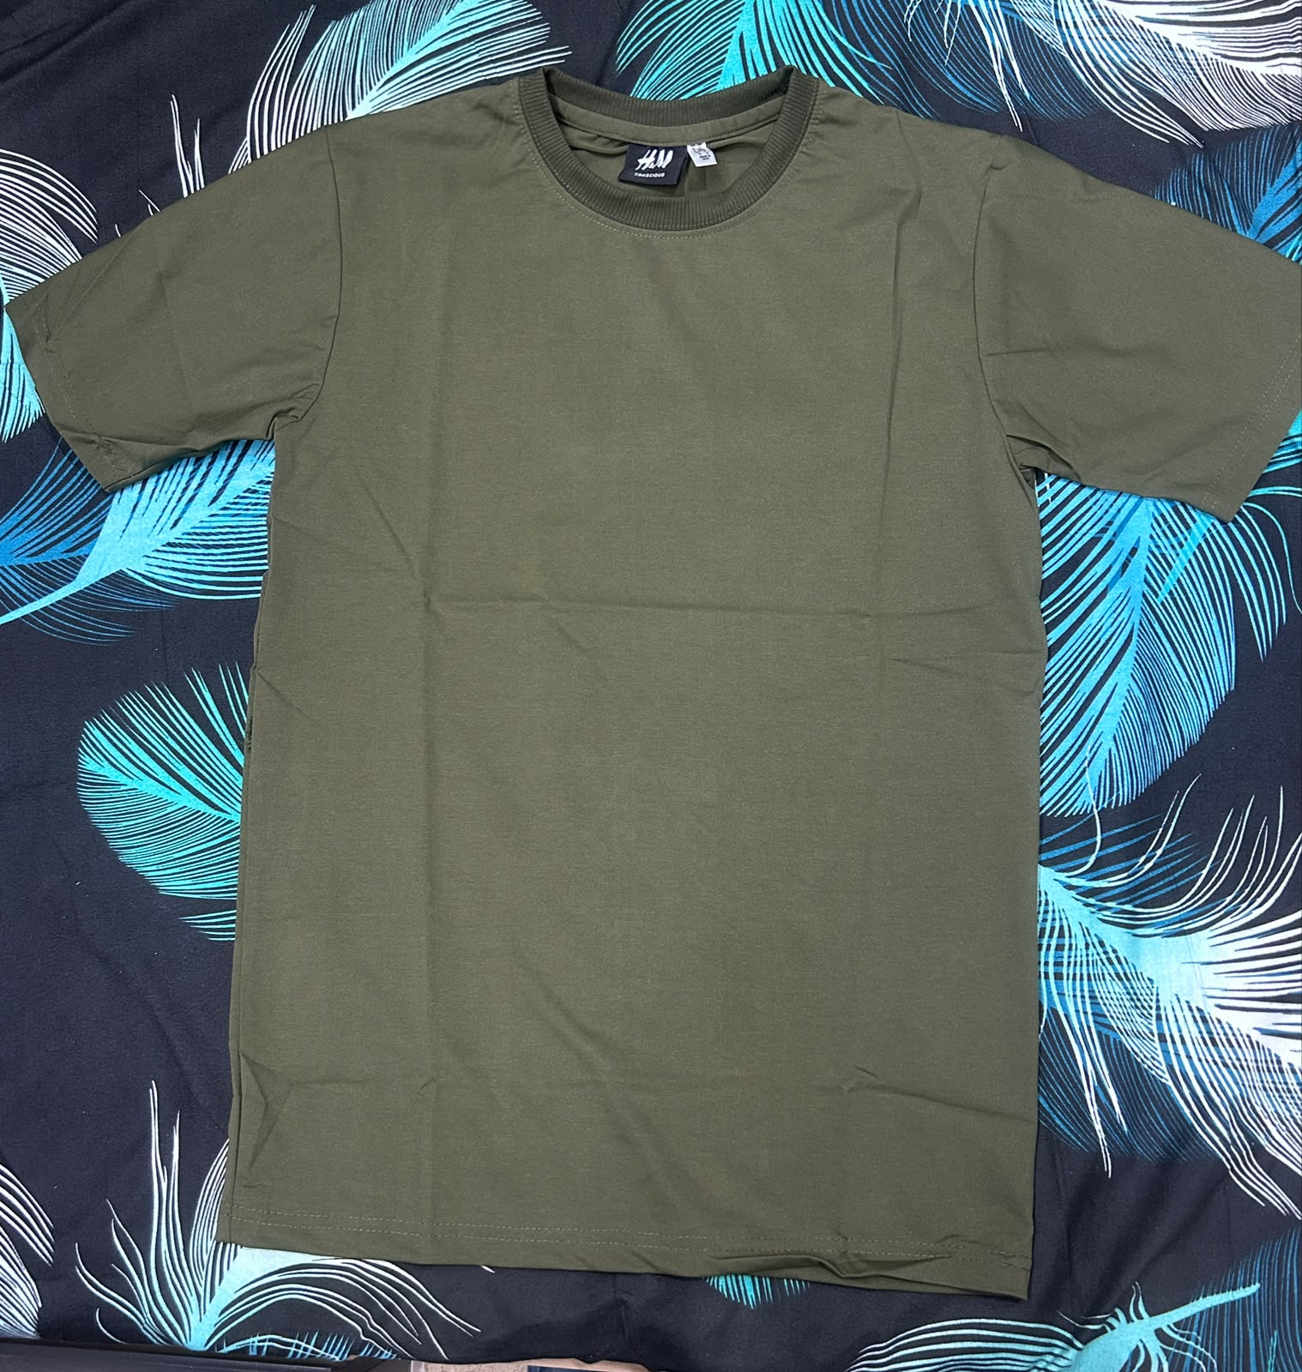
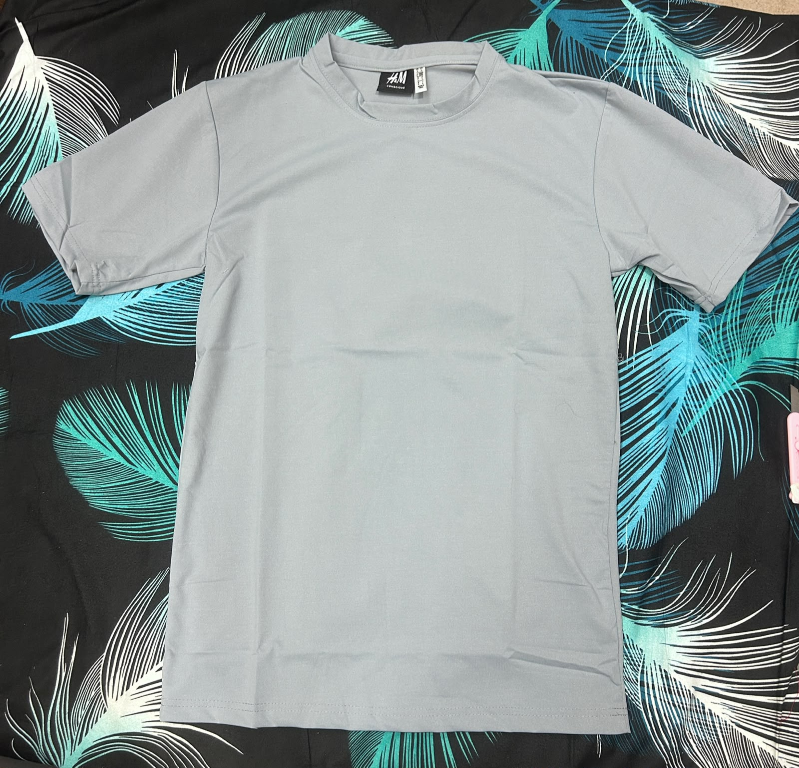
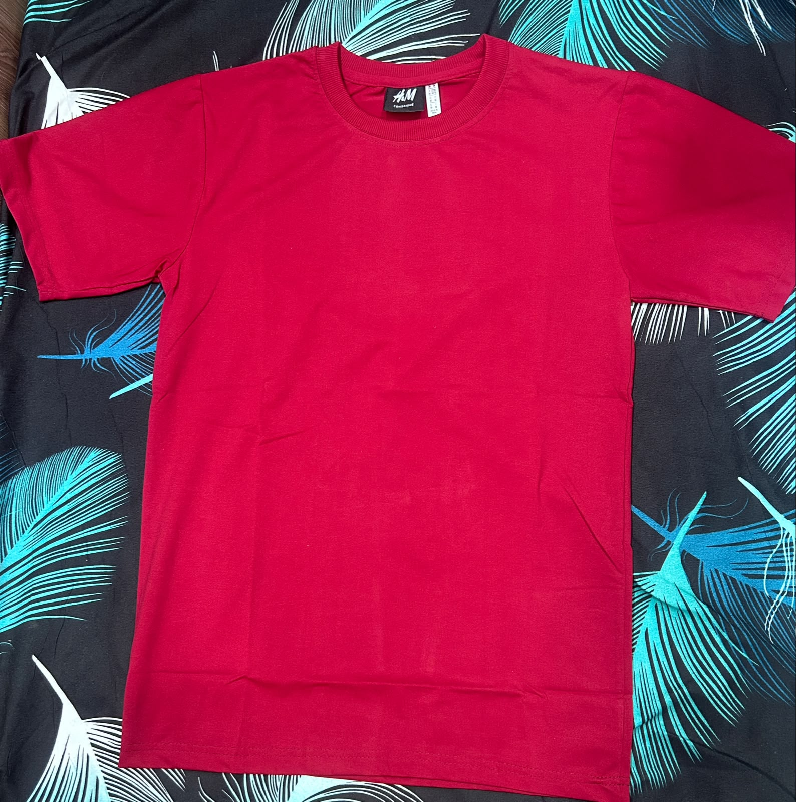
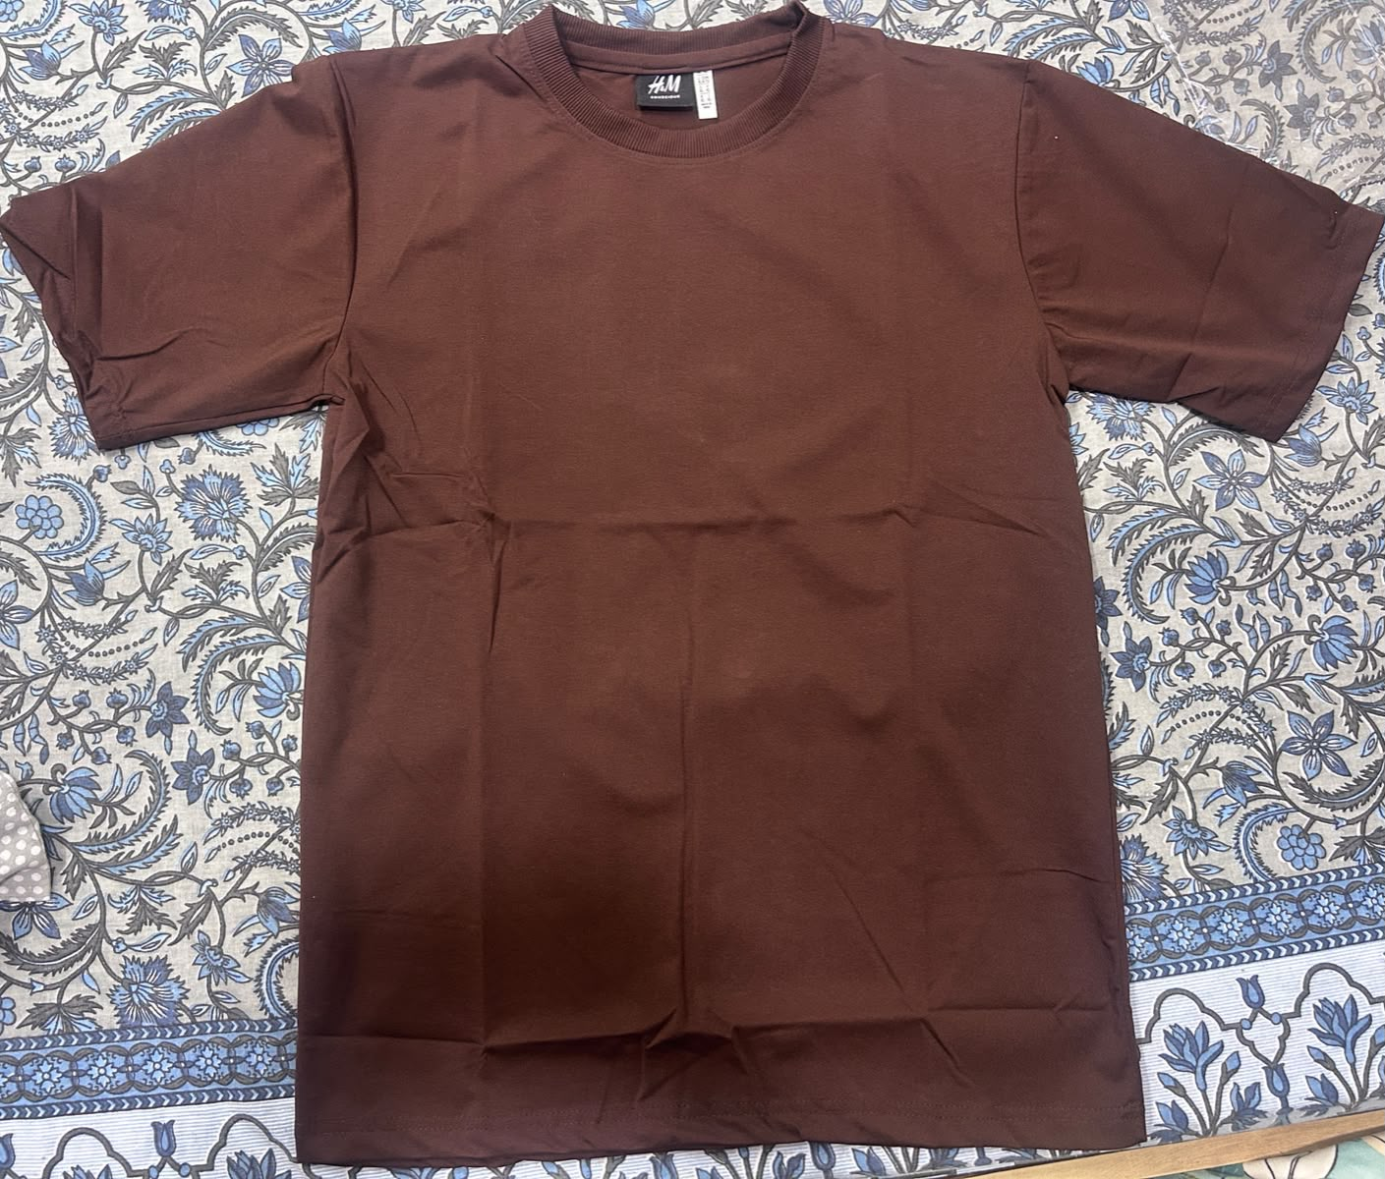
05 — BRAND IDENTITY
15 MARKS
Brand Identity, Story & Physical Expression
Plain colour range: actual product photographs
Olive green plain T-shirt
Grey plain T-shirt
Brown plain T-shirt
Red plain T-shirt
MKTM503 · Brand the Unbranded — CA Report
08 / 12
Notes:
Actual product photographs supplied by the team on 15 October 2026: WhatsApp Image 2026-10-14 at 10.42.50 PM (1).jpeg; WhatsApp Image 2026-10-14 at 10.42.50 PM (2).jpeg; WhatsApp Image 2026-10-14 at 10.42.51 PM (1).jpeg; WhatsApp Image 2026-10-14 at 10.42.51 PM.jpeg. These illustrate the plain colour range. Packaging cost of INR 500 appears in Daily Record J13 of the final tracker.

Slide 9
06 — DIGITAL PRESENCE
10 MARKS
Digital Presence & Engagement
Marketing activities used during the project
01
Platform & Page
We used WhatsApp and WhatsApp Status for promotion. We also created an Instagram profile for VYBE.
02
Asset Quality
Our brand assets include the VYBE logo and actual photographs of the plain and printed T-shirt range.
03
Content Variety
Digital promotion included WhatsApp communication and Status updates. Instagram activity was limited to profile creation, with no posts, reels or stories published.
04
Copywriting
Suggested promotional wording: “Plain or printed? Wear Your Vibe. Message VYBE to enquire.”
05
Audience Engagement
We reached classmates and personal contacts, supported by referrals and word of mouth. The tracker does not record sales by marketing channel.
MKTM503 · Brand the Unbranded — CA Report
09 / 12
Notes:
Source: the team’s statement in this conversation on 15 October 2026 confirms use of WhatsApp, classmates, personal contacts, referrals, WhatsApp Status, word of mouth and Instagram profile creation. The team explicitly states that it published no Instagram posts, reels or stories. These slides report the team’s stated activities. There are no channel-level reach, response, follower, enquiry, conversion or sales counts in the supplied tracker. No such values are inferred. Suggested promotional wording is a proposed copy example, rather than a claimed published caption. The Instagram account handle and screenshot have not been supplied, so no account identity or screenshot is invented.

Slide 10
06 — DIGITAL PRESENCE
10 MARKS
Digital Presence & Engagement
Customer outreach and sales promotion
Channel | How we used it | Marketing role
WhatsApp & WhatsApp Status | Promoted VYBE through WhatsApp communication and Status updates. | Digital promotion
Classmates & personal contacts | Reached buyers through our classmates and personal networks. | Personal selling
Referrals & word of mouth | Used personal recommendations to spread awareness of VYBE. | Recommendations
Instagram profile | Created an Instagram profile for VYBE. | Brand setup only. No posts, reels or stories.
Overall recorded result: 104 T-shirts sold across 80 sales entries, with ₹36,850 revenue.
The tracker records group totals without attributing sales to individual marketing channels.
MKTM503 · Brand the Unbranded — CA Report
10 / 12
Notes:
Source: the team’s statement in this conversation on 15 October 2026 confirms use of WhatsApp, classmates, personal contacts, referrals, WhatsApp Status, word of mouth and Instagram profile creation. The team explicitly states that it published no Instagram posts, reels or stories. These slides report the team’s stated activities. There are no channel-level reach, response, follower, enquiry, conversion or sales counts in the supplied tracker. No such values are inferred. Suggested promotional wording is a proposed copy example, rather than a claimed published caption. The Instagram account handle and screenshot have not been supplied, so no account identity or screenshot is invented. Overall recorded sales of INR 36,850 from 104 T-shirts and 80 sales entries are retained from the financial tracker MKTM503 Financial Tracker 1 (1)(1).xlsx, Daily Record and Consolidated Statement C13:C14. They are group totals, not an attribution of revenue to any particular channel. The source financial slide’s date and payment-reference checks remain applicable.

Slide 11
07 — RESULTS
45 MARKS
Revenue Generated
TOTAL COST
TOTAL REVENUE
TOTAL PROFIT
₹10,630
₹36,850
₹26,220
8 expense entries in final tracker
104 T-shirts across 80 sales entries
Reported net margin: 71.15%
Tracker block | Sales (₹) | Units
Praharsha Reddy | 7,450 | 23
Shivani Sethi | 9,200 | 23
Glimina C Morais | 13,150 | 41
Kunal | 7,050 | 17
Recorded total | 36,850 | 104
Target: ₹20,000
Recorded revenue: 184.25% of target
Stock ₹8,240. Transport ₹1,890. Packing ₹500.
80 sales entries / 79 unique payment refs.
Complete receipts folder: https://drive.google.com/file/d/1oq4wVhC4_Tj6-2-VNfSH3vJ9mkmXiucm/view?usp=sharing
Tracker checks: B11 sale dated 16 Oct. H10/H11 expenses dated 20 Oct / 6 Sep.
K84 and K86 share a payment reference. Figures above retain all recorded entries.
MKTM503 · Brand the Unbranded — CA Report
11 / 12
Notes:
Source: MKTM503 Financial Tracker 1 (1)(1).xlsx, Daily Record rows 6:88 and 6:13 (expenses), Consolidated Statement C13:C26, supplied 15 October 2026. The report uses all entries from this final tracker. Sales total INR 36,850 across 80 entries and 104 T-shirts. Plain: 39 units and INR 12,650. Printed: 65 units and INR 24,200. Mixed orders split by the stated quantities at their recorded per-unit rate. Initial T-shirt stock INR 5,040 plus restock INR 3,200 gives stock cost INR 8,240. Transportation entries of INR 400, 400, 40, 50 and 1,000 total INR 1,890. Packing is INR 500. Total recorded expenses = 8,240 + 1,890 + 500 = INR 10,630. Reported net profit = 36,850 - 10,630 = INR 26,220. Reported net margin = 26,220 / 36,850 = 71.1533243%, displayed as 71.15%. Calculations agree with the workbook consolidated statement. This is the recorded project result. B11 contains an INR 300 sale dated 16 October, after the user’s 15 October deadline. H10 contains an INR 50 expense dated 20 October and H11 an INR 1,000 expense dated 6 September. Confirm those dates against the original records. K84 and K86 repeat the same reference for two INR 400 printed T-shirt entries. Verify whether one combined payment supports both rows or an entry is duplicated. Both rows remain in the reported totals. The workbook has 80 populated proof-reference cells and 79 unique references. The Group Information submission date remains 25 September, while the Consolidated Statement report date and user deadline are 15 October 2026. The report uses the user’s project period of approximately 15 September to 15 October 2026. Four contiguous tracker blocks total INR 7,450 / 23 units, INR 9,200 / 23, INR 13,150 / 41, and INR 7,050 / 17. The group has not explicitly assigned member names to those row blocks, so those labels remain editable. Cash sales do not count under the teacher’s template. Target attainment = 36,850 / 20,000 = 184.25%, with recorded revenue INR 16,850 above target. Keep complete receipts in a shared folder and link that folder on the slide. Selected receipts may be shown as examples, with original references retained. Team details and peer ratings remain for the group to complete.

Slide 12
08 — TEAM
Peer Rating (out of 10)
Student Name | Registration No. | Peer Rating
Glimina C Morais | 12602119 | [10 / 10]
Shivani Sethi | 12613604 | [9 / 10]
Praharsha Reddy | 12602119 | [9 / 10]
Kunal | 12604088 | [7 / 10]
MKTM503 · Brand the Unbranded — CA Report
12 / 12
Notes:
Team names, registration numbers and peer ratings are intentionally editable, as requested by the user. Peer ratings must reflect the consensus of all four members. No rating has been invented.

