Slide 1

BATA
NEXT
Gen Z Consumer & Brand Relevance Strategy
A Business Analytics case study combining primary research, Excel analysis, Power BI and strategic recommendations.
CONSUMER ANALYTICS
BRAND STRATEGY
POWER BI
Shivani Sethi
Business Analyst
Independent portfolio project · October 2026
Not affiliated with Bata India

Slide 2

01 / EXECUTIVE SUMMARY
Bata is familiar — but it is not first-choice.
The project identifies a potential perception and positioning gap among the surveyed young consumers.
PAST USAGE
CURRENT PREFERENCE
PURCHASE INTENT
TOP REQUEST
78.6%
0
3.0 / 5
6 / 14
11 of 14 have purchased Bata
Respondents chose Bata first
Average consideration score
Want more sneakers
THE CORE DIAGNOSIS
The issue may be less about product availability and more about
visibility, style relevance and youth-facing positioning.
Bata already competes on affordability and offers sneakers through North Star and Power. Yet the exploratory sample still associates the brand more strongly with functional value than trend relevance.
Source: Primary exploratory survey, n=14; secondary research from official brand websites.

Slide 3







02 / METHODOLOGY
From survey response to business recommendation.
A compact end-to-end analytics workflow designed to connect consumer evidence with strategy.
01
02
03
04
05
06
Primary Research
Data Preparation
EDA & Insights
Power BI
Market Context
Strategy
12-question survey
14 responses
Excel cleaning
Binary helper fields
PivotTables
Cross-analysis
Interactive dashboard
DAX measures
Bata + competitors
Official websites
Gap analysis
Roadmap + KPIs
Research caveat
The sample is a convenience sample of 14 respondents. Findings are directional and exploratory — not representative of all Gen Z consumers in India.
Project workbook: BATA_NEXT_Business_Analytics_Project.xlsx

Slide 4
03 / CONSUMER SNAPSHOT
The sample is sneaker-led and strongly value-conscious.
Three simple patterns shape the opportunity: footwear type, spend level and brand choice.
MOST PURCHASED FOOTWEAR
TYPICAL SPEND PER PAIR
CURRENT FIRST-CHOICE BRAND
Sneakers
8
5
5
Red Tape
4
Nike
3
Sports
4
3
Puma
2
Skechers
2
Casual
2
1
Other
2
Adidas
1
<₹1k
₹1–2k
₹2–3k
₹5k+
Bata
0
8 of 14
respondents mainly buy sneakers
10 of 14
spend below ₹2,000
Bata was not selected as first choice
Source: Primary exploratory survey, n=14.

Slide 5
04 / PREFERENCE GAP
High familiarity is not converting into current preference.
The strongest story in the data is the drop between past usage and present-day choice.
78.6%
0
3.0 / 5
have purchased Bata
chose Bata first
average future consideration
WHAT THIS MEANS
Bata still has trust and memory. The challenge is turning that familiarity into active relevance at the moment of choice.
This makes brand perception and communication as important as product availability.
Source: Primary exploratory survey, n=14.

Slide 6
05 / PERCEPTION & BARRIERS
Bata wins on functional value — but style relevance is the friction.
The data points to a mismatch between what Bata is known for and what younger buyers want to feel.
HOW RESPONDENTS PERCEIVE BATA
KEY BARRIERS TO CHOOSING BATA
Affordable
5
Not trendy enough
4
Good quality
5
Designs don’t match taste
3
Comfortable
4
Reliable
3
Prefer other brands
2
Youth friendly
2
Low awareness of newer products
2
Easily available
2
Brand image
1
Stylish
1
Trendy
0
Nothing / other
2
Signal:
Protect affordability and quality — but strengthen style cues, sneaker visibility and awareness of newer products.
Source: Primary exploratory survey, n=14. Multi-response perception question.

Slide 7
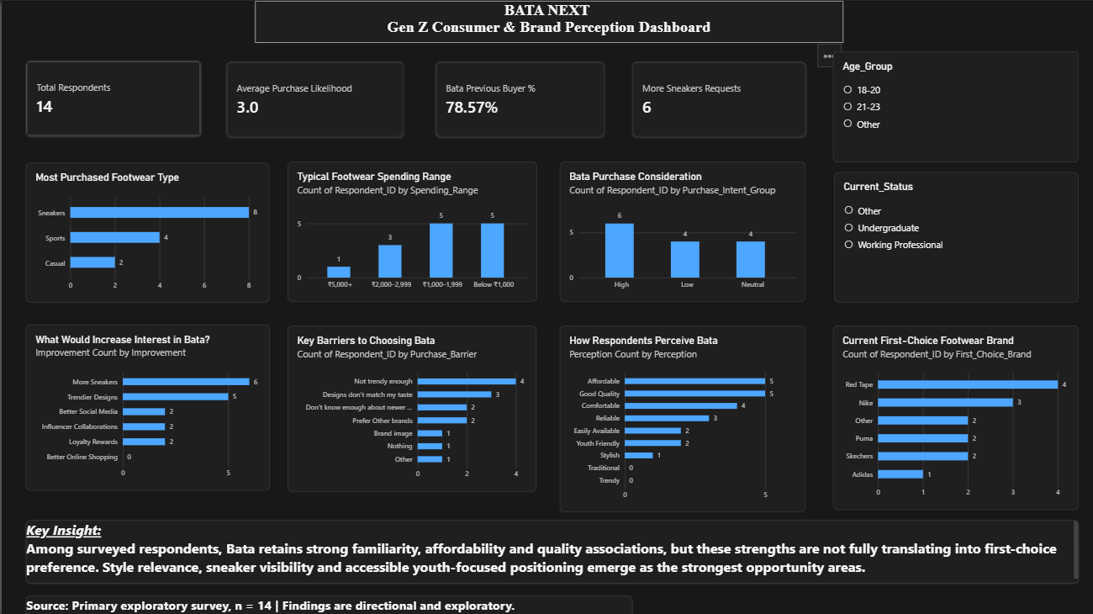
06 / ANALYTICS OUTPUT
The Power BI dashboard makes the evidence interactive.
Built from the cleaned respondent-level dataset with DAX measures and slicers.
POWER BI
Interactive filters: Age group · Current status
Dashboard source: primary exploratory survey, n=14.

Slide 8
07 / SECONDARY RESEARCH
The market context changes the diagnosis.
Bata already has youth-oriented sneaker products — so the issue is not simply “make more sneakers.”
Bata already has the product
Value competitors are aggressive
Premium brands sell culture
North Star and Power sneaker/running options are currently visible from about ₹899 to ₹2,499.
Campus and Red Tape lean heavily on accessible price points, variety and visible promotional discounts.
PUMA combines performance with trend-led icons, collaborations and stronger lifestyle storytelling.
POSITIONING MAP (ILLUSTRATIVE)
More
trend-led
PUMA
Red Tape
Campus
BATA
More value-led
More premium / style-led
Implication: the likely gap is converting existing value + sneaker offerings into stronger youth perception and first-choice preference.
Sources: Bata, Campus Shoes, RedTape and PUMA India official websites; accessed Oct 2026.

Slide 9
08 / BUSINESS DIAGNOSIS
The opportunity is to shift from “known & functional” to “considered & contemporary.”
A clear target and positioning direction emerges from the combined evidence.
AS-IS
TO-BE
PRIMARY TARGET
Known / previously purchased
Known + actively considered
The Value-Conscious
Trend Seeker
Affordable / good quality
Affordable + stylish
18–25
< ₹2,000
Sneaker-led
Sneakers available
Sneakers visibly relevant
Needs
Style · comfort · affordability
Barrier
Outdated / low-excitement perception
Functional brand cues
Functional + fashionable
Positioning direction
“Style that fits your life and your budget.”
Working hypothesis
The primary challenge may be perception and visibility — not absence of youth-oriented products.
Derived from primary survey + secondary research.

Slide 10




09 / STRATEGIC RECOMMENDATION
BATA NEXT: keep the core strengths, modernise the youth-facing experience.
Four pillars translate the diagnosis into actions that can be tested before scaling.
01
02
03
04
Sneaker Visibility
Trend-Led Communication
Student Value
Youth Engagement
Make existing youth products easier to discover across digital and store journeys.
Show styling, drops and outfit-led content — not only functional product claims.
Test accessible price points, campus offers and “Under ₹1,999” merchandising.
Use campus creators, short-form video and micro-influencers to build salience.
Strategic rule:
Do not replace Bata’s value identity — extend it into a more contemporary, visible youth proposition.
Recommendations are exploratory and should be validated through pilot testing.

Slide 11
10 / ROADMAP & MEASUREMENT
Test → learn → scale.
A phased pilot reduces risk and creates measurable evidence before a broader rollout.
0–3 months
3–6 months
6–12 months
TEST & LEARN
BUILD ENGAGEMENT
SCALE WHAT WORKS
Improve sneaker visibility
Test “Under ₹1,999”
Run small student/social pilots
Campus activations
Micro-influencer content
Optimise based on response
Expand winning campaigns
Refine youth collections
Strengthen retention
SUCCESS METRICS
AWARENESS
CONSIDERATION
DISCOVERY
CONVERSION
PERCEPTION
Youth product awareness %
Purchase consideration score
Sneaker product page views
Sneaker conversion rate
Style / trend perception score
Proposed KPI framework for pilot evaluation.

Slide 12

11 / CONCLUSION
The strongest opportunity is not to reinvent Bata — it is to reconnect it.
A focused pilot can test whether clearer sneaker visibility and contemporary presentation improve youth consideration.
FINAL RECOMMENDATION
Pilot hypothesis
Strengthen the connection between Bata’s existing value proposition and younger consumers through:
Better visibility + contemporary presentation can improve consideration.
clearer sneaker visibility
more trend-led communication
Study limitation
accessible student-oriented pricing
n=14 convenience sample. Findings are directional; validate with a larger pilot.
targeted youth engagement
Shivani Sethi · Business Analyst
Primary data: exploratory survey, n=14. Secondary sources: official Bata, Campus, RedTape and PUMA India websites.
BATA NEXT · Consumer Analytics × Brand Strategy

