Slide 1


“Call Type” Predictions for Fire Department Calls for the city of San Francisco
Presented by(Group 5)
David Ward
Shivaniben Shah
Tanjina Akter Reema
Yangyang Jia

Slide 2


Our Goal:
Predict & Classify Emergency “Call Type” For the
Fire Department of San Francisco.
Explosion
Fuel Spill
Gas Leak
Outside Fire
Water Rescue
Traffic Collision
“Other”

Slide 3
Dataset and source
Dataset Size:
Rows: 4.61 Million
Columns: 34
Data: From Year 2000 to 2018
Size in GBs: 1.9 GB
Dataset Source Type:
Public Dataset from “Fire Department Calls For Service” from DataSF
Data Source:
https://data.sfgov.org/Public-Safety/Fire-Department-Calls-forService/nuek-vuh 3/data

Slide 4

WHY WE CHOSE THIS DATASET

Slide 5
The data set represents historical records from years 2000 to 2018 of Fire Department Calls for the city of San Francisco to predict(classify) “Call Type” for a specific location for certain day and time of week.
The data sources include insights to respective fire departments to make important decisions to improve their services and save more lives by predicting “Call Type” for future calls.

Slide 6
Workflow
Gathering Data
Data Processing
Data Transformation
Train and Test
Data split
Evaluate

Slide 7
Data Preprocessing & Exploration
According to our use case, found out irrelevant features and removed them, such as - 'call_number', 'unit_id', 'rowid’ etc.
We have retained only single representation for these values and also we have only retained numeric representation for 'supervisor_district', ‘box’ and 'station_area’.
Removed features which can only be known after providing response to a Call and do not contribute to predict 'call_type’ .

Slide 8
Data Preprocessing & Exploration
Remove the duplicate instances involved in refined dataset after removing the irrelevant features. - Found out the missing values, null values for remaining 14 attributes and removed those tuples.
After removing those tuples still we have nearly 2 Millions of tuples remaining to train model.

Slide 9
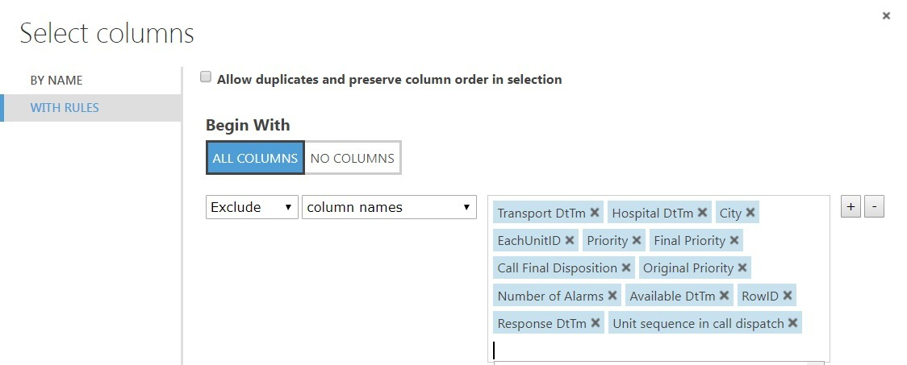

Slide 10
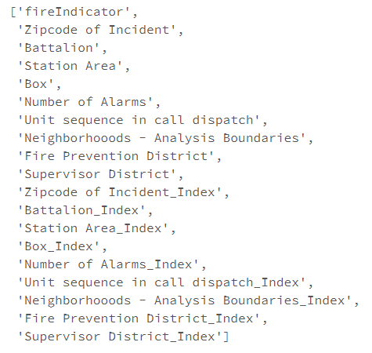
Data Transformation
From available features we extract new features using dimensionality reduction techniques - Date and time features, numeric to categorical mappings, grouping sparse classes, etc. that are more suitable for prediction task to achieve maximum accuracy. These columns are selected to avoid data leakage in our modeling. Data leakage is common in modeling and can lead to invalid predictive models

Slide 11
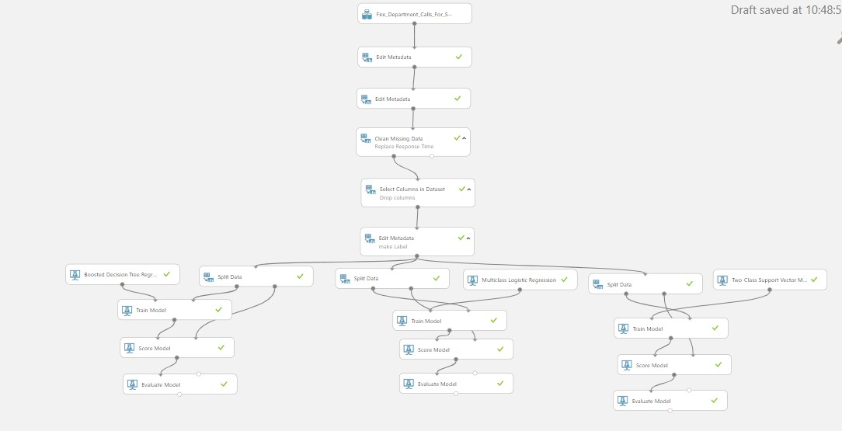

Slide 12
Model Training and Testing
Divided the dataset into
Training Dataset - 1.80 M
Testing dataset - 0.26 M
Trained and tested following models
Logistic Regression
Decision Tree
SVM (Support Vector Machine)

Slide 13
Technical Specifications
Azure ML
Free Workspace
10 Gb Storage
Single node
Spark
DataBricks Subscription
Cluster 5.2 ( Apache Spark 2.4.0, Scala 2.11)
6 GB Memory, 0.88 Cores, 1 DBU
Python Version 3

Slide 14
ALGORITHMS
Azure ML
Decision Forest Regression
Boosted Decision Tree Regression
Spark
Collaborative Filtering
Conclusion Matrix

Slide 15

Model Name | Training Accuracy | Testing Accuracy
Logistic Regression | 0.937 | 0.938
Decision Tree | 0.566 | 0.867
SVM (Support Vector Machine | 0.777 | 0.877

Slide 16
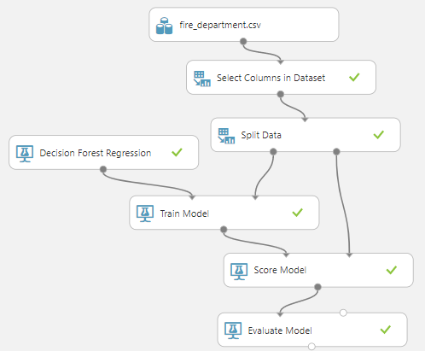
Decision Forest Regression
Selected Columns in Dataset:
Transport DtTm, Hospital DtTm, Priority, Original Priority, Final Priority, Call Final Disposition, Number of Alarms, AvailableDtTm, RowID, Response DtTm, Unit sequence in call dispatch
Train Model: (Label column)
“Call Type Group”

Slide 17
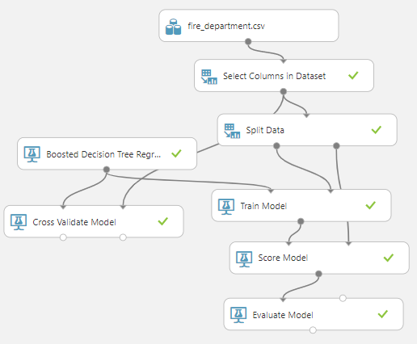
Boosted Decision Tree Regression
70:30 Split Train-Test
Cross Validation
Permutation Feature Importance
Regression Coefficient Determination

Slide 18
Comparisons | Decision Forest Regression | Boosted Decision Tree Regressions
Mean Absolute Value | 0.952309 | 0.73024
Root Mean Squared Error | 1.143721 | 0.903232
Relative Absolute Error | 0.96286 | 0.77431
Relative Squared Error | 0.902967 | 0.602112
Coefficient of Determination | 0.097033 | 0.397888

Slide 19
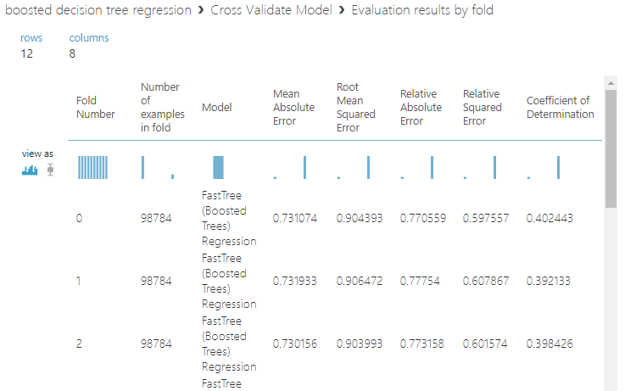
Cross Validation

Slide 20
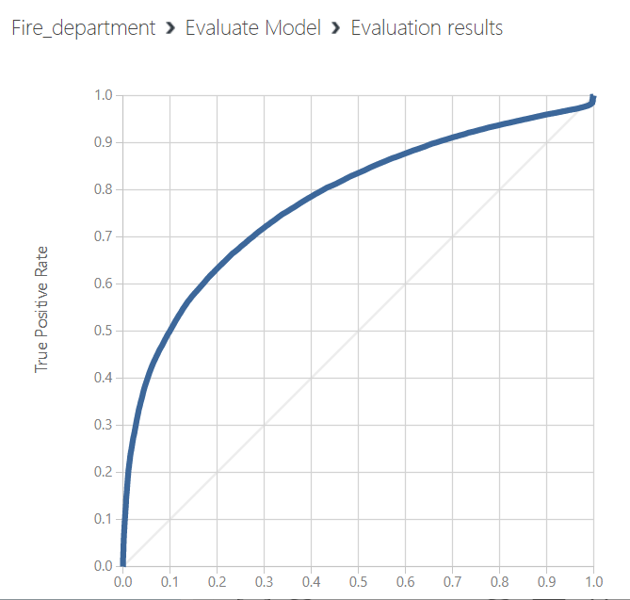
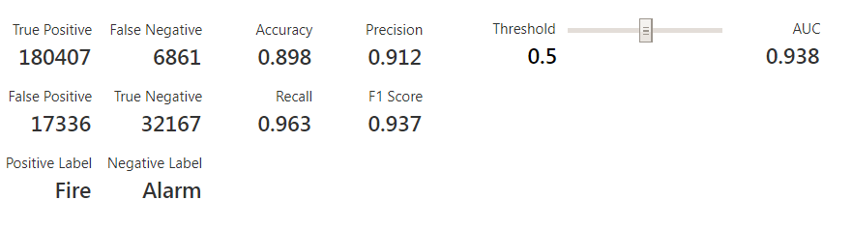
Support Vector Mechanism

Slide 21
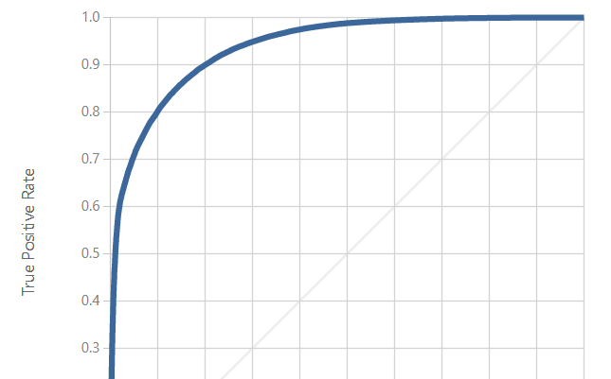
Logistic Regression

Slide 22
Challenges Faced
Due to the real life dataset collected from SF Fire Department website, the need for preprocessing was crucial. Data preprocessing required precise understanding of importance of features and what kind of inputs are accepted by classification algorithm.
Due to the large size of the dataset - 2.08 million rows, we couldn’t apply one hot encoding directly to all the categorical variables. So, we had to utilize CSR matrix to handle the large sized sparse data

Slide 23
Summary
Achieved 90% accuracy for Testing dataset in predicting the ‘call type’ for incoming calls for San Francisco Fire department.
Learned the importance of Data Preprocessing and Feature engineering (Feature Extraction, Feature Transformation, Feature Reduction) in case of real life dataset.

Slide 24
Summary
The prediction of “Call Type” may help respective Fire Department of city of San Francisco to predict the type of situation beforehand at the place of incident. So, they can allocate resources Optimizely and can manage more than one incidents in their area efficiently, to save precious lives of people.

Slide 25
References
https://planspace.org/20150423-forward_selection_with_statsmodels/
https://docs.scipy.org/doc/scipy/reference/generated/scipy.stats.normaltest.html
https://www.statisticssolutions.com/assumptions-of-logistic-regression/
https://www.statisticssolutions.com/assumptions-of-multiple-linear-regression/
https://stackoverflow.com/questions/35417111/python-how-to-evaluate-the-residuals-in-statsmodels
https://underthecurve.github.io/jekyll/update/2016/07/01/one-regression-six-ways.html#Python
https://data.library.virginia.edu/diagnostic-plots/
https://en.wikipedia.org/wiki/Cross-validation_(statistics)

Slide 26
References
https://data.sfgov.org/Public-Safety/Fire-Department-Calls-for-Service/nuek-vuh3
https://www.youtube.com/watch?v=gRvE94hO4TM
https://www.kdnuggets.com/2016/03/data-science-process.html
https://stackoverflow.com/questions/35077507/how-to-right-align-and-justify-align-in-markdown
https://medium.com/ibm-data-science-experience/markdown-for-jupyter-notebooks-cheatsheet-386c05aeebed
https://medium.com/@sambozek/ipython-er-jupyter-table-of-contents-69bb72cf39d3
http://gradientdissent.com/blog/analyzing-2-months-of-real-crime-data-from-san-francisco-and-seattle.html#.W_3u1vZFxPY
https://www.statisticssolutions.com/assumptions-of-multiple-linear-regression/

Slide 27


