Slide 1
Zylentrix
Shivani Whachal

Slide 2
Who We Are – Zylentrix
Empowering Talent. Elevating Business. Zylentrix is a global consultancy founded in 2025 to bridge the gap between
people, technology, and growth.
We go beyond advice—we build real solutions that help students, professionals, startups, and enterprises scale smarter and faster.

Slide 3
Why Zylentrix Exists
The Problem:
Skilled individuals lost in complex job markets
Startups stuck without the right tech or talent
Corporates lagging due to outdated systems

Slide 4
Our Spark: Born from lived challenges and global vision during an MBA journey—Zylentrix was created to be the partner that connects strategy, innovation, and opportunity.

Slide 5
Project Overview – Student Engagement Analysis

Slide 6
Objective: Analyze student engagement, course completion, and feedback trends on an online learning platform using Python (Pandas, Seaborn, Matplotlib).

Slide 7
Our Data Landscape
The datasets used –
students.csv, course_activity.csv, and feedback.csv.
A small visual diagram to show how they connect
(e.g., Student_ID and Course_ID relationships).

Slide 8
Preparing for Insights
importing libraries
merging datasets
handling missing values
transforming columns

Slide 9
What the Data Tells Us
Demographics Snapshot
Total Students: 100
Age Range: 18 to 34 years
Average Age: 25.5 years
Gender Distribution (Sample): Female, Male & Others
Locations (Sample): Kolkata, Chennai, Mumbai, Bangalore, Delhi
Course Engagement Overview
Total Activities Logged: 659
Average Time Spent per Session: ~98 mins
Completion Rate (avg.): 54.8%
Time Spent Range: 10 to 180 minutes
Completion % Range: 10.2% to 100%

Slide 10
What the Data Tells Us
Insights:
Majority of users are young adults (21–29).
Students spend a significant amount of time (~1.5 hours/session) on average.
Only half of the course content gets completed on average.
Feedback is neutral to slightly positive, suggesting room for content improvement or better engagement.

Slide 11
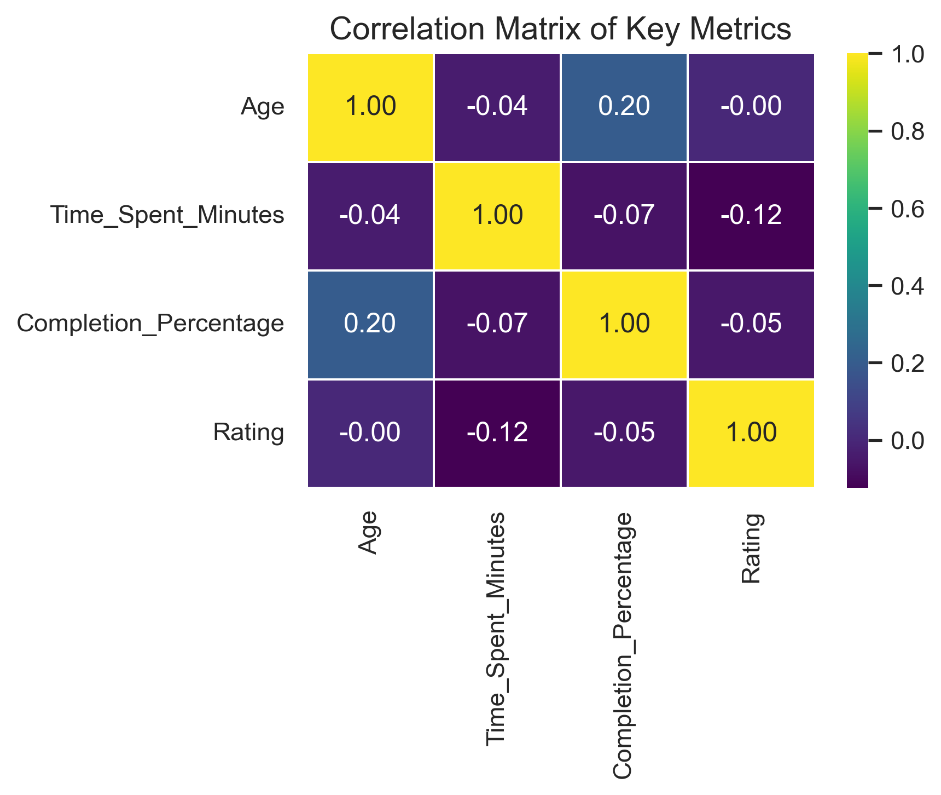
Correlation Matrix of Key Metrics

Slide 12
Key Observation
Age vs. Completion Percentage (0.20)
Time Spent vs. Other Metrics
Rating vs. Other Metrics
A positive correlation of 0.20 indicates that older students tend to complete courses slightly more than younger ones.
Ratings show nearly no correlation with other metrics:
Rating vs. Completion: -0.05
Rating vs. Age: -0.00
Very weak negative correlation, suggesting that more time spent doesn’t necessarily lead to higher completion.

Slide 13
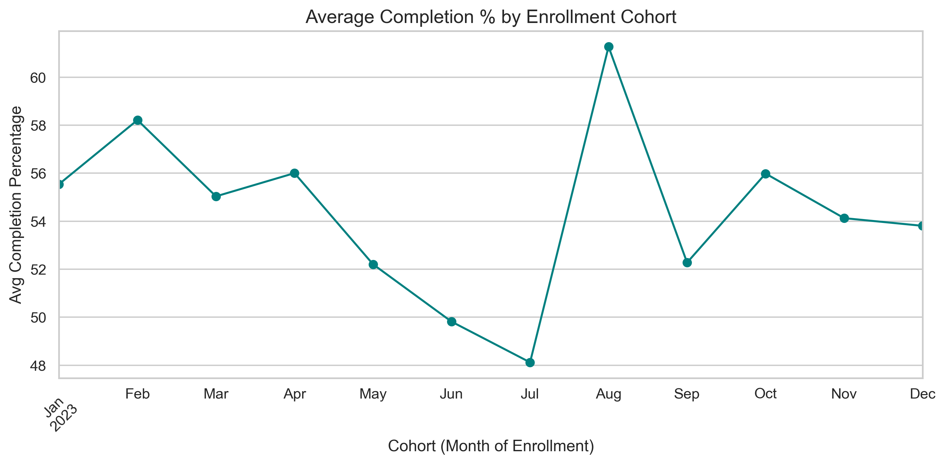
Average Completion % by Enrollment Cohort

Slide 14
Key Insights
This line chart visualizes how the average course completion percentage varies across student cohorts, based on their month of enrollment in 2023.
The X-axis shows cohorts by month (e.g., Jan 2023 to Dec 2023).
The Y-axis represents the average completion percentage of courses by students who enrolled in that specific month.

Slide 15
Key Insights
Fluctuating Trends: The average completion percentage does not follow a steady pattern; it varies across months, indicating that cohort behavior or course engagement differs over time.
High Point – August: Students enrolled in August had the highest completion rate, around 61%, suggesting strong engagement or possibly more motivated learners during this period.

Slide 16
Key Insights
3. Low Point – July: In contrast, the July cohort recorded the lowest completion rate, dropping to around 48%, which may indicate lower motivation or possible external factors (e.g., summer vacations)
4. Mid-Year Dip: There’s a noticeable dip in May–July, followed by a sharp spike in August, then a gradual decline again.
5. Stabilization: After September, the completion rate appears to stabilize between 54–56%, suggesting more consistent engagement in later months.

Slide 17
Possible Reasons to Explore:
Did the course structure or delivery change during the year?
Was there a marketing push in August attracting more serious learners?
Were external academic or seasonal factors influencing July drop?

Slide 18
SUMMARY
This analysis explored key patterns in learner engagement, completion rates, and satisfaction across various courses and demographics.
We discovered that:
Completion rates don’t guarantee high ratings, pointing to content quality as a critical driver of satisfaction.
Age group 31–35 emerged as the most efficient learners, completing more in less time.
PY202 (Python) stands out for its high rating, highlighting content effectiveness.
A positive trend in engagement over recent months suggests growing user interest.
However, overall ratings remain low, indicating room for improvement in course delivery.

Slide 19
THANK YOU
Thank you for taking the time to go through this analysis.
We hope these insights help guide future improvements and strategic decisions to create more impactful learning experiences.
Looking forward to your feedback and next steps!

