Slide 1
Automated Toll Collection System using Number
Plate Detection
Guided by- Mrs. Ashwini Shingare
Prathamesh Dhawale - 1710838
Saurabh Kshirsagar - 1710423
Shivanjay Wagh - 1710463
Pranit Jadhao - 1710283

Slide 2
OBJECTIVE
While collecting toll on toll plaza, save the time of people crossing the toll plaza via deduction of toll from the bank account of the respective vehicle owner.

Slide 3
ABSTRACT
The scientific world is deploying research in intelligent transportation system which has a significant impact on people’s life.
Automatic Toll Deduction using Number Plate Recognition is an application of a computer vision technology to extract the number plate of vehicles for collecting toll.
The number plate of the vehicle will be obtained using Image Processing.
By using the number plate, we get account details of vehicle owner.
The toll fee will be automatically deducted from the vehicle owner’s bank account and will be credited into the bank account of the toll booth contractor.

Slide 4
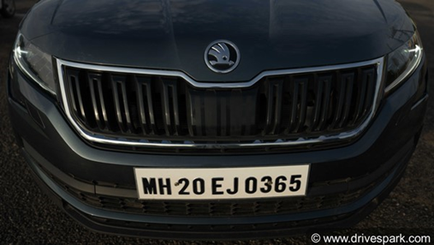
METHODOLOGY
Capturing the image of vehicle :-
While the vehicle passes through the toll booth, image of the vehicle will be captured and further processing will be done.
Resizing the Image:-
If the captured image is less than 776 pixels in width then it is resized to 900 pixels using resize function of imutils library.

Slide 5
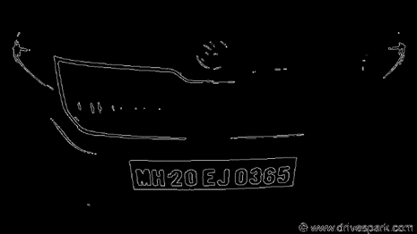
3. Grey Scale Conversion :- Captured image is converted to grey scale using cv2 library and processed further. The resized image is then converted to a black and white image. This is done using a binary function named threshold which converts pixels above certain value to white pixels and below it to black pixels. 4. Canny’s edge detection :- The edges of the image are then identified using Canny’s edge detection. Here, A kernel of min value 100 and max. Value 200 is used to process the image.

Slide 6
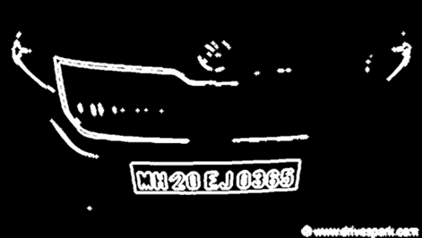
5. Morph dilation:- In general, number plate is passed through a dilation process. This makes the edges pf the image thicker and hence it becomes easy to recognize the text in it. 6. Giving an approximately nearby shape to contours:- First of all, all the contours are found out from the image and then they are sorted in descending order and the top 10 of them are selected for further processing. Now, these selected contour, if not in proper shape, are shaped approximately .

Slide 7
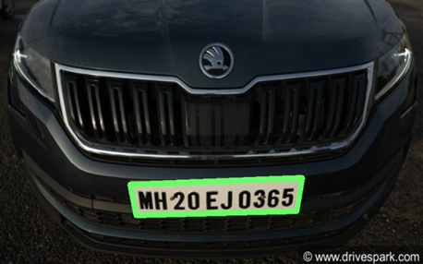
7. Drawing Contours:-
Final step for identifying the number plate is drawing the contour around the number plate.
8. Extracting Number Plate:-
Now, based on the contour drawn around the number plate, the number plate is extracted and used for further processing.

Slide 8
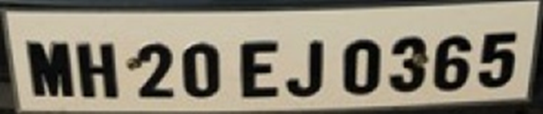
9. Converting image content to text:- the extracted image is given as input to image-to-text function of pytesseract library, which is then converted to text and this vehicle number is stored in a variable for further transactions. 10. Fetching the owner’s account from database:- the obtained vehicle number is searched in the database of owners’ vehicle details. The Aadhar number of corresponding vehicle owner is obtained and then searched in the database of bank account details.

Slide 9
11. Deducting toll fee and crediting the same in the contractor’s account:- once the bank account of vehicle owner is fetched the required toll fee is deducted and further credited to the perspective toll booth contractor

Slide 10
ADVANTAGES
Lot of time is saved due to automation.
Cashless transactions help to put a step forward in the direction of Digital India.
Transparency in money flow is maintained.
Manual labor is reduced thereby increasing the profit of the contractor.

Slide 11
TECHNOLOGIES
Image processing using OpenCV
DBMS using MySQL
Server using XAMPP
Database connectivity using PHP

Slide 12
Future scope
After deducting the money, for security purposes, an SMS will be sent to the vehicle owner as well as the respective contractor of the toll booth.
In a way, this will also help in tracking the vehicle, if stolen.
A video will be given as input to the code and then the image of it will be taken for further processing.

Slide 13
Thank You!!!

