Slide 1

CSCD 434
Spring 2014
Lecture 10
Attacks and More Attacks
Root kits

Slide 2
Introduction
Today ...
Rootkits
  Includes Trojan/Backdoors
  Many other programs all bundled together
  For ease of use

Slide 3

What is a Rootkit?
Collection of attacker tools installed after an intruder has gained access
  Log cleaners
  File/process/user hiding tools
  Network sniffers
  Backdoor programs
The Legendary “Q”

Slide 4
What are Rootkits?
Quick Answer
Rootkits are software that makes an operating system lie

Slide 5
Rootkit Goals
Remove evidence of original attack and activity that led to rootkit installation
Hide future attacker activity (files, network connections, processes) and prevent it from being logged
Enable future access to system by attacker
Install tools to widen scope of penetration
Secure system so other attackers can’t take control of system from original attacker

Slide 6
Rootkits
How do you get infected with a rootkit?
  Attacker can install it once they've obtained root access
  Result of direct attack on a system
    Exploited a known vulnerability
    Password cracking,
    Social engineering
      Phishing with embedded link
      Website enticement - games, porn or torrents

Slide 7
How rootkits work
Vulnerable system targeted
    Unpatched,
    Zero-day exploit,
    Poor configuration - leaving vulnerable processes up
  Results in
    Targeted system exploited
    Root or Administrator access is obtained!!!
    Rootkit Payload is installed

Slide 8


Rootkit Operations
Rootkit hides its presence
Controls interfaces between Operating System components
  Intercepts and alters interface communications
C:\> dir RootkitFile.exe
  C:\> no files found

Slide 9


Rootkit Operations
Example
1. Application tries to see if executable file
  for rootkit X exists
2. Application calls FindFile API, via Operating System
3. Invisible to application, rootkit X has compromised
API interface to file manager
4. Rootkit intercepts application’s call to FindFile,
returns incorrect message file does not exist
5. Rootkit file is hidden from application and its users
despite fact that it clearly still exists

Slide 10

History of Rootkits
1989: Phrack 25 Black Tie Affair: wtmp wiping
1994: Advisory CA-1994-01 about SunOS rootkits.
1996: Linux Rootkits (lrk3 released.)‏
1997: Phrack 51 halflife article: LKM-based rootkits
1998: Silvio Cesare’s kernel patching via kmem.
1999: Greg Hoglund’s NT kernel rootkit paper.
2005: Sony ships CDs with rootkits that hide DRM and spyware that auto-installs when CD played
2006: SubVirt rootkit moves real OS to a VM
Current Rootkits
ZeroAccess rootkit
2012 Rootkit Virus
Unix/Darbe-A

Slide 11
Rootkits
2 Different ways of classifying rootkits
  User Mode
  Kernel Mode

Slide 12
Rootkits
User Mode Rootkits
  Critical operating system components are replaced or modified by attacker to create backdoors, hide on the system
  Examples
    Linux RootKit 5 (lrk5)‏
    T0rnKit for Linux, Solaris
    Other platform specific Rootkits
      SunOS, AIX, SCO, Solaris

Slide 13

Rootkits
Attacker
User Mode Rootkits
    Don’t add applications but replace existing system components with Trojan versions
    These Rootkits have existed since 1990’s
  What do they do?
    Don’t give you root privilege, should already be root
    Allows attacker to maintain root access and hide their presence on machine

Slide 14

Rootkits
User Mode
  At a minimum
    1) Install backdoor for attacker
    2) Hide evidence of system compromise
  Extra
    Collect information via sniffer for attacker
      Useful traffic such as passwords, other information

Slide 15
Rootkits
User Mode Rootkits
  For example ... replace system programs
    Replace ssh or other login programs with one containing backdoor password for root access
    Replace ifconfig program so it hides presence of interface running in promiscuous mode
      Network card into promiscuous mode is done by most sniffer programs
      System administrator can become suspicious of sniffer

Slide 16
Rootkits
Program Original Function Rootkit Version
Replaced
du Disk utilization Lies about disk space
Hides attackers tool space
find Finds files and dirs Lies about attackers files
ifconfig Shows interface status Masks promiscuous mode
login Lets users login to system Also a backdoor root level password
ls Contents of a directory Lies about rootkit files
netstat Show processes listening Lies about ports TCP/UDP, used
ps Process list Lies about processes
attacker/wants to hide
Above list shows typically replaced programs

Slide 17
User Mode Rootkit
Replaces known OS files
Tripwire should identify these
User mode Rootkit
Trojan Trojan Trojan good
login pd ifconfig Tripwire
Kernel

Slide 18


Tripwire Protection
Open Source Tripwire detects changes to file system objects
Tripwire first scans file system as directed by
administrator and stores information
on each file scanned in a database
Later, same files are scanned and results compared against stored database values
Changes are reported to the user
Cryptographic hashes detect changes to files

Slide 19
Rootkits
User Mode Rootkits
  Where can I get one?
    Unix/Linux
    http://www.packetstormsecurity.org/UNIX/penetration/rootkits
    Lrk6– Linux Rootkit 6
    shv4 – another popular Linux rootkit
    Another URL- Precaution Recommended
    http://www.malwaredomainlist.com/

Slide 20
Rootkits
User Mode Rootkits
  For example, the real rootkit, lrk5 includes the following files:
  chfn ifconfig netstat syslogd
  chsh inetd passwd tcpd
  crontab killall pidof top
  du login ps sshd
  find ls rshd su

Slide 21
Rootkits
Other files found with rootkits
    Sniffers
      linsniffer – network sniffer for Linux
      sniffchk – checks to make sure the sniffer is still
      running
      sniff, sniff-10mb, sniff-100mb – other sniffers
    Utilities
      fix – fixes file checksum and timstamp information
      wted – wtmp editor, login file modifier
      z2 – erases entries from wtmp/utmp/lastlog
      bindshell – binds a root shell to a port, 31337 is default
      zap3 – erase tracks from all logs

Slide 22
Windows User Level Rootkits
API Hook
  In Windows dynamic linking happens with functions
  Code for dynamic linked functions stored in DLL's
    Dynamic Linked Libraries
  Reference to a Dynamic Linked function resolved at runtime
  Offset stored in Import Address Table (IAT)‏
    Has function pointers filled in by the windows loader as the dlls are loaded

Slide 23
Windows User Level Rootkits
More Details
You can ...
Hijack the Import Address Table (IAT)‏
Pointer will point to block of injected code
  Example: OpenFile call
    An Intrusion Detection System uses OpenFile
    Looking for unusual file names
    Rootkit intercepts the call, inspects parameters
    Sees its own name and returns results that the file doesn't exist

Slide 24
Windows User Level Rootkits
Windows system services implemented in a layered architecture
Layer exposed to user applications when, for example, they need to call a KERNEL32.DLL function like OpenFile
It is, however, oftentimes just a wrapper for a lower level call into NTDLL.DLL, library implements system calls

Slide 25
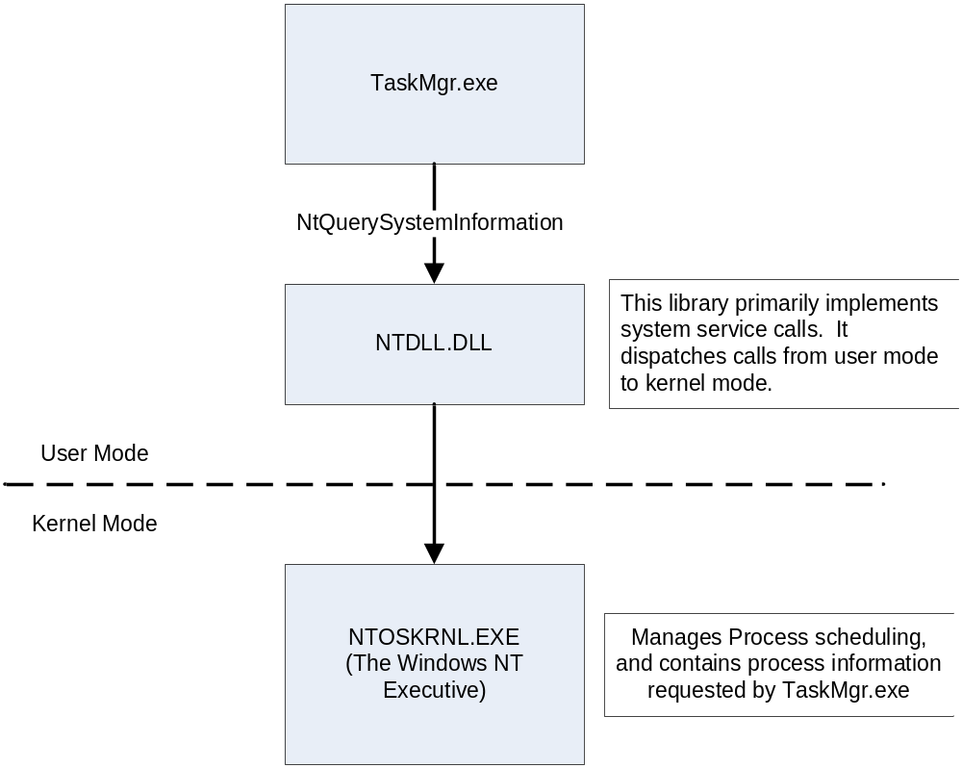
Taskmgr Gets Process Information

Slide 26
Technique: Import Address Table Hooks
Take advantage of (IAT) Import Address Table
Redirect calls to a hook dll

Slide 27
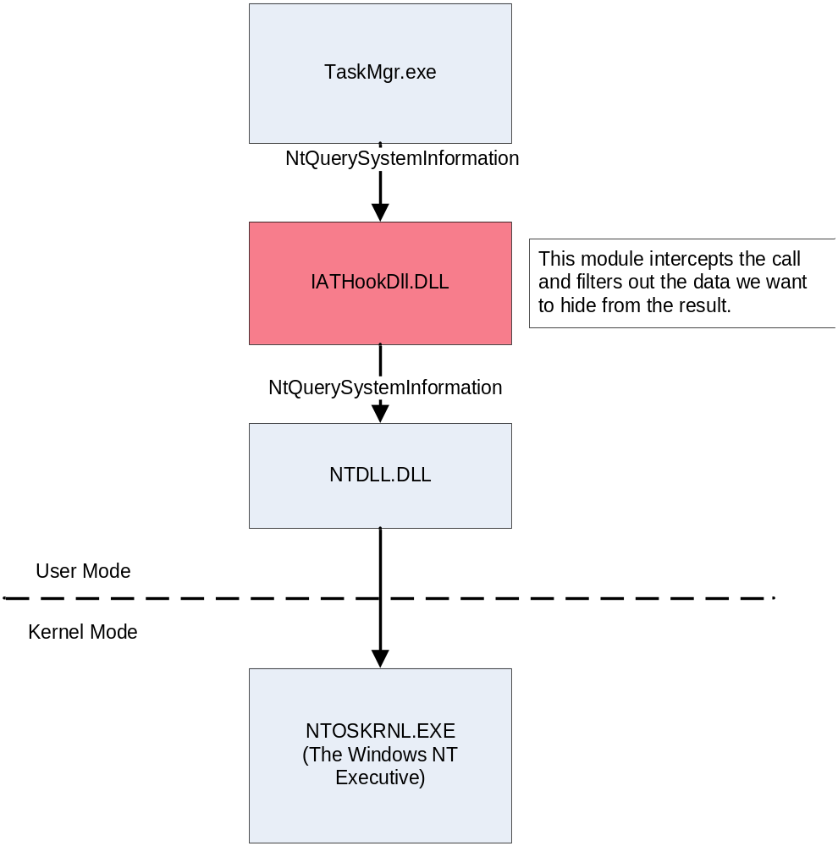
Taskmgr.exe Hooked to Hide Processes

Slide 28
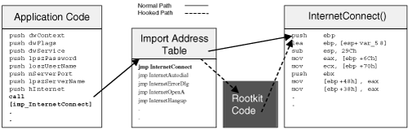
Taskmgr.exe Hooked to Hide Processes

Slide 29
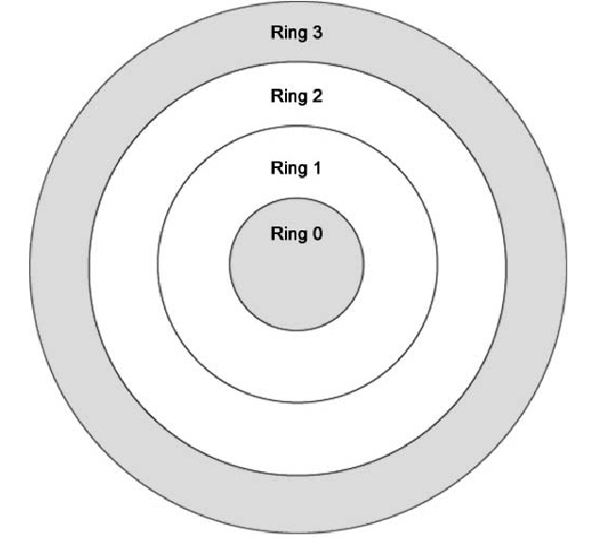
Operating System Design
Intel has four privilege levels or rings
Linux and many other OS vendors use only two rings
  User Mode : In this level some restriction in accessing system hardware and certain memory regions apply. User address space restricted to application memory maps
  Kernel Mode : Everything is allowed
User Mode
Supervisor /
Kernel Mode

Slide 30
Rootkits
Kernel Mode Rootkit
    More devious or harder to detect
    Modify kernel to completely and transparently transform system to attacker’s needs
    If you can’t trust kernel, you can’t trust anything on your system
  What a kernel rootkit does
    It redirects system calls made by other programs at a deeper level

Slide 31
Rootkits
Kernel Mode Rootkits
  Example - Linux
    You want to login to system, so a call made to /bin/login
    Kernel maps request to a hidden program
    /bin/backdoorlogin
      Contains a backdoor whenever it is run that allows access for root
    When you run your file integrity checker, Tripwire, /bin/login
      It passes

Slide 32

Rootkits
Kernel-level Root Kits
  The operating system itself is modified to allow backdoor access and allow attacker to hide
    Example Programs
      Knark for Linux
      Adore for Linux
      Plasmoid’s Solaris Kernel-level Rootkit
      Hacker Defender - Windows

Slide 33

Rootkits
Kernel Mode Rootkits
    Everything on your system looks pretty good but isn’t
    All execution is potentially altered
    Your system is a total lie!
    In addition to execution redirection kernel rooted machine hides processes that run and associated files

Slide 34
Rootkit
Kernel Mode Rootkits
    Example of hidden processes
      A process is listening to port 31337
      You do a netstat to see what ports are open
      It will lie and hide that the port is open
      What could you do?
      Perform a scan of your system with nmap from the network
        - Would see the open 31337 port

Slide 35
Rootkits
Creating a Kernel Rootkit
  Linux - Easiest
    LKM – Loadable Kernel Modules
    Used legitimately for dynamically updating system functionality
      Example
        Support for new disk drive
        Can either rebuild the kernel to support new capability or
        Dynamically update the kernel with a loadable kernel module

Slide 36
Comparison of Rootkits
User Mode vs. Kernel Linux
User mode Rootkit
Trojan Trojan Trojan good
login pd ifconfig Tripwire
Kernel
Kernel Rootkit
good good good good
login pd ifconfig Tripwire
Kernel
Trojan Module

Slide 37
Rootkits
Kernel Mode rootkits
  Linux
    Adore-ng for linux running kernels 2.4. 2.5 2.6
      Runs as a loadable kernel module
      Full featured including module hiding
  Windows
    FU
      Name comes from su command in Unix for substituting users

Slide 38

Windows Kernel Level
Lower Level Hooks
Similar to Windows user level rootkit and Import Address Table Hooks
Same effect in Kernel level rootkit by hooking System Service Dispatch Table (SSDT)‏
NTDLL provides the actual interface between user and kernel mode

Slide 39
Windows Kernel Level
Steps to SSDT Hooking
Kernelmode interrupt handler, KiSystemSerivce,
  Looks up ID of requestedservice in
  System Service Dispatch Table (SSDT)‏
  On behalf of user application
Kernel API’s themselves funneled to a single entry point in
system service dispatch table
Default service table, KeServiceDescriptorTable, defines primary kernel services implemented in ntoskrnl.exe
Set of services that rootkits are primarily interested in intercepting
Similar to IAT hooking, it only involves overwriting a single function pointer

Slide 40
Windows: Understand System Calls
System calls are exported from NTDLL.DLL
  In NTDLL.DLL each system call has an associated numeric value
  NTDLL.DLL moves that hard-coded value into a register, and calls sysenter (or int 2e)‏
NtQuerySystemInformation@16 proc near
mov eax, 0F8h ; the system call number
mov edx, 7FFE0300h ; do sysenter
call dword ptr [edx]
retn 10h
_NtQuerySystemInformation@16 endp

Slide 41
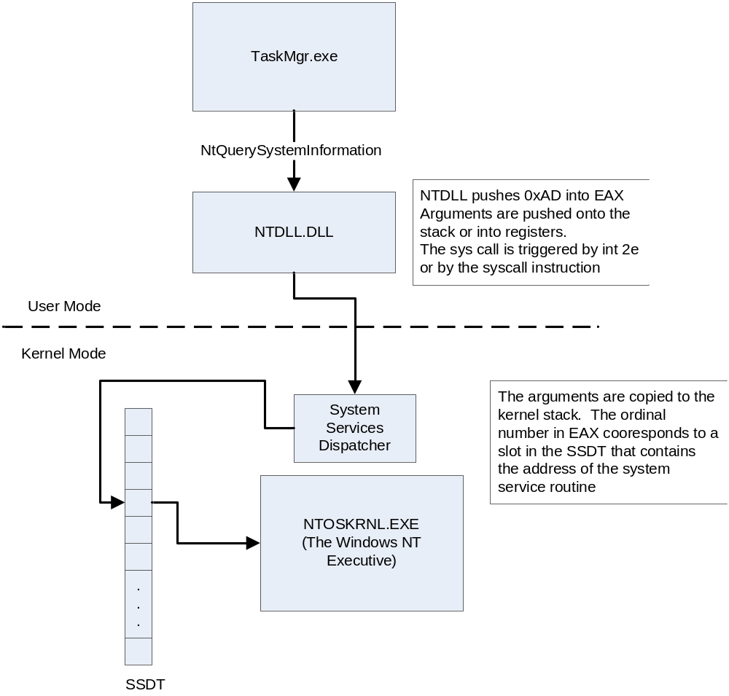
Understanding A System Call
Where would you subvert the process?
System Service
Dispatch
Table, SSDT
Notes:
The sysenter call moves transitions into kernel mode
The system services dispatcher copies syscall parameters off the user stack and puts them into kernel memory
The system services dispatcher executes the method in the System Services Dispatch Table (SSDT) at the requested system service number

Slide 42
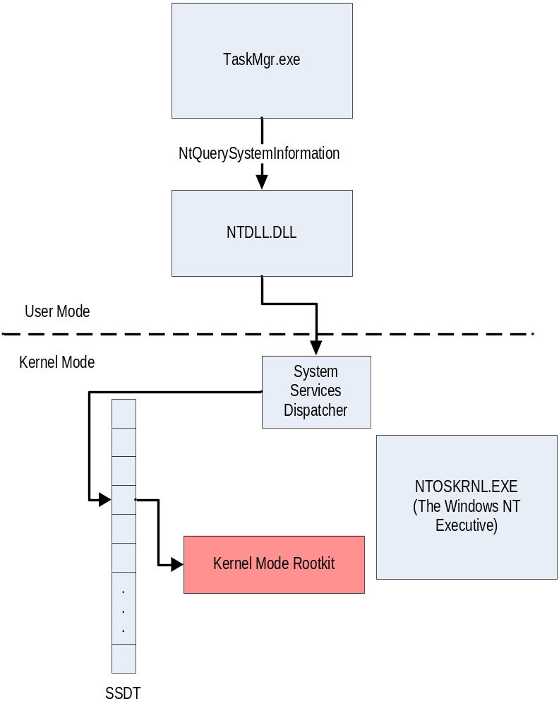
SSDT Hook Implementation
Notes:
Find the SSDT entry for NtQuerySystemInformation
When our driver is started, we swap the value in the SSDT for that entry with a pointer to our implementation of NtQuerySystemInformation
Notice that this is just like an IAT hook, but it attacks a different table

Slide 43

Rootkit Detection and Defense

Slide 44
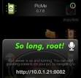

Rootkits
Defenses Against Rootkits
  1. Don’t let them get root in the first
  place
  2. Patch systems, close down services
3. Disable loadable modules in Linux
    Don’t need this functionality for critical systems like servers

Slide 45

Defenses Against Rootkits
  3. File Integrity Check
    Computes MD5 hash on system files
    Creates a DB of hashes for critical system files
    Also can check against a known DB of file hashes, 36,645,143 files
      http://www.nsrl.nist.gov
    Store offline and periodically check your files against hashes for changes
    Tripwire original file integrity checker from Purdue

Slide 46
Rootkits
Example continued
    Use the following commands to show .puta
    $ echo .*
    . .. .puta linux linux-2.2.14 redhat
    $ Can compare it with
    ls -d .*

Slide 47
Rootkits
Kernel Mode Rootkits – Finding them
  If entire system is a lie, how do you find them?
  If you scan your network with nmap
    Shows you ports open on your system
    Good idea to occasionally scan your own networks
  If you run a sniffer and ifconfig doesn’t show promiscuous mode, may be a problem

Slide 48
Windows Kernel Mode
Detecting SSDT Hooks
Scan table looking for invalid data
Valid SSDT entries should all point to ntoskrnl.exe
  Some benign software uses SSDT hooks
    A white list is needed

Slide 49

Rootkits
  Detection
    Automated tool, chkrootkit program, free,
    Unix/Linux
    Available from: http://www.chkrootkit.org/
    Searches for fingerprinting of user mode rootkits
    Shell script that checks system for binaries for rootkit modification
    Plus detect well-known LKM rootkits. Using the following commands chkrootkit searches for common files rootkits place on the system
      Awk, cut, echo, egrep, find, head, id, ls, netstat, ps, strings, sed, and uname.
    Also, searches for hidden processes by comparing contents of /proc directory with results from ps command

Slide 50
Backdoors and Rootkits
Kernel Level Rootkits
  Detection
      Rootkit Hunter www.rootkit.nl/projects/rootkit_hunter.html
      Similar to chkrootkit
      Use it for second opinion
    For Windows rootkits
      Rootkit Revealer www.sysinternals.com
      Blacklight www.f-secure.com/blacklight

Slide 51
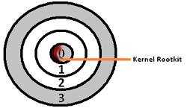
Rootkits
Kernel Level Rootkits
  Detection
    Host based IDS’s can also check for rootkits
    Virus scanners have signatures now of many rootkits
    Skilled attackers can bypass this by disabling virus scanner, then installing rootkit
    Still effective for less skilled attacks

Slide 52

Rootkits
Cleanup
    After the initial attack a system may never be the same.
    A complete clean up and system recovery should be performed to prevent future attacks.
    It must be assumed that all information on the system during the time of the attack has been exposed.
    Locating all Trojan versions of standard system can be difficult.
    A system administrator should not trust any system utilities until they have been restored from a safe source such as distribution media.
    Unless you are positive that back ups were made before the security breach, backups discarded

Slide 53
References
Joanna Rutkowska
  http://invisiblethingslab.com/itl/Resources.html
Rootkits
Windows Rootkits - Good Details
  http://www.tebyan.net/index.aspx?pid=31159&BookID=23844&PageIndex=46&Language=3
Windows Rootkits Paper - Great
  “WINDOWS ROOTKITS A GAME OF “HIDE AND SEEK”
  http://whitepapers.hackerjournals.com/?p=10849

Slide 54

The End
Lab 3 – Malware, Please bring results for Monday !!!

