Slide 1
Chapter 4
The Divide-and-Conquer Strategy
5 -<number>

Slide 2
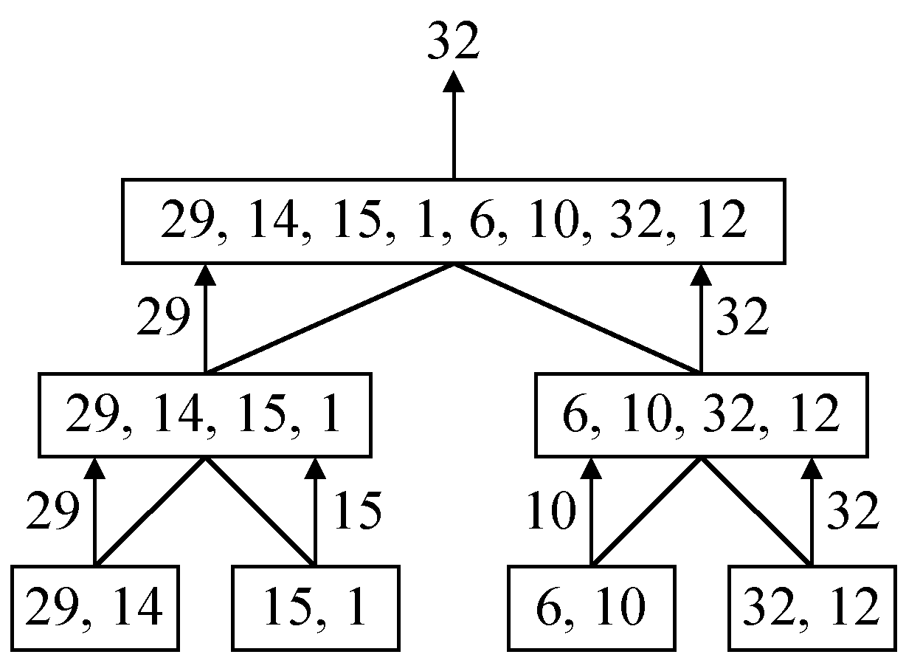
A simple example
finding the maximum of a set S of n numbers
5 -<number>

Slide 3

Time complexity
Time complexity:
Calculation of T(n):
Assume n = 2^{k},
T(n) = 2T(n/2)+1
= 2(2T(n/4)+1)+1
= 4T(n/4)+2+1
:
=2^{k-1}T(2)+2^{k-2}+…+4+2+1
=2^{k-1}+2^{k-2}+…+4+2+1
=2^{k}-1 = n-1
5 -<number>

Slide 4
A general divide-and-conquer algorithm
Step 1: If the problem size is small, solve this problem directly; otherwise, split the original problem into 2 sub-problems with equal sizes.
Step 2: Recursively solve these 2 sub-problems by applying this algorithm.
Step 3: Merge the solutions of the 2 sub- problems into a solution of the original problem.
5 -<number>

Slide 5
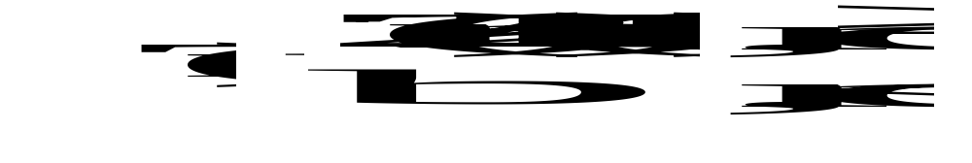
Time complexity of the general algorithm
Time complexity:
where S(n) : time for splitting
M(n) : time for merging
b : a constant
c : a constant
e.g. Binary search
e.g. quick sort
e.g. merge sort
5 -<number>

Slide 6
Binary search
sorted sequence : (search 9)
1 4 5 7 9 10 12 15
step 1 ↑
step 2 ↑
step 3 ↑
best case: 1 step = Θ(1)
worst case: (⎣log₂ n⎦+1) steps = Θ(log n)
average case: Θ(log n) steps
2 -<number>

Slide 7
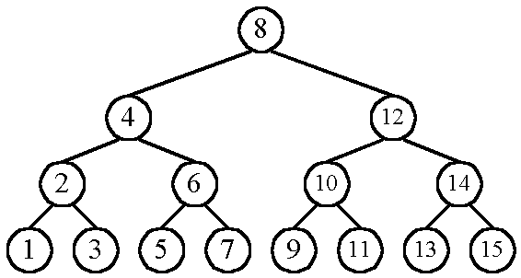
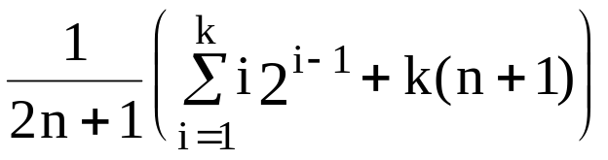
    n cases for successful search
    n+1 cases for unsuccessful search
    Average # of comparisons done in the binary tree:
    A(n) = , where k = ⎣log n⎦+1
2 -<number>

Slide 8
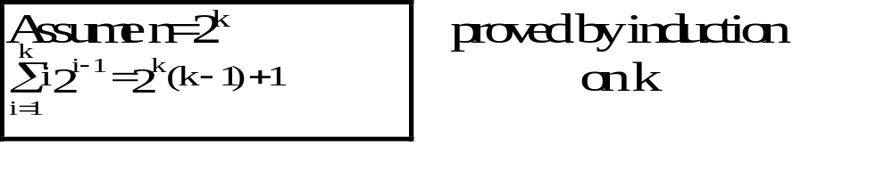
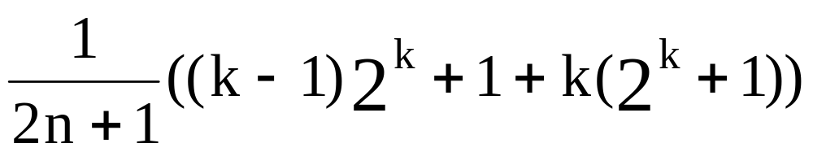
      A(n) =
      ≈ k as n is very large
      = log n
      = Θ(log n)
2 -<number>

Slide 9
2-D ranking finding
Def: Let A = (a₁,a₂), B = (b₁,b₂). A dominates B iff a₁> b₁ and a₂ > b₂
Def: Given a set S of n points, the rank of a point x is the number of points dominated by x.
D
B
A
C
E
rank(A)= 0 rank(B) = 1 rank(C) = 1
rank(D) = 3 rank(E) = 0
2 -<number>

Slide 10
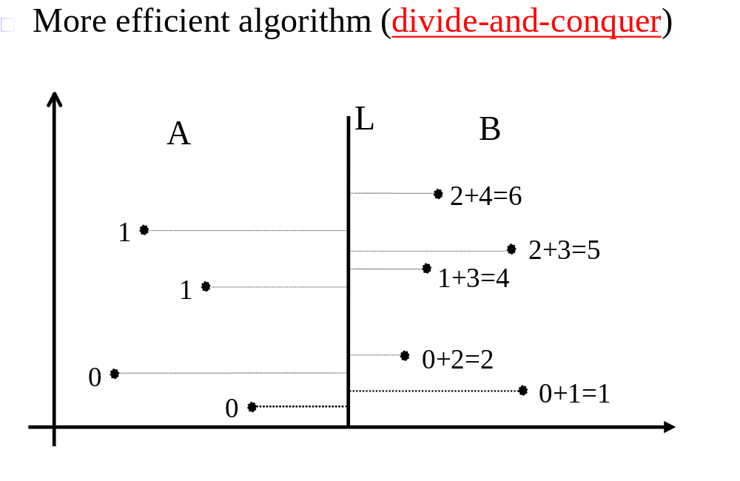
Straightforward algorithm:
compare all pairs of points : O(n²)
2 -<number>

Slide 11


Divide-and-conquer 2-D ranking finding
Input: A set S of planar points P₁,P₂,…,P_{n}
Output: The rank of every point in S
Step 1: (Split the points along the median line L into A and B.)
a.If S contains only one point, return its rank its rank as 0.
b.Otherwise,choose a cut line L perpendicular to the x-axis such that n/2 points of S have X-values L (call this set of points A) and the remainder points have X-values L(call this set B).Note that L is a median X-value of this set.
Step 2:
Find ranks of points in A and ranks of points in B, recursively.
Step 3:
Sort points in A and B according to their y-values.
Scan these points sequentially and determine, for each point in B, the number of points in A whose y-values are less than its y-value. The rank of this point is equal to the rank of this point among points in B, plus the number of points in A whose y-values are less than its y-value.
2 -<number>

Slide 12
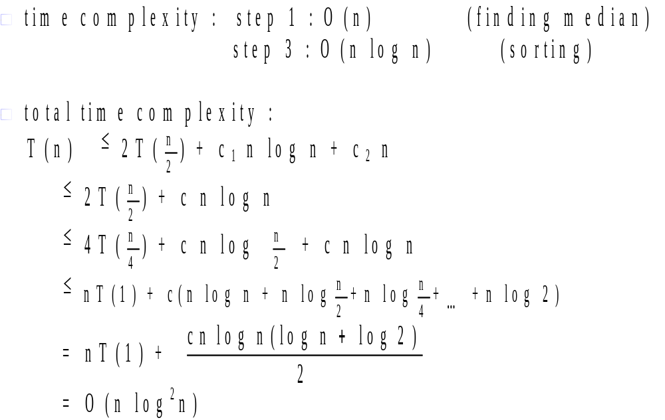
2 -<number>

Slide 13
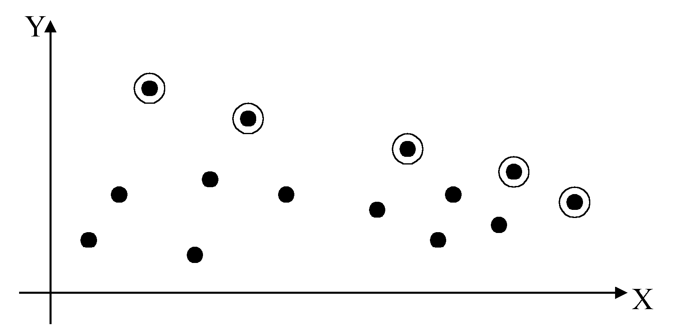
2-D maxima finding problem
Def : A point (x₁, y₁) dominates (x₂, y₂) if x₁ > x₂ and y₁ > y₂. A point is called a maxima if no other point dominates it
Straightforward method : Compare every pair of points.
Time complexity:
O(n²)
5 -<number>

Slide 14
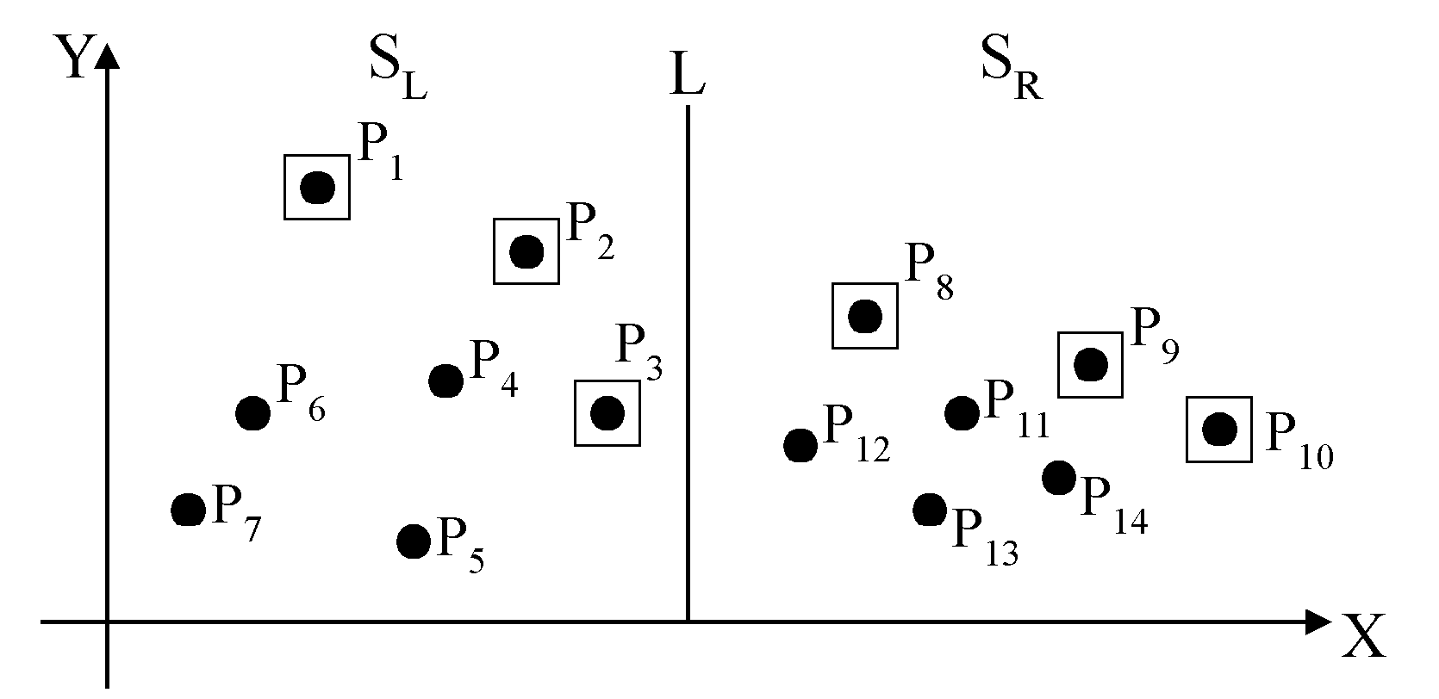
Divide-and-conquer for maxima finding
The maximal points of S_{L} and S_{R}
5 -<number>

Slide 15
The algorithm:
Input: A set of n planar points.
Output: The maximal points of S.
Step 1: If S contains only one point, return it as the maxima. Otherwise, find a line L perpendicular to the X-axis which separates the set of points into two subsets S_{L}and S_{R} , each of which consisting of n/2 points.
Step 2: Recursively find the maximal points of S_{L} and S_{R} .
Step 3: Find the largest y-value of S_{R}. Project the maximal points of S_{L} onto L. Discard each of the maximal points of S_{L} if its y-value is less than the largest y-value of S_{R} .
5 -<number>

Slide 16
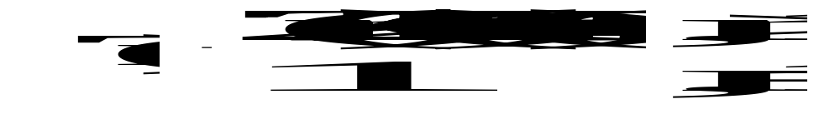
Time complexity: T(n)
Step 1: O(n)
Step 2: 2T(n/2)
Step 3: O(n)
Assume n = 2^{k}
T(n) = O(n log n)
5 -<number>

Slide 17
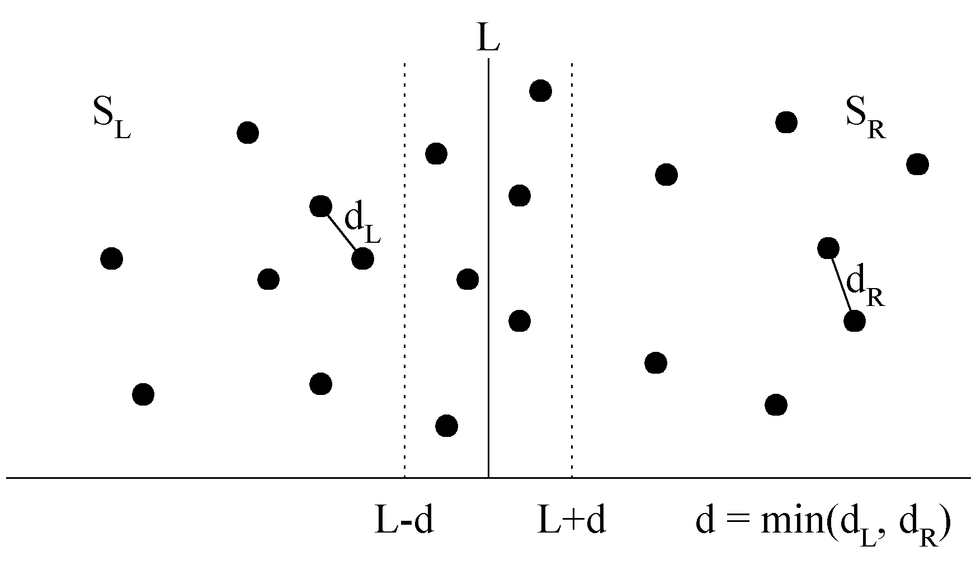
The closest pair problem
Given a set S of n points, find a pair of points which are closest together.
1-D version :
Solved by sorting
Time complexity :
O(n log n)
 2-D version
5 -<number>

Slide 18
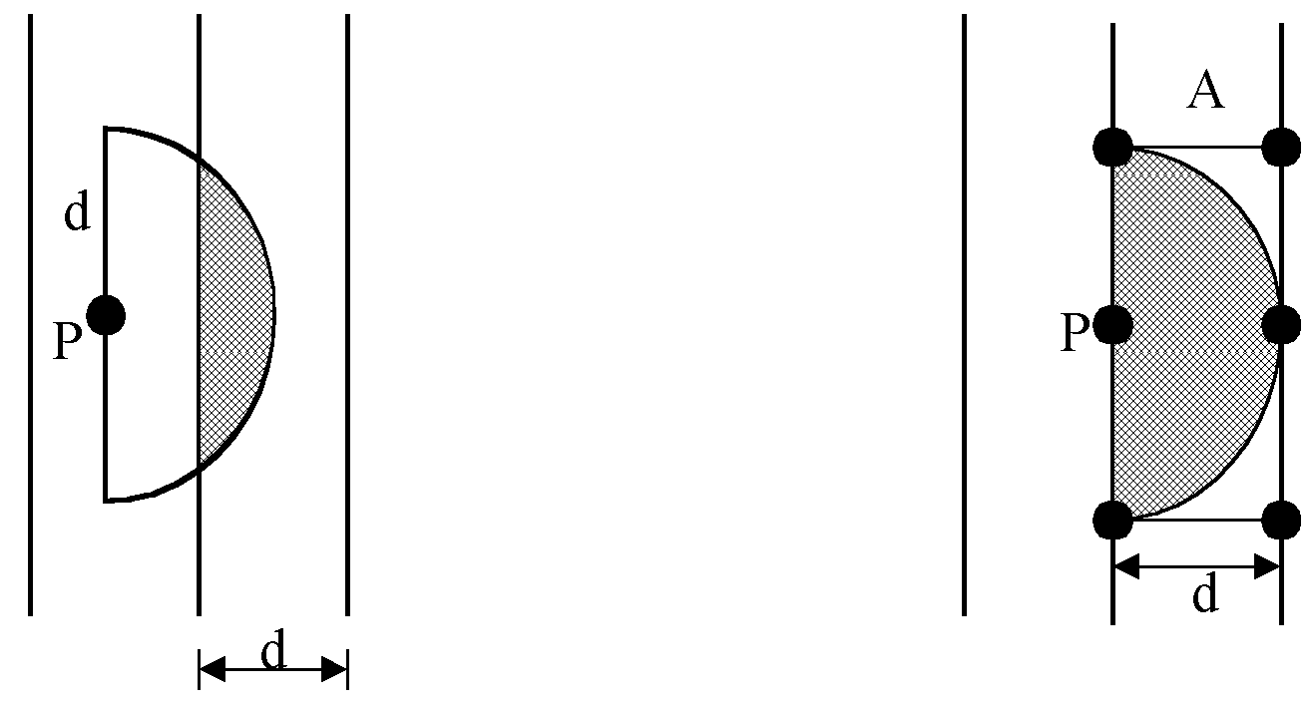
at most 6 points in area A:
5 -<number>

Slide 19
The algorithm:
Input: A set of n planar points.
Output: The distance between two closest points.
Step 1: Sort points in S according to their y-values and x-values.
Step 2: If S contains only two points, return infinity as their distance.
Step 3: Find a median line L perpendicular to the X-axis to divide S into two subsets, with equal sizes, S_{L} and S_{R}.
Step 4: Recursively apply Step 2 and Step 3 to solve the closest pair problems of S_{L} and S_{R}. Let d_{L}(d_{R}) denote the distance between the closest pair in S_{L} (S_{R}). Let d = min(d_{L}, d_{R}).
5 -<number>

Slide 20
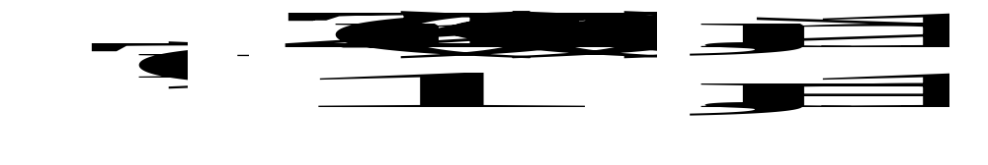
Step 5: For a point P in the half-slab bounded by L-d and L, let its y-value by denoted as y_{P} . For each such P, find all points in the half-slab bounded by L and L+d whose y-value fall within y_{P} +d and y_{P} -d. If the distance d′ between P and a point in the other half-slab is less than d, let d=d′ . The final value of d is the answer.
Time complexity: O(n log n)
Step 1: O(n log n)
Steps 2~5:
⇒T(n) = O(n log n)
5 -<number>

Slide 21
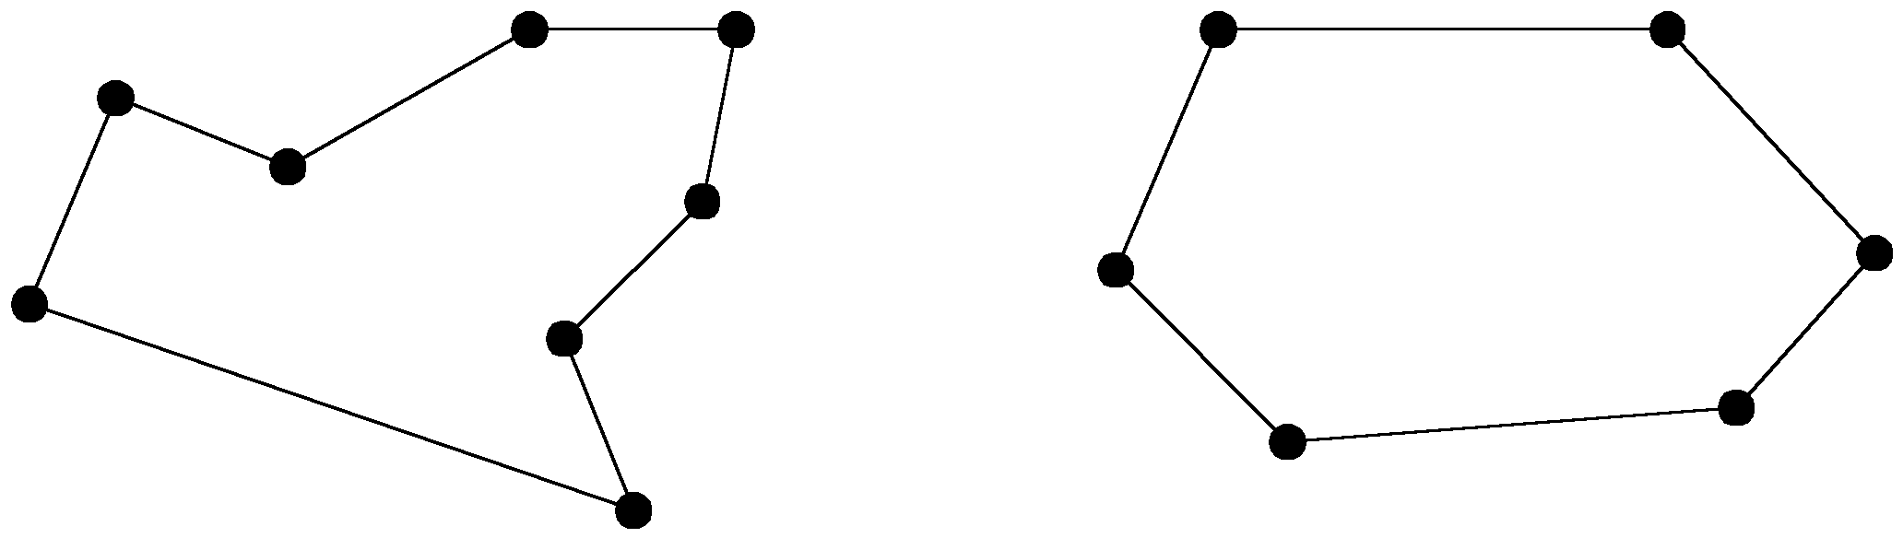
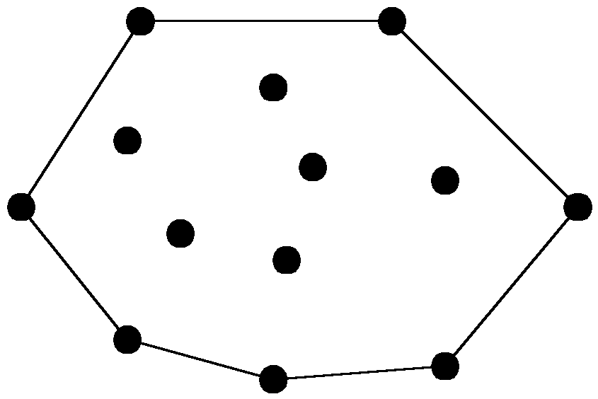
The convex hull problem
concave polygon:
convex polygon:
The convex hull of a set of planar points is the smallest convex polygon containing all of the points.
5 -<number>

Slide 22
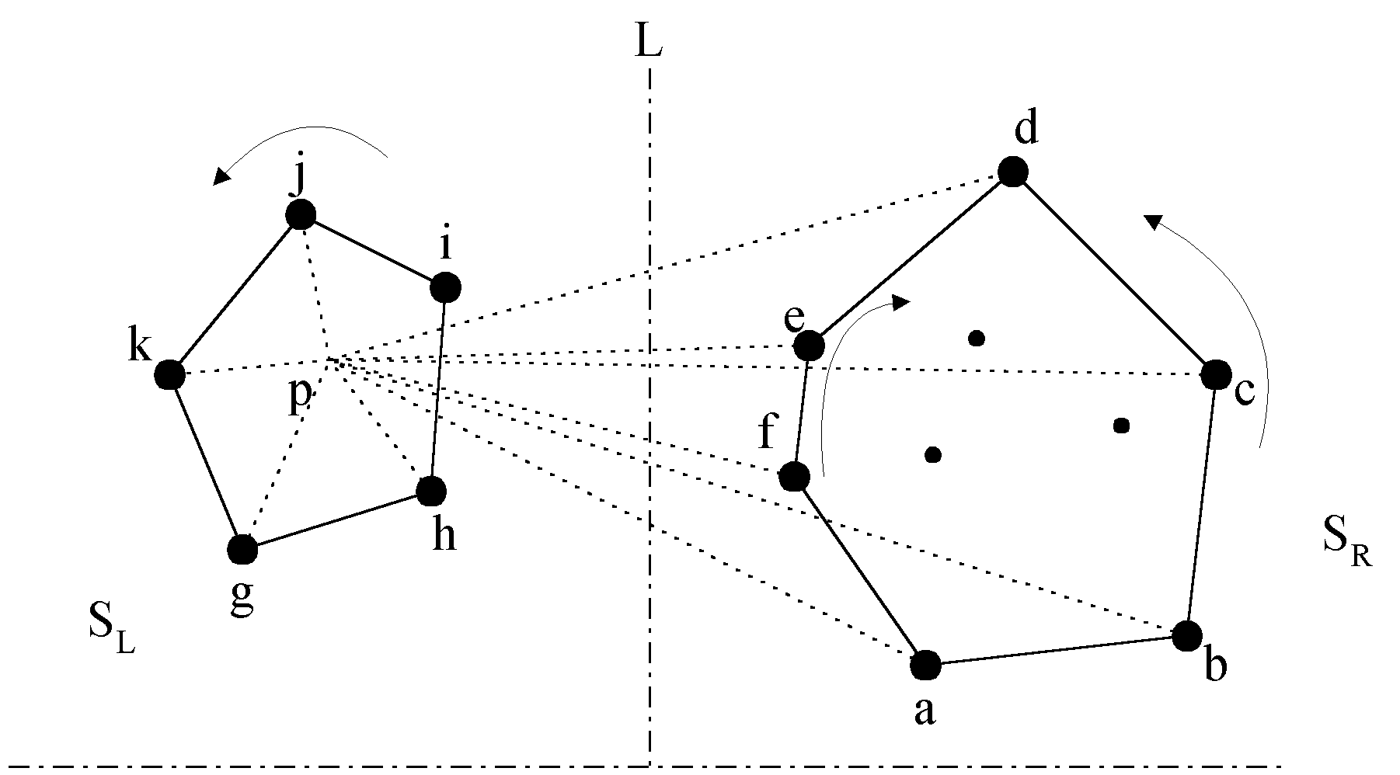
The divide-and-conquer strategy to solve the problem:
5 -<number>

Slide 23
The merging procedure:
Select an interior point p.
There are 3 sequences of points which have increasing polar angles with respect to p.
(1) g, h, i, j, k
(2) a, b, c, d
(3) f, e
Merge these 3 sequences into 1 sequence:
g, h, a, b, f, c, e, d, i, j, k.
Apply Graham scan to examine the points one by one and eliminate the points which cause reflexive angles.
(See the example on the next page.)
5 -<number>

Slide 24
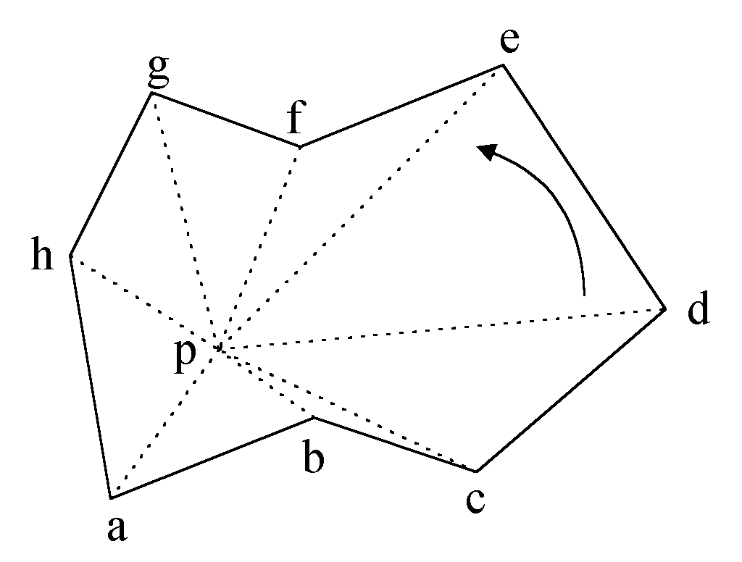
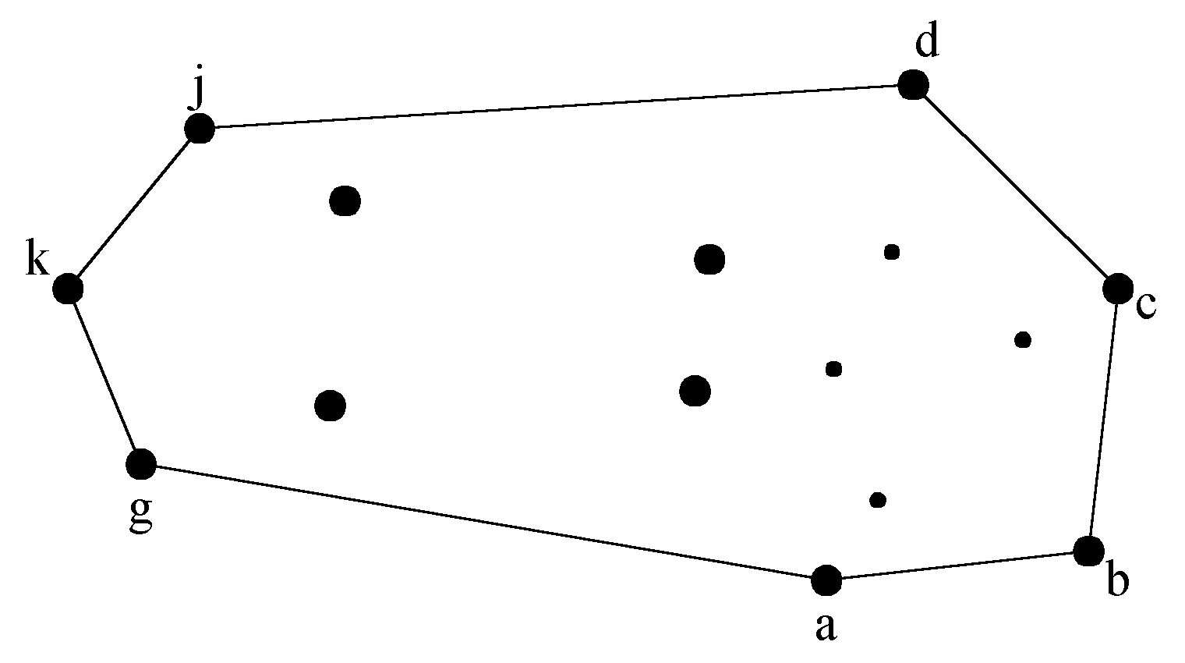
e.g. points b and f need to be deleted.
Final result:
5 -<number>

Slide 25
Divide-and-conquer for convex hull
Input : A set S of planar points
Output : A convex hull for S
Step 1: If S contains no more than five points, use exhaustive searching to find the convex hull and return.
Step 2: Find a median line perpendicular to the X-axis which divides S into S_{L} and S_{R} ; S_{L} lies to the left of S_{R} .
Step 3: Recursively construct convex hulls for S_{L} and S_{R}. Denote these convex hulls by Hull(S_{L}) and Hull(S_{R}) respectively.
5 -<number>

Slide 26
Step 4: Apply the merging procedure to merge Hull(S_{L}) and Hull(S_{R}) together to form a convex hull.
Time complexity:
T(n) = 2T(n/2) + O(n)
= O(n log n)
5 -<number>

Slide 27
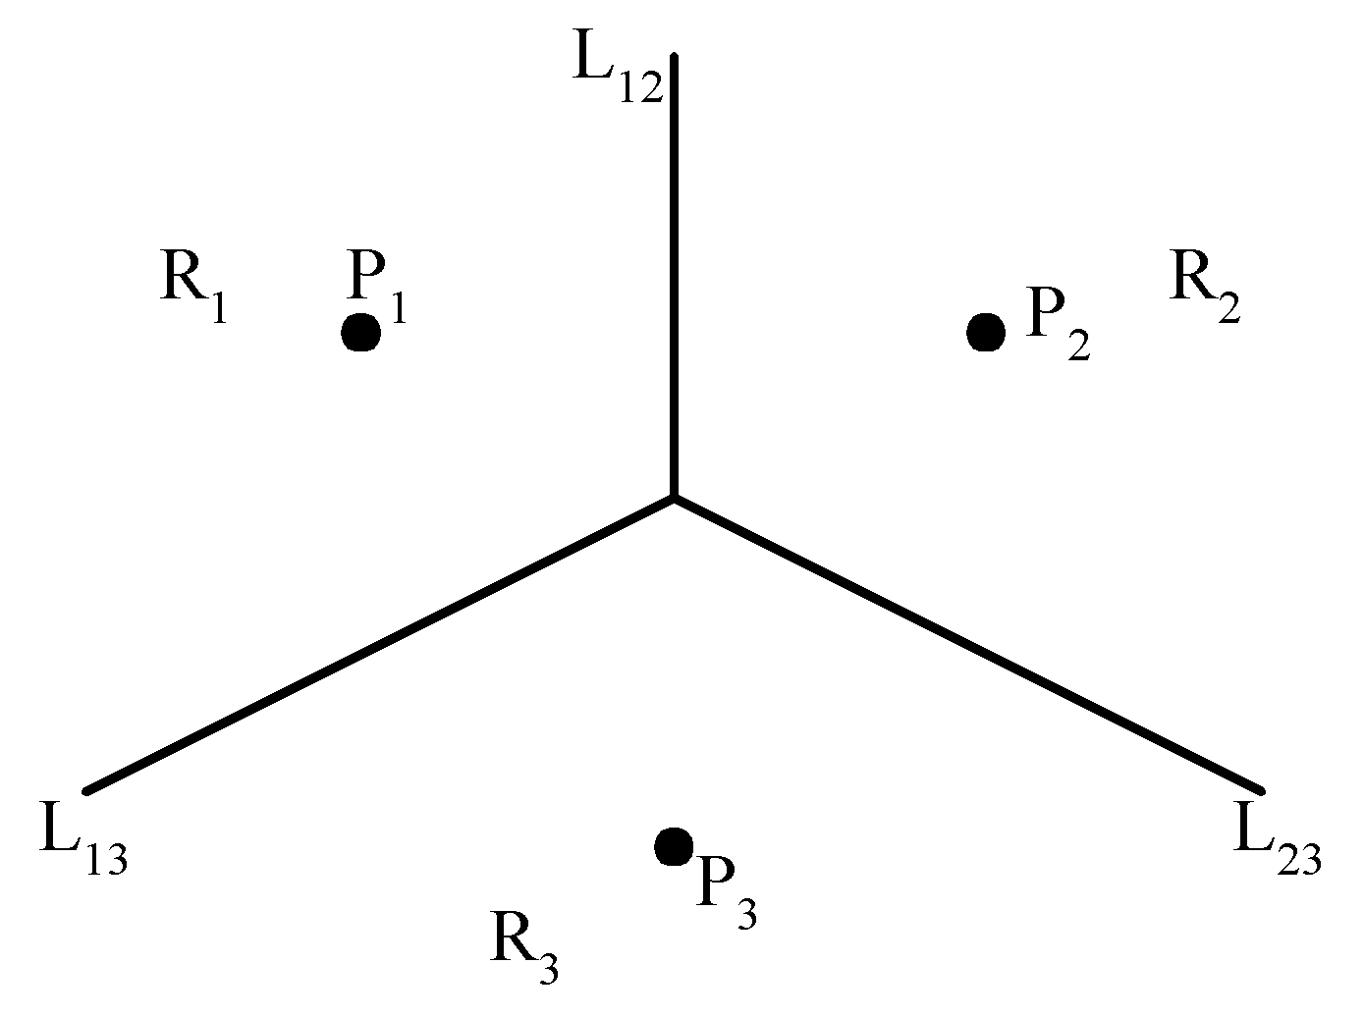
The Voronoi diagram problem
e.g. The Voronoi diagram for three points
Each L_{ij} is the perpendicular bisector of the line.
5 -<number>

Slide 28
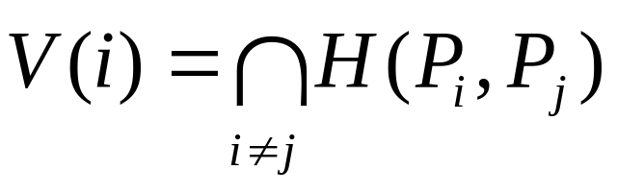
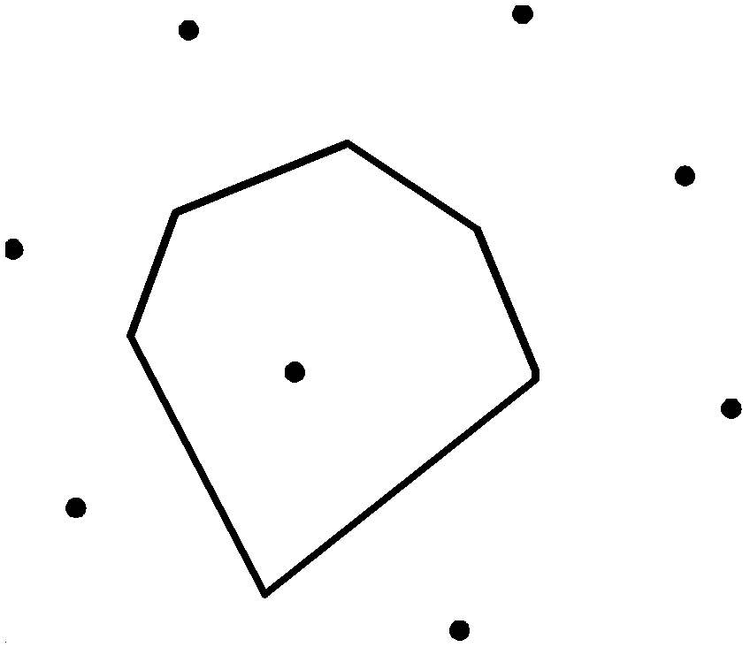
Definition of Voronoi diagrams
Def : Given two points P_{i}, P_{j} ∈ S, let H(P_{i},P_{j}) denote the half plane containing P_{i}. The Voronoi polygon associated with P_{i} is defined as
5 -<number>

Slide 29
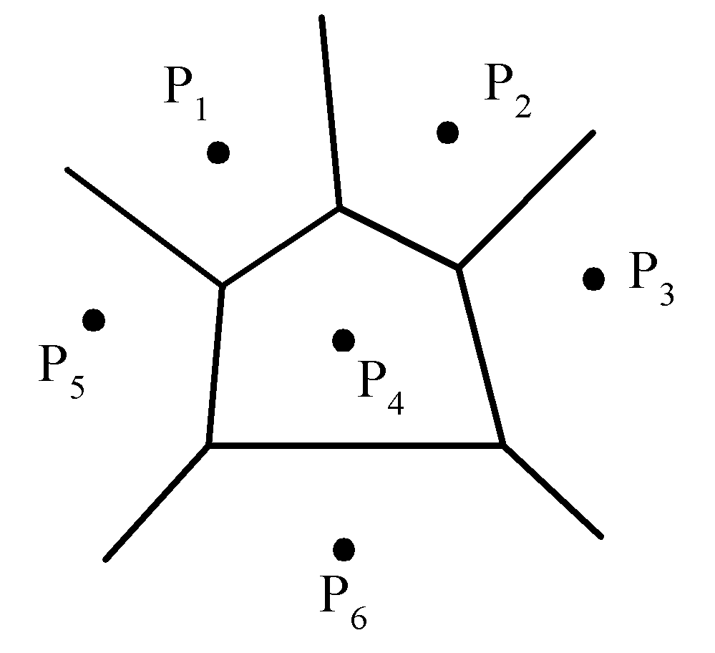
Given a set of n points, the Voronoi diagram consists of all the Voronoi polygons of these points.
The vertices of the Voronoi diagram are called Voronoi points and its segments are called Voronoi edges.
5 -<number>

Slide 30
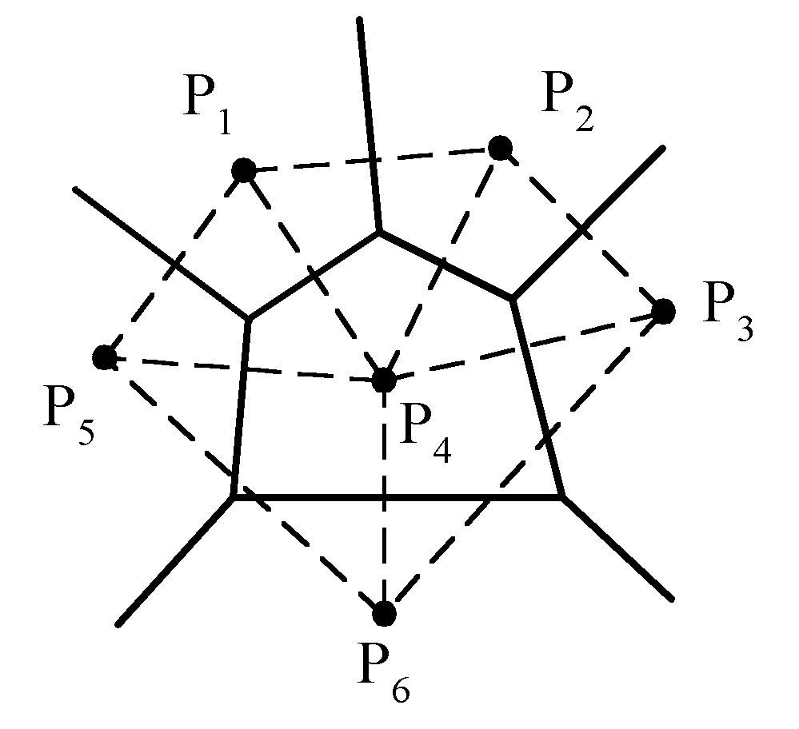
Delaunay triangulation
5 -<number>

Slide 31
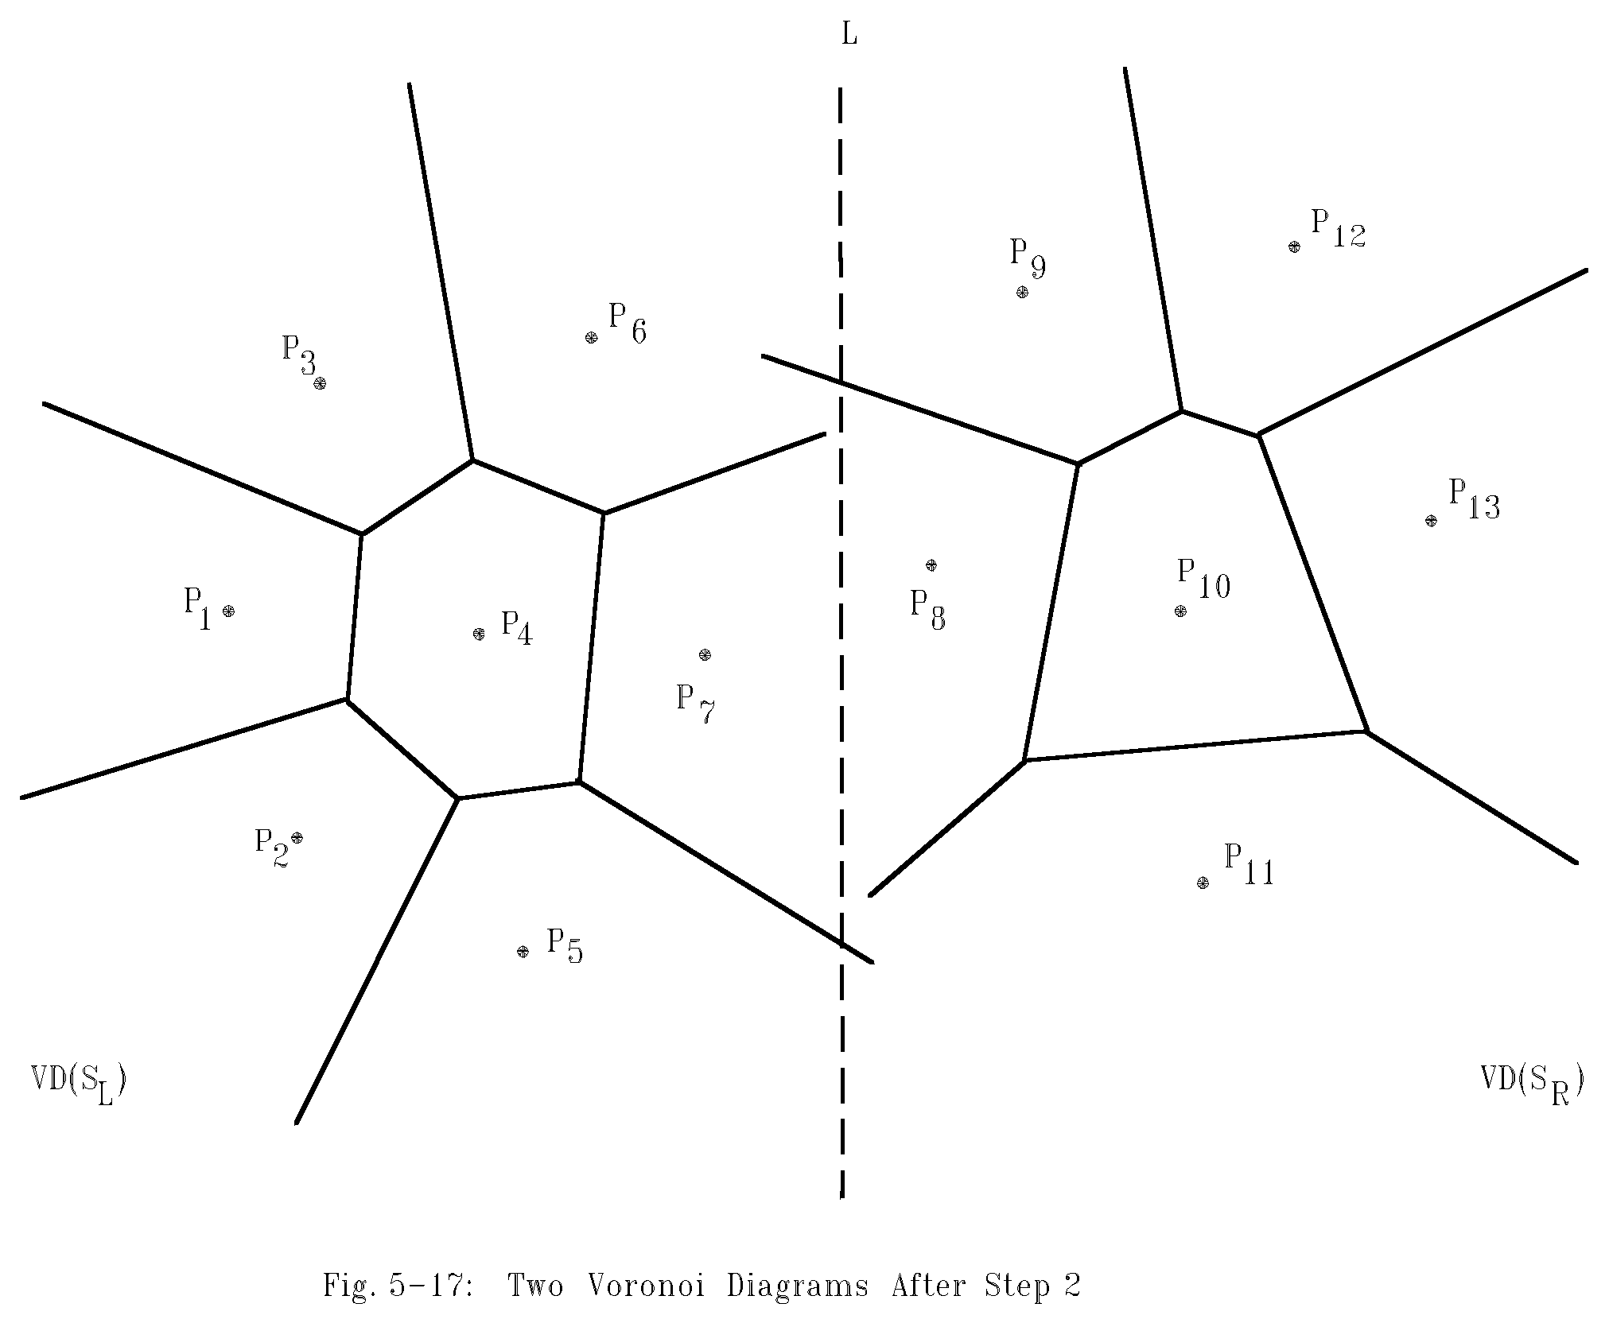
Example for constructing Voronoi diagrams
Divide the points into two parts.
5 -<number>

Slide 32
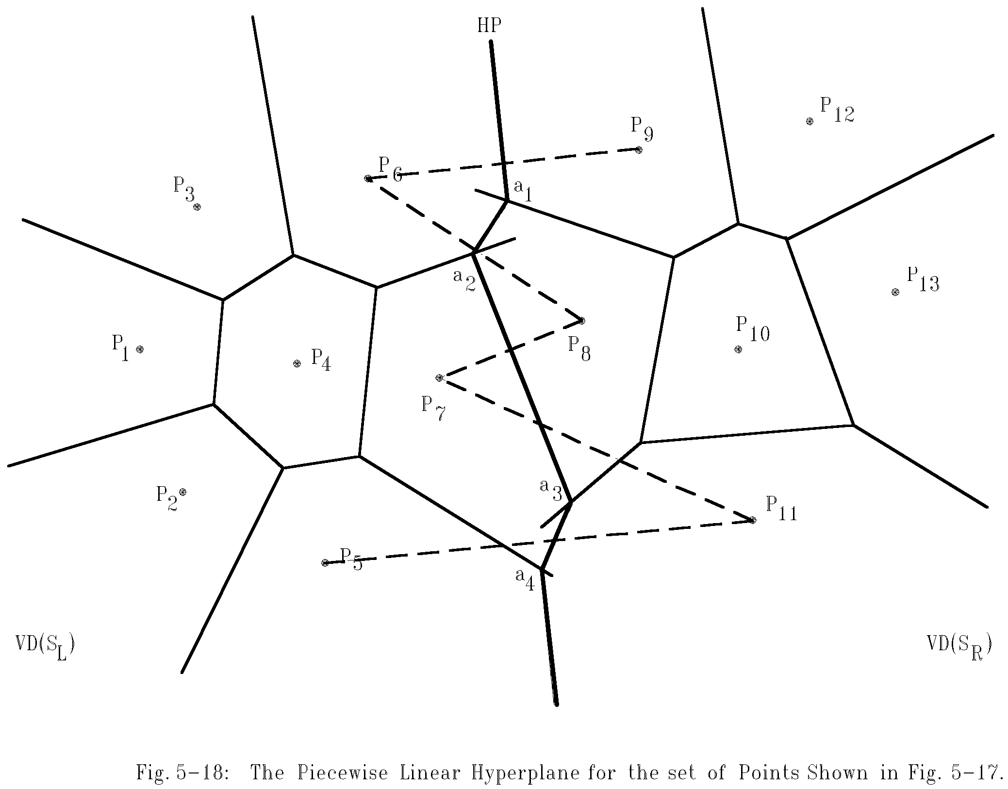
Merging two Voronoi diagrams
Merging along the piecewise linear hyperplane
5 -<number>

Slide 33
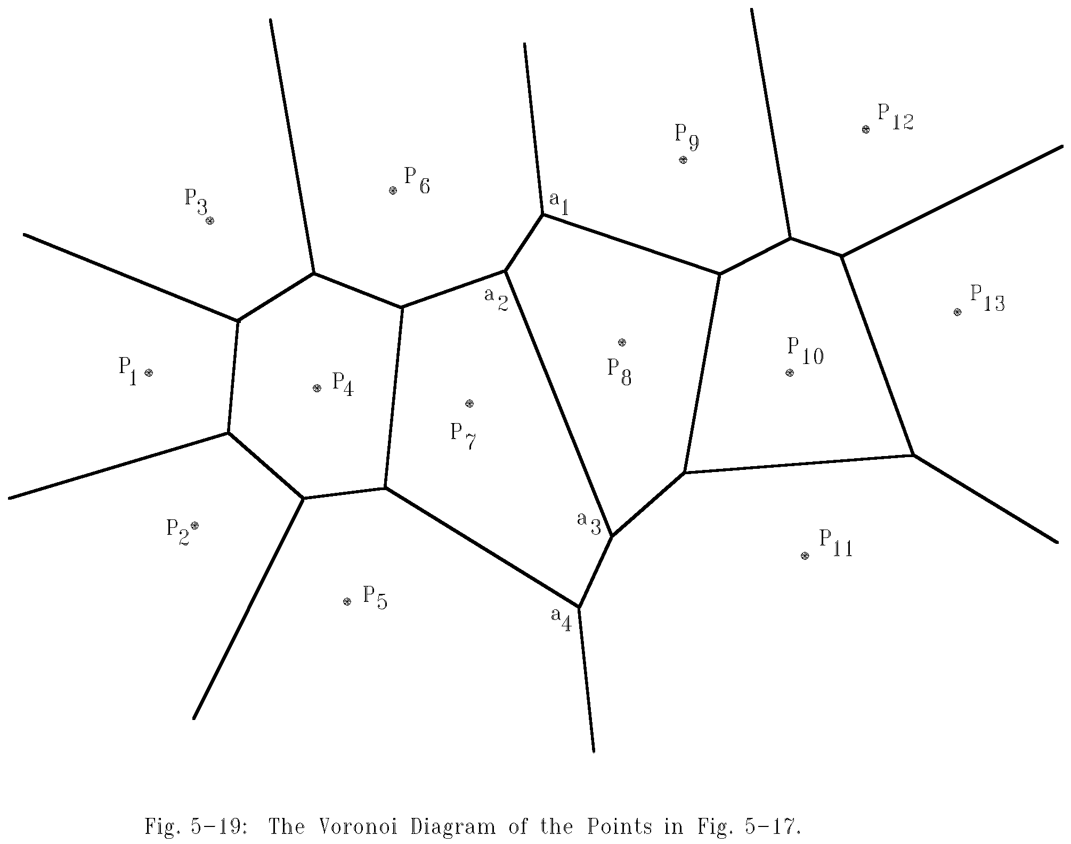
The final Voronoi diagram
After merging
5 -<number>

Slide 34
Divide-and-conquer for Voronoi diagram
Input: A set S of n planar points.
Output: The Voronoi diagram of S.
Step 1: If S contains only one point, return.
Step 2: Find a median line L perpendicular to the X-axis which divides S into S_{L} and S_{R} such that S_{L} (S_{R}) lies to the left(right) of L and the sizes of S_{L} and S_{R} are equal.
5 -<number>

Slide 35
Step 3: Construct Voronoi diagrams of S_{L} and S_{R} recursively. Denote these Voronoi diagrams by VD(S_{L}) and VD(S_{R}).
Step 4: Construct a dividing piece-wise linear hyperplane HP which is the locus of points simultaneously closest to a point in S_{L} and a point in S_{R}. Discard all segments of VD(S_{L}) which lie to the right of HP and all segments of VD(S_{R}) that lie to the left of HP. The resulting graph is the Voronoi diagram of S.
(See details on the next page.)
5 -<number>

Slide 36
Mergeing Two Voronoi Diagrams into One Voronoi Diagram
Input: (a) S_{L} and S_{R} where S_{L} and S_{R} are divided by a perpendicular line L.
(b) VD(S_{L} ) and VD(S_{R} ).
Output: VD(S) where S = S_{L} ∩S_{R}
Step 1: Find the convex hulls of S_{L} and S_{R}, denoted as Hull(S_{L}) and Hull(S_{R}), respectively. (A special algorithm for finding a convex hull in this case will by given later.)
5 -<number>

Slide 37
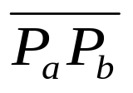
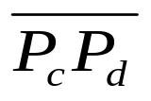
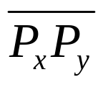
Step 2: Find segments and which join HULL(S_{L} ) and HULL(S_{R} ) into a convex hull (P_{a} and P_{c} belong to S_{L} and P_{b} and P_{d} belong to S_{R}) Assume that lies above . Let x = a, y = b, SG= and HP = ∅ .
Step 3: Find the perpendicular bisector of SG. Denote it by BS. Let HP = HP∪{BS}. If SG = , go to Step 5; otherwise, go to Step 4.
5 -<number>

Slide 38
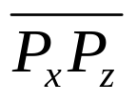

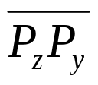
Step 4: The ray from VD(S_{L} ) and VD(S_{R}) which BS first intersects with must be a perpendicular bisector of either or for some z. If this ray is the perpendicular bisector of , then let SG = ; otherwise, let SG = . Go to Step 3.
Step 5: Discard the edges of VD(S_{L}) which extend to the right of HP and discard the edges of VD(S_{R}) which extend to the left of HP. The resulting graph is the Voronoi diagram of S = S_{L}∪S_{R}.
5 -<number>

Slide 39
Properties of Voronoi Diagrams
Def : Given a point P and a set S of points, the distance between P and S is the distance between P and P_{i} which is the nearest neighbor of P in S.
The HP obtained from the above algorithm is the locus of points which keep equal distances to S_{L} and S_{R} .
The HP is monotonic in y.
5 -<number>

Slide 40

# of Voronoi edges
# of edges of a Voronoi diagram ≤ 3n - 6, where n is # of points.
Reasoning:
  # of edges of a planar graph with n vertices ≤ 3n - 6.
  A Delaunay triangulation is a planar graph.
  Edges in Delaunay triangulation
  edges in Voronoi diagram.
5 -<number>

Slide 41
# of Voronoi vertices
# of Voronoi vertices ≤ 2n - 4.
Reasoning:
  Let F, E and V denote # of face, edges and vertices in a planar graph.
  Euler’s relation: F = E - V + 2.
  In a Delaunay triangulation,
  V = n, E ≤ 3n – 6
  ⇒ F = E - V + 2 ≤ 3n - 6 - n + 2 = 2n - 4.
5 -<number>

Slide 42
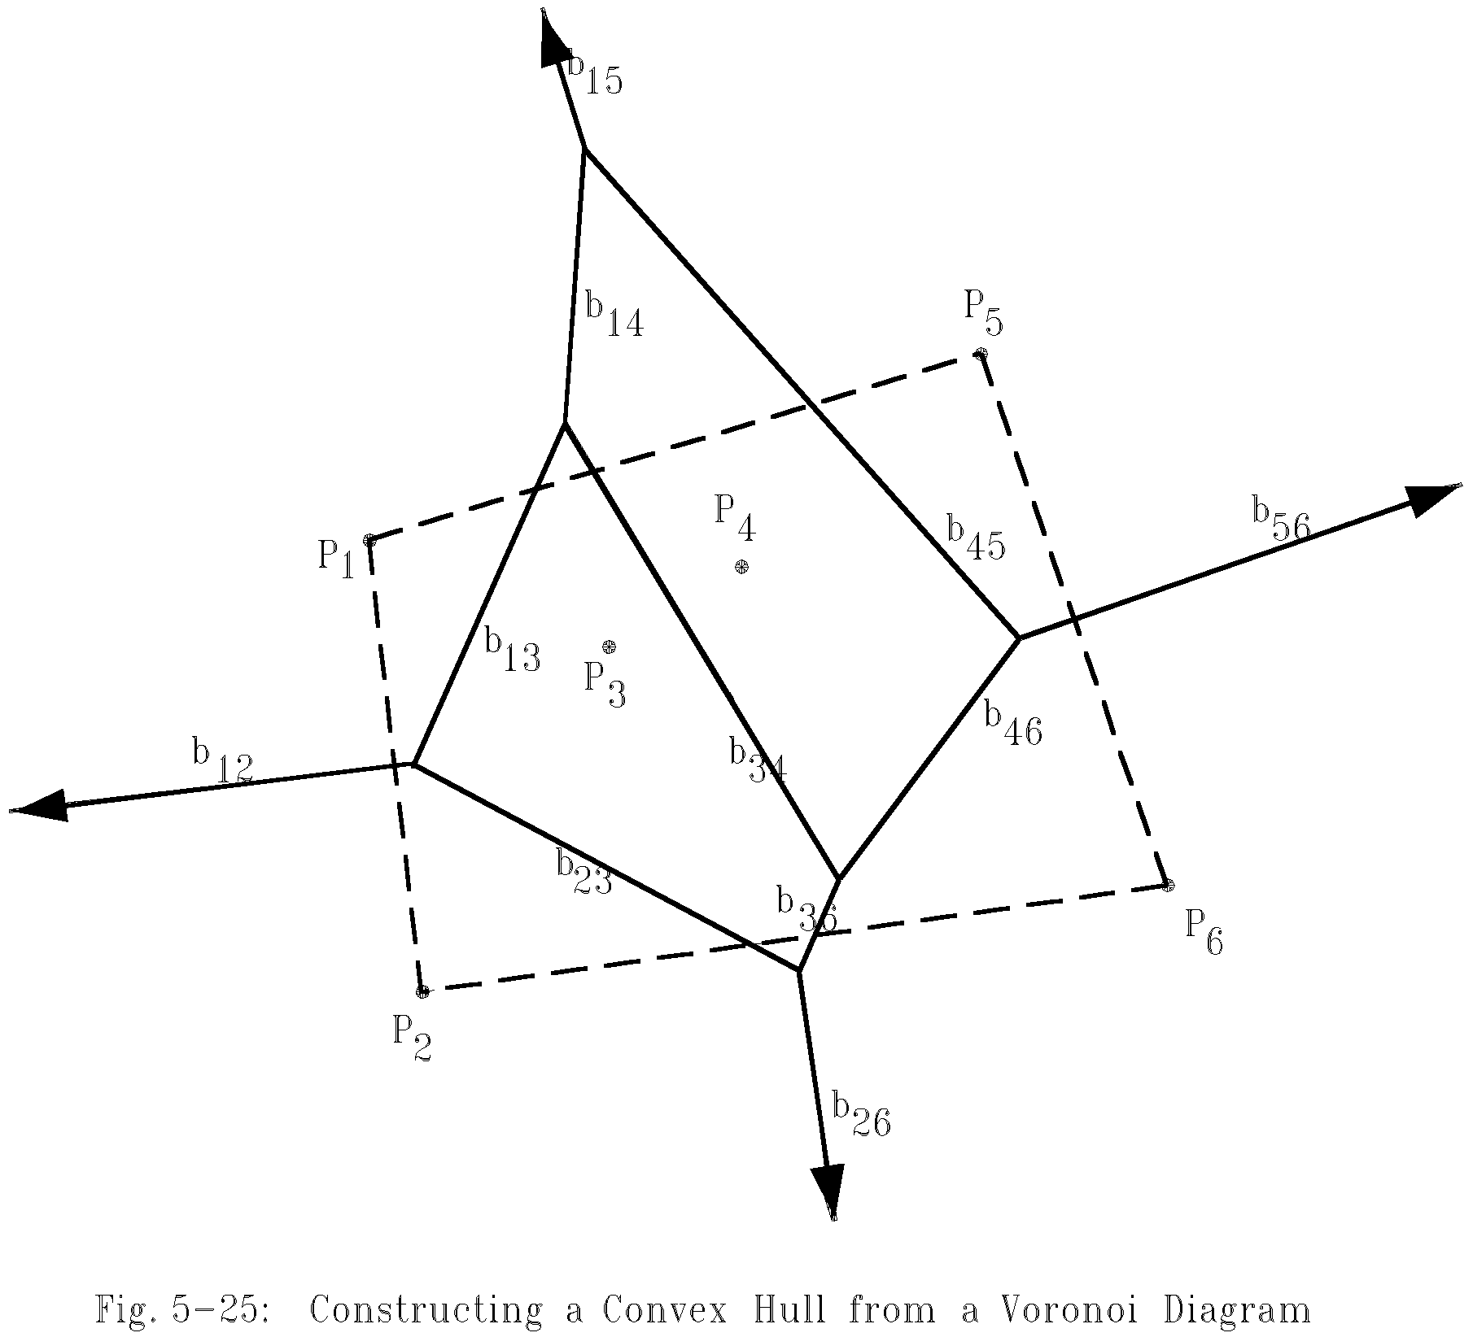
Construct a convex hull from a Voronoi diagram
After a Voronoi diagram is constructed, a convex hull can by found in O(n) time.
5 -<number>

Slide 43
Construct Convex Hull from Voronoi diagram
Step 1: Find an infinite ray by examining all Voronoi edges.
Step 2: Let P_{i} be the point to the left of the infinite ray. P_{i} is a convex hull vertex. Examine the Voronoi polygon of P_{i} to find the next infinite ray.
Step 3: Repeat Step 2 until we return to the Starting ray.
5 -<number>

Slide 44
Time complexity
Time complexity for merging 2 Voronoi diagrams:
Total: O(n)
  Step 1: O(n)
  Step 2: O(n)
  Step 3 ~ Step 5: O(n)
  (at most 3n - 6 edges in VD(S_{L}) and VD(S_{R}) and at most n segments in HP)
Time complexity for constructing a Voronoi diagram: O(n log n)
  because T(n) = 2T(n/2) + O(n)=O(n log n)
5 -<number>

Slide 45
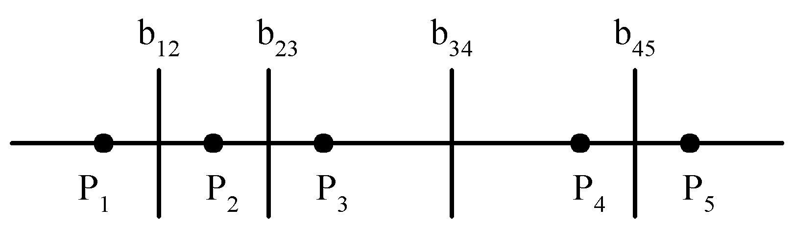
Lower bound
The lower bound of the Voronoi diagram problem is Ω(n log n).
sorting ∝ Voronoi diagram problem
The Voronoi diagram for a set of points on a straight line
5 -<number>

Slide 46
Applications of Voronoi diagrams
The Euclidean nearest neighbor searching problem.
The Euclidean all nearest neighbor problem.
5 -<number>

Slide 47
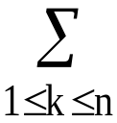
Matrix multiplication
Let A, B and C be n × n matrices
C = AB
C(i, j) = A(i, k)B(k, j)
The straightforward method to perform a matrix multiplication requires O(n³) time.
5 -<number>

Slide 48


Divide-and-conquer approach
C = AB
C₁₁ = A₁₁ B₁₁ + A₁₂ B₂₁
C₁₂ = A₁₁B₁₂ + A₁₂ B₂₂
C₂₁ = A₂₁ B₁₁ + A₂₂ B₂₁
C₂₂ = A₂₁ B₁₂ + A₂₂ B₂₂
Time complexity:
(# of additions : n²)
  We get T(n) = O(n³)
5 -<number>

Slide 49
Strassen’s matrix multiplicaiton
P = (A₁₁ + A₂₂)(B₁₁ + B₂₂)
Q = (A₂₁ + A₂₂)B₁₁
R = A₁₁(B₁₂ - B₂₂)
S = A₂₂(B₂₁ - B₁₁)
T = (A₁₁ + A₁₂)B₂₂
U = (A₂₁ - A₁₁)(B₁₁ + B₁₂)
V = (A₁₂ - A₂₂)(B₂₁ + B₂₂).
C₁₁ = P + S - T + V
C₁₂ = R + T
C₂₁ = Q + S
C₂₂ = P + R - Q + U
5 -<number>

Slide 50

Time complexity
7 multiplications and 18 additions or subtractions
Time complexity:
T(n) = an² + 7T(n/2)
= an² + 7(a(n/2)² + 7T(n/4))
= an² + (7/4)an² + 7²T(n/4)
= …
:
= an²(1 + 7/4 + (7/4)²+…+(7/4)^{k-1}+7^{k}T(1))
≤ cn²(7/4)^{log2n}+7^{log2n}, c is a constant
= cn^{log24+log27-log24} +n^{log27}
= O(n^{log27})
≅ O(n^{2.81})
5 -<number>

