Slide 1
FinSightAI Your AI Finance Advisor Streamlit-based AI App for Personalized Financial Guidance
Presented By:
- Lavya
- Mokksh
- Shivankur
- Zubair

Slide 2
Problem Statement:
Navigating Personal Finance is Hard.
Many struggle with low financial literacy.
Understanding complex documents (contracts, balance sheets) is difficult and time-consuming.
Knowing “how” and “where” to start investing based on personal finances is confusing.
Accessing trustworthy, personalized, AI-driven financial guidance is limited.

Slide 3
Our Solution: FinSightAI
An Integrated AI Platform for Smarter Finance.
FinSightAI combines three essential tools into one easy-to-use web application.
Answers: Get clear explanations for financial queries via an AI Chatbot.
Analyzes: Automatically understand uploaded documents and identify potential financial risks.
Advises: Receive personalized investment strategies tailored to user’s profile and goals.

Slide 4
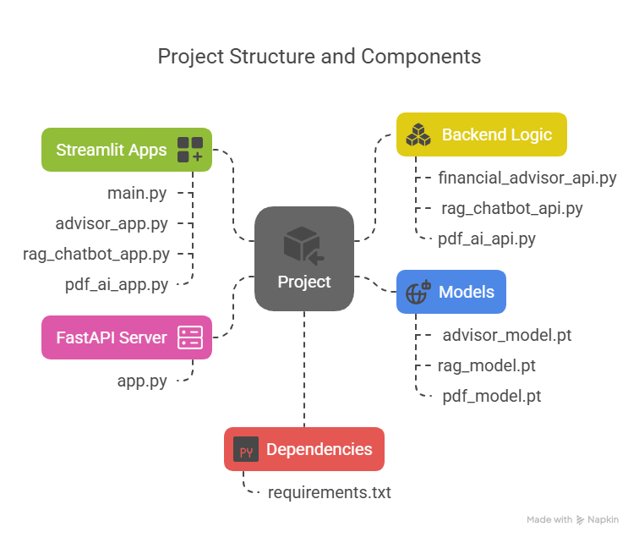

Slide 5
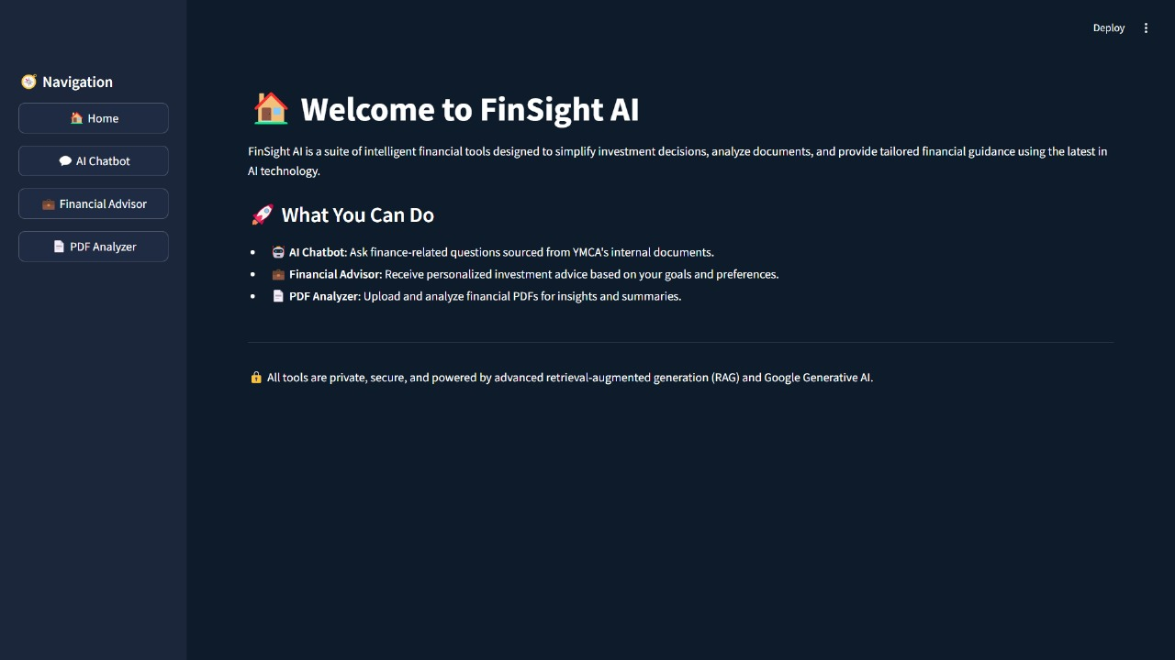
User Interface Overview
FinSightAI offers a clean and user-friendly interface for financial decision-making. Key features include a smart chatbot for queries, document upload for risk analysis, and personalized strategy generation — all within an intuitive, tab-based layout.

Slide 6
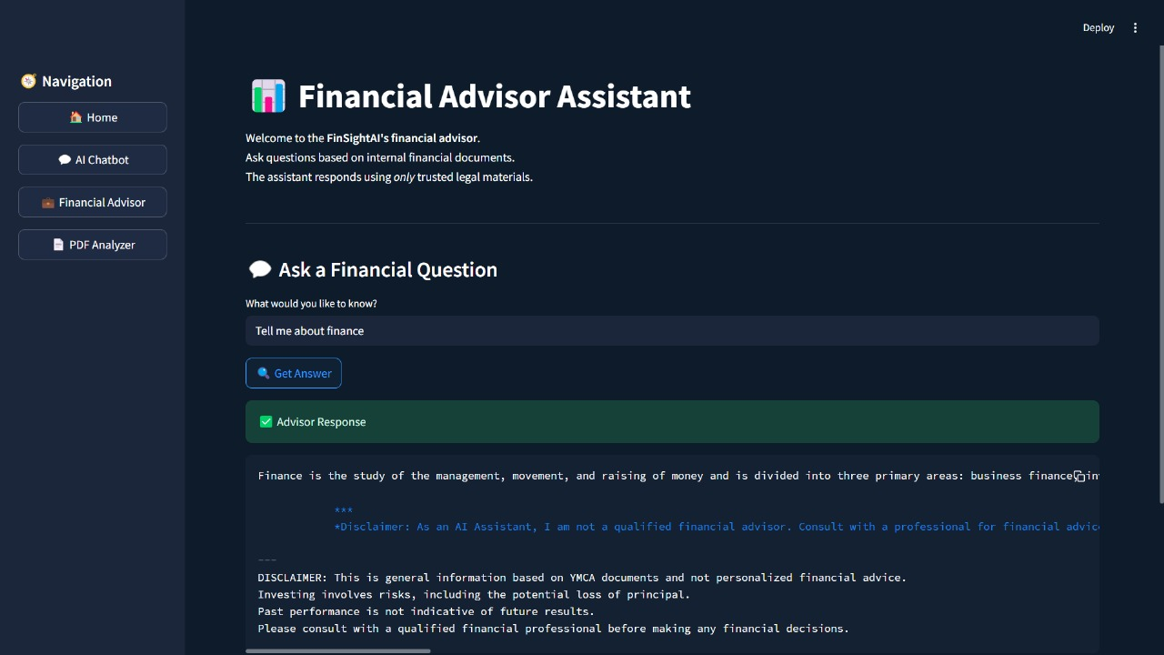
Functionality: RAG Chat
The 'Ask Chat' feature in FinSightAI uses a Retrieval-Augmented Generation (RAG) approach to answer financial questions. It pulls from a curated knowledge base to deliver accurate, jargon-free responses tailored to the user's query.

Slide 7
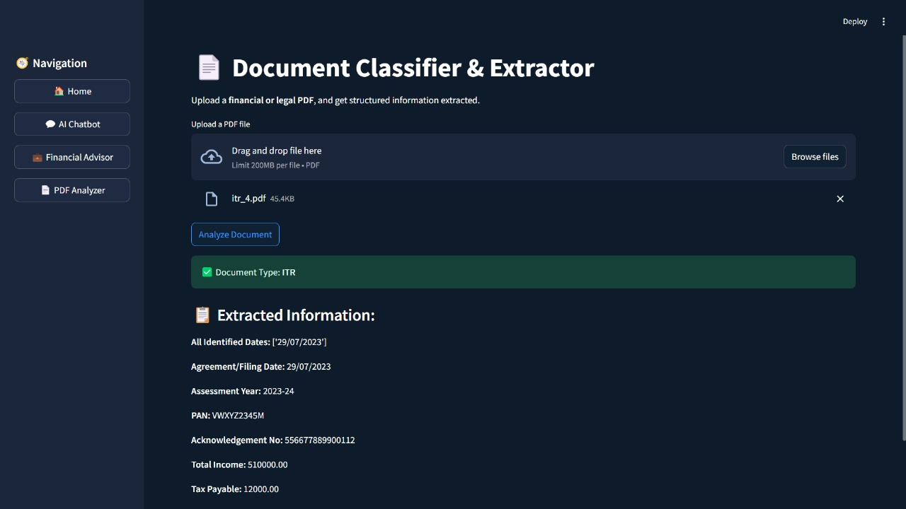
Functionality: Document Scanner
The 'Upload Document' feature allows users to scan PDFs, Word files, or images. It extracts key financial data, and presents a summary report for quick review.

Slide 8
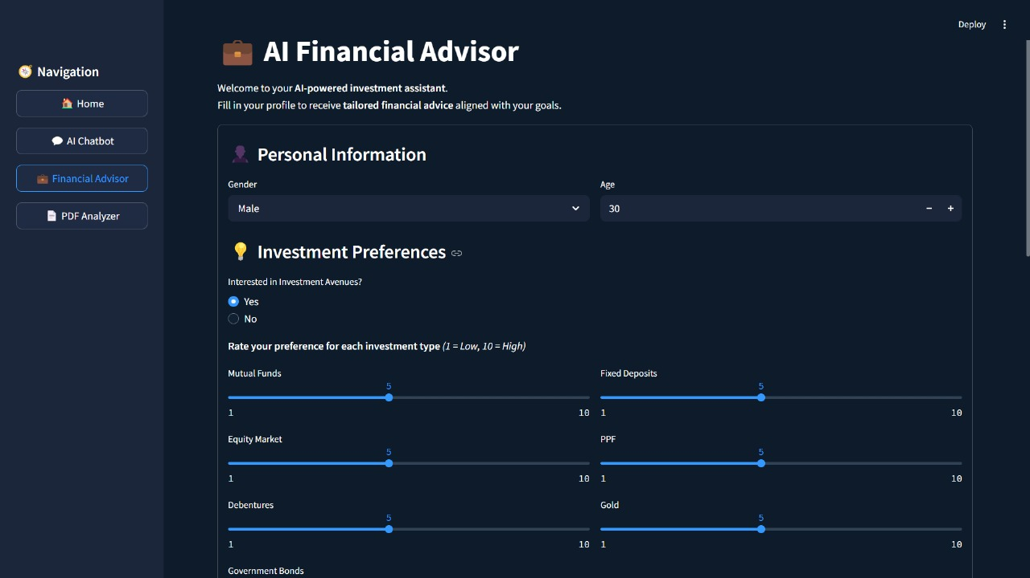
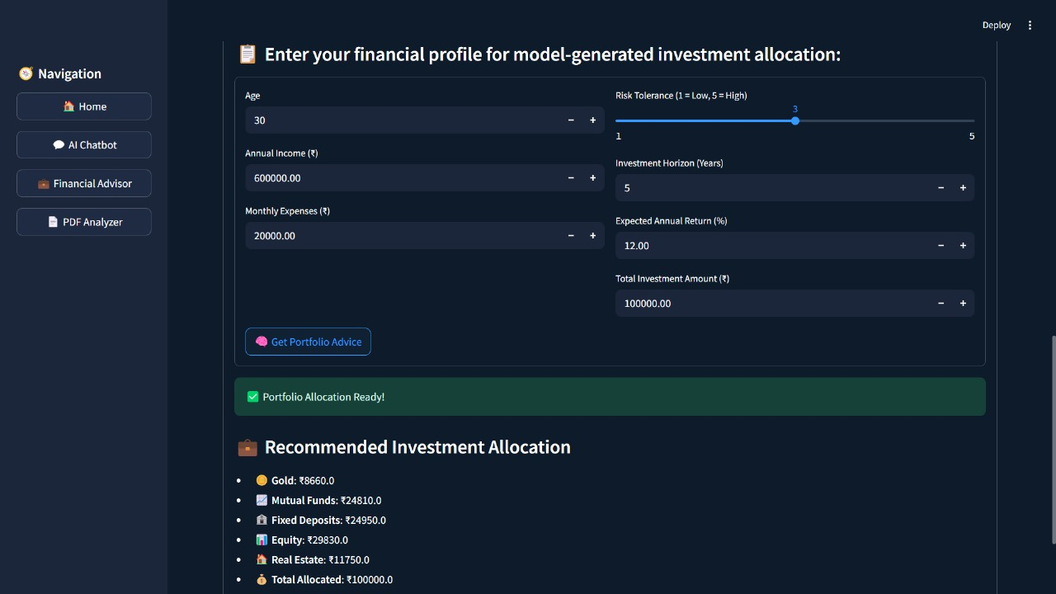
Functionality: Portfolio Adviser
The 'Get Advice' feature in FinSightAI collects user inputs such as age, income, expenses, and risk tolerance. It validates the data and generates a personalized investment strategy, displaying results with actionable insights and a success notification.

Slide 9
Tech Stack
• Backend: FastAPI (Python), PyTorch
• Frontend: Streamlit
• AI: Gemini + LangChain, FinBERT
•ML: Transformers, PyTorch, scikit-learn
• Document Embedding: FAISS
• Parsing: PyMuPDF, Tesseract
• ML: scikit-learn, Transformers

Slide 10
Future Scope: What's Next for FinSightAI
Enhanced Document Intelligence • OCR support for image-based and handwritten documents • Detect fraud risks and complex legal terms in contracts
Live Data Integration • Connect to APIs like Alpha Vantage for real-time financial data • Auto-adjust strategies based on market trends
Report Exporting • Downloadable PDFs of advice, risk reports, and portfolio plans • Easy sharing for advisors or financial planning

Slide 11
Thank You!

