Slide 1
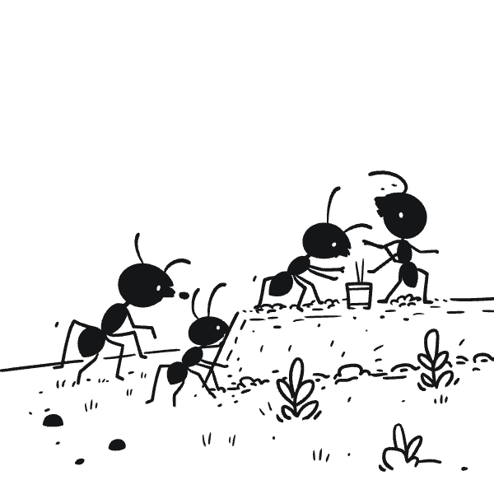

LIVE PROJECT-IV & INDUSTRIAL VISIT (21CS4115)
Group Doodle: Real-Time Collaborative Drawing
Web-based collaborative drawing for real-time creative interaction. Join a shared canvas from anywhere, draw simultaneously with teammates, and experience digital whiteboarding like never before.

Slide 2
Project Vision & Core Idea
Seamless Collaboration
Addressing Remote Challenges
Real-time drawing collaboration via the internet—making digital whiteboarding as natural as physical interaction.
Intuitive, immediately accessible tool requiring nothing more than a web browser to connect distributed teams.
Online Classes
Group Brainstorming
Art Collaboration
Remote Design Thinking
Interactive learning environments for students and teachers
Artists creating together, breaking geographical barriers
Collective creativity and idea generation in virtual meetings
Iterative design processes and visual problem-solving

Slide 3



Technology Stack
Robust, modern technologies delivering high-performance real-time collaboration
Next.js & React Frontend
Node.js Backend
Socket.io for Real-time
Fast, component-driven interface with server-side rendering for optimal performance and seamless user experience
Efficient WebSocket connection handling enabling real-time, bi-directional communication between all connected clients
Instant data exchange ensuring every drawing stroke broadcasts and receives with minimal latency
TailwindCSS Styling
Font Optimization
Sleek, responsive, highly customizable design ensuring consistent appeal across all devices
Enhanced loading speeds and visual consistency through optimized font delivery

Slide 4
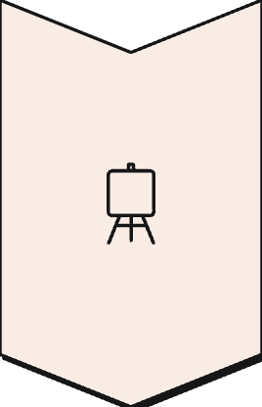
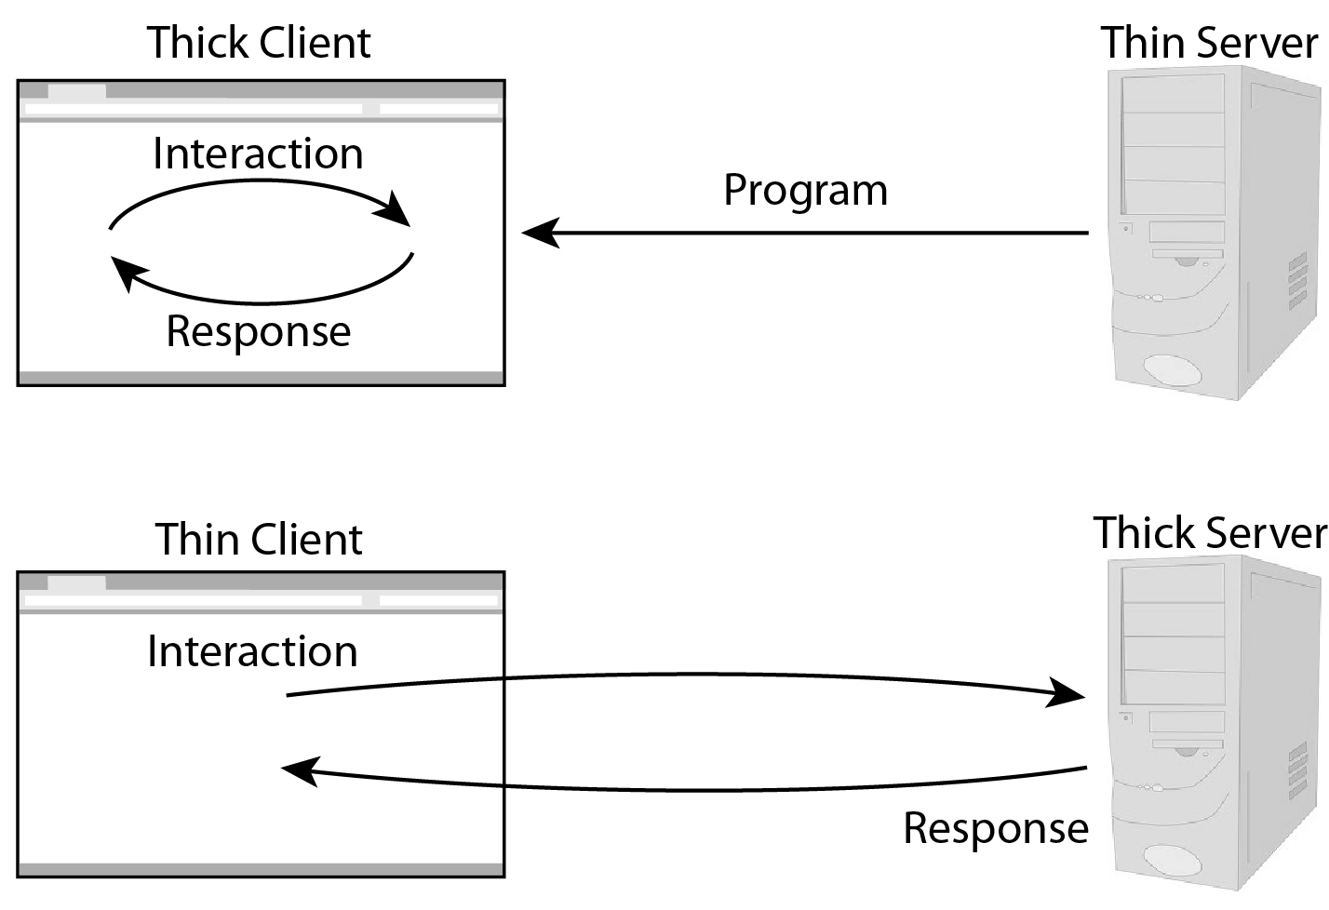
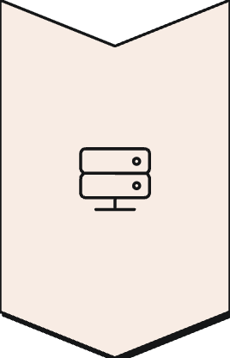

Architecture: Client-Server Model
Classic client-server architecture optimized for real-time synchronization
Frontend Canvas
Users interact on drawing canvas—every stroke, erase, or selection transmitted live to server
Backend Server
Manages communication channels, securely relays drawing events between all connected clients
Synchronized Updates
Server broadcasts events simultaneously, maintaining consistent shared canvas view across all users

Slide 5

Key Components: Bringing the Canvas to Life
Interconnected components working in harmony to deliver smooth, responsive collaborative environment
01
02
React Drawing Canvas
WebSocket Handlers
Central interaction point enabling drawing with mouse and touch inputs for versatile creative experience
Real-time event broadcasting managing drawing actions, user connections, and disconnections
03
State Synchronization
Ensures all connected users consistently see the same drawing status, maintaining accuracy and cohesion

Slide 6
UI/UX Design: Intuitive & Responsive
1
2
3
Responsive Interface
Dynamic Canvas & Toolbar
Optimized Typography
TailwindCSS creates clean interface seamlessly adapting to various screen sizes—desktops to mobile devices
User-friendly toolbar housing essential drawing tools: pens, erasers, color pickers alongside dynamic canvas
Meticulously optimized spacing with Next.js font utilities ensuring excellent readability and aesthetic appeal

Slide 7
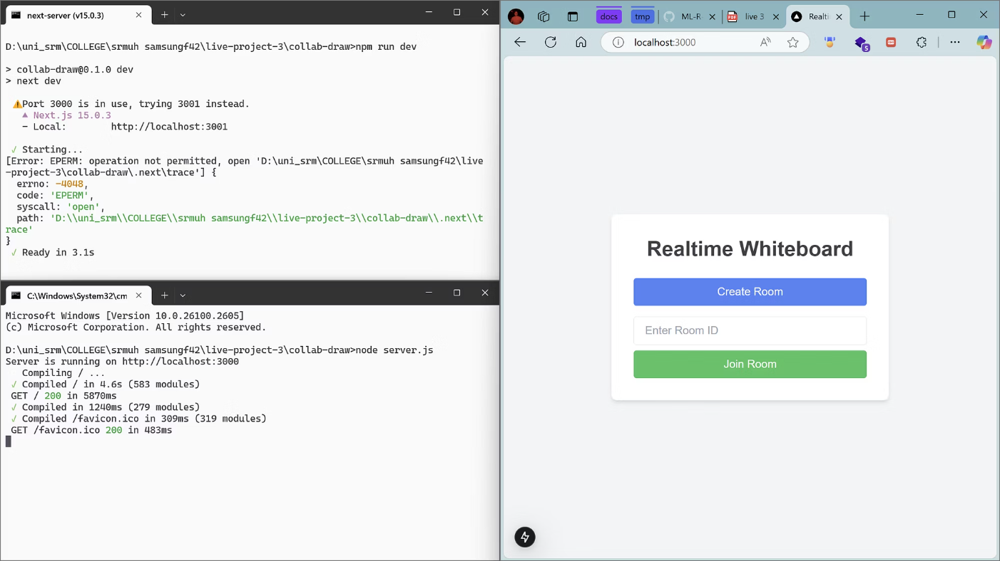
Real-Time Collaboration in Action
Seamless, low-latency drawing reflecting every stroke instantly across all connected devices
Instant Action Broadcast
Each drawing action immediately sent to server
Global Synchronization
Server efficiently broadcasts actions to all connected users
Minimal Delay
Fluid experience even with multiple users drawing simultaneously
Stable & Low-Latency
Handles multiple concurrent connections with robust stability

Slide 8
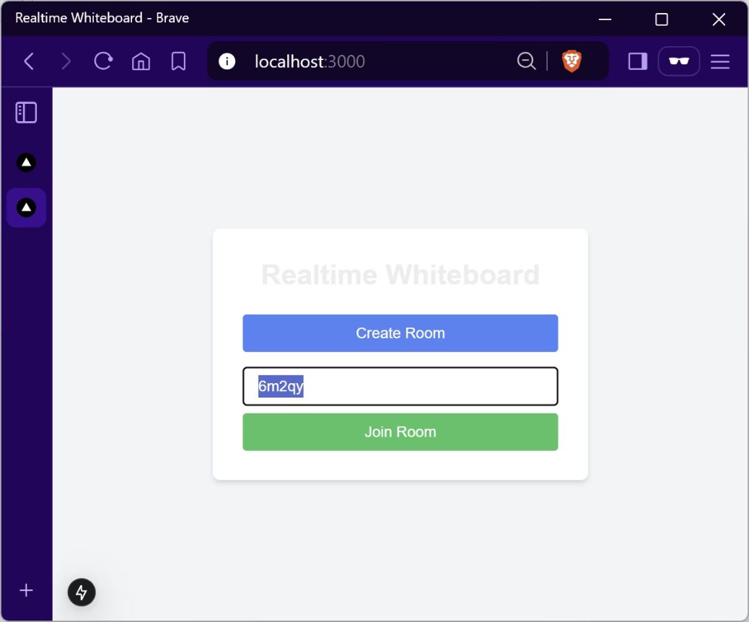
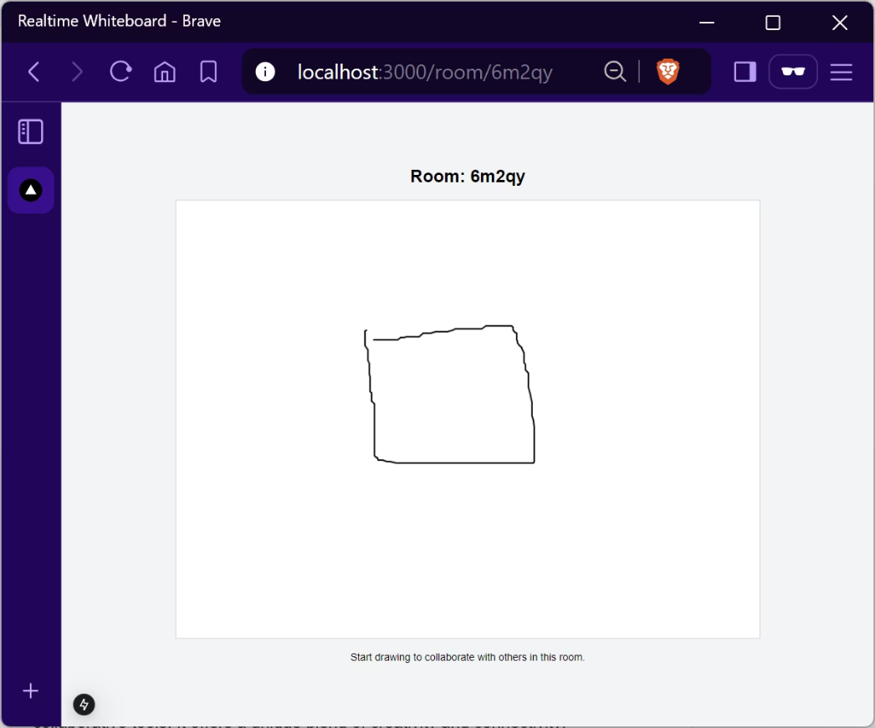
User Interface Overview
Home Page: Create or join a room
Room Page: Canvas for drawing
Responsive Design
Simple & Intuitive Layout
Adapts seamlessly to any screen size and device type
Clean interface prioritizing ease of use and immediate accessibility

Slide 9
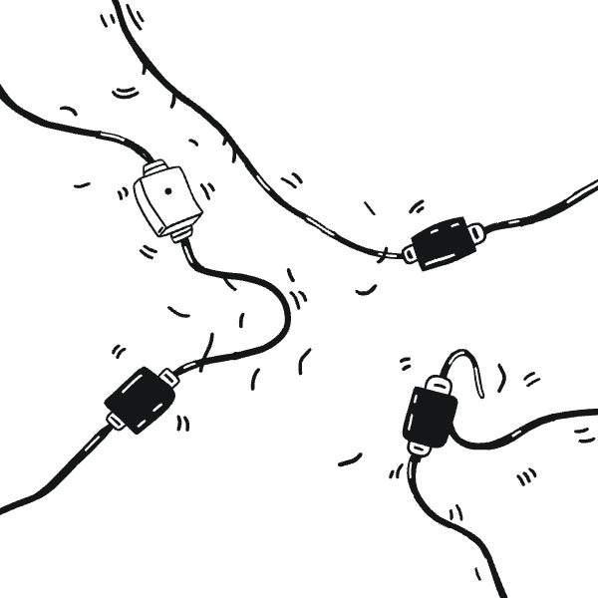

Addressing Challenges
Real-time Synchronization
Achieved near real-time sync without performance drops, even on slower networks
Cross-Device UI
Maintained simple yet effective UI working seamlessly across various devices
Connection Robustness
Ensured stability against connection drops, seamlessly managing users joining or leaving

Slide 10
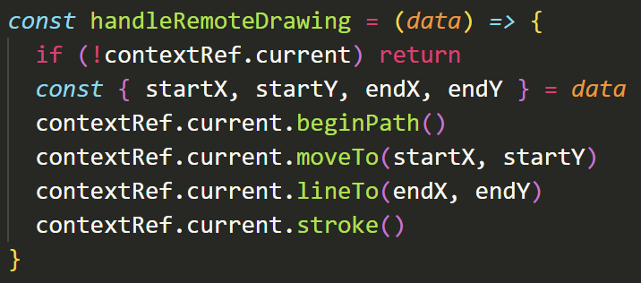
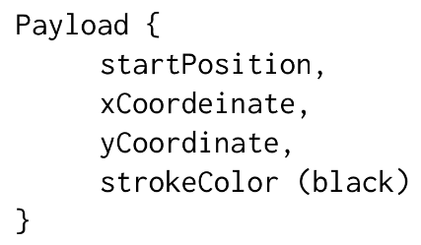
Future Enhancements
Adding different stroke sizes
Adding more colors, current default = black
Enhancing User Experience, opening creative doors

Slide 11
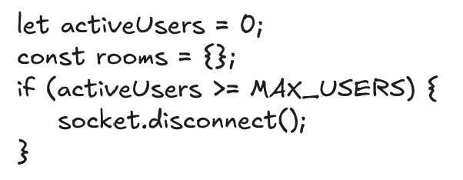
Future Enhancements
Concurrency Thresholds (Room Limits)
To prevent the "mess" of overcrowding and maintain rendering performance
A hard limit (e.g., maximum 10 users per room) will be set
This ensures the canvas remains readable and the experience remains clutter-free

Slide 12
THANK YOU
Mayank Arya 11022210015 B.Tech. CSE (DSAI)
Shivankur Sharma 11022210033
Divyansh Lather 11022210045

