Slide 1


Cambridge Institute of Technology
Bangalore -36
Department of Information Science and Engineering
21ISP76 – Project Presentation
AI Forecasting for Investor Decisions
Department of Information Science and Engineering
Batch - 38
Guided by-Dr. Preethi S, Head of Department, ISE.
Utkarsh Kumar 1CD21IS171
Raviteja GK 1CD21IS133
Shaik Mohammad Afraz 1CD21IS139
Shivanna 1CD21IS145
Department of Information Science & Engineering
www.cambridge.edu.in

Slide 2
Introduction
Stock Market Investing:
Investors purchase shares with the expectation of future financial gains, using various financial instruments like stocks.
Challenges in Stock Market Prediction:
Predicting stock prices is complex due to market volatility, influenced by various factors such as economic changes, investor sentiment, and global events.
Role of Artificial Intelligence :
AI-based techniques enhance the accuracy of stock market predictions by identifying and analyzing patterns in historical data, enabling more reliable forecasting.
Department of Information Science & Engineering
www.cambridge.edu.in

Slide 3
Implementation and Features
Objective: Fast and relevant Price forecasting.
Core Features:
  More accurate In pricing
  Day, Month and Yearly bases price prediction
Significance:
  Enhanced Decision-Making for Investors
  Simplifies user decision-making
Future Scope:
  Integration with Real-Time Trading Platforms
  Expansion to Multi-Asset Predictions
Department of Information Science & Engineering
www.cambridge.edu.in
Notes:
Enhanced Decision-Making for Investors: By providing hourly stock price predictions, the model empowers investors with timely insights, allowing them to make more informed decisions and respond quickly to market changes.
Increased Prediction Accuracy through Advanced AI Techniques: Using LSTM and CNN models, this project captures both long-term trends and short-term market fluctuations, significantly improving prediction accuracy compared to traditional daily prediction models.
Integration with Real-Time Trading Platforms: The model can be further developed to integrate directly with trading platforms, enabling automated trading based on real-time predictions, which could optimize trade timing and profitability.
Expansion to Multi-Asset Predictions: Beyond stocks, the model could be adapted to predict prices for other financial assets like commodities, cryptocurrencies, and forex, broadening its application in diverse financial markets.

Slide 4
Literature Review
Sl.no | Title | Summary | Critical Review | Year Published | Journal/ Conference
1 | Stock Market Price Prediction Using Machine Learning Techniques | Analyse real-time stock market data values ​​as they change over time | It uses ANN techniques, but accuracy is 91% | 2023 | 2023 4th International Conference for Emerging Technology (INCET)
2 | Survey of Stock Market Price Prediction Trends using Machine Learning Techniques | Challenge by comparing various Machine Learning and Deep Learning techniques for predicting stock trends. | The research evaluates and compares different models, including Long Short-Term Memory but lack in accuracy. | 2023 | IEEE International Conference on ML
Department of Information Science & Engineering
www.cambridge.edu.in

Slide 5
Literature Review
Sl.no | Title | Summary | Critical Review | Year Published | Journal/ Conference
3 | Stock Market Prediction Using Recurrent Neural Network | The main objective of this paper is to build a model that guides the person to invest in a particular stock in which the there won’t be any risk factors. | Can predict the future stocks prices but only for the short period of time after that it won’t be able to predict. | 2022 | 2022 IEEE International Conference on Current Development in Engineering and Technology (CCET)
4 | LSTM Optimized with Improved Artificial Rabbits Optimization Algorithm for Stock Market Price Prediction | The IARO algorithm is utilized to optimize hyperparameters of LSTM method to maximize accuracy of stock market price prediction. | The dataset used for predicting stock market price is collected dataset. But it gives 95% accuracy. | 2023 | 2023 International Conference on Integrated Intelligence and Communication Systems (ICIICS)
Department of Information Science & Engineering
www.cambridge.eduin.

Slide 6
Methodology
This project will improve traditional daily predictions, providing investors with timely, fine-grained insights that support more agile trading decisions.
Data Collection: Collecting historical and real-time stock market data from trusted sources, such as financial websites, and stock exchanges.
Collected Data Storage: Store the collected data efficiently in a structured database to allow for quick access and retrieval during analysis and prediction processes.
Mapping Integration: Integrate data visualization tools to display trends and patterns, providing a visual aid for easier interpretation and analysis.
Department of Information Science & Engineering
www.cambridge.edu.in
Notes:
Data Collection: Collect historical and real-time stock market data from trusted sources, such as financial websites, APIs, and stock exchanges.
Data Storage: Store the collected data efficiently in a structured database to allow for quick access and retrieval during analysis and prediction processes.
Indexing: Implement effective indexing techniques to speed up data queries and improve search performance within the dataset.
Search Processing: Apply relevance ranking techniques to prioritize data that will have the highest impact on prediction accuracy, enhancing the precision of forecasts.
Mapping Integration: Integrate data visualization tools to display trends and patterns, providing a visual aid for easier interpretation and analysis.
User Feedback Collection: Gather user feedback and insights to continually improve the model and refine prediction accuracy based on practical usage and performance reviews.

Slide 7
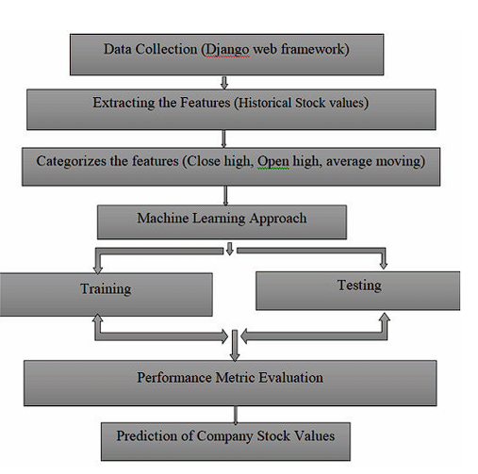
Methodology
Department of Information Science & Engineering
www.cambridge.edu.in
Notes:
Data Collection: Collect historical and real-time stock market data from trusted sources, such as financial websites, APIs, and stock exchanges.
Data Storage: Store the collected data efficiently in a structured database to allow for quick access and retrieval during analysis and prediction processes.
Indexing: Implement effective indexing techniques to speed up data queries and improve search performance within the dataset.
Search Processing: Apply relevance ranking techniques to prioritize data that will have the highest impact on prediction accuracy, enhancing the precision of forecasts.
Mapping Integration: Integrate data visualization tools to display trends and patterns, providing a visual aid for easier interpretation and analysis.
User Feedback Collection: Gather user feedback and insights to continually improve the model and refine prediction accuracy based on practical usage and performance reviews.

Slide 8
THANK YOU
Department of Information Science & Engineering
www.cambridge.edu.in

